Slide 1


Scaling the Web: Unraveling Online Reptile Leather Trade Networks with Machine Learning and Network Analysis
ESC 2025
Presented by: Joshua A. Lang
Petrossian, G.A., Lang, J., von Ferber, J., Gondhali, U., Lieu, B., Bernstein, K., Barbosa, J., Chakraborty S., Sharma, K., Ramos, E. & Freire, J.

Slide 2
Background
Wildlife trafficking remains a significant global problem that has:
Decimated species’ populations and their ecosystems
Harmed socioeconomic development
Corroded governance and rule of law
Become increasingly associated with loosely organized or known criminal groups
Reptiles have been exploited for their leather, particularly by the fashion industry
$140mil (1996) → $600mil (2018)
In 2013, over 3,500 metric tons of reptile skins were sold worldwide
Online marketplaces, like eBay and Etsy, have become a hub for selling animal products online
Loosely regulated
Exacerbated by COVID-19
Potentially Illegal Wildlife Sale
Notes:
Decimated Species – The removal of critically endangered species, especially umbrella species like the orangutan, have widespread effects on species beyond those being removed. Without orangutans, for instance, populations of tigers, Asian elephants, and Bornean Rhinos would be severely affected
Harmed Socioeconomic Development: Wildlife trafficking has led to communities losing their sources of food and money. Ex. Those in the Caspian Sea have lost their primary sources of food and money due to the overharvesting and illegal trafficking of sturgeon caviar
Rule of Law: Eroded by corrupt gov’t officials who take bribes, allowing the passage of animal products across borders
Criminal Groups: As the trafficking of wildlife has become more lucrative, more and more criminal groups such as Mexican Drug Cartels have diversified into the trade themselves. For example, the Mexican Drug Cartels diversified into the illegal sale of totoaba maw. Wildlife trafficking is seen as highly lucrative with low risk law enforcement is typically minimal
Reptile leather is used to small items such as footwear, bags, and belts.
3,500 metric tons represents between 2 and 50 million individual reptiles estimated to be worth $650 million at the time
Loosely regulated
Allows for digital anonymity
Enables users to code words to avoid detection more easily
Permits sellers adjust to changing law enforcement strategies
Complex networks
Covid-19
Online wildlife trade was already occurring prior to COVID 19, COVID 19 simply revealed how effective online wildlife trafficking could be
Previous research has documented the presence of threatened species on eBay, such as jaws from threatened shark species, including those listed in CITES Appendix II (e.g. mako, dusky, and thresher sharks)
As the online wildlife trade continues to grow in scale, especially after COVID-19, its unregulated nature poses severe threats to conservation efforts and species biodiversity.
the extent of sales of small leather items made from CITES-protected reptile species remains largely unexplored.

Slide 3
Research Objectives
Map online reptile trade on eBay
Identify network structures of sellers, products, and countries
Test network disruption strategies (random vs. targeted removals)
Goal: Determine the most effective ways to dismantle the online trade of potentially illegal reptile leather
Notes:
This knowledge is necessary to ensure that wildlife trafficking prevention and intervention efforts are effective

Slide 4
Methods – Data
Data Collection:
Used ACHE Web Crawler → 152,495 eBay ads (Feb-Mar 2024)
Info Extraction → price, seller, name, product type, product description, seller location, and associated images
Data Triage → Learn to Sample (LTS) Approach
Leveraged large language models (LLMs) to generate training data
Sample reduced to 20,741 eBay ads
Data Cleaning and Preparation
Employed Nuextract to extract specific information from the listings
Animal Name, Animal Body Part, Product Type
Constructed a dictionary to standardize variations in the extracted data
Animal Name → Alligator: “allig,” “alligatore,” “Florida alligator,” “aligator”
Animal Body Part → Skin: “skin”, “hide”, “dermis”, “epidermis”, “pelt”, “leather”, “leathers”, “skins”
Product Type → Bag: “bags”, “purse”, “handbag”, “clutch”, “shoulderbag”
Final Sample: 14,226 eBay ads
Notes:
Focused web crawler for targeted information retrieval
Collected data from 7 eBay domains with ads in English
- Data Triage: training data making it possible to derive specialized classifiers for different data triage tasks at a
low cost.
Requires a classifier. We created one to identify leather products
We did encounter many challenges
Missing values across our three primary variables (animal name, part, and product)
Attributed to misspellings and variations.
We reviewed and cross-validated the mislabeled and missing items, removing

Slide 5
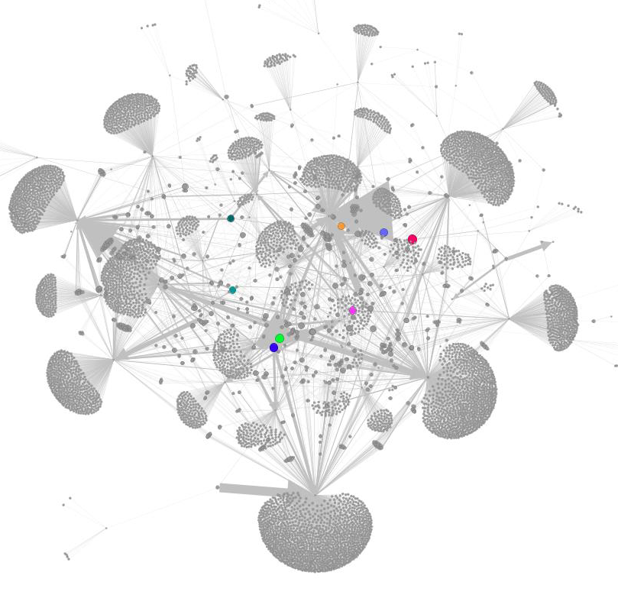
Methods – Network Analysis
Network Creation
Built Bipartite Network: Sellers – Products + Species
Network Percolation Analysis
Assesses the robustness and resilience under conditions of node failure or removal
Five Node Removal Strategies:
Random
Targeted removal based on node degree
Targeted removal based on accumulated edge weights
Removal based on the cumulative price of products
Removal based on the seller’s shipping countries
Notes:
Sellers are distinct nodes
Products + Species are also distinct nodes
Edges connect the nodes. An edge exists between a seller and a reptile+product node if the seller created at least one eBay listing for that
product. The weight w of each edge reflects the number of listings a seller posted for the same product.
Node removal is conducted to determine the necessary percolation threshold required for the largest connected component to collapse, leading to a phase transition where the network moves from being connected o fragmented
Random Removal: Nodes are deleted uniformly until the LCC collapses
Targeted: Nodes are removed based on certain criteria.

Slide 6
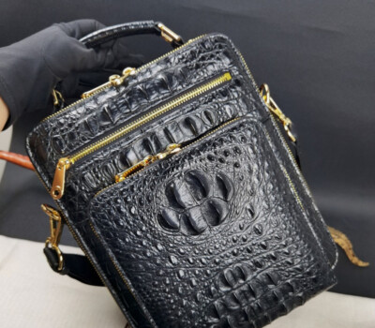
Key Findings - Concentration
65 different “ship from” countries
10 countries = 93% of small leather product shipments
The United States was the top “ship from” country (59%)
84 different animal+product combinations
The top 10 combinations account for 72% of the animal+products listed on eBay
Most popular:
Crocodile Bags
Alligator Bags
Alligator Watches
Caiman Footwear
Notes:
Picture: Alligator Bag
The 10 countries shouldbe interpreted cautiously as these results may be due to these sites predominantly using English wkeywords
12% of the total product combinations accounted for 72% of all listings, indicating that the mar

Slide 7
Key Findings – Sellers and Products
Most sellers exclusively sold one product type
A small proportion were linked with multiple animals and products
Most sellers sold exclusively on one eBay domain
Notes:
Sellers that sold one type are clustered by the combinations
Sellers that sold multiple are in the middle

Slide 8
Key Words – Network Resilience
Scale-free Topology
Random removals = little effect (network stable until ~95% removed)
Occasional takedowns = low disruption
Notes:
Scale-free topology → Could explain why random removals didn’t work. You’d need to randomly remove the highest degree centrality items

Slide 9
Key Findings – Disruption Strategies
Seller targeting = effective but impractical
Product Targeting = Most Consistent + Scalable
Country or Price Targeting = Weak unless > 60% removed
Notes:
Add Example

Slide 10
Policy Implications
Focus on high-risk products
Require: CITES permits, species names, non-reusable tags
Platforms (eBay) must enforce compliance
Notes:
For example, sellers need to explicitly state “American alligator,”
“Nile crocodile,” etc., in the listing title/description, or else eBay may take down the listing.
- As per our observations during this study, most sellers don’t mention species names. They use generic
or common names like snakeskin, python skin, or lizard skin. Many listings mention caiman,
crocodile, and alligator in a single advertisement for similarly textured skin.
- Additionally, eBay doesn’t require sellers to explicitly force sellers to share their authorization to sell such products
or mention permit details on their listings. However, if flagged, the listing may be taken down
(eBay, 2021)

Slide 11
Conclusion
First study of online reptile leather trade using network percolation
Market = Concentrated, scale-free, resilient
Target products, not random sellers, for best results
Framework could apply to other species and platforms

Slide 12
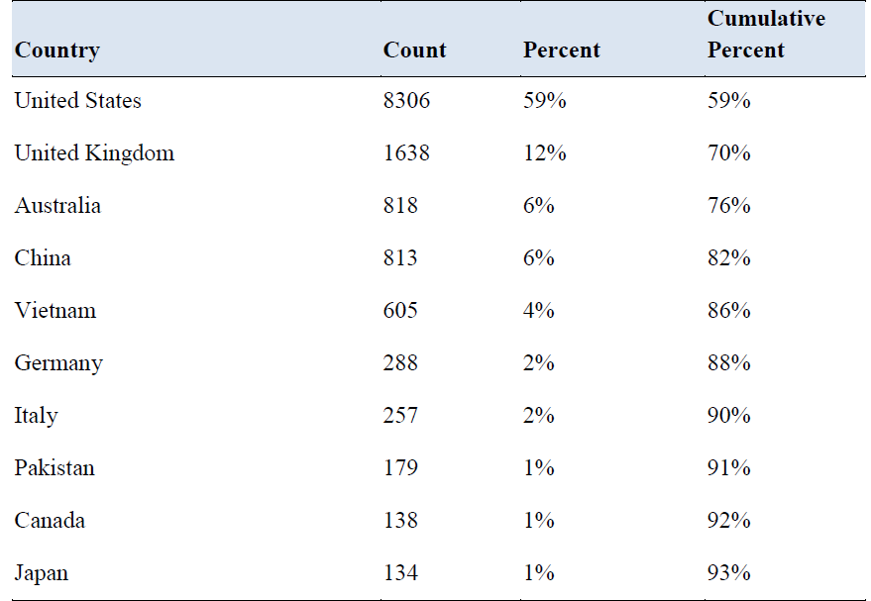
Table 1

Slide 13
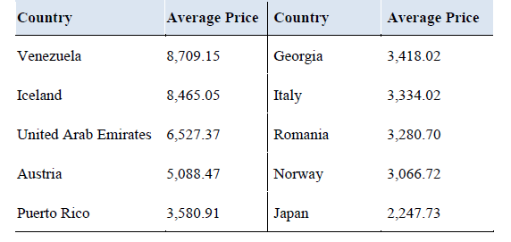
Table 2

