Slide 1
Article presentation
Fast Generalized Subset Scan for Anomalous Pattern Detection
Edward McFowland III, Skyler Speakman, Daniel B. Neill

Slide 2
Executive Summary
Goal of FGSS
Data: categorical multivariate data sets
Find self-similar anomalous records
Find anomalous attributes
Framework of the algorithm
Learn expected probability Bayesian Network Model on a ‘clean’ data set → H0
Define scoring function for anomalousness
Define search procedure for anomalous subsets of records
FGSS Strengths
Detect self-similar records which are subtly anomalous
Computationally efficient
Good characterization of anomalous attributes

Slide 3
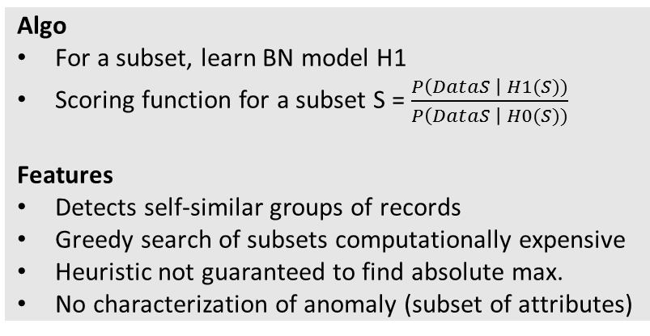
State-of-the-art of pattern detection in categorical datasets
Bayesian Network Detection
Anomalous Pattern Detection
Algo
Scoring records with their likelihood given H0
Features
Detects highly anomalous individual records
No anomaly characterization
Computationally efficient
Algo
Scoring records with their likelihood given H0
Look for anomalous rules involving 2 attributes
“Gender = male & country = India”
Fisher exact test to determine significance
Features
Individual records, fast computation
Approximate anomaly characterization
Anomalous Group Detection
Fast Subset Scan
Algo
For a subset, learn BN model H1
Scoring function for a subset S = $\frac{P\left(DataS \right| H1(S))}{P\left(DataS \right| H0(S))}$
Features
Detects self-similar groups of records
Greedy search of subsets computationally expensive
Heuristic not guaranteed to find absolute max.
No characterization of anomaly (subset of attributes)
Algo
Similar to FGSS
Stricter hypotheses: spatio-temporal data
Features
More efficient on spatio-temporal data
Not applicable to other categorical datasets

Slide 4


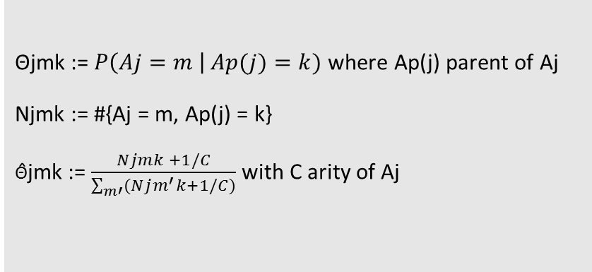
Learning Bayesian Network on clean train data
Bayesian Network
Notations
Records {R1,…, RN}
Attributes {A1,…, AM}
Vij: value of Aj in Ri
$$P\left(A2=m \right| A1=l)$$
A1
A2
$$P\left(A2=m \right| A4=k)$$
Estimation of conditional probabilities
A4
Θjmk := $P\left(Aj=m \right| Ap(j)=k)$ where Ap(j) parent of Aj
Njmk := #{Aj = m, Ap(j) = k}
Θ̂jmk := $\frac{Njmk +1/C}{\sum_{m′}{(Njm^{′}k+1/C)}}$ with C arity of Aj
A3
A Bayesian Network relates parent attributes to child attributes with conditional probability

Slide 5
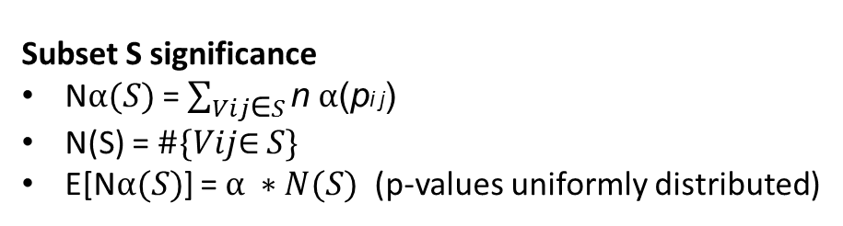
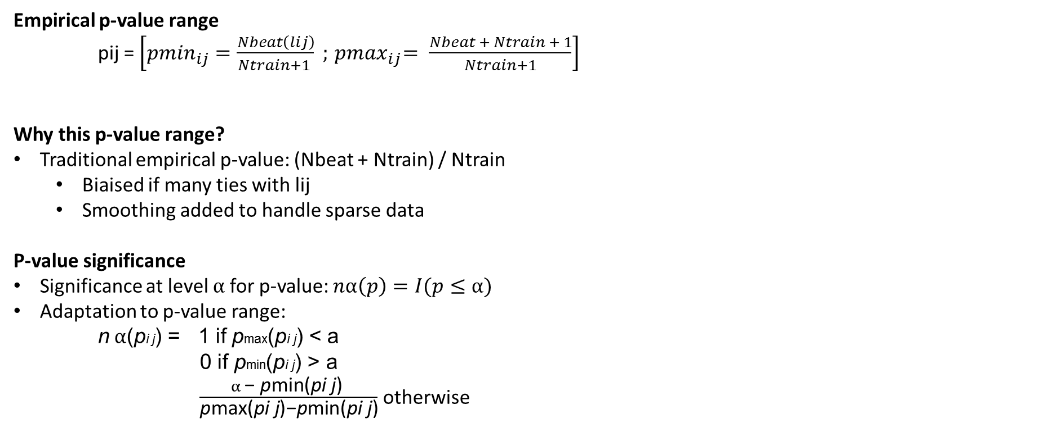
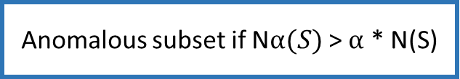
Scoring function 1 - how to measure a record’s significance
Empirical p-value range
pij = $\left[{pmin}_{ij}=\frac{Nbeat\left(lij\right)}{Ntrain+1 } ;{ pmax}_{ij}= \frac{Nbeat + Ntrain + 1}{Ntrain+1}\right]$
Why this p-value range?
Traditional empirical p-value: (Nbeat + Ntrain) / Ntrain
Biaised if many ties with lij
Smoothing added to handle sparse data
P-value significance
Significance at level $α$for p-value: $nα\left(p\right)=I(p≤α)$
Adaptation to p-value range:
n $α$(pi j) = 1 if pmax(pi j) < a
0 if pmin(pi j) > a
$\frac{α \text{−} \text{p}\text{min}\text{(}\text{pi} \text{j}\text{) }}{\text{p}\text{m}\text{a}\text{x}\text{(}\text{pi} \text{j}\text{)−}\text{p}\text{min}\text{(}\text{pi} \text{j}\text{)}}$ otherwise
lij: likelihood of vij under H0
Nbeat = #{k | lkj < lij}
Ntie = #{k | lkj = lij}
Subset S significance
N$α(S)$ = $\sum_{Vij\text{∈} S}{\text{n} α\text{(}\text{p}\text{i} \text{j}\text{)}}$
N(S) = $\#\{Vij\text{∈} S\}$
E[N$α(S)$] = $α ∗N(S)$ (p-values uniformly distributed)
Anomalous subset if N$α(S)$ > $α$ * N(S)

Slide 6
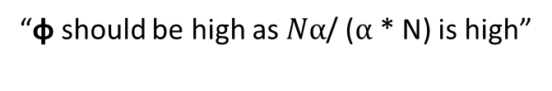
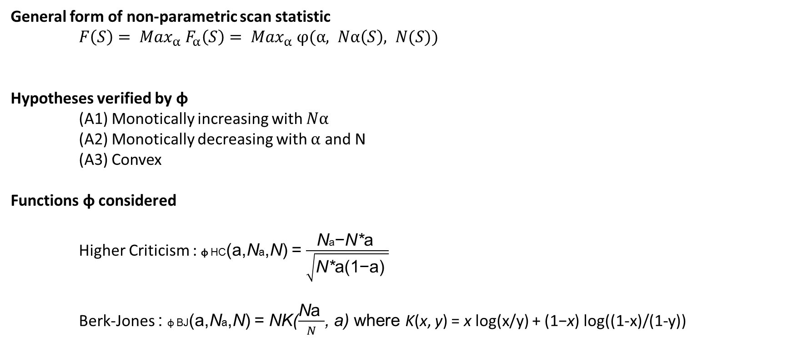
Scoring function 2 – Non-parametric scan statistic
General form of non-parametric scan statistic
$F\left(S\right)= {Max}_{α} F_{α}\left(S\right)= {Max}_{α} φ(α, Nα\left(S\right), N(S))$
Hypotheses verified by φ
(A1) Monotically increasing with $Nα$
(A2) Monotically decreasing with $α$ and N
(A3) Convex
Functions φ considered
Higher Criticism : φ HC(a,Na,N) = $\frac{\text{N}\text{a}\text{−}\text{N}\text{∗}\text{a} }{\sqrt{\text{N}\text{∗}\text{a}\text{(}\text{1}\text{−}\text{a}\text{) }}}$
Berk-Jones : φ BJ(a,Na,N) = NK($\frac{\text{N}\text{a} }{N}$, a) where K(x, y) = x log(x/y) + (1−x) log((1-x)/(1-y))
“φ should be high as $Nα$/ ($α$* N) is high”

Slide 7
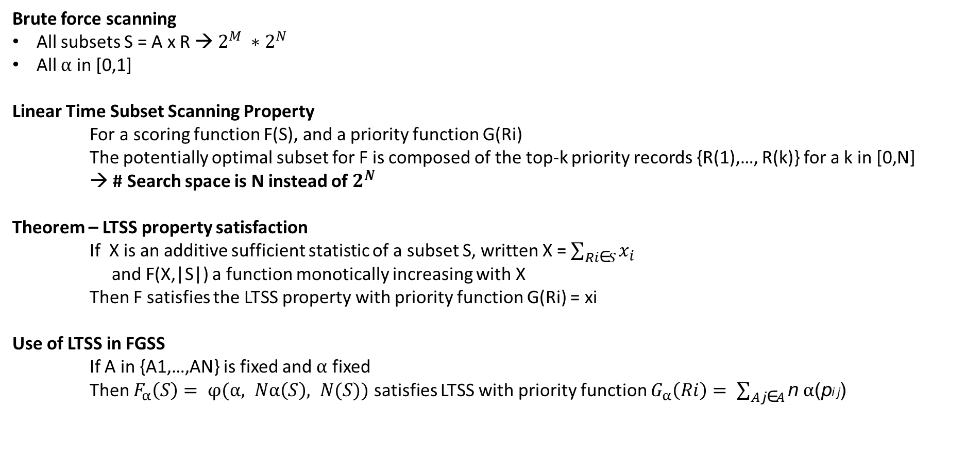
Search procedure 1 - LTSS Property
Brute force scanning
All subsets S = A x R → $2^{M} ∗2^{N}$
All $α$ in [0,1]
Linear Time Subset Scanning Property
For a scoring function F(S), and a priority function G(Ri)
The potentially optimal subset for F is composed of the top-k priority records {R(1),…, R(k)} for a k in [0,N]
→ # Search space is N instead of $2^{N}$
Theorem – LTSS property satisfaction
If X is an additive sufficient statistic of a subset S, written X = $\sum_{Ri\text{∈}S}{x_{i}}$
and F(X,|S|) a function monotically increasing with X
Then F satisfies the LTSS property with priority function G(Ri) = xi
Use of LTSS in FGSS
If A in {A1,…,AN} is fixed and $α$ fixed
Then $F_{α}\left(S\right)= φ(α, Nα\left(S\right), N(S))$ satisfies LTSS with priority function $G_{α}\left(Ri\right)= \sum_{Aj\text{∈}A}{\text{n} α\text{(}\text{p}\text{i} \text{j}\text{)}}$

Slide 8
Search procedure 2 - Taking advantage of LTSS
New search for optimal A x R subset for a given α
Fix A randomly
Sort records by priority
Check the N records subsets composed with the top-k prioritarian records with k in [1,N]
Fix the optimal records subset R’
Sort attributes by priority
… until convergence
The optimal is not global but close to it
In practice, convergence in Z~3-4 steps
In practice, with Y~50 random initializations, 98% probability to have less than 2% error on optimum on test data
Step | Complexity
Aggregation (computing p-values) | N*M
Sorting records and check for max. subset | Nlog(N) + N
Sorting attributes and check for max. subset | Mlog(M) + M
Z steps to convergence | Z
Y random initialization | Y
Search complexity for fixed α
O(YZ(MN + Nlog(N) + Mlog(M)))

Slide 9
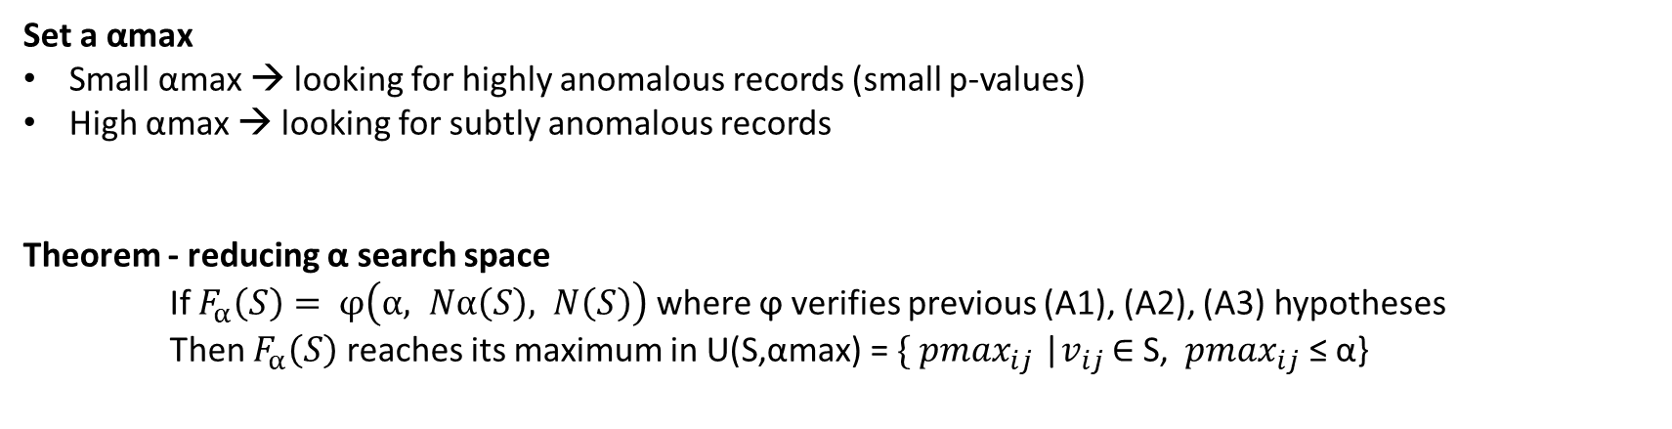
Search procedure 3 - Reducing α range
Set a αmax
Small αmax → looking for highly anomalous records (small p-values)
High αmax → looking for subtly anomalous records
Theorem - reducing α search space
If $F_{α}\left(S\right)= φ\left(α, Nα\left(S\right), N\left(S\right)\right)$ where ϕ verifies previous (A1), (A2), (A3) hypotheses
Then $F_{α}\left(S\right)$ reaches its maximum in U(S,αmax) = $\{{ pmax}_{ij}$ |$v_{ij}$ ∈ S, ${ pmax}_{ij}$ ≤ α}
Total complexity for unconstrained FGSS
O( |U|*Y*Z*(MN + Nlog(N) + Mlog(M)) )

Slide 10

Search procedure 4 - Incorporating similarity constraints
Limits with unconstrained FGSS
Provides unhomogenous subsets → no pattern characterization
How to take subsets similarity into account?
Local neighborhoods for each Ri
Constrained search procedure
Repeat the previous search procedure for each of the N neighborhoods
Mean cardinal of neighborhoods: k
Take the maximum among all neighborhoods
R8
R39
R1
R25
R3
$$d\left(R3,Rj\right)≤r$$
R7
R9
R6
Complexity of constrained FGSS
O( N*|U|*Y*Z*(Mk + klog(k) + Mlog(M)) )
R2
R5

Slide 11
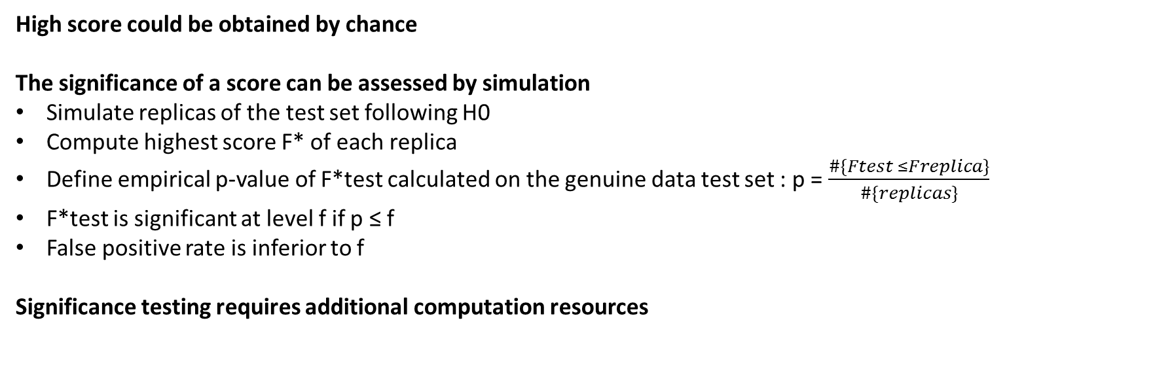
Optional statistical significance testing
High score could be obtained by chance
The significance of a score can be assessed by simulation
Simulate replicas of the test set following H0
Compute highest score F* of each replica
Define empirical p-value of F*test calculated on the genuine data test set : p = $\frac{\#\{Ftest ≤Freplica\}}{\#\{replicas\}}$
F*test is significant at level f if p ≤ f
False positive rate is inferior to f
Significance testing requires additional computation resources

Slide 12
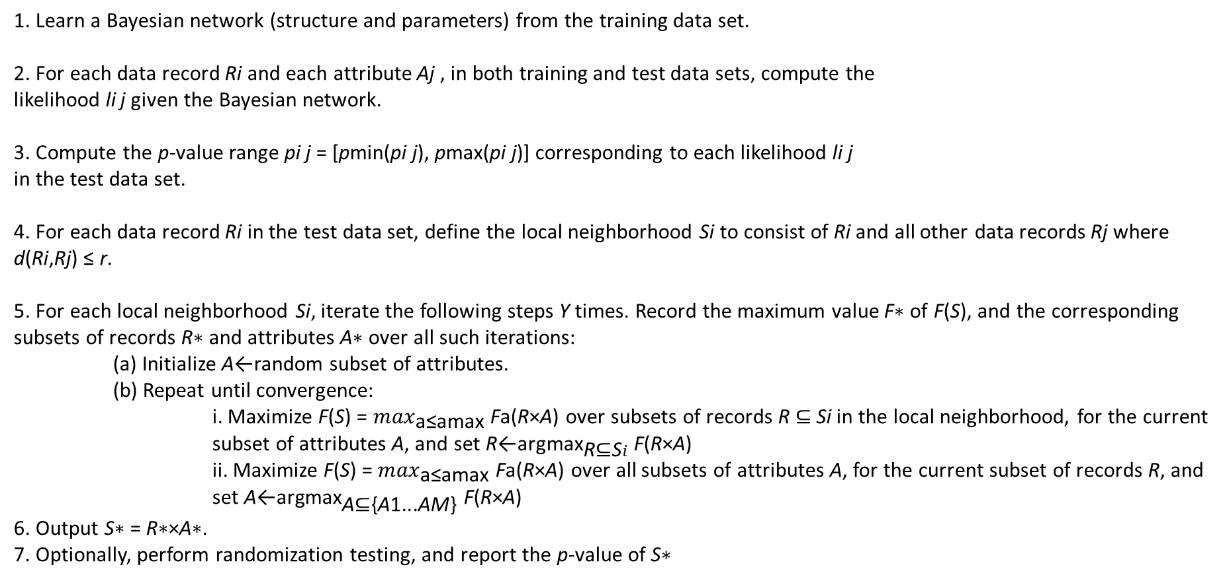
FGSS complete algorithm
1. Learn a Bayesian network (structure and parameters) from the training data set.
2. For each data record Ri and each attribute Aj , in both training and test data sets, compute the
likelihood li j given the Bayesian network.
3. Compute the p-value range pi j = [pmin(pi j), pmax(pi j)] corresponding to each likelihood li j
in the test data set.
4. For each data record Ri in the test data set, define the local neighborhood Si to consist of Ri and all other data records Rj where d(Ri,Rj) ≤ r.
5. For each local neighborhood Si, iterate the following steps Y times. Record the maximum value F∗ of F(S), and the corresponding subsets of records R∗ and attributes A∗ over all such iterations:
(a) Initialize A←random subset of attributes.
(b) Repeat until convergence:
i. Maximize F(S) = $\max_{\text{a}\text{≤}\text{amax}}$ Fa(R×A) over subsets of records R ⊆ Si in the local neighborhood, for the current subset of attributes A, and set R←${\text{argmax}}_{\text{R}\text{⊆}\text{S}i}$ F(R×A)
ii. Maximize F(S) = $\max_{\text{a}\text{≤}\text{amax} }$Fa(R×A) over all subsets of attributes A, for the current subset of records R, and set A←${\text{argmax}}_{\text{A}\text{⊆\{}\text{A}\text{1...}\text{AM}\text{\}}}$ F(R×A)
6. Output S∗ = R∗×A∗.
7. Optionally, perform randomization testing, and report the p-value of S∗

Slide 13
Test: FGSS performs better and provides insight on anomaly
Metrics used
PR curve: ability to identify an anomalous record in a dataset
Thresholds used: all the scores taken by records
For each thresholds, precision and recall calculated
ROC curve: ability to detect whether a dataset contains an anomaly
50 “clean” test datasets, 50 anomalous test datasets
Thresholds used: all the scores taken by datasets (?)
For each threshold, true positive and false positive rates calculated
Pattern characterization
Time of computation
Experiments
Container shipments
Emergency Department
Network intrusion
Experiment procedure
Algorithms applied to 50 anomalous test datasets + 50 normal datasets → mean AUC and standard error
No significance testing
Area Under the Curve

Slide 14
Experiment design - Record and dataset score
Record score
Dataset score
Parameters
BN
Negative likelihood of Ri given H0
Average for all records
NA
APD
Negative likelihood of Ri given H0, only considered if respects anomaly rule (“gender=M & country=India”)
Highest scoring record
NA
AGD
Highest neg. likelihood score among the different groups Ri belongs to
Highest scoring group
NA
FGSS
Negative likelihood of Ri given H0
Find the k disjoint highest scoring subsets of R
Dataset score = weighted mean of those k scores
Similarity constraint r=1 (distance?)
αmax = 0,1
k = 20
Why not take the highest scoring subset?

Slide 15
Experiment results summary
Data source
Observations
Container shipments
10 attributes of containers (weight, provenance…)
Simulation of anomaly
Duplication of a record
Random perturbation of a subset of attributes following marginal distribution of attributes
➔ Non-perturbated attributes ~ fraud strategy
FGSS significantly better on ROC & PR
FGSS-HC, APD, BN more sensitive to individual anomaly
AGD limited in computation
Simulated anomaly matches FGSS algorithm?
Emergency Department
5 attributes of patient (age, symptom…)
Simulation of anomaly by a anthrax simulation model
AGD significantly better on PR
FGSS-BJ slightly better on ROC
AGD & FGSS-BJ prove more sensitive to subtle self-similar anomaly
Network intrusion
21 attributes of login (name, time…)
Data from data challenge
1% anomaly: FGSS-HC, APD, BN perform better
10% anomaly: FGSS-BJ, AGD better

Slide 16
Experiment results – Detailed container results: ROC curve
N: number of records
Kinj: numberof perturbated groups
Sinj: number of perturbated records per group
Minj: number of perturbated attributes

Slide 17
Experiment results – Detailed container results: PR curve
N: number of records
Kinj: numberof perturbated groups
Sinj: number of perturbated records per group
Minj: number of perturbated attributes

Slide 18
Experiment results – Detailed ED results

Slide 19
Experiment results – Detailed Network results: PR curve

Slide 20
Experiment results – Detailed Network results: ROC curve

Slide 21
Computational aspects – AGD is far more expensive than FGSS
BN and APD are extremely fast

Slide 22
Pattern Characterization – FGSS is far better than APD
Experiment design
Data: Container shipments, where the subset of anomalous attributes is known
Metric
Overlap
BN structure taken into account: spotting either the parent or the child is considered correct
Comparison
FGSS-HC, FGSS-BJ
APD
P-vals method
Attribute declared anomalous if p-value range < αmax
Other possibility: %p-value range < αmax
Remark
The number of the “different” injected attributes is not specified. Since APD only checks for 2-attributes rules, the overlap cannot be high for a high value of anomalous attributes. This is significant if the injected attributes are the same as previous test (1 or 2).

Slide 23
FGSS Next steps
Incorporate continuous attributes
Instead of discretizing them
Extend to other statistics than HC or BJ
Could better handle mutual dependences between p-values (?)
Extend to multiple-models learnt on train data
H1, H2, H3… instead of H0

