Slide 1
Article presentation
A Multivariate Bayesian Scan Statistic for early event detection and characterization
Neill, Cooper; 2010

Slide 2
Executive Summary
MBSS Goals
Data: multivariate time series in different regions
Look for anomalous emerging event in space-time regions
Detect general or specific events
Characterize the emergence pattern of the event
MBSS Framework
Compares observed counts to Gamma-Poisson expectancy model learnt on history
Uses prior information to compute posterior probability of an event occurring
Expert knowledge or previous observed events
Very specific model: adapted to disease outbreak detection (tbd?)
Advantages of MBSS
Early detection of an emerging event
Can be very effective with prior knowledge on the event
Can learn and characterize a simple event
Easy interpretation and visualization on a map
Efficient computation: no randomization testing

Slide 3
MBSS Framework
Notations
Test Framework
si: locations
S: space-time regions = space region
monitored on days t = 1…Wmax
Dm: data streams (Over-The-Counter sales)
C(i,m,t): count in region si on Dm at time t
Test hypotheses
H0: no event occurring
H1(S,Ek): event of type k occurring in region S
Assumptions
Set of events {Ek} is given
Events are mutually exclusive
Set of affected locations constant in time
Each event affect a single region
Goal: compute event probability with Bayes Theorem
prior

Slide 4
Obtaining priors
Prior = previous knowledge of the event
How to obtain priors?
Expert knowledge
Learning from labeled historical data “There was an outbreak on April 7th, 11th, 14th…”
Uniform prior = indifference principle
Article focuses on uniform prior, but prior knowledge is the great advantage of MBSS
Overall probability of the event
Distribution of Ek in space and time

Slide 5
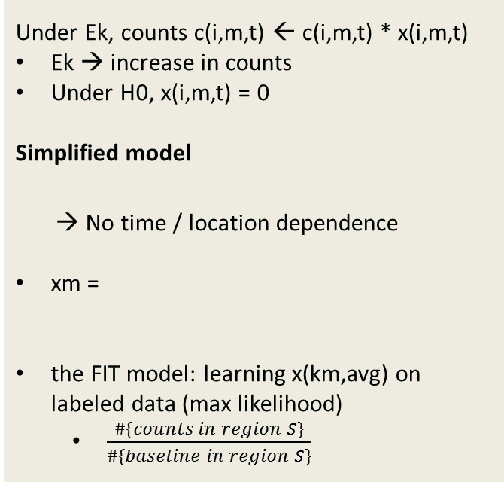
Probability model
Event modeling
Hierarchical Gamma-Poisson model
b(i,m,t) baseline of counts given historical data
q(i,m,t) risk of the zone – latent variable
c(i,m,t) ~ Poisson(b(i,m,t) * q(i,m,t))
q(i,m,t) ~ Gamma(x(i,m,t) * αm, βm)
αm and βm are learned from the data
If x(i,m,t) > 1, then mean risk increases
Under Ek, counts c(i,m,t) ← c(i,m,t) * x(i,m,t)
Ek → increase in counts
Under H0, x(i,m,t) = 0
Simplified model
→ No time / location dependence
xm =
the FIT model: learning x(km,avg) on labeled data (max likelihood)
$\frac{\#\{counts in region S\}}{\#\{baseline in region S\}}$
for t < Wmax
adapted to disease surveillance
θ: magnitude of event
FIT models events which have a ¼ to 4 order of magnitude compared to observed event
b(i,m,t) = $\frac{\#\{counts on whole period in si\}}{\#\{counts on whole period everywhere\}}∗\#\{counts everywhere on day t\}$

Slide 6
Computing data likelihood
Likelihood of count given b(i,m,t), x(i,m,t), αm, βm → Marginal probability
P(c(i,m,t)|b,x,α,β) ~ NegativeBinomial(x(i,m,t) * αm , )
Computing likelihood of data
Marginalize over all x(i,m,t) values possible under H1(S,Ek)
conditional independence
Computing parameter priors αm and βm
Use empirical mean and variance of c(i,m,t) / b(i,m,t)

Slide 7
Computational considerations
MBSS uses efficient computation
γ ratio:
Can be computed once for all location / time / data stream / xm
Assume uniform distribution of xm
MBSS Complexity
I: #{locations}
M:#{streams}
T:#{days in period}
K:#{events}
Nθ:#{vectors xmθ}
Ns:#{space-time regions}
Task | Complexity
Load all c(i,m,t) ∀i,m,t | O(IMT)
Compute all b(i,m,t) ∀i,m,t | O(IMT)
Compute all αm, βm ∀m | O(IMT)
Compute all LRi ∀i,m,k,x(m,k); t<Wmax; | O(IMWmax K Nθ)
Compute all γ ratios | O(Ns K Nθ)
Compute probe with Bayes theorem | O(1)
Total MBSS Complexity: O(IMT + IMWmax KNθ + NsKNθ)
Remark: no need for randomization → x1000 speedup / state-of-the-art

Slide 8
Evaluation 1 – Test design
Test design
Methods chosen
3 OTC data streams
250 outbreak simulated averaged
7 days
Event = increased counts
Disease cases increasing linearly with time
Level of test (FP rate) fixed 1/month
Metric: days to detect the outbreak
If no detection → counted as 14 days
Wmax = 1 day
Dynamic of event is taken into account with the multiple magnitude θ
Search space
Allengheny County → 16x16 grid
Regions up to 8x8 rectangles
Methods compared
MBSS-EQ with x = (1,5;1,5;1,5)
Univariate Bayes Scan Statistics for each stream
Kulldorff Mutivariate Scan Statistic (2007)
MBSS-FIT
MBSS FIT that learns incrementally
First step x = (1,5;1,5;1,5)
Convergence in 15 examples

Slide 9
Evaluation 2 – Event detection results
MBSS-FIT is significantly better in ~50% cases
Mean 1,3 days faster (typical detection in 4 days)
Both for univariate and multivariate outbreaks
Equivalent to Kulldorff in 50% remaining case
With wrong event design, results are abysmal
Very poor performance of MBSS-EQ
With perfect event design, results would have been excellent
No test conducted because obvious
MBSS-FIT is efficient on test because it learned the event pattern
Can be implemented with low prior knowledge
The test event event was with a modelization close to the algorithm model
Need 15 examples to learn the pattern
Historical data available for common events: flu
Simulation needed for exceptional event: bioterrorism

Slide 10
Evaluation 3 – Event characterization results
Observations
MBSS-FIT learns event type with 15 examples
After learning, MBSS-FIT is a specific detector: it cannot detect event {H1 incorrect}
This could be used to focus on relevant events outbreaks and ignore others – promotional sales

Slide 11
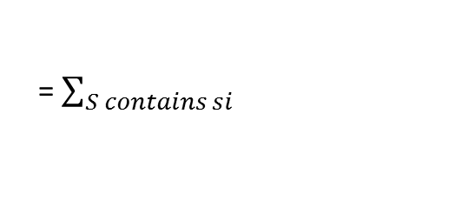
Interpretation and visualization
= $\sum_{S contains si}{}$

