Slide 1
Event detection - Comparisons
Do you know the model of your event?
Is the event characterized?
What is the event type?
What is the data?
FGSS
No: non parametric model
Counts, categories
Multivariate
Anomalous attributes & region are detected
Recurrent / outbreak
Parametric FSS
Assume probability distribution of counts
Counts Multivariate
tbd – region detected, maybe attribute
Outbreak, maybe recurrent (tbd)
MBSS
Assume probability distribution of counts
Counts Multivariate
Region detected
Event learning if the event form is know (ex. multiplication of counts)
Outbreak
Topology
No
Counts Univariate
TBD
TBD

Slide 2
Event detection – Topics to be studied
Event
Find all events or just a single one?
What kind of events can be detected?
Regular / anomalous?
Spatial & temporal extension predefined?
Recurrent event vs outbreak
Specific or general event detection?
Assumption on the form of the event?
Parametric vs non-parametric
How is the event characterized?
Spatial/temporal extension?
Features?
Data
What kind of dataset?
Nature: counts vs categorical
Scale
Univariate vs Multivariate
Requires specific preprocessing? (Bayesian Network)
Algorithm performance
Computation time
Accuracy
Detection time
Comparison time
Current
Future : how techniques could be adapted

Slide 3
Comparisons of methods – 05/12
Event categories & DCRF method
End of comparison Neill vs Topology

Slide 4
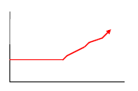
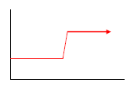
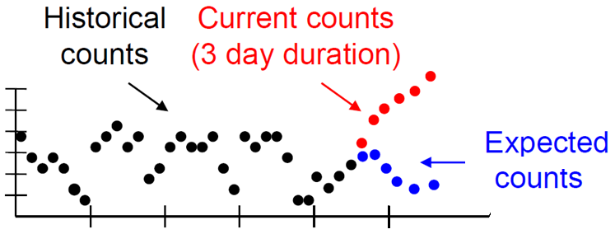
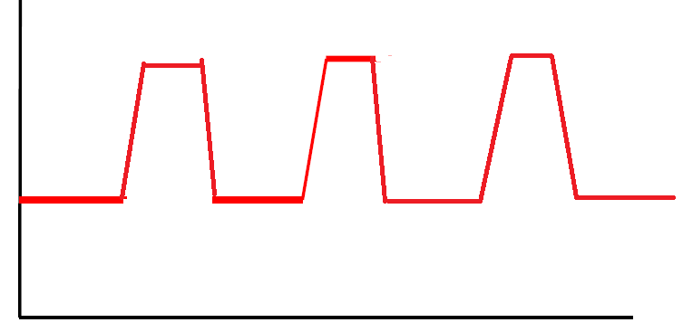
Emerging / Persistent / Recurrent events
Emerging: ML techniques
Persistent or Recurrent: Topology
Persistent
Recurrent
beginning of event
Niell aggregates anomalies over time
Too high cumulate gap with expectancy ➔ ALARM
Topology will discover all the main recurrent and persistent events of period studied

Slide 5
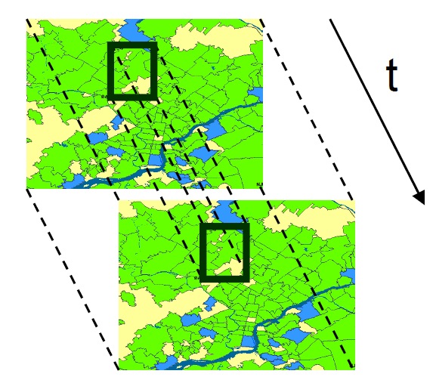
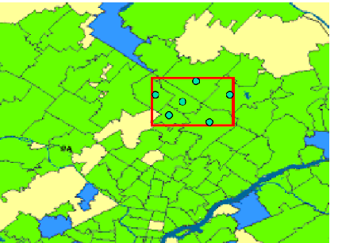


Typology of events -
Static / Dynamic event
Static
Dynamic
ML
You can launch static search at different times
Topology
DCRF
DCRF may not work

Slide 6
Dynamic Diffuse / Moving events – DCRF
Persistent→ Region affected at t1 is affected at t2
Non persistent → Region affected at t1 is not affected at t2
DCRF method should detect those events, but the article I read (2009) is unconvincing

Slide 7
Main differences: Machine Learning vs Topology
FSS / FGSS / MBSS
Topological analysis
Type of Event
Emerging or persistent (emerging by multiple persistent scan? Check)
Anomalous
Persistent
Anomalous, Trends, Periodic events
Less subtle (?)
Temporal Constraints
CURRENT event, lasts for up to Wmax days before present date
PAST event that happened in a time interval (typically 1 month)
Spatial constraints
Constrained search regions to save computation time
→ Circles, rectangles, ellipses, k-nn
Very little constraint: event must occur in same map grid cell
#Variables
Multiple → improves detection power
Univariate
Detection of a current anomalous (emerging) event
Global monitoring of persistent & recurrent past events

Slide 8
Scope & Tradeoffs implied
Are you interested in current or past events? → Neill/DCRF vs Topo
Do you want to detect emerging events? → Neill
Is the event subtle? → Neill / Topo untested
Is the event anomalous or periodic/trend? → Neill vs Topo
Is your event dynamic? → DCRF (?) or static at =/= times
Pretty clear distinction of techniques given the type of event which is looked for
Possible next steps
Continue mapping of use cases and associated techniques
Compare techniques on similar problems
Different ML techniques on emerging events
Topo vs ML for anomaly detection (ML may win)

Slide 9
FGSS
Goal
Data
Find with high accuracy subtly anomalous self-similar datasets
Characterization → find anomalous attributes
Kind: multivariate categorical
Scale: test on 10k-100k records x 5-20 attributes, r=1 (one-attribute difference bet. records)
Historical data used: yes
Event model
Spatio-temporal framework
#Events searched: Single
Comparison to expectancy: Bayesian Network learnt on historical data
Assumption: None
Event level: subtle
Examples: Container shipment fraud, disease outbreak, network intrusion
Space: Unconstrained or r-circles (k-nn)
Time: no constraint
Detects patterns with no time consideration
Performance
Complexity: O(|U|(kM + klogk + MlogM))
Accuracy
Evaluation metric: PR & ROC curves
Anomalous attributes found
Detection features
Anomalous records
Anomalous attributes
Significance computed by randomization

Slide 10
MBSS
Goal
Data
Quick detection of anomalous emerging subtle events
Detect spatial-temporal region affected
Characterize the event
Kind: multivariate time series
Scale: test on
58 locations x 3 variables x 56 or 377 days (unclear)
Number of space-time regions : Ns = 1292 (unclear)
Set of 9 events, 1-day long
Historical data used: yes
Event model
#Events searched : Single or set
Comparison to expectancy: Gamma-Poisson model learnt on historical data
Assumption: multiplicative increase in counts
Event level: subtle
Examples: disease outbreak
Spatio-temporal framework
Space
Test on rectangular shapes 1x1 up to 8x8 on a 16x16 grid
Can be adapted to any region shape, typically maximum extension is fixed
Time:
Detects current event that started W<Wmax days before
Test on Wmax = 1 day
Duration of event can be captured by detection of this event on different days
Detection features
Spatial region & time of the most at risk region
Probability an event affects
Any region
Any location
Learning a simple event in ~15 examples
Performance
Complexity O(IMT + IMWmaxKNθ + NsKNθ)
No experiment on computation time
Evaluation metric: Days to detect an outbreak
Distinguish two different learnt events in 1 day

Slide 11
Univariate FSS + EBP
Goal
Event model
Quick detection of anomalous emerging subtle events
Detect spatial-temporal region affected
Efficient computation
#Events searched : Single
Comparison to expectancy: Poisson model learnt on historical data
Assumption: multiplicative increase in counts
Event level: subtle
Examples: disease outbreak
Data
Kind: univariate time series
Count of respiratory cases at Emergency Department
Scale: test on
97 locations x 700 days = 400k records
3-day long events
Historical data used: yes
Detection features
Spatial region & time of the most at risk region
Performance
Complexity: O(Nkmax² + NlogN)
For 100 days of data ~ 55k records and kmax-NN = 20 → 10s computation
Evaluation metric:
Days to detect an outbreak: 2 days quicker than Kulldorff (duration = 14days)
Overlap / Precision on the last day of outbreak: limited relevance
Better detection on irregular/elongated clusters compared to Kulldorff
Spatio-temporal framework
Space
Subsets of k-NN / r-circle regions around locations
→ Can be irregular regions
Time:
Detects current event that started W<Wmax days before. Test with Wmax = 3 days

Slide 12
Topological Analysis
Goal
Data
Detect most important space-time events occurring
Non-emerging event, regular trends or rough anomaly, recurrent events, periodic events
Visualize & query events
Kind: univariate time series
Scale: test on taxis (and subway)
graph with xx vertices
time step = 1 hour, time interval for event group = 1 month
top-k (k=50) events per hour
Historical data used: no
Event model
Spatio-temporal framework
#Events searched : all min/max counts events
Comparison to expectancy: None
Assumption: None
Event level: Easy, not tested on subtle events
Examples: street blockage, station deficiency
Space
Map → grid. Event must occur in same grid cell
Time: maximum span Wmax of event fixed
Test on Wmax = 1 month
Event can occur any subset time in the Wmax last days
Detection features
Performance
Spatial region & time of all events
importance = amplitude of events
Complexity O(NlogN + Nα(N) + n²)
N: #vertices, n: #events per time interval = top-k (k=50) events for each time step * time interval
In practice, O(n²) → O(n²) / 20
Evaluation metric: Days to detect an outbreak
Distinguish two different learnt events in 1 day

Slide 13
Dynamic Conditional Random Fields, Jie 2009
Goal
Data
Detect events in real time in a sensor network
Moving or Diffuse events
Label all sensors “affected” or not at each time step
Kind: univariate time series
Scale: test on simulated data
500 sensors x 1000 time steps
Historical data used: unclear
Yes in theory, unclear in test
Event model
Spatio-temporal framework
#Events searched : single
Comparison to expectancy: In theory
Assumption: Simplistic / Unclear framework
Event level: Simplistic / Unclear
Examples: geometric shape moving
Space
Depends on model assumptions which are unclear
Test not specified
Time:
Test not specified
Detection features
Performance
Labelling all sensors 0 or 1 at each time step
Test in performed in simplistic cases, far from any real application
Complexity: Unclear
Evaluation metric: Precision / Recall
Does not seem close to real-life application, too strong assumptions

Slide 14
Multivariate FSS + EBP
Adapts Univariate FSS by aggregation (sum of streams) → Subset Aggregation algo
Subset Aggregation algorithm ~ Kulldorff multivariate scan in performance, quicker
Detection
Spatial accuracy
Anomalous stream identification
Identifies ~60-80% of streams affected

Slide 15
GFSSums
Extends MBSS and FSSums
MBSS is a GFSSums with some “sparsity parameter” fixed
Same Bayesian model as MBSS, with a prior P(H1(S,E)|E) more elaborated
Same advantages as MBSS (Interpretability, computation)
Quicker and slightly more accurate than MBSS

Slide 16
Spatial scan in spatial event detection
Computing anomalousness of all locations sets is infeasible
Alternative solutions
Regions searched shapes
Heuristic search
Tradeoff
Computational efficiency
Approximate / global optimum
Adequation between shape of region and event
Possible regions
Circles
K-NN around locations
Rectangles
Ellipses
Irregular shapes

Slide 17
CrimeScan: Event Detection on urban crime data
Neill 2013: CrimeScan and CityScan[1]
Crimescan = software used by Chicago Police Department in 2013
Detects emerging clusters of leading indicators: minor crimes, 911 calls… → spatial scan
Prediction methods use the Leading Indicator clusters as features of predicting model
Next: all kinds of clusters: rats, abandoned buildings, sanitation complains…
CityScan project
Prediction techniques[1]
Density-based: proba of violent crime occurring is high if the location is close to multiple LI clusters
Model-based prediction: logistic regression model, with variables = 1 if a LI cluster is in a given radius
Results
1 week in advance, 1 block accuracy
1-day long crime hot spot
At block level, Crime Scan predicts 60% of clustered VC which will occur next week
[1] http://www.cs.cmu.edu/~neill/papers/dssg13.pdf 2013
Event detection part = detecting emerging clusters of minor crimes / 911 calls
➔ Those clusters have no real meaning, they are just used as variables for prediction of future crimes
Simpler approach: use minor crime / 911 density of neighbor locations as predicting variables

Slide 18
Crime Epidemics
Niell’s first framework for crime prediction [2]
Time 1990 – 99, 52x64 grid
2 Datasets: Violent Crimes & Leading Indicator (less grave)
EBP prediction of crime count for each cell every week
Detects space-time cluster 1-4 week duration, radius <20 of higher counts → gold standard
How many clusters can be detected by LI data?
Detection def = one of the 100 highest scoring LI clusters spatially close & 1-3 weeks prior
Results
19/93 highest scoring VC clusters predicted by LI, (by chance: 11)
18/60 highest scoring VC clusters predicted by LI, (by chance: 7)
12/60 VC predicted among the 50 hisghest LI (by chance:3,5)
Computation: for 100 randomization, 8min/week
Comments
Not properly “event detection”. You rather compare LI clusters with post-3-week VC clusters.
Possible application: reinforce patrols in the 1-3 weeks after LI clusters indicated as violent?
19 of them will become VC clusters after LI detection
Limit:
Only 1/5 patrol in LI cluster useful
Waiting up to 3 weeks → long time you need to remain vigilant
Next step: CrimeScan → NEED INFO
[2] http://www.cs.cmu.edu/~neill/papers/crime-epidemics.pdf 2007
Very basic application: spatial clustering of minor crimes
→ Cf CrimeScan for the use of those clusters

Slide 19
Space Time Data Mining Survey – Shekhar 2015
https://www.google.fr/url?sa=t&rct=j&q=&esrc=s&source=web&cd=8&cad=rja&uact=8&ved=0ahUKEwi_qfirh9fMAhVCWSwKHRunCCQQFgheMAc&url=http%3A%2F%2Fwww.mdpi.com%2F2220-9964%2F4%2F4%2F2306%2Fpdf&usg=AFQjCNHoOfdXZbAyKTTZSShFxH9dcIP6OA&sig2=fYqIkBLfVZQ_VfpITOqX6w

