Slide 1
SaTScan performance analysis - Executive summary
SaTScan detects ~8 space-time clusters on October 2011 data
Main limit is that reported clusters cannot overlap geographically, whatever the time of the event → Small number of clusters
When parameters vary, only the most significant results are very consistent
May be different without the non-overlapping constraint
Adding a cluster size bound allows detection of more clusters with more even significance
Ellipse scan performs better than circular but is more expensive
Computation: Ellipse ~ Circles x 100 on data
Ellipses fit events better than circles – elongated events on road network
Results are more significant when ellipse can elongate more – no constraint

Slide 2
0. Experiment design
SaTScan experiment parameters
Time analysis
Time bounds: October
Year / Month / Day / Generic: Day
Aggregation period: 1 Day (minimum)
Cluster
max/min bounds: all time clusters
Adjust day-of-week: No
Spatial analysis
Window shape
Circular
Ellipse
Compactness constraint: none / mid / strong
Cluster size bound / cluster count bound: none / 1km / 0.5km for circular – none / 25k cart.units / 10k for ellipses
Type of analysis
Retrospective/Prospective: Retrospective
Proba model: Space-Time permutation – only one that fits the data
High/Low rates: Low rates
Cluster selection: No geographical overlap whatever the time
Coord system
Lat/Long or Cartesian:
# Replications: 0
Output
Temporal graph for clusters
kml file

Slide 3
SaTScan experiments summary
Name of experiment | Run time PC | Clusters detected | Bound cluster radius (radius km/semi-minor axis units) | Ellipse constraint | Max/Med/Min cluster size rad km / semi-minor k cart. units | Max/med/min semi-major (k cart.units) | Stat score: max/nedian/min | Replicas
graph | 1’09’’ | 6 | NA |  | 2.4/0.8k/0.2 |  | 7500/1200/500 | 0
graph05 | 24’’ | 10 | 0.5 |  | 0.5/0.48/0.2 |  | 4700/2300/1100 | 0
graph1 | 19’’ | 10 | 1.0 |  | 0.94/0.6/0.08 |  | 6700/1500/750 | 0
graph_elp | 2h10’ | 3 | NA | mid | 50/24/10 | 78/71/20 | 9300/7600/600 | 0
graph_elp_10k | 7’ | 10 | 10k | mid | 10/9.5/6 | 50/45/8 | 6300/1400/800 | 0
graph_elp_25k | 25’ | 6 | 25k | Mid | 25/23/10 | 98/72/20 | 9400/900/75 | 0
graph_elp_10k_none | 3’ | 10 | 10k | none | 10/9.7/6 | 50/49/30 | 8500/1950/750 | 0
graph_elp_10k_strong | 7’ | 10 | 10k | strong | 10/9.7/6.5 | 50/20/8 | 5000/1300/750 | 0

Slide 4
Main limit of executable SaTScan: small number of reported clusters
Small number of reported clusters
→ Maximum = 10, down to 3 sometimes
→ Important parts of Manhattan where no event is detected over the whole month
→ Due to “Non-geographical overlap” option only?
→ Actually, test statistic are computed for every point of the grid. It would be possible to report all of them and choose a significance threshold
→ Makes the results difficult to interpret since for each area
Currently, impossible to use SaTScan as an exploratory tool
This version is better to detect the most significant event on a given period

Slide 5
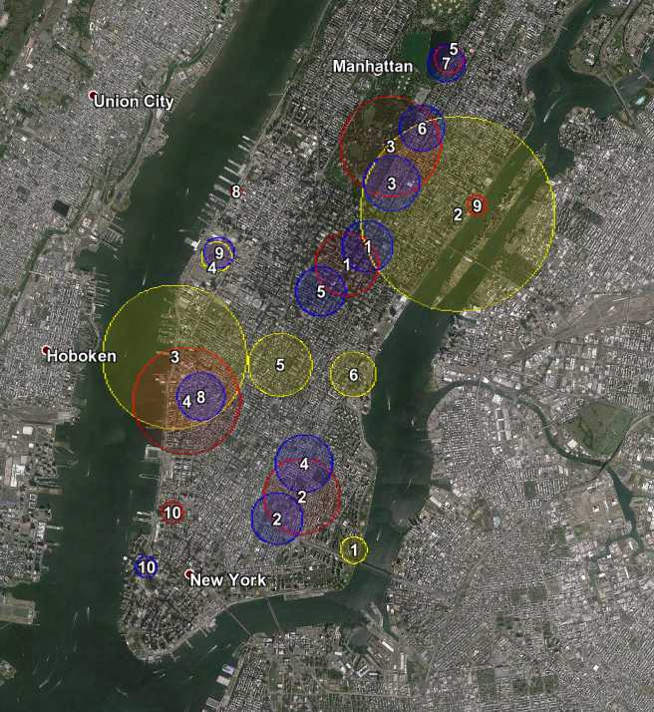
1.1. Cluster size bound - Circular
Significance
→ Increases with cluster size
Max test statistic: 7500 / 6700 / 4500
→ More equally distributed with small size bound
Median test statistic: 1200 / 1500 / 2300
Number of clusters
→ High when small bound (overlap option)
Consistency
→ Overlapping clusters always have same dates
→ Strong consistency 1km / 0.5km
Event Analysis
→ Halloween parade
None 1km 0.5km

Slide 6
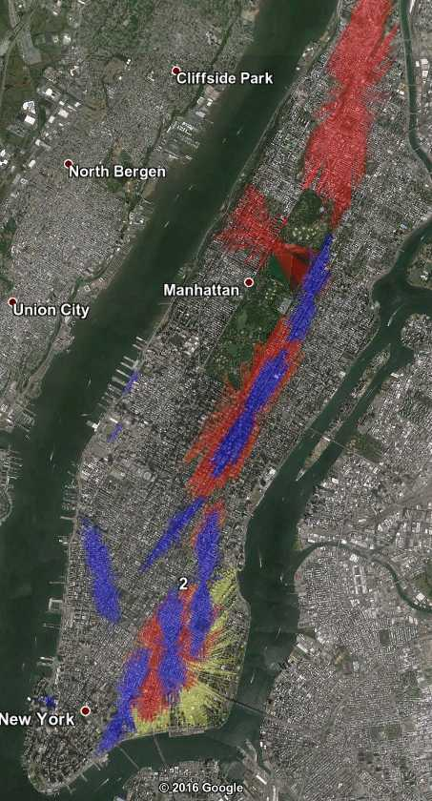
1.2. Cluster size bound - Ellipses
Significance → same as circular
→ Increases with cluster size
→ More equally distributed with small size bound
Number of clusters → same as circular
→ High when small bound (overlap option)
Consistency
→ Overlapping clusters always have same dates
→ Strong consistency for high test significances
Small bound allows to detect a
greater number of clusters of
more even significance
Bound in cartesian units, arbitrary unit
None 25k 10k

Slide 7
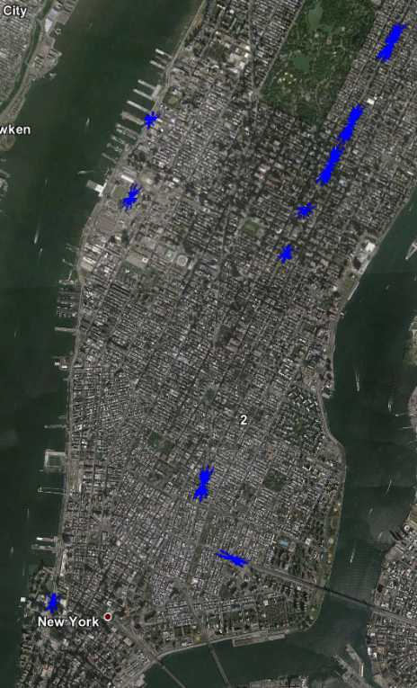
1.2. Cluster size bound - Ellipses
Events are focused on main lowspots
→ Consistent events compared to bigger size bounds
2k units size bound

Slide 8
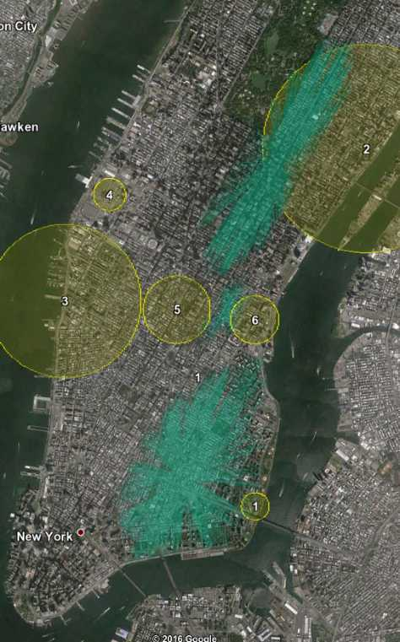
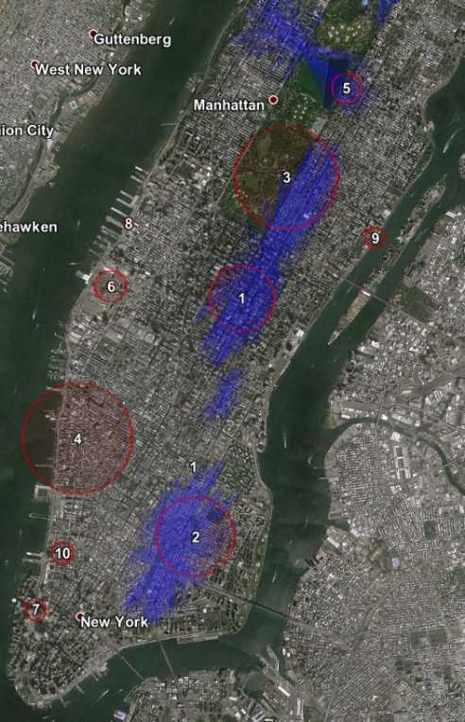
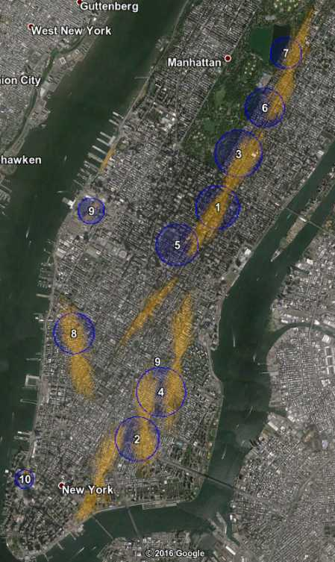
2. Circles vs Ellipses

Slide 9
2. Circles vs Ellipses
Significance
→ Ellipse clusters have ~25% better test statistic
→ More equally distributed with small size bound
Median test statistic: 1200 / 1500 / 2300
Number of clusters
→ Similar
Shape of clusters
→ Flat ellipses are favored, possibly because they fit better the road network
Consistency
→ Quite bad for none or large size bounds
→ Very strong with small size bounds
→ Most overlapping events have same dates
Computation for circles is much cheaper
→ No bound: x120
→ Mid bound: x50
→ Small bound: x30

Slide 10
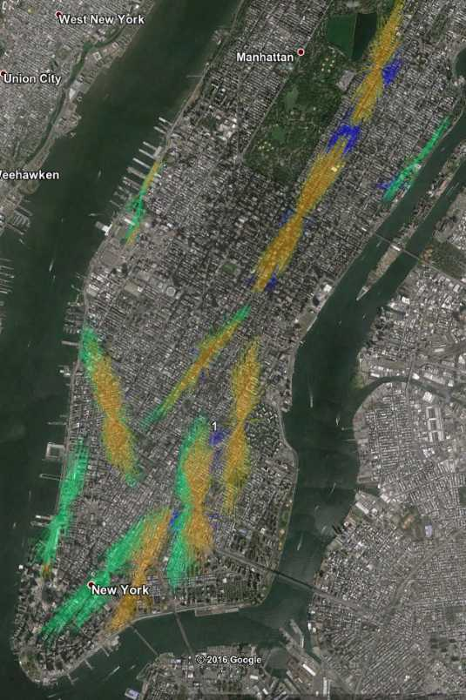
3. Ellipse constraints
Significance
→ No constraint => Most significant
Max test stat 8500 / 6300 / 5000
Number of clusters
→ Similar
Consistency
→ On most significant
→ Two geographical neighbors may have different dates
None Medium Strong

Slide 11
No easy event interpretability for daily aggregation of data
None of the detected clusters match a real-life easy to find
event - Parade, demonstration...
Scan | # Cluster | Main st 1 | Main st 2 | Time | Significance | Zone | Event research on the cluster’s dates | Day-of-Week
Elp | 1 | 34th → 75th st | Lexington / Park / Madison | 29 → 30 | 9000 | E.Mid / UES | Not relevant – Central Park Pumpkin Festival | Sat29
 | 2 | E.Bway → 14th st | Bowery → Pitt st | 3 → 6 | 7500 | LES | Not found | Mon3
 | (3) |  |  |  | 500
Elp25k | 1 | 34th → 75th st | Lexington – Park - Madison | 29 → 30 | 9300 | E.Mid / UES | Not found
 | 2 | Canal St → 14th st | Bowery – Allen – Essex | 3 –> 6 | 7300 | LES | Not found | Mon3
 | 3 | 90th → 100th | Madison - 5th – Central Park - Columbus | 8 → 9 | 1100 | UWS |  | Sat8
Elp10k | 1 | 40th → 70th | Lexington – Park - Madison | 29 → 30 | 6300 | E.Mid / UES | Not found | Sat29
 | 2 | Grand – Houston – Delancey - 10th | Essex – Allen - 2nd Ave | 24 → 27 | 3500 | LES/ EV | 24: Grub Street Food - not significant | Mon24
 | 3 | 79th → 96th | Park - Madison | 1 → 2 | 2600 | E.Mid / UES | Not found | Sat1
 | 4 | Bleeker – Christopher – W 14th | 6th → 8th | 24 → 27 | 1800 | Greenwhich/West Village | Not found | Mon24

Slide 12
No daily aggregation cluster match October 2011 NY events
Idea: look for events and then see if they were detected
10: Columbus parade, 5thAve&44th st → 5thAve&79th
31: Halloween Parade, Greenwich village
29: snow storm → OUT, a priori not localized in particular neighborhood
3 inches of snow in 1 day
Urgency state in New Jersey, two rail service closed in NY area
Occupy Wall Street
Sat 8 & Sat 1 in Union Square
5: 15k demonstrators from Foley Square to Zuccotti Park Wikipedia → NO, different location
15: thousands protestors from downtown Manhattan to Times Square Armed Forces recruiting station, Broadway? → NO, different location
http://abcnews.go.com/Business/occupy-wall-street-movement-worldwide/story?id=14743648
No cluster match either of those events

Slide 13
Event research protocol & possible reasons for daily non-interpretability
Research from detected clusters
“october DD” “2011” nyc lower east side on Google
“october DD” “2011” nyc park avenue, etc
Check 1st page of results
Nothing found
Research from events
Occupy Wall Street
Columbus Parade
Halloween Parade
→ No match found
Possible reasons for inability to interpret events
Need to double check the dates: shift → NO since next experiments detect Halloween Parade
Too big spatial window? → NO
→ With smaller window, clusters detected at the centers of previously detected clusters → changes nothing

Slide 14
Possible improvements
Increase # reported cluster with overlap options
→ Report clusters which are non overlapping in geography OR time
→ Select manually clusters
Search for more ellipses → Very secondary
→ Add ellipse shapes (flatter)
→ Add ellipse angles
(Adjust for day-of-week effect
→ TBD: check if many events are if the week-end)
Possible next steps:
1) Get SaTScan source code and adapt it to the problem
2) Look for other techniques → Seem more reasonable at first

Slide 15
SaTScan hour precision results –
Executive Summary
Like daily events, hourly events are generally non interpretable
For many events, counts are significantly low but cannot be linked to an obvious event – e.g. Halloween Parade
Relevant evaluation would require comparison with events found by other techniques
SaTScan seems to have a time additive bias under a certain time window size ~ 10h
Clusters tend to maximize event duration under the bound
Number of reported clusters seems to be bounded by 10

Slide 16
Looking for events in hourly analysis – experiment design
Experiment design
Ellipse unconstrained scan
Small size bound 2kc.u.~40m and 10kc.u.~200m semi-minor axis
Maximum event duration: 3h / 7h / 23h
SaTScan seems to have a time additive bias
==> Reduce size bound to look for a particular event → focus on 3h event duration
SaTScan seems to limit the number of reported clusters to 10
Many other applications of SaTScan stick to 10 clusters
 | Time window min/max, hours | Bound cluster semi-minor, k cart units | Run time PC | Clusters detected | Max/Median semi-minor (k units) | Max/Med/Min semi-major (k units) | Statistic score: max/med/min | Mean ev. duration, hours
2k_none_23 | 5 - 23 | 2 | 4’ | 10 | 1.95/1.9/1.75 | 9.8/9.6/8.8 | 1.7/1.05/0.85 | 13.8
2k_none_7 | 3 - 7 | 2 | 3’17’’ | 10 | 1.95/1.9/1.7 | 9.8/9.6/8.4 | 1.2/0.75/0.65 | 6.8
2k_none_3 | 1 – 3 | 2 | 2’ |  | - | - | 0.7/0.55/0.45 | 3.0
10k_none_23 | 5 - 23 | 10 | 55’ | 10 | 9.9/9.8/7.7 | 49/49/30 | 8.2/1.9/0.8 | 15.3
10k_none_7 | 3 - 7 | 10 | - | 10 | - | - | - | 6.9
10k_none_3 | 1 - 3 | 10 |  |  |  |  | 3.0/1.5/0.45 | 3.0

Slide 17
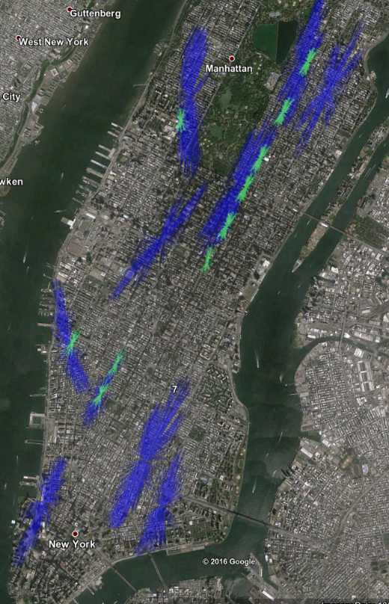
Hourly aggregation - event analysis
Only event easily interpretable: Halloween parade
Missing event: Columbus parade
10/11 - 11.30am → 3pm in W Mid / UWS (the UWS event detected happens the 8th at 8am)
Are there so many easily interpretable events?
UES shows troubles at night
Detail next slide
Not interpretable =/= not interesting
Detects lower than normal traffic density → could be used to balance taxis’ supply
Small events may correspond to traffic accidents, road construction sites...
Halloween
2k 10k / 3h maximum event duration

Slide 18
3-hour event analysis – most event at night, E Mid / UES troubled
# Cluster | Test statistic | Beginning | End | Obs/Expected | Expected | Location
1 | 690 | 31-19 | 31-22 | 0 | 700 | Greenwich
2 | 590 | 24-6 | 24-9 | 0.2 | 1200 | Meatpacking
3 | 580 | 2-1 | 2-4 | 0.14 | 1000 | E Mid.
4 | 550 | 30-0 | 30-3 | 0.2 | 1200 | UES
5 | 540 | 29-2 | 29-5 | 0.15 | 950 | E Mid.
6 | 450 | 30-1 | 30-4 | 0.25 | 1150 | UWS
7 | 420 | 31-19 | 31-21 | 0.02 | 500 | Greenwich
8 | 420 | 9-1 | 9-4 | 0.11 | 650 | UES
9 | 420 | 29-1 | 29-4 | 0.14 | 700 | E Mid.
10 | 400 | 29-1 | 29-3 | 0.11 | 620 | UES
The majority of events happen between 00h and 5h
Noise improbable: expected count >600
Observed / Expected counts are significantly low <20%
Many events happen in UES / E Midtown
Halloween

Slide 19
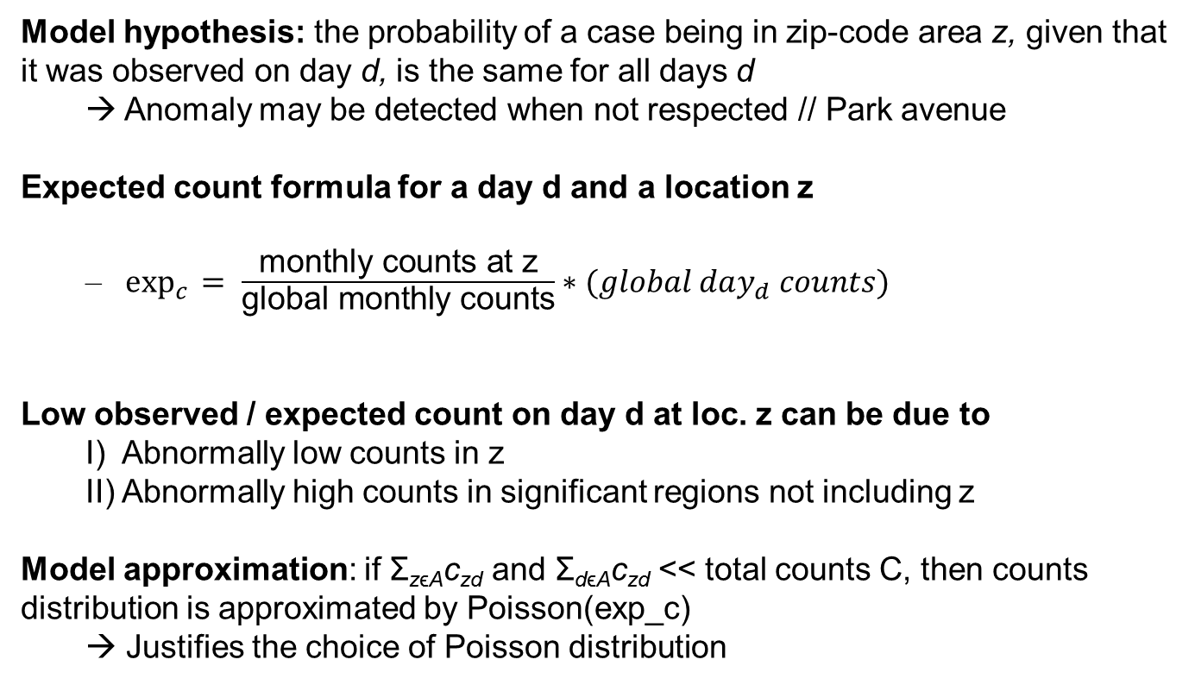
Important precision: model hypothesis and expected count of a location
Model hypothesis: the probability of a case being in zip-code area z, given that it was observed on day d, is the same for all days d
→ Anomaly may be detected when not respected // Park avenue
Expected count formula for a day d and a location z
$\exp_{c}{ = \frac{\text{monthly} \text{counts} \text{at} \text{z}}{\text{global} \text{monthly} \text{counts}}∗(global day_{d} counts)}$
Low observed / expected count on day d at loc. z can be due to
I) Abnormally low counts in z
II) Abnormally high counts in significant regions not including z
Model approximation: if Σ_{zϵA}c_{zd} and Σ_{dϵA}c_{zd} << total counts C, then counts distribution is approximated by Poisson(exp_c)
→ Justifies the choice of Poisson distribution

Slide 20
SaTScan exec. not for event exploration, but source code - unavailable - could be adapted
SaTScan is a rather consistent algorithm under a certain cluster size
Coherent from ~1km radius, gets more consistent for smaller bounds
SaTScan seems to be time & space additively biased
Maybe intended not to be trapped in punctual hotspots – thought for large-scale outbreak detection
SaTScan exec display too few clusters to explore events
Cluster reporting could be adapted with source code but takes time
No source code available, but maybe alternative open source tools
SaTScan evaluation could be improved
Does not detect societal events – but are there many?
How to evaluate the relevance of low-density region detection?
Depends on the purpose of the algorithm: detect punctual anomalies (accidents), trends in the city...?

