Slide 1
Event detection on urban data
Meeting with Daniel B. Neill
2016/07/05

Slide 2
2016-06-23 – Presentation Plan
Scope of study
Current state of the art
SaTScan experiments
Prior understanding of D. Neill’s work & questions

Slide 3
1/4 - Scope: comparison of ED techniques on urban space time series
Problem: Given a space time series urban data set i. What sort of events can be detected by available ED methods?
With what computation cost?
Case study: taxi data
Event Definition
Event as Anomaly = Outlier
Regular event?
Periodic? May be detected as periodic anomalies / different techniques?
Data
Generic event scope
Spatial time series, ex: grid time series. General application
Attributes → Counts
Univariate
Scale of taxi data
Space: 4000 locations
Time Resolution: hour/day
Time Period: couple years
Specific or general
Spatial & temporal extension not necessarily predefined
Persistent or emerging
One-time or periodic
No / little assumption on event / regular behavior
Parametric vs non-parametric

Slide 4
2/4 – Current state-of-the-art in Anomaly Detection for space-time data
Supervision & Extension
Density / Nearest Neighbors-based
Classification-based
Unsupervised
Outlier Detection extension
Collective / Region
Point: adaptable?
Fits spatial data → distance
Some spatial applications
Only spatial for now (Chawla 06)
To be determined
Possible ST applicable techniques
Bayesian Networks → Wong 2003
(SVM on temporal sequence → Perkin 2003)
Other methods
Topology → H. Doraiswamy
Detects similarity between topo. profiles in time → persistent / periodic reg. ED
Depth based / geometry → TBD
Information theoretic AD → TBD
Spatial data → Lin & Brown 2003
Spectral AD // PCA → Point OD
Yang 2011-2014, Chawla 2012
Wavelet transform → TBD
Clustering-based
Statistical-based
Extensive spatial applications
ST applicable techniques
DBSCAN Birant 06 → Point OD, waive height anomaly
ST-DBSCAN → cluster ST-neighborhoods - clusters with anomalous avg value could be outputted as outliers
Parametric / Non-parametric model
ST applicable techniques
LRT: Kulldorff, Neill, Pang – Reg. OD
Hidden Markov Mod. → Yang 2011, tbd
Regression → Guo 2014, Point AD
Addressing computation: Neill, Pang

Slide 5
3/4 - SaTScan experiments
Model used
Space-Time Permutation model → LRT test ~ Poisson when region counts << total counts
Assumption: the probability of a case being in zip-code area z, given that it was observed on day d, is the same for all days d
Experiment design
October 2011, day or hour aggregation
Scan for low counts
Varying cluster time & space bound: 3h → no bound / 200m → no bound. Often bounds for computation
Clusters shape: circles & ellipses
No statistical significance – 0 replications
No geographical overlapping → time not taken into account, important limit to exploration

Slide 6
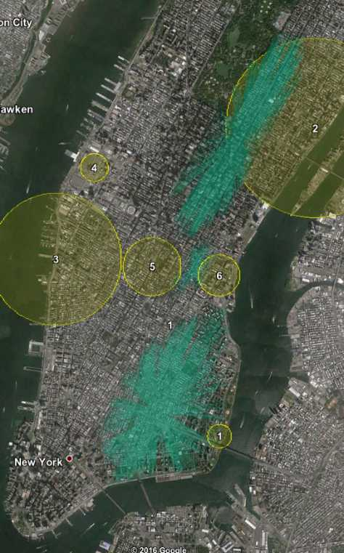
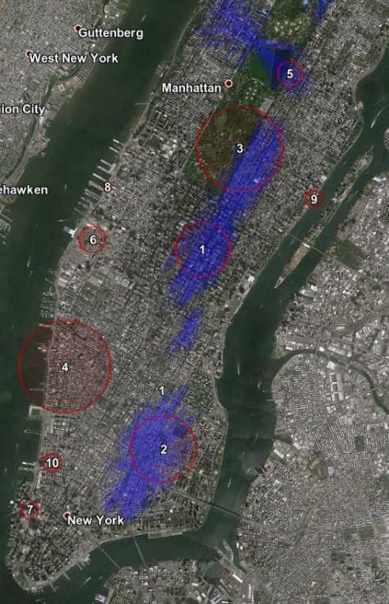
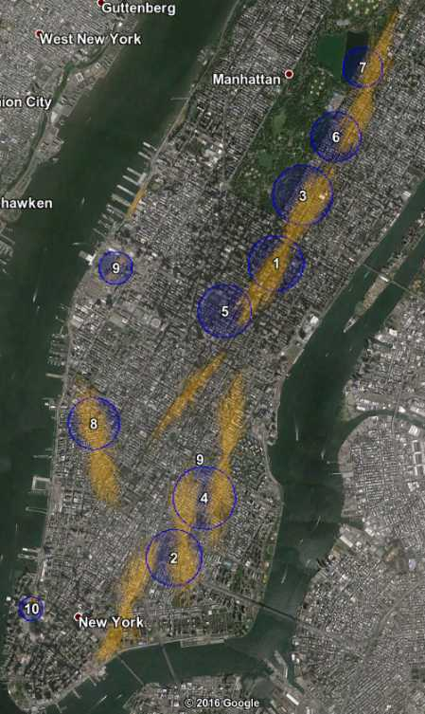
3/4 – SaTScan experiments output examples
Circles vs ellipses with different cluster size bound (200m → 1km)

Slide 7
3/4 – SaTScan performance analysis
Main limit is due to executable file 1. reported clusters cannot overlap geographically, whatever the time of the event - 2. limited to 10 clusters – TO BE CONFIRMED
SaTScan is a rather consistent algorithm under a certain cluster size
“Winner takes all” effect
Coherent under ~1km radius, Smaller bounds → more consistent & more evenly significant events
Ellipse scan performs better than circular but is ~10-100 times longer to run
Ellipses fit events better than circles – elongated events on road network
SaTScan seems to be time & space additively biased
Maybe intended not to be trapped in punctual hotspots – thought for large-scale outbreak detection
Difficult interpretability since events records are not available, only Halloween parade identified

Slide 8
4/4 – Prior understanding of D. Neill’s work
Scan statistics / Fast subset scan with parametric modeling, 2012
Fast computation, ~ same events detected than SaTScan
Various parametric modeling: Poisson, Gaussian
(Variantions: different expectation forecasting time series techniques
An empirical comparison of spatial scan statistics for outbreak detection, 2009)
Article: Fast subset scan for spatial pattern detection, 2012
Scan statistics / Non-parametric scan statistics, 2007
Only assumption of the model: independent counts from stationary time series
Adapt fast subset scan // FGSS ? TS analysis?
Article: A Nonparametric Scan Statistic for Multivariate Disease Surveillance, 2007
Bayesian statistics / Bayesian parametric scan statistic – univariate, 2006
Hierarchical Gamma-Poisson model
Better with prior knowledge of event, but can be used without it - uniform distribution
Interpretability and visualization
Looks for
a given event
a set of multiplicative increase event: {counts x 0.5, counts x 1.5, counts x 2,...}
Article: A Bayesian Scan Statistic for Spatial Cluster Detection, 2006
(Extra - Scan statistics / Fast subset scan with connectivity constraint – GraphScan)
New papers focus on multivariate data

Slide 9
4/4 - Key questions
Parametric vs non-Parametric for generic purpose?
Pang 2013 uses Poisson on taxi data
What are the non-parametric options → little literature?
What is the state-of-the-art in univariate event detection techniques?
Statistical and other AD techniques
Are Point anomaly detection techniques worth studying?
Parallel monitoring seems less efficient. Other way of aggregating point anomalies → Yang 2014 coupling?
Define relevant grid data
What is the code available?
Almost all techniques are tested on real data in papers
What techniques were used for urban data analysis?
CityScan: monitors 311 data in Chicago
CrimeScan: monitors 911 data in Chicago

Slide 10
4/4 - Broader questions
Sensor event detection?
Energy-efficiency / information distribution constraints make the problem quite specific → currently P2
Can TS analysis be “plugged in” any statistical technique? How easy? → Guo traffic TS forecast parallel monitoring
Fast computation: Pruning strategies vs LTSS?

