Slide 1
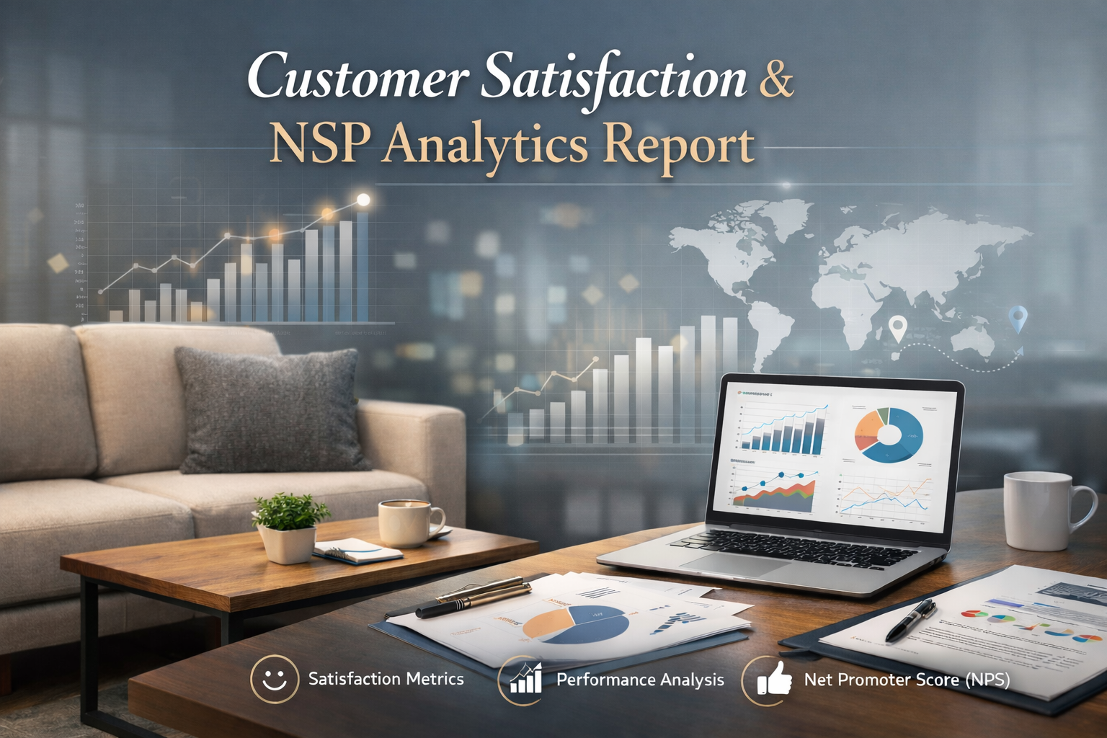
Prepared By: VIDHYA V
Tools Used: Excel ,SQL, Python (Pandas, Matplotlib, Seaborn), Power BI
Dataset: Online Furniture Orders – Delivery and Assembly
Year:2026

Slide 2
OBJECTIVE 3
BUSINESS / CLIENT QUESTIONS 4
DATA OVERVIEW 5
TOOLS AND TECHNOLOGY USED 8
DATA CLEANING AND PREPARATION 9
EXPLORATORY DATA ANALYSIS 11
SQL DATA EXPLORATION 16
POWER BI DASHBOARD 24
KEY INSIGHTS AND FINDINGS 32
RECOMMENDATIONS 35
LIMITATIONS 39
CONCLUSION 40
REFERENCES 41

Slide 3
1.Objective:
The purpose of this project is to analyze online furniture order data to understand customer ordering patterns, delivery performance, service choices (such as assembly requests), customer ratings. and payment preferences. You will derive actionable insights that can help improve operational efficiency, customer satisfaction, and revenue performance for an e-commerce furniture retailer.

Slide 4
2. Business/Client Questions
How can improving delivery timelines increase customer satisfaction, and what actions can be taken to achieve this?
Why should assembly services be promoted, and how can this increase revenue for an online furniture retailer?
How can focusing on high-revenue product categories and brands help drive overall sales growth?
What strategies can reduce delivery delays and improve fulfillment performance to enhance customer experience?
How can optimizing brand and category performance improve revenue growth and inventory utilization?
Why is it important to optimize pricing and cost structure, and what benefits can it bring to the business?
Which is Low-Performing Product- Categories and how to overcome
Find Important Calculations

Slide 5
3.Data Overview
Dataset Name: Online Furniture Orders – Delivery and Assembly (2025)
Data Source: Kaggle (Public Dataset)
Description: The dataset contains transactional data related to online furniture orders placed in 2025. It captures detailed information about customer purchases, product characteristics, delivery timelines, optional assembly services, payment methods, and customer feedback. This data enables analysis of sales performance, logistics efficiency, service adoption, and customer satisfaction.

Slide 6
Key Variables:
order_id – Unique identifier assigned to each customer order
customer_id – Unique identifier for each customer
product_category – High-level category of the furniture product
product_subcategory – Specific type of furniture within the category
brand – Brand or manufacturer of the furniture item
product_price – Base price of the product excluding additional charges
shipping_cost – Cost charged for delivering the product
assembly_service_requested – Indicates whether the customer requested assembly service (Yes/No)
assembly_cost – Cost of assembly service applied to the order
total_amount – Total value of the order including product price, shipping, and assembly costs
delivery_window_days – Number of days promised for order delivery
delivery_status – Final delivery outcome of the order
payment_method – Payment mode used by the customer
customer_rating – Customer satisfaction rating on a scale of 1 to 5 after delivery

Slide 7
Time Period Covered: Orders recorded during the year 2025
Data Type:
Numerical data: product_price, shipping_cost, assembly_cost, total_amount, delivery_window_days, customer_rating
Categorical data: product_category, product_subcategory, brand, assembly_service_requested, delivery_status, payment_method, NPS_category

Slide 8
4.Tools and Technology Used
Microsoft Excel: Used for initial data inspection, quick validation, pivot tables, and basic exploratory analysis
Python: Used for data cleaning, preprocessing, exploratory data analysis, feature engineering, and statistical analysis.
SQL: Used for data extraction, filtering, joining tables, and performing aggregations to answer business questions.
Power BI: Used to create interactive dashboards and visualizations for analyzing sales performance, delivery efficiency, and customer satisfaction.

Slide 9
5. Data Cleaning and Preparation
Excel
Step 1: Initial Data Inspection in Excel
Microsoft Excel was used for the initial review and validation of the dataset.
• Verified column names and ensured consistency across all fields • Checked for missing, blank, and duplicate values in key columns such as order_id and customer_id • Reviewed numerical fields (product_price, shipping_cost, assembly_cost, total_amount) for invalid or negative values • Inspected categorical columns for spelling inconsistencies and standardized values where required • Used pivot tables to perform a preliminary review of sales totals, delivery status counts, and rating distributions

Slide 10
Step 2: Data Cleaning and Transformation
• Removed duplicate records based on order_id • Replaced missing numerical values with appropriate defaults (e.g., assembly_cost set to 0 when assembly service was not requested) • Standardized categorical values such as delivery_status and payment_method • Ensured correct data types were assigned to all columns
Step 3: Data Validation
• Cross-checked total_amount against the sum of product_price, shipping_cost, and assembly_cost • Identified and flagged outliers in pricing and cost fields for further analysis
Step 4: Prepared Dataset for Further Analysis
After Excel-based cleaning, the dataset was exported for advanced analysis using Python, SQL, and Power BI.

Slide 11
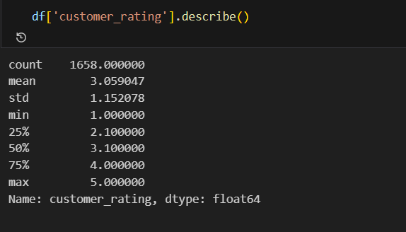
6. Exploratory Data Analysis (EDA)
Exploratory Data Analysis (EDA) :was conducted to understand the structure, quality, and basic characteristics of the dataset before performing detailed analysis. This step helped identify data distributions, initial patterns, and potential anomalies that could affect further analysis.
Fig 5.1 :Basic descriptive statistics such as mean, median, minimum, maximum, and standard deviation were calculated for key numerical variables including sales value, delivery time, customer ratings, and order quantity to understand data distribution and central tendencies.

Slide 12
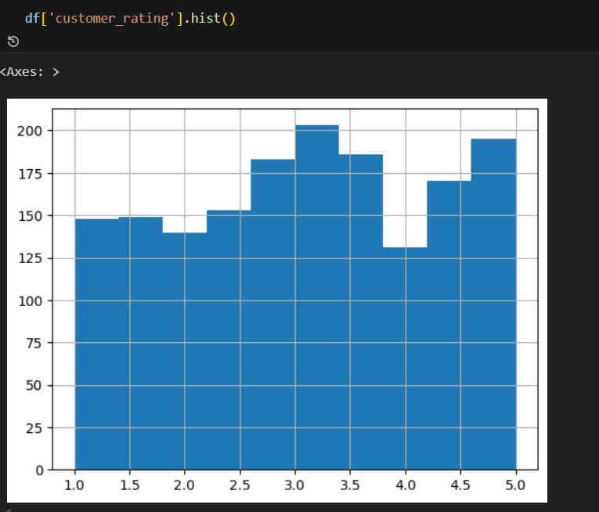
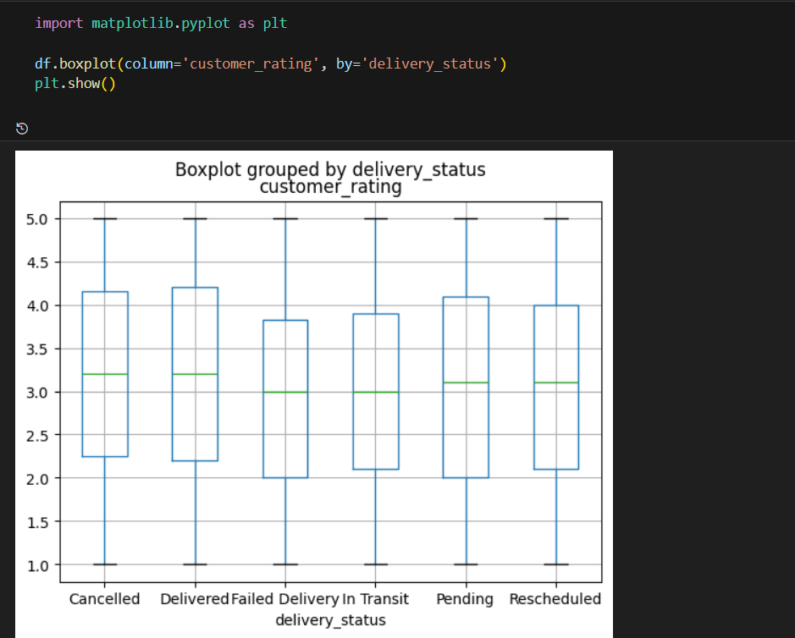
2. Key Patterns and Trends
Fig 5.2.1: Distribution of customer ratings showing concentration of ratings between 2 and 5 with an average around 3.
Fig 5.2.2: Boxplot of customer ratings by delivery status showing higher ratings for delivered orders and lower, more variable ratings for failed and in-transit orders.

Slide 13
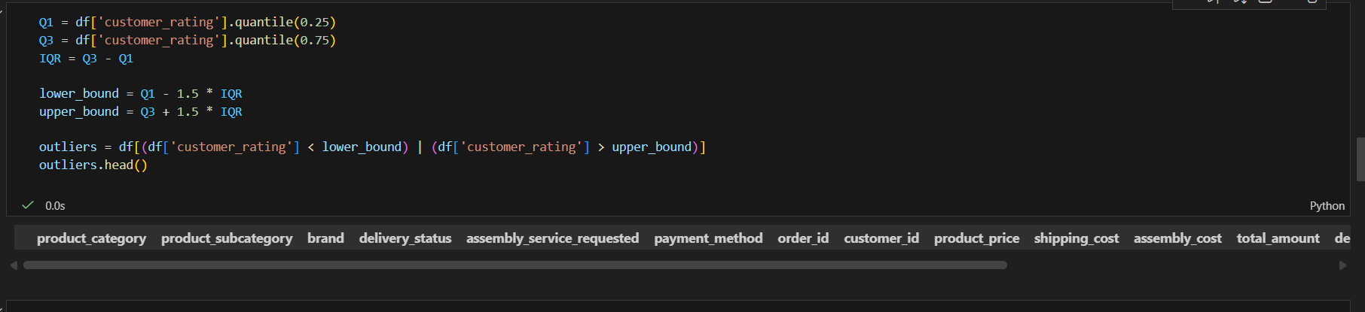
3. Outliers and Anomalies
Outlier detection was performed using the Interquartile Range (IQR) method on the customer rating variable. The first and third quartiles (Q1 and Q3) were computed, and observations outside the range defined by Q1 − 1.5×IQR and Q3 + 1.5×IQR were classified as potential outliers.
The analysis indicated that no significant outliers were present in the customer ratings, as all observations fell within the acceptable statistical bounds. This suggests that the dataset is free from extreme anomalous values and that the rating distribution is stable and reliable for further analysis.
Fig 5.3.1: Outlier detection using the IQR method showing no significant outliers in customer ratings.

Slide 14
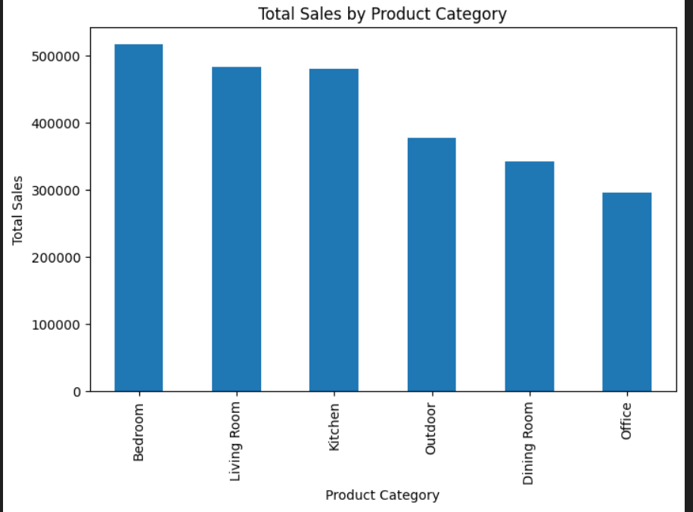
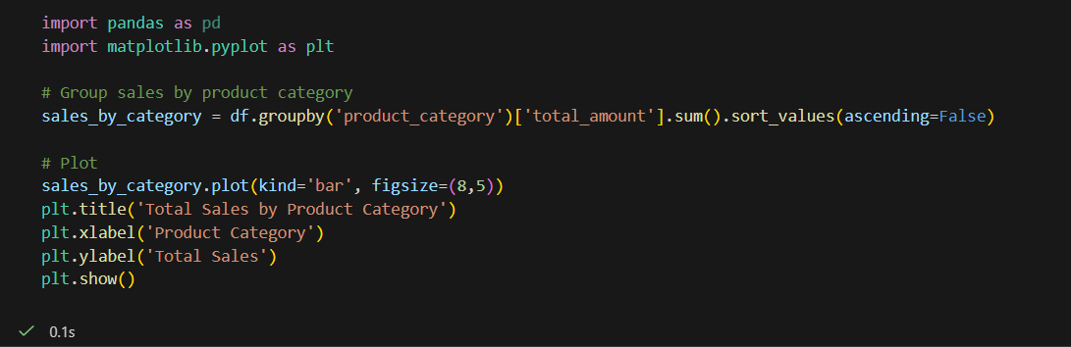
4. Sales Analysis
This section presents the core analytical results obtained using Python to evaluate sales performance, delivery efficiency, and the key drivers of customer satisfaction.
Fig 8.1: Sales analysis shows that the Bedroom category records the highest total sales, followed by Living Room and Kitchen, indicating that these categories are the primary revenue drivers. In contrast, Office and Dining Room categories generate comparatively lower sales, reflecting weaker demand in these segments.This suggests that marketing and inventory strategies should prioritize high-performing categories while introducing targeted promotions to improve performance in underperforming product lines.

Slide 15
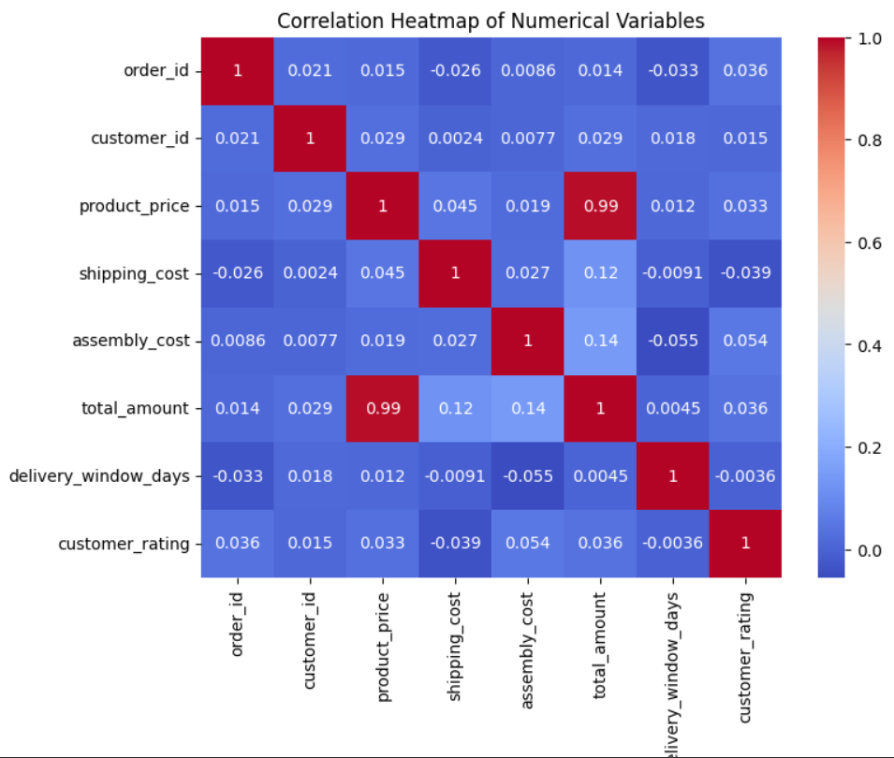
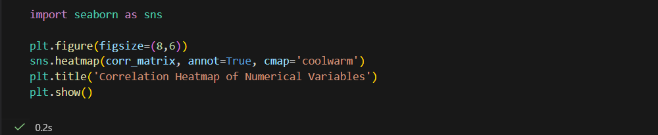
5. Correlation Analysis
Fig 8.2: The correlation heatmap shows a strong positive relationship between product price and total amount (r ≈ 0.99). All other variables, including shipping cost, assembly cost, delivery window, and customer rating, show very weak or no correlation, indicating that customer satisfaction is not strongly influenced by price or cost factors.

Slide 16
7.SQL Analysis
SQL was used as the core tool for business-level analysis on the furniture orders dataset to understand customer satisfaction, delivery performance, and service quality. It enabled efficient aggregation of large datasets and helped identify the main operational drivers behind customer dissatisfaction and loyalty.
SQL was used to:
Calculate key KPIs such as Average Rating and Net Promoter Score (NPS)
Analyze the impact of delivery performance on customer satisfaction
Evaluate the effectiveness of assembly service
Identify underperforming product categories
Segment high-value customers and assess their risk
Prepare structured data for Power BI visualization and Python validation

Slide 17
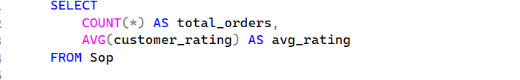
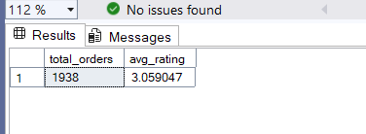
1. What is the overall customer satisfaction level
Business Insight: Provides a high-level indicator of customer experience health.

Slide 18
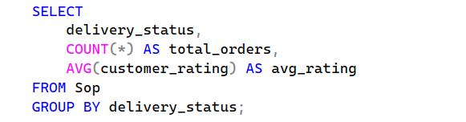
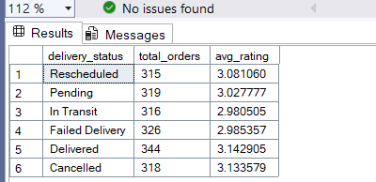
2.Does delivery performance impact customer satisfaction?
Business Insight: Identifies whether delayed or failed deliveries are major drivers of dissatisfaction.

Slide 19
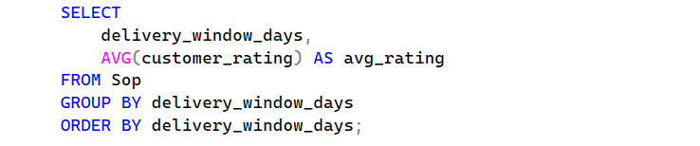
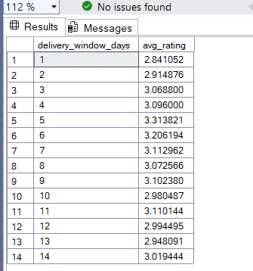
3.How does delivery time affect customer satisfaction?
Business Insight: Reveals customer tolerance levels for delivery delays.

Slide 20
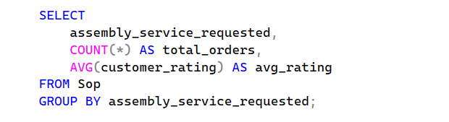
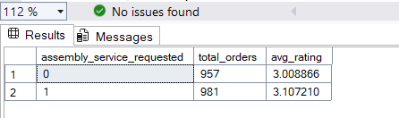
4.Does offering assembly service improve customer satisfaction?
Business Insight: Supports decisions on promoting or expanding value-added services

Slide 21
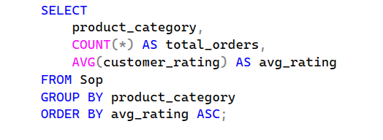
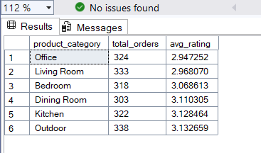
5.Which product categories have low customer satisfaction?
Business Insight: Helps prioritize product or logistics improvements by category.

Slide 22
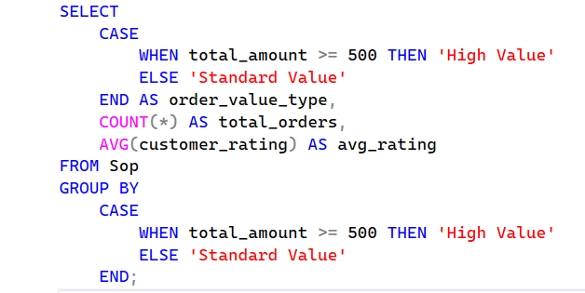
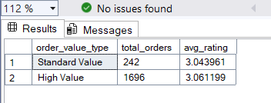
6. Are premium customers more sensitive to service issues?
Business Insight: Identifies revenue-critical customer segments at higher dissatisfaction risk.

Slide 23
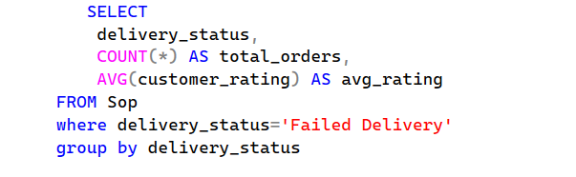
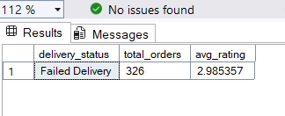
7.How damaging are failed deliveries?
Business Insight: Quantifies the severity of service failures on customer perception.

Slide 24
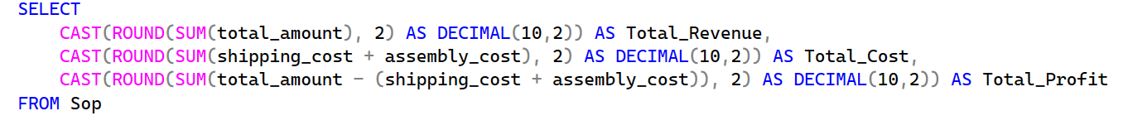
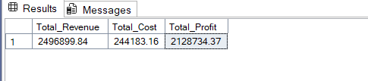
8.Total Revenue, Profit , Cost
Business Insight:
💰 High Profitability: Profit is significantly higher than cost
📈 Strong Margins: Indicates efficient cost management
🎯 Opportunity: Business can scale or invest in growth

Slide 25
9. Power BI Dashboard
The Power BI dashboard was developed to visually communicate key insights related to customer satisfaction and operational performance in the furniture orders dataset. The dashboard was designed with a business-first approach, enabling stakeholders to quickly understand performance, identify risks, and take action.
KPIs Displayed
The following KPIs were included at the top of the dashboard to provide an executive summary:
Total Orders – Indicates business volume
Total Revenue – Reflects total business income generated
Total Profit – Indicates overall profitability of the business
Total Cost – Total expenses for products sold
Percentage of Detractors – Highlights dissatisfaction risk
Net Promoter Score (NPS) – Represents customer loyalty and churn risk
Average Customer Rating – Measures overall satisfaction

Slide 26
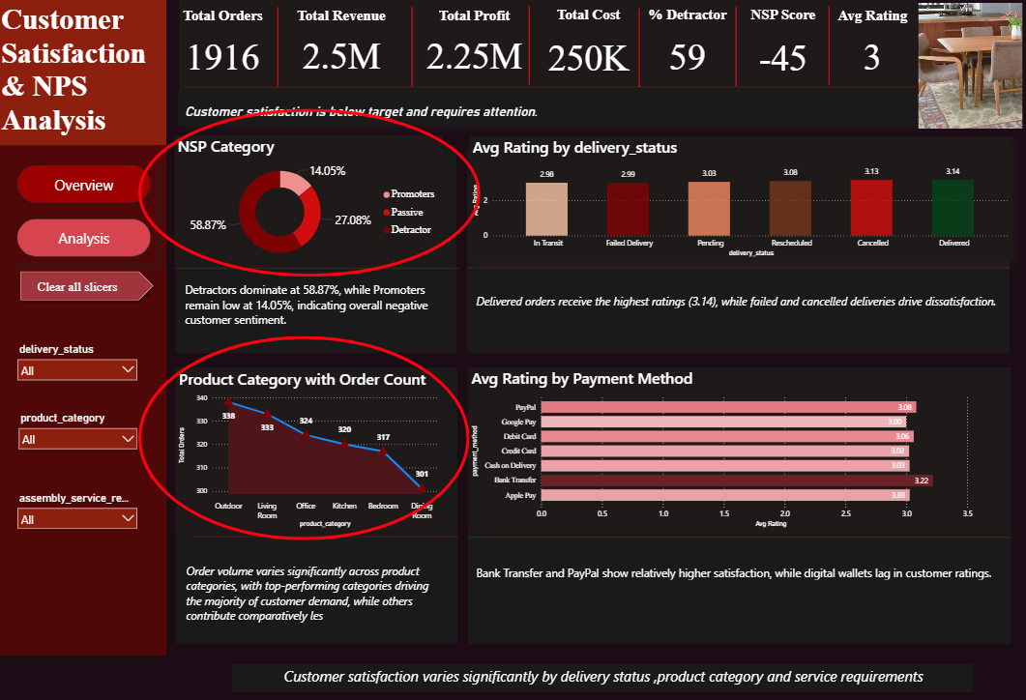
Power BI Dashboard Analysis
Customer satisfaction varies across categories based on ratings and order counts.The Area chart clearly explain Outdoor (338) and Living Room (333) perform better, Office (324) and Kitchen (322) show moderate results, while Bedroom (318) and Dining Room (303) record the lowest ratings and are the main drivers of dissatisfaction.
The Outdoor category emerges as the market leader, recording the highest volume with 338 total orders. The Living Room category follows closely, showing strong and consistent customer demand with 333 orders. Office and Kitchen categories demonstrate stable mid-level performance, with 324 and 320 orders respectively. Demand begins to decline in the Bedroom category, which registers 317 orders and trends toward the lower end. The Dining Room category ranks lowest, contributing the least with just 301 orders.

Slide 27
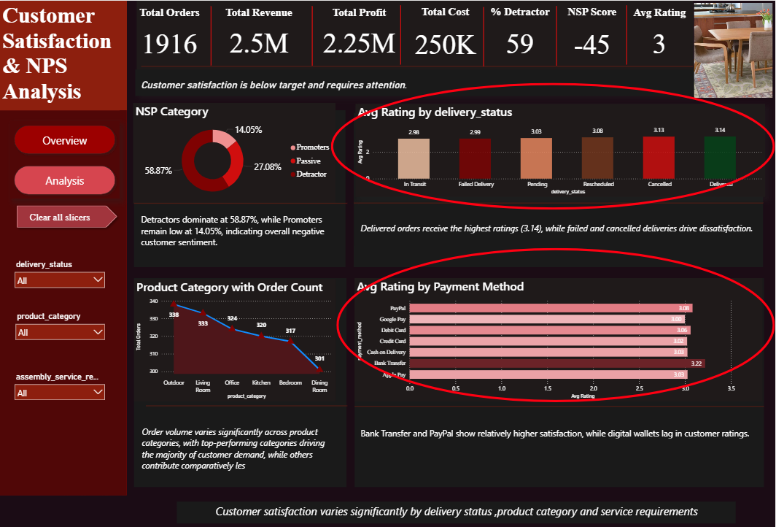
With the Product Category slicer set to “Kitchen”, customer satisfaction varies significantly by delivery outcome. Delivered orders achieve the highest average rating (3.40), indicating successful fulfillment strongly enhances customer experience, while failed and cancelled deliveries receive lower ratings, highlighting delivery performance as a critical driver of dissatisfaction and a priority area for operational improvement.
The Avg Rating by Payment Method chart reveals that PayPal and Debit Cards are the most satisfying transaction options for customers, boasting the highest scores of 3.41 and 3.36 respectively. In contrast, digital wallets like Apple Pay and Google Pay lag behind, with Credit Card transactions showing a notable dip in satisfaction at a low 2.79.

Slide 28
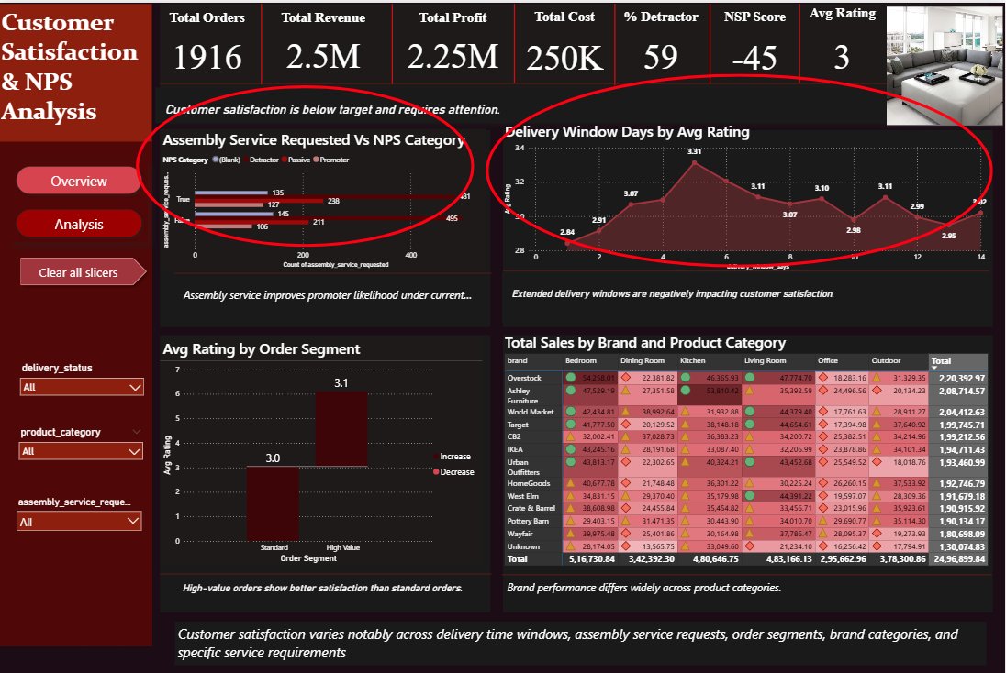
In Analysis Section
Assembly Service Requested vs NPS Category
This chart shows that orders with assembly service have slightly more promoters (127) than orders without assembly (106), but they also generate a higher number of detractors. This indicates that while assembly service can create promoters, it is also a significant source of dissatisfaction and negatively impacts overall NPS
Delivery window section
This chart shows that average customer ratings decline as the delivery window increases. Longer delivery durations are strongly associated with lower satisfaction and higher detractor levels, making delivery time a key driver of the negative NPS score. strongest for delivery windows between 1 and 6 days, with higher average ratings in this range

Slide 29
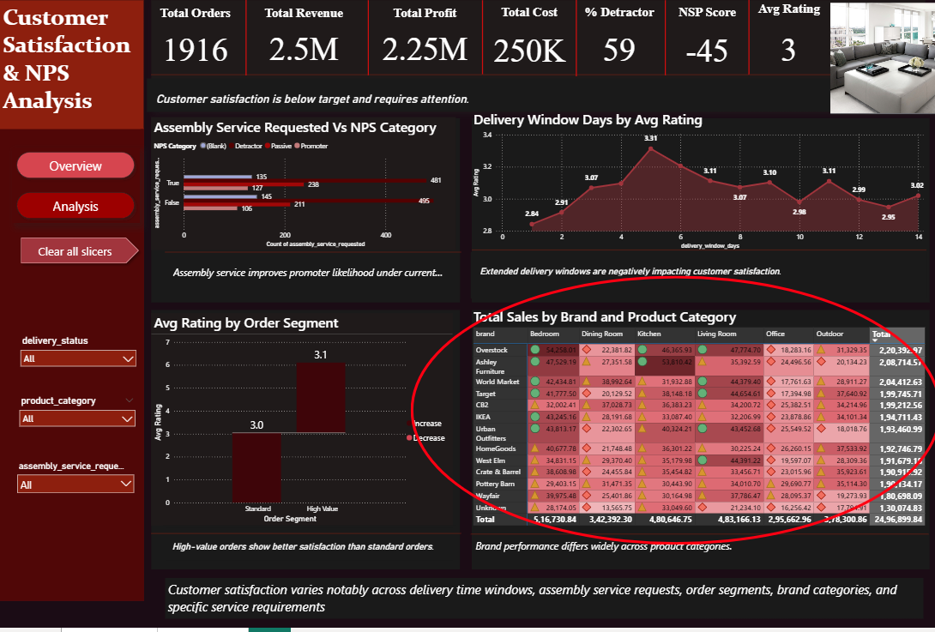
Brand Performance by Product Category (Total Sales)
This chart is a Heatmap Matrix tracking sales by brand and room. It uses a red color scale (darker = higher sales) and status icons—Green Circles for high performance, Yellow Triangles for average, and Red Diamonds for low—to visualize the Sum of Total Amount for each category.
The data reveals that Bedroom is the top-selling category ($516k+), while Office is the weakest ($295k+). Overstock leads all brands with over $220k in total sales, followed by Ashley Furniture. Overall, the chart shows that while brands thrive in private living spaces, they struggle to capture the home office and dining markets across a total combined revenue of $2,496,899.84.

Slide 30

Avg Rating by Order Segment
This section compares customer satisfaction between Standard and High Value orders, where orders above 500 are classified as “High Value” and others as “Standard.” The chart shows that High Value orders receive higher average ratings than Standard orders, indicating that higher-spending customers tend to be more satisfied and report a better overall experience.

Slide 31
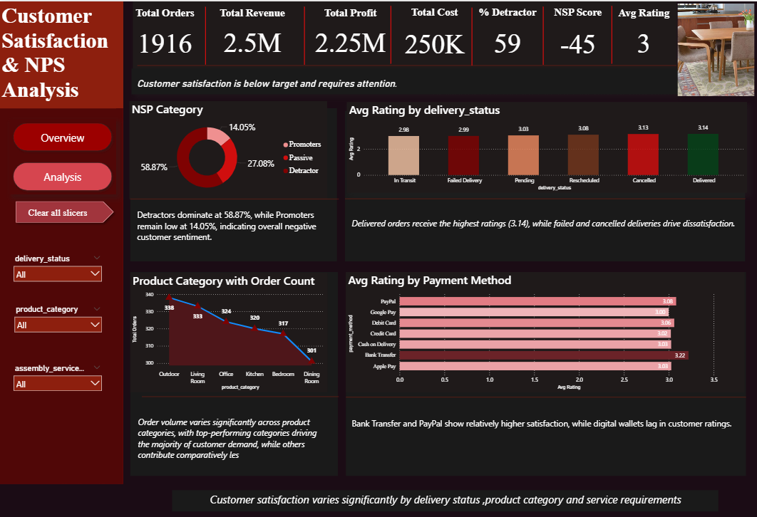

Slide 32
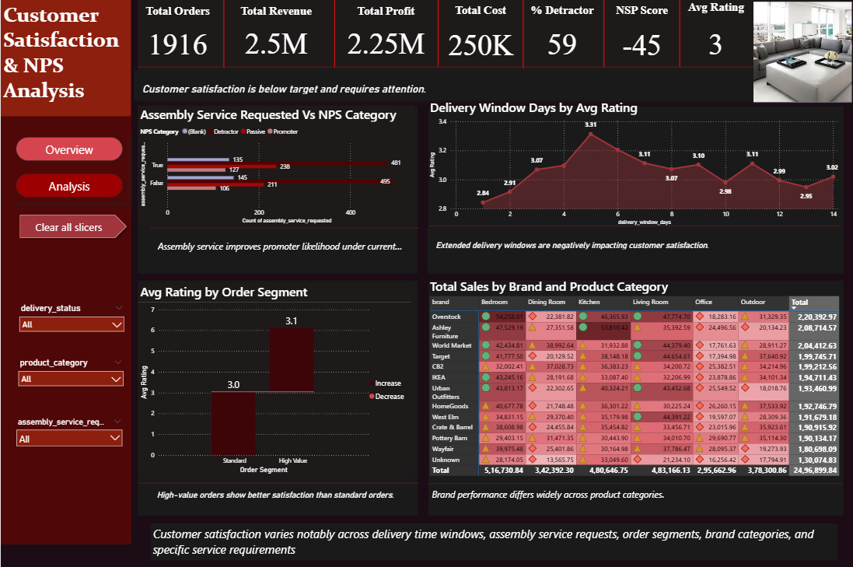

Slide 33
10. Key Insights and Findings
1. Overall Customer Sentiment Is Critically Negative
Insight: Customer satisfaction is severely below acceptable levels.
Supporting data: NPS = -45, with 59% detractors and only 14% promoters across 1,938 orders.
Business impact: High risk of customer churn, reduced repeat purchases, and damage to brand reputation if corrective actions are not taken urgently.
2. Delivery Failures and Cancellations Are the Primary Drivers of Dissatisfaction
Insight: Delivery performance is the strongest factor influencing customer ratings.
Supporting data: Delivered orders show the highest rating (3.14), while Failed Delivery (2.99) and Cancelled (3.08) orders generate significantly lower satisfaction and more detractors.
Business impact: Improving delivery reliability will directly increase NPS, reduce complaints, and strengthen customer retention.
3. Extended Delivery Windows Negatively Affect Customer Satisfaction
Insight: Longer delivery time windows reduce customer satisfaction.
Supporting data: Ratings decline as delivery windows extend beyond 1–2 days, with lower scores observed for longer delivery periods.
Business impact: Shortening delivery timelines and setting realistic expectations can improve satisfaction without major cost increases.

Slide 34
4. Assembly Service Increases the Likelihood of Promoters
Insight: Offering assembly services improves the customer experience.
Supporting data: Orders with assembly service show more promoters (135) and fewer detractors compared to orders without assembly.
Business impact: Promoting assembly services can convert passive customers into promoters and reduce post-delivery dissatisfaction.
5. Payment Method Influences Perceived Customer Experience
Insight: Payment channel choice affects satisfaction levels.
Supporting data: Bank Transfer and PayPal achieve the highest ratings (~3.2), while Google Pay and other digital wallets perform lower (~3.0).
Business impact: Improving digital wallet performance and payment experience can reduce friction and enhance overall satisfaction.
6. Customer Satisfaction Varies Significantly Across Product Categories
Insight: Certain product categories underperform in customer satisfaction.
Supporting data: Ratings decline from Outdoor (338) and Living Room (332) to Dining Room (303) and Bedroom categories.
Business impact: Targeted quality and logistics improvements in low-performing categories can generate focused NPS improvements.

Slide 35
7. High-Value Orders Generate Higher Customer Satisfaction
Insight: Premium customers report better experiences than standard customers.
Supporting data: High-value orders average near 6, compared with approximately 3 for standard orders.
Business impact: Expanding premium service features to mid-tier customers can increase satisfaction, loyalty, and lifetime customer value.
8. Brand Performance by Product Category
Insight: Sales are concentrated in key living spaces, with Bedroom and Living Room leading, while the Office category shows consistently weak performance across brands. Top brands like Overstock dominate, whereas smaller or Unknown brands lack consistency
Supporting Data: Bedroom generates the highest revenue (~$516K), followed by Living Room (~$483K), while Office is the lowest (~$295K). Overstock leads overall sales, whereas the Unknown brand records the lowest performance.
Business Impact: Focus on expanding Bedroom and Living Room categories to maximize revenue, while improving Office offerings presents a strong opportunity for significant growth.

Slide 36
11.Recommendations
1. Improve Delivery Timelines to Increase Customer Satisfaction
The analysis indicates a negative relationship between delivery window days and customer ratings, suggesting that longer delivery times reduce customer satisfaction.
Action: • Optimize logistics operations and partner with faster delivery service providers • Introduce express or priority delivery options for high-value orders
Expected Benefit: Reduced delivery times can improve customer ratings, enhance customer experience, and increase repeat purchases.
2. Promote Assembly Services to Increase Revenue
Orders that included assembly services showed higher average total order values.
Action: • Highlight assembly services during the checkout process • Offer bundled discounts or promotional pricing for assembly services on selected products
Expected Benefit: Increased adoption of assembly services can raise average order value and generate additional service revenue.

Slide 37
3. Focus on High-Revenue Product Categories and Brands
Certain product categories and brands contributed a significant portion of total revenue.
Action: • Increase marketing and promotional efforts for top-performing categories and brands • Ensure sufficient inventory availability for high-demand products
Expected Benefit: Improved focus on high-performing segments can drive revenue growth and improve inventory turnover.
4. Reduce Delivery Delays and Improve Fulfillment Performance
Lower customer ratings were frequently associated with delayed or unsuccessful deliveries.
Action: • Strengthen delivery monitoring and tracking systems • Implement proactive customer communication for delayed orders
Expected Benefit: Improved fulfillment performance can reduce complaints, minimize returns, and increase customer satisfaction.

Slide 38
5.Optimize Brand and Category Performance
Overstock and Ashley Furniture perform strongly across major categories, while Wayfair and Pottery Barn underperform in Office and Dining Room segments.
Action: • Focus promotions and inventory on high-performing brands and categories • Apply targeted discounts and assortment improvements for underperforming brands
Expected Benefit: Improved revenue growth, better inventory utilization, and stronger category-level profitability.
6. Optimize Pricing and Cost Structure
Outliers in shipping and assembly costs indicate potential operational inefficiencies.
Action: • Review high-cost delivery and assembly cases for process optimization • Negotiate improved pricing with logistics and service partners
Expected Benefit: Cost optimization can improve profit margins while maintaining service quality.

Slide 39
7. Low-Performing Categories
Based on the Band analysis with Products chart, the "Low" performance is clearly concentrated in the Office and Dining Room categories, marked by red diamonds and lighter shading.
Action:
Office: Modernize Inventory: Update the catalog with ergonomic chairs and "small-space" desks to target the remote-work market.
Expected Benefit:
Increased Conversion: Attracts a higher-intent demographic currently underserved by the existing basic furniture line.
Action:
Dining Room: Bundle & Save: Create "Complete Set" deals (e.g., Table + 4 Chairs) or cross-category bundles with Kitchen items.
Expected Benefit: Higher Average Order Value (AOV): Encourages customers to buy multiple items at once rather than just single pieces.

Slide 40
12. Limitations
The analysis is based on historical data and may not reflect recent operational changes or seasonal variations in customer behavior.
Customer demographic information was not available, limiting the ability to perform detailed segmentation and personalization analysis.
Satisfaction metrics are presented as aggregated averages, which may hide extreme individual customer experiences and reduce diagnostic precision.
Detailed operational variables such as courier performance, warehouse location, packaging quality, and specific delay reasons were not included in the dataset.
Customer feedback data was limited to quantitative ratings, without qualitative comments to explain the underlying causes of dissatisfaction.

Slide 41
13. Conclusion
Problem Summary
This project aimed to analyze customer satisfaction and brand performance using order, delivery, service, and product category data. The primary objective was to identify the key drivers of low Net Promoter Score (NPS), understand variations in customer experience across operational factors and brands, and highlight areas requiring operational and strategic improvement.
Value Delivered
The analysis provided clear, data-driven insights into the main causes of customer dissatisfaction, particularly delivery failures, extended delivery windows, and category-specific performance gaps. It also identified high-impact opportunities such as promoting assembly services, improving payment experience, and prioritizing high-performing product categories and brands. These findings enable management to take targeted actions to improve service quality, enhance customer satisfaction, and protect long-term revenue and brand equity.
Final Remarks
Overall, the study demonstrates the importance of operational excellence and service quality in driving customer loyalty and business performance. By addressing the identified gaps and implementing the recommended improvements, the organization can significantly improve NPS, reduce churn risk, and strengthen its competitive position. Future enhancements through richer data and predictive analytics will further support informed decision-making and sustained growth.

Slide 42
14.References
Dataset Name: Online Furniture Orders – Delivery and Assembly (2025)
Source: Kaggle (Public Dataset)
Author: Pratyush Puri
URL: https://www.kaggle.com/datasets/pratyushpuri/online-furniture-orders-delivery-and-assembly-2025

