Slide 1
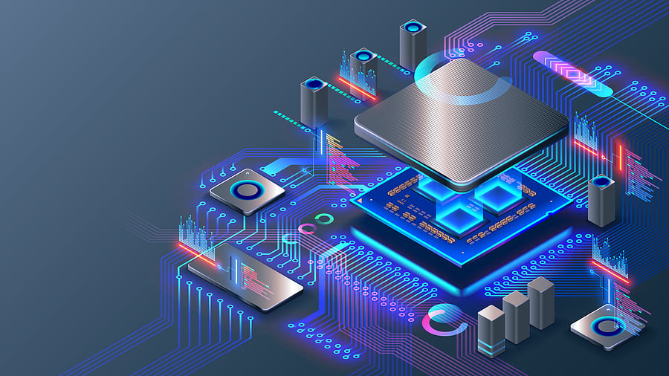
EMERTXE
EMBEDDED SYSTEMS
INTERNSHIP

Slide 2

V.S.B ENGINEERING COLLEGE
PROJECT NAME : MICROWAVE OVEN
PRESENTED BY:
VIDHYA P
4TH YEAR ECE

Slide 3

CONTENTS:
Embedded System
Embedded C
Microcontroller
Microwave Oven Project
Working Principle
Software Used
Components of PIC
Demonstration of Project

Slide 4
Embedded Systems:
An embedded system is a computer system—a combination of a computer processor, computer memory, and input/output peripheral devices—that has a dedicated function within a larger mechanical or electronic system.
Examples:
Mobile phones, Medical Equipments,…

Slide 5

EMBEDDED C:
Embedded C is an extension of C language and it is used to develop micro-controller-based applications. The extensions in the Embedded C language from normal C Programming Language are the I/O Hardware Addressing, fixed-point arithmetic operations, accessing address spaces, etc..

Slide 6

MICROCONTROLLER:
A microcontroller is a compact integrated circuit (IC) that combines a processor (CPU), memory, input/output peripherals, and other essential components required for controlling various electronic systems and devices. Microcontrollers are commonly used in embedded systems to perform specific tasks or functions within a larger system. They are versatile and find applications in a wide range of industries, including automotive, consumer electronics, industrial automation, and more.

Slide 7

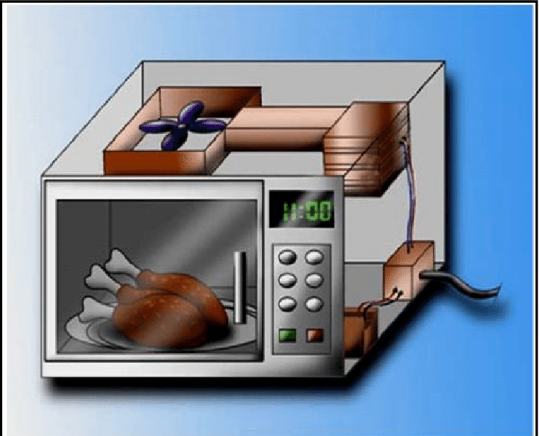
Microwave Oven
A microwave oven is a relatively small, boxlike oven that raises the temperature of food by subjecting it to a high-frequency electromagnetic field. The microwaves are absorbed by water, fats, sugars, and certain other molecules, whose consequent vibrations produce heat.

Slide 8

Working Principle:
A device called a magnetron inside the oven produces microwaves. The microwaves reflect off the metal interior of the oven and cause the water molecules in food to vibrate. This vibration results in friction between molecules, which produces heat that cooks the food.

Slide 9


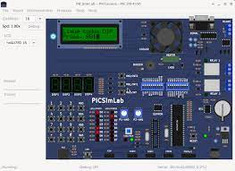
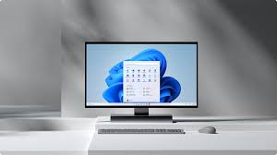
SOFTWARE USED:
HOST - PC
TARGET - PICSIMLAB
CROSS COMPILER – MPLAB X IDE

Slide 10

COMPONENTS OF PIC:
LEDs
Digital Keypad
Interrupts
Timers
CLCDs
Matrix Keypad

Slide 11

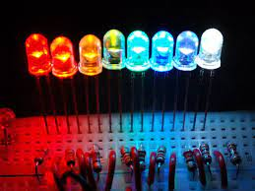
LEDs:
Light-emitting diode (LED) is a widely used standard source of light in electrical equipment. It has a wide range of applications ranging from your mobile phone to large advertising billboards. They mostly find applications in devices that show the time and display different types of data.

Slide 12

DIGITAL KEYPAD:
Keypad is an analog switching device which is generally available in matrix structure. It is used in many embedded system application for allowing the user to perform a necessary task. A matrix keypad is consists of an arrangement of switches connected in matrix format in rows and columns.

Slide 13

INTERRUPT:
An interrupt is a signal to the processor emitted by hardware or software indicating an event that needs immediate attention. Whenever an interrupt occurs, the controller completes the execution of the current instruction and starts the execution of an Interrupt Service Routine (ISR) or Interrupt Handler.

Slide 14

TIMERS:
Timers are used to keep a record of time for different events occurring in the embedded systems. The timer is a simpler binary counter which is configured in a circuit or a system as per the need to count the pulses in the system. The value of the timer is automatically set to zero once it is at its maximum value.

Slide 15

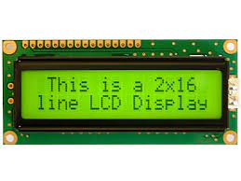
CLCDs:
The CLCD fetches the data for display from a frame buffer and uses its own dedicated DMA controller to transfer the display data to the LCD panel.

Slide 16

MATRIX KEYBOARD:
The matrix keyboard is taken as the basic input device of MCU or embedded systems. For traditional matrix keyboard, the number of interface signal lines connected to the MCU will rapidly increase with the rise of the number of keys. And it uses row scanning to get key values in software.

Slide 17
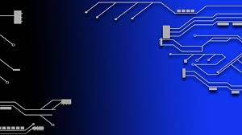
DEMONSTRATION OF PROJECT…..

