Slide 1

AGENT-BASED ARCHITECTURE WITH MCP INTEGRATION
VIDIT AGARWAL

Slide 2

INTRODUCTION
A lightweight, agent-based Retrieval-Augmented Generation (RAG) chatbot designed to answer user questions from uploaded documents of various formats — powered by Model Context Protocol (MCP) and Streamlit.
Supports PDF, DOCX, PPTX, CSV, TXT, Markdown files.
Built with modular agents and vector search using ChromaDB.
Agents:
IngestionAgent: Parses uploaded documents (PDF, DOCX, PPTX, etc.)
RetrievalAgent: Adds to vector store & retrieves top-matching chunks
LLMResponseAgent: Uses retrieved chunks + query to call the LLM
In-memory queue-based MCP:
Agents send/receive structured messages via a shared in-memory mcp_queue (like a message bus).
There is no network communication (like HTTP or WebSocket).
So everything runs in a single process, or at least in the same memory space.

Slide 3

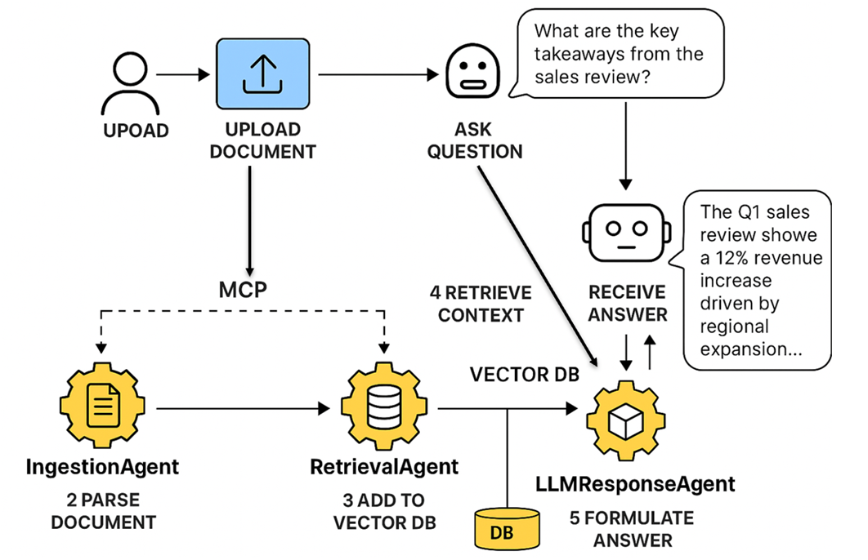
SYSTEM ARCHITECTURE

Slide 4
TECH STACK
->
->
->
->
->
Frontend:
Streamlit for UI
Backend:
Python (3.10+)
Agent logic via custom classes
LLM + Embeddings:
LLM: Groq API (LLaMA3)
Embeddings: HuggingFace (MiniLM)
Vector Store:
ChromaDB
Document Parsing:
PyMuPDF, python-docx, python-pptx, pandas, markdown

Slide 5
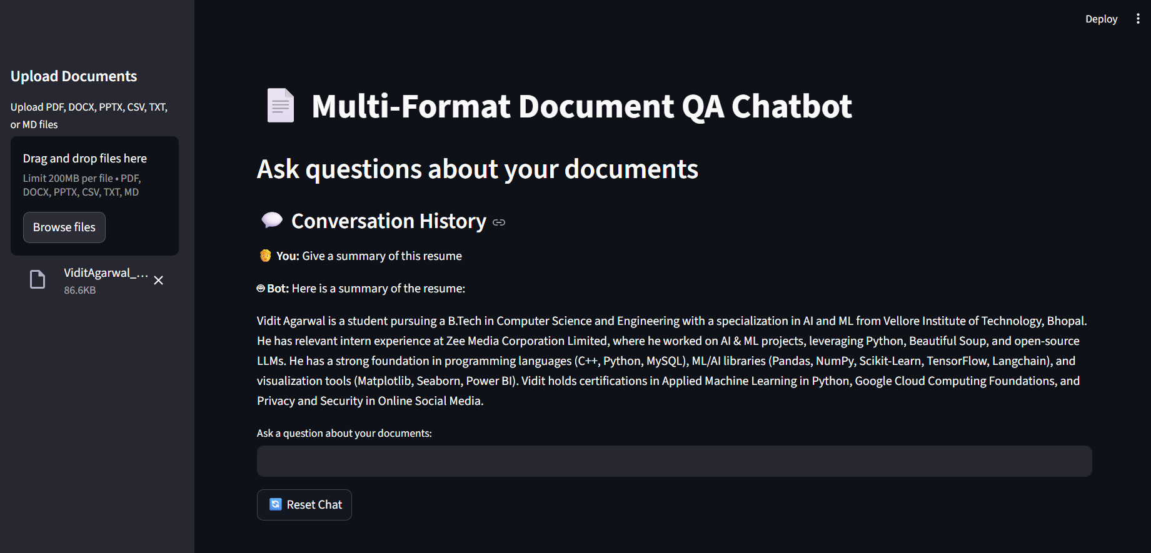

UI DEMO

Slide 6

CHALLENGES FACED
EMBEDDING & API CONSTRAINTS
DOCUMENT PARSING ISSUES
VECTOR STORE BOTTLENECKS
Frequent HuggingFace model load delays and API quota limitations affected response latency.
Inconsistent PDF table extraction
Custom cleanup logic for Markdown and plain text files
Cold-start delays in ChromaDB due to embedding downloads on first load.

Slide 7
FUTURE IMPROVEMENTS
Workflow Orchestration with LangGraph
Enable advanced flow control with loops, branching, and retry logic in agent execution.
Session-Aware Memory & Personalization
Store conversation context and user preferences for richer multi-turn interactions.
Secure Access with Authentication
Introduce user login, session tokens, and document-level access controls.
Distributed MCP via Pub/Sub
Replace in-memory messaging with Redis channels or FastAPI endpoints for scalability.
Export & Share Capabilities
Allow users to export chat sessions with source highlights as PDF or markdown.

Slide 8
THANK
YOU

