Slide 1
Movie/Project Success Prediction
DIH Summer Project
Mentor: Dr. Bhaskar Biswas
Project By: Aman Pratik (14084002)

Slide 2
Abstract
Predicting the success of a Bollywood movie before its release for the public. This would be done by considering various parameters such as the star cast, movie genre etc. combined with appropriate machine learning algorithms such as Polynomial Regression.

Slide 3


Success Criteria
Commercial Success: The Revenue generated by the movie worldwide could possibly tell us about the success of the movie. More Revenue generated means more profit.
Public Opinion: The overall opinion of the common mass about the movie( e.g. IMDb Rating). Movies are meant for the entertainment of the audience, hence their opinion is most important.

Slide 4
Aim:
Prepare a mathematical model to predict the IMDb Rating of a Bollywood movie based on various parameters/data of the movie available to us before its official release to the public.

Slide 5
List of probable features for the model:
Star Cast
Director
Genre
Movie length
Budget
Twitter Data
YouTube Data

Slide 6
Data Collection:
omdbapi.com: A third party online service which provides the user with various data about the movie such as its IMDb Rating, Star Cast, Genre, Title etc. This data has been collected from IMDb itself and available to us in JSON or XML format.

Slide 7
Data Collection:
cinemalytics.com: It’s a Bollywood movie database which provides us various data about the movie such as its Budget, Runtime, YouTube Trailer link etc. It is also available in JSON or XML format.
YouTube data: YouTube pages with the movie trailer were downloaded and its views, likes and dislikes were scrapped from the page to be used as features.

Slide 8
Data Collection:
Twitter Data: Unfortunately the datasets suitable for our use was not available and the Twitter API did not provide historic data. We were unable to use Twitter data in our model.

Slide 9
Feature Analysis:
Various features like Star Cast, Genre, Movie Trailer views and likes were taken into account individually and their variation with the IMDb Rating was analysed.

Slide 10
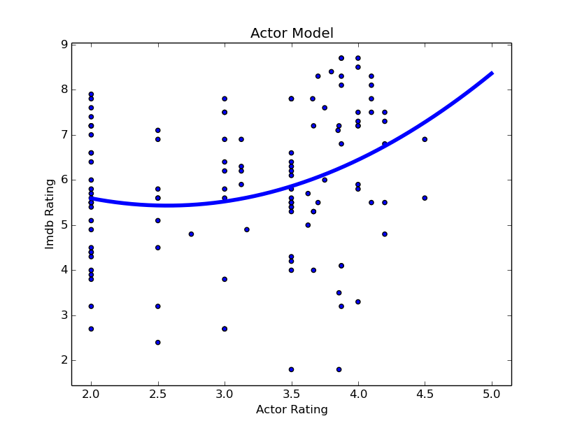
Feature: Star Cast

Slide 11
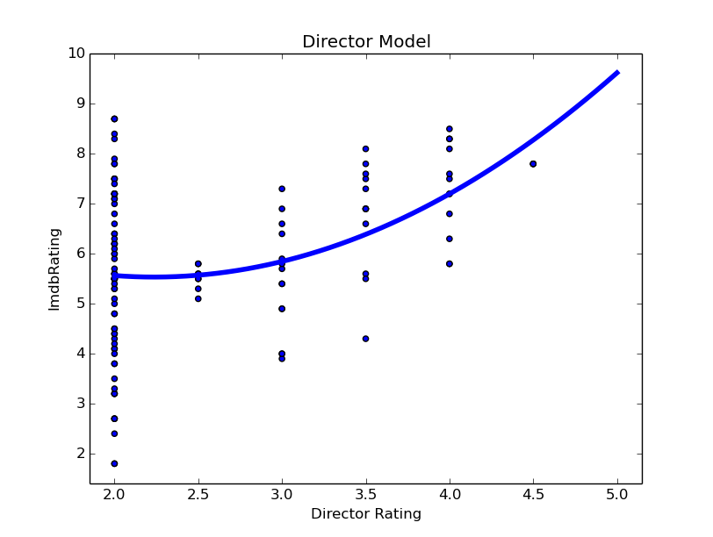
Feature: Director

Slide 12
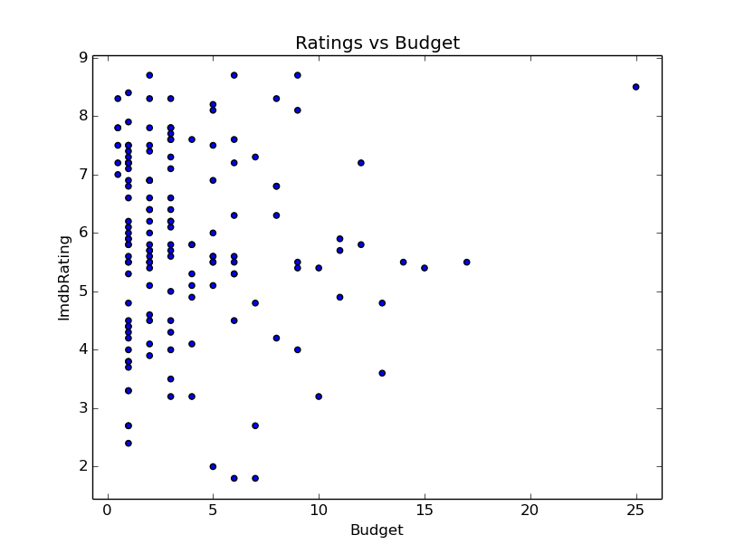
Feature: Budget

Slide 13
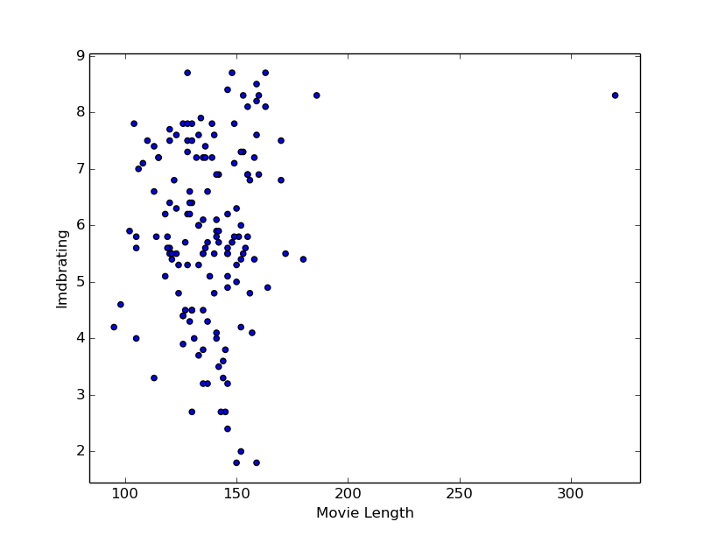
Feature: Movie Length

Slide 14
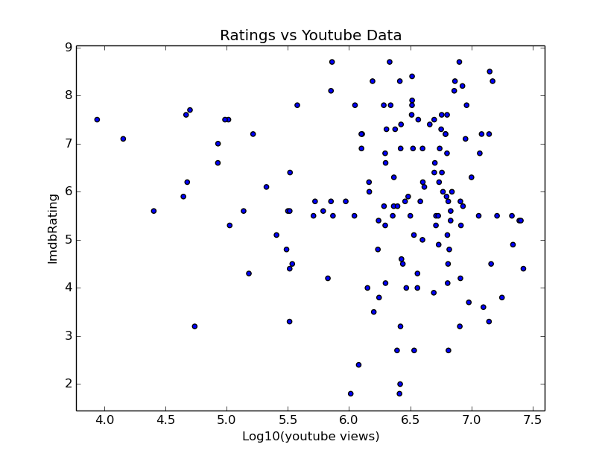
Feature: Trailer Views

Slide 15
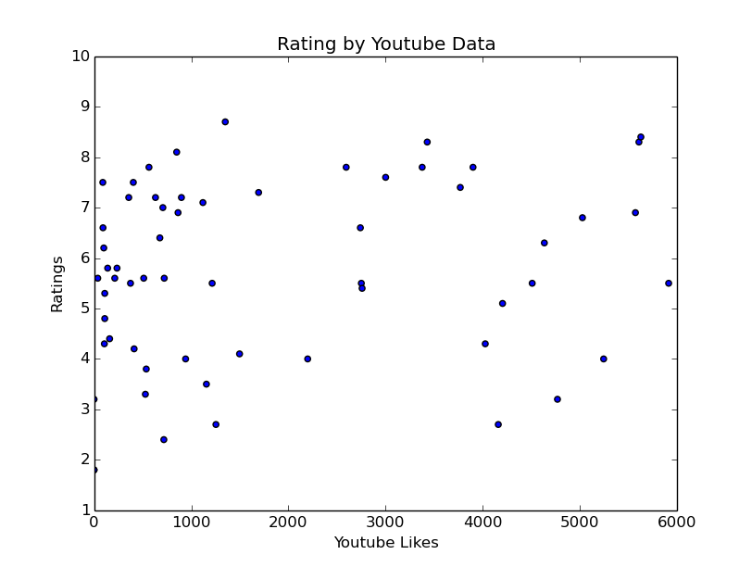
Feature: Trailer Likes

Slide 16
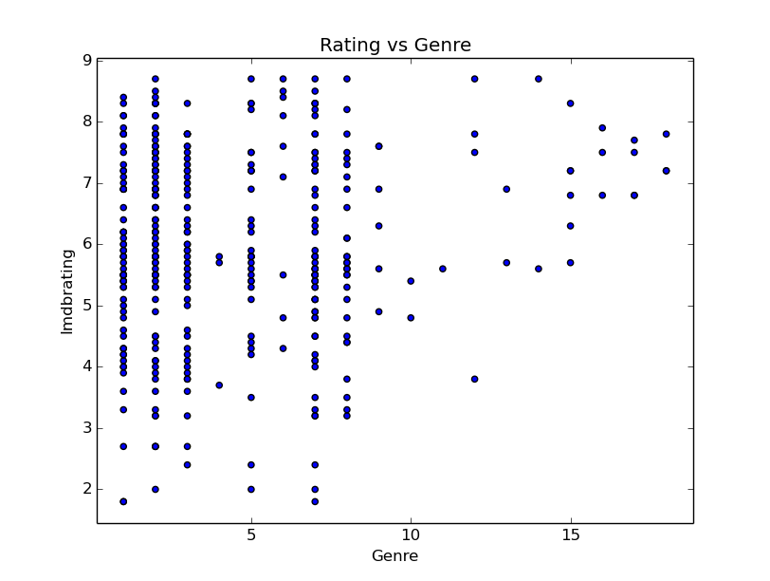
Feature: Genre

Slide 17
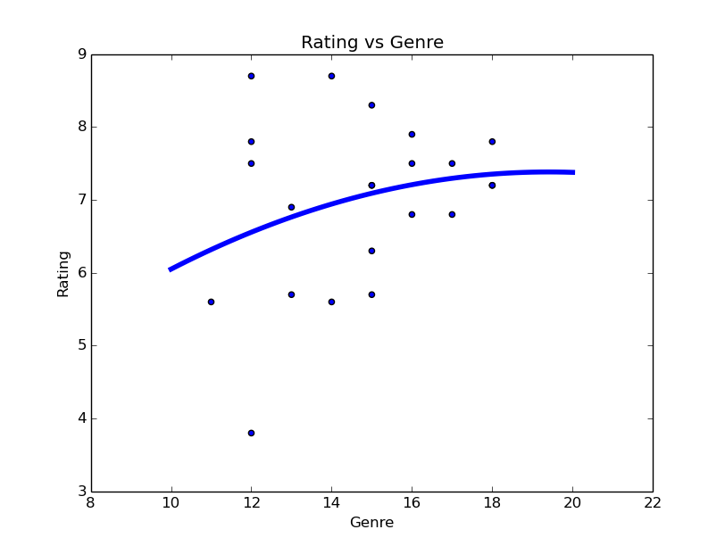
Feature: Genre (Contd.)

Slide 18
Fitting Polynomials:
IMDb Rating vs. Director Rating:
F(d): 0.535*(d^2) - 2.393*d + 8.21
IMDb Rating vs. Actor Rating:
F(a): 0.495*(a^2) – 2.547*a + 8.705
IMDb Rating vs. Genre Label:
F(g): -0.015*(g^2) + 0.585*g + 1.703
d= Director Rating
a= Actor Rating
g= Genre Label
F()= Fitting Polynomial

Slide 19
Final Model:
After some experiments using Python libraries like scipy, matplotlib, numpy etc. a model was created to calculate the IMDb Rating of a movie using Actor Rating, Director Rating, Genre as features. There are 2 multivariable polynomial expressions depending on the Genre label.

Slide 20
Model:
For g >= 10:
R(a,d,g): 0.2*[0.495*(a^2) – 2.547*a + 8.705] + 0.1*[0.535*(d^2) - 2.393*d + 8.21] + 0.7*[-0.015*(g^2) + 0.585*g + 1.703]
For g < 10:
R(a,d): 0.7*[0.495*(a^2) – 2.547*a + 8.705] + 0.3*[0.535*(d^2) - 2.393*d + 8.21]
d= Director Rating
a= Actor Rating
g= Genre Label
R()= Predicted Rating

Slide 21
Error:
Training Data:
Dataset size: 120
Σ(Error)^2 = 276.4
Maximum Error = 3.87
Test Data:
Dataset size: 30
Σ(Error)^2 = 63.87
Maximum Error = 2.03

Slide 22
Further Tasks:
Improvise the model to get better accuracy and make it apt for more cases/datasets.
Looking for patterns and classes in the dataset using machine learning algorithms such as SVM, K-Means clustering to get some useful information for predicting the IMDb Rating.

Slide 23


