Slide 1
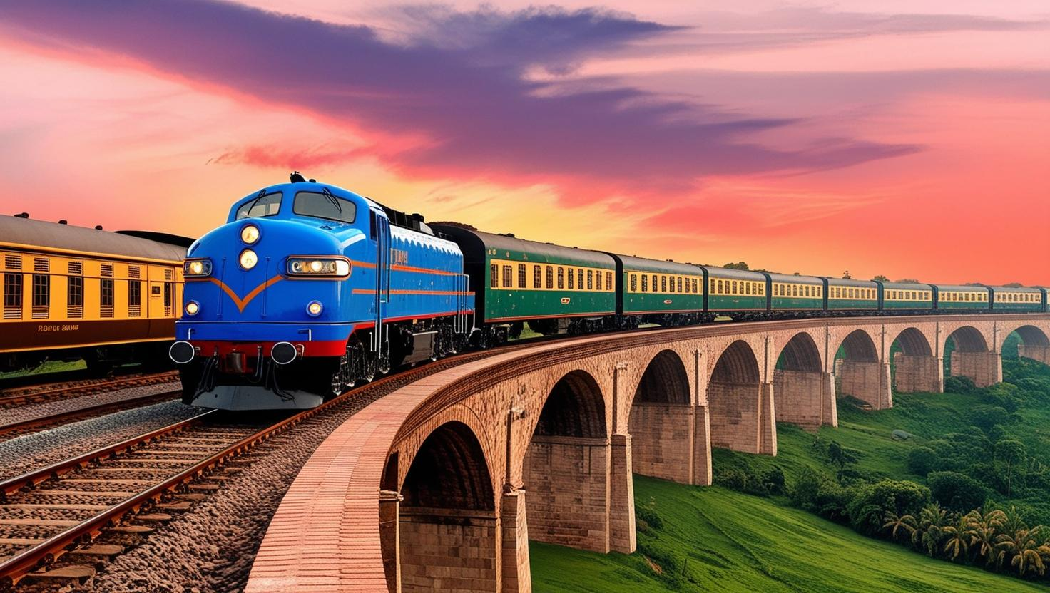
RAILWAY COMPLAINT BOT

Slide 2
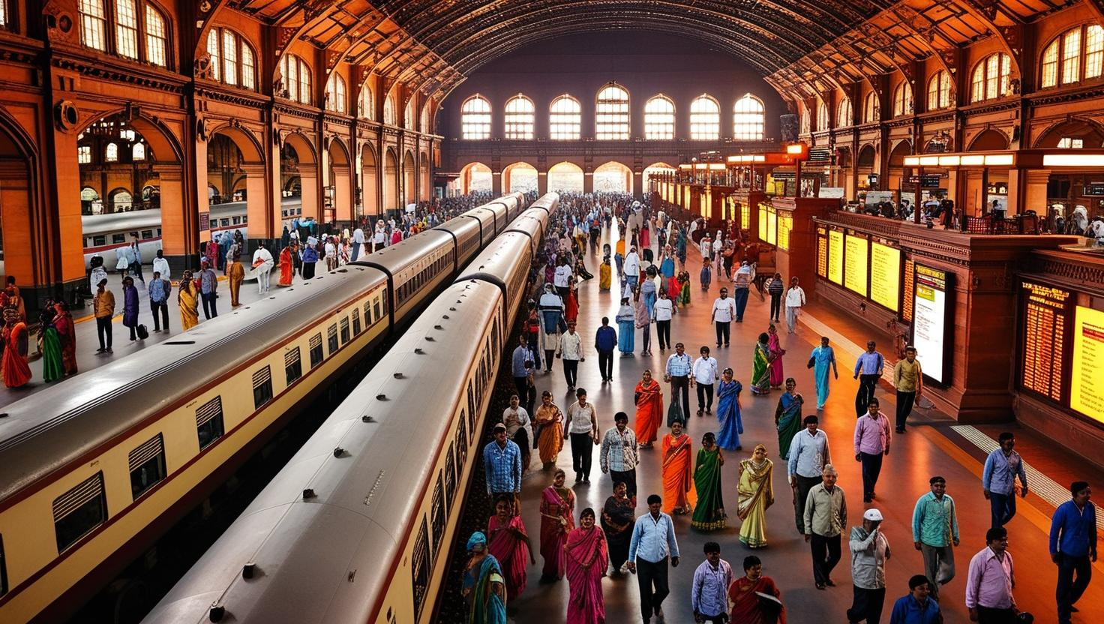
Overview
Problem Statement
Approaches Taken to arrive at Solution
Tech Stack Used
How 5 Frameworks Helped
Challenges Faced
Impact of Solution Proposed
Future Outlook
Individual Contributions
02
04
07
08
09
10
11
12

Slide 3
Problem Statement:
Passengers face issues related to security, cleanliness, staff behavior, electrical faults, and catering.
Traditional complaint management is inefficient, leading to delayed responses and unresolved issues.
Manual handling causes misclassification, inconsistencies, and difficulty in tracking complaints.
Passengers struggle with complex submission processes and lack of real-time updates.
No intelligent system to categorize and forward complaints to relevant authorities.
Need for an AI-powered Railway Complaint Management System to automate classification, improve efficiency, and enhance passenger satisfaction.

Slide 4
Approach Taken to Arrive at the Solution
1. Understanding User Needs
Identified common railway-related complaints from passengers.
Researched existing complaint redressal mechanisms and their limitations.
Defined categories of complaints for effective classification.
2. Leveraging AI and Automation
Large Language Model (LLM) Integration: Used Google's Gemini AI to classify complaints and validate image-based evidence.
Speech-to-Text: Enabled voice-based complaint submission using SpeechRecognition to improve accessibility.

Slide 5
3. Database and Storage Setup
MySQL Database: Designed an efficient schema to store complaints, categorize them, and track status updates.
Unique ID Generation: Implemented UUIDs for easy tracking of complaints.
4. Automated Email Forwarding System
Dynamic Email Routing: Mapped complaint categories to relevant railway authorities using predefined email addresses.
SMTP Integration: Automated email dispatch to ensure rapid complaint escalation.
5. Streamlit-Based User Interface
Interactive UI: Developed a Streamlit-based web app for users to submit complaints effortlessly.
Image Upload & Evidence Verification: Allowed users to submit images as supporting evidence.

Slide 6
6. AI-Based Complaint Verification
Automated Approval/Rejection: The LLM verifies complaints by analyzing text input and attached images.
Decision Explanation: If rejected, users are provided with a reason for rejection.
7. Admin Panel & Complaint Tracking
Admin Dashboard: Allowed railway officials to track complaints, review statuses, and download reports.
User Complaint Tracking: Enabled users to check their complaint status using a unique complaint ID.

Slide 7
Tech Stack Used:
Programming Languages: Python 🔹 Frameworks: Streamlit (UI), Flask (Backend) 🔹 AI & NLP: Google Gemini AI (Complaint Classification), SpeechRecognition (Speech-to-Text) 🔹 Database: MySQL (Stores complaints and tracking info) 🔹 Automation: SMTP (Email forwarding to authorities) 🔹 Frontend: Streamlit (User Interface)

Slide 8
How the 5-Step Framework Helped?
Problem Understanding – Identified common issues in complaint management.
Data Collection & Processing – Used past complaints for training and classification.
Model Selection & Implementation – Leveraged Google Gemini AI for NLP and categorization.
Integration & Automation – Combined Speech-to-Text, AI processing, and MySQL database to streamline the system.
Testing & Deployment – Ensured system efficiency and accuracy through real-time user testing.

Slide 9
Challenges Faced
Speech-to-Text Accuracy – Handling different accents, background noise, and unclear speech.
Complaint Classification – Ensuring AI correctly categorizes diverse complaints.
Integration Issues – Linking AI, database, and email automation seamlessly.
Scalability – Managing high complaint volumes efficiently.

Slide 10
Impact of the Solution Proposed
Improved Efficiency – Automates complaint classification, reducing manual effort and processing time.
Enhanced Accuracy – Utilizes LLM-based classification and speech-to-text for precise complaint handling.
Better Customer Experience – Faster resolution leads to higher customer satisfaction and reduced frustration.
Scalability – Handles a large volume of complaints efficiently, making it suitable for enterprise applications.
Cost Reduction – Reduces dependency on manual workforce, optimizing operational costs.
Data-Driven Insights – Helps organizations identify common issues and improve services based on complaint trends.

Slide 11
Future Outlook
Emotion & Sentiment Analysis – Integrating AI to detect customer emotions and prioritize urgent complaints.
Automated Resolution Suggestions – Enhancing the system to suggest solutions based on past resolved cases.
Integration with Chatbots & Voice Assistants – Enabling real-time complaint registration and tracking via AI-driven chatbots and voice assistants.
Adaptive Learning – Continuously improving complaint classification accuracy using feedback and reinforcement learning.
Blockchain for Transparency – Ensuring secure and tamper-proof complaint handling and resolution tracking.
Self-Service Portal – Empowering users to resolve common complaints without human intervention.

Slide 12
Individual Contributions:
Rajesh and Sagar focused on the coding part. They worked on AI development and report preparation, ensuring the functionality of key components.
Nishith and Kartik handled architecture design using specialized software, studied the Railway Madath platform, and contributed to coding.
Vidyasagar created the PowerPoint presentation, organizing content and designing slides for clarity.

Slide 13
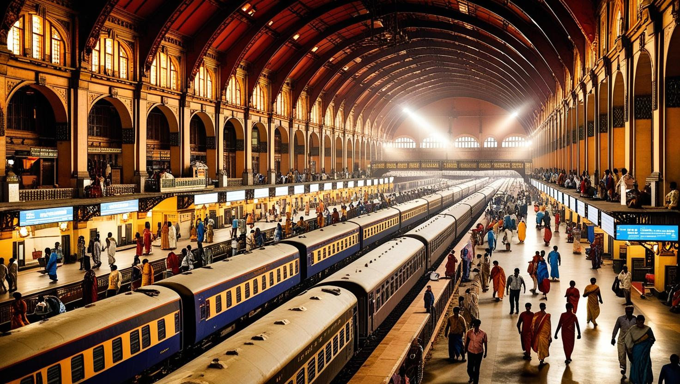
Thank You

