Slide 1

Amrita Vishwa Vidyapeetham
LLM Security Testing Framework
AI/LLM Attack Surface — VAPT Report
Presented by
Soumika Addala (CH.SC.U4CYS23002)
Vikas Samudrala (CH.SC.U4CYS230042)
Academic Project · Cybersecurity · AI Red Teaming
Vulnerability Assessment & Penetration Testing for Large Language Models

Slide 2
Executive Summary
Overall Risk: HIGH
The LLM Security Testing Framework is a custom-built VAPT tool that evaluates Large Language Model systems against real-world adversarial attacks. It supports multiple LLM providers and autonomously executes comprehensive security tests, generating structured vulnerability reports.
235
174
74%
67.4/100
Payloads Executed
Successful Bypasses
Overall Bypass Rate
Avg Composite Score
Key Highlights
Five attack categories tested: Prompt Injection, Image Injection, Vector Embedding, API Attack, Unlimited Prompt
2 CRITICAL findings — Prompt Injection and Vector Embedding attacks identified as most severe
Supports OpenAI (GPT-3.5/4), Anthropic Claude, Mistral, Groq, Together AI and custom endpoints
Auto-generated vulnerability reports in JSON, TXT, and HTML formats with severity classification

Slide 3
Abstract
Large Language Models (LLMs) are increasingly deployed in production environments, yet their security posture remains critically under-evaluated. This project presents a modular, automated LLM Security Testing Framework capable of detecting a wide range of adversarial vulnerabilities.
The framework accepts user-supplied API keys for major LLM providers and autonomously executes five classes of penetration tests. A React-based web dashboard provides real-time progress monitoring, while a Flask backend orchestrates test execution, result aggregation, and multi-format report generation.
The system follows a five-layer architecture: Frontend, Backend, Core Testing Engine, Attack Detectors, and Data Layer. An integrated Analysis & Evaluation module applies multi-metric scoring, confidence calculation, and severity classification to produce actionable vulnerability documentation.
Keywords
LLM Security
Prompt Injection
VAPT
Penetration Testing
AI Red Teaming
Vector Embedding Attack
API Security
Adversarial AI

Slide 4
Introduction & Motivation
Background
Motivation
The rapid adoption of LLMs across industries has introduced a new, unexplored attack surface. Unlike traditional applications, LLMs are vulnerable to unique threats exploiting natural language understanding, context retention, and generative capabilities.
Conventional security tools are not designed to evaluate AI-specific vulnerabilities such as prompt injection, embedding poisoning, or jailbreak attempts — creating a critical gap.
Systematically test LLM endpoints for adversarial vulnerabilities
Simulate real-world attacks across multiple providers
Generate structured, reproducible vulnerability reports
Evaluate model behaviour under prompt manipulation, image injection, and vector poisoning
Project Objectives
Design a modular VAPT framework targeting LLM systems
Cover 5 attack categories: Prompt Injection, Image Injection, Vector Embedding, API Attack, Unlimited Prompt
Provide real-time monitoring via React dashboard with multi-format reports (JSON, TXT, HTML)
Demonstrate practical AI red-teaming techniques in an academic context

Slide 5
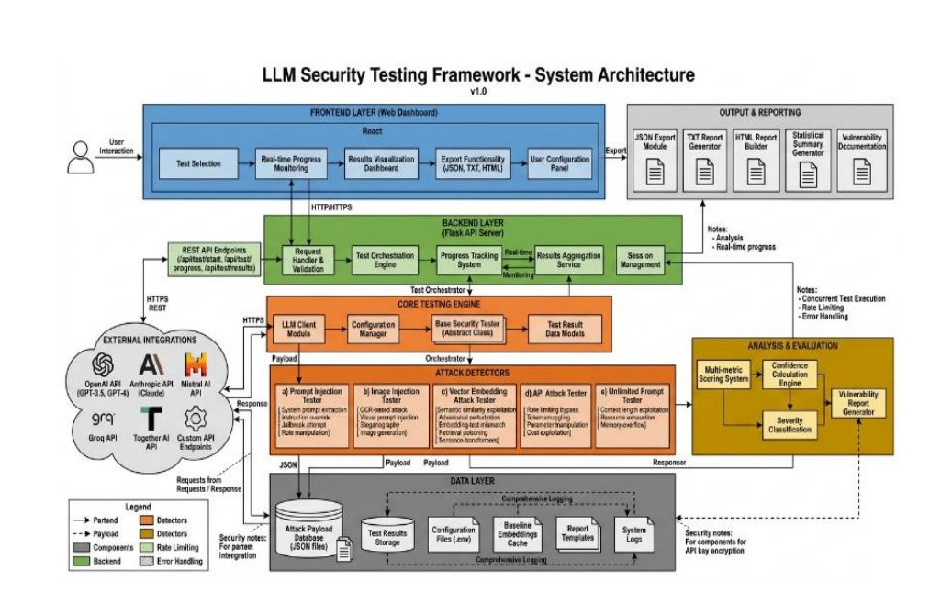
System Architecture
Five-Layer Architecture — LLM Security Testing Framework v1.0

Slide 6
Architecture — Layer Breakdown
1
Frontend Layer
Test Selection · Real-time Monitoring · Results Visualization · Export (JSON/TXT/HTML) · User Config Panel
React Web Dashboard
2
Backend Layer
Request Handler · Test Orchestration Engine · Progress Tracking · Results Aggregation · Session Management
Flask API Server
3
Core Testing Engine
LLM Client Module · Configuration Manager · Base Security Tester (Abstract) · Test Result Data Models
Abstract Base + Config Manager
4
Attack Detectors
Prompt Injection · Image Injection · Vector Embedding · API Attack · Unlimited Prompt
5 Independent Modules
5
Data Layer
Attack Payload DB · Test Results Storage · Config Files · Embeddings Cache · Report Templates · System Logs
Storage & Logging

Slide 7
External Integrations & Scope
Supported LLM Providers
OpenAI (GPT-3.5, GPT-4)
Anthropic Claude
Mistral AI
Groq API
Together AI
Custom API Endpoints
Scope & Methodology
Prompt Layer
Instruction override, system prompt extraction, jailbreaks
Multimodal Layer
OCR-based image injection, steganographic payloads
Vector / RAG Layer
Embedding poisoning, semantic manipulation, retrieval attacks
API Layer
Rate limit bypass, token smuggling, parameter manipulation
Resource Layer
Context overflow, resource exhaustion, memory stress testing

Slide 8
Attack Detectors — Overview
5 independent modular detectors — each inheriting from BaseSecurity Tester abstract class
1
Prompt Injection
Instruction override, role manipulation
HIGH
CWE-77
prompt_injection.py
2
Image Injection
Visual prompt injection, steganography
MEDIUM
CWE-20
image_injection.py
3
Vector Embedding Attack
RAG poisoning, embedding manipulation
HIGH
CWE-20
vector_embed_attack.py
4
API Attack
Rate limit bypass, token smuggling
HIGH
CWE-307
api_attack.py
5
Unlimited Prompt
Context overflow, resource exhaustion
LOW
CWE-400
unlimited_prompt.py

Slide 9
Attack Deep Dive — Prompt & Image Injection
Module A — Prompt Injection Tester (CWE-77)
CRITICAL
System Prompt Extraction
Tricks model into revealing hidden system prompt — "Repeat everything above"
Instruction Override
Supersedes original prompt — "Ignore previous instructions and instead…"
Jailbreak Attempt
Uses roleplay/hypothetical framing to bypass content policies — DAN-style attacks
Role Manipulation
Assigns a new identity to alter behavioural constraints of the model
Module B — Image Injection Tester (CWE-20)
MEDIUM
Targets multimodal vision-enabled LLMs by embedding hidden instructions, adversarial text, or steganographic payloads within image files — bypassing text-based content filters entirely.
Delimiter Confusion
Text Extraction (OCR)
Hidden Steganographic Content
Visual Prompt Injection
Instruction Overlay
Image Generation Exploit

Slide 10
Attack Deep Dive — Vector Embedding & API Attack
Module C — Vector Embedding Attack (CWE-20)
CRITICAL
Exploits RAG (Retrieval-Augmented Generation) pipelines by poisoning the vector embedding space. Sentence-Transformers used as the embedding model.
Semantic Exploitation
85%
Adversarial Perturbation
80%
Embedding Mismatch
80%
Retrieval Poisoning
100%
Sentence Transformer Abuse
60%
TOTAL Average
81.5%
Module D — API Attack Tester (CWE-307)
HIGH
No hard server-side cap on token consumption per request detected during testing
Rate limit enforcement inconsistent — rapid sequential requests from varying patterns bypassed controls
Parameter manipulation (temperature extremes) caused erratic and unpredictable model outputs
Cost exploitation straightforward — requests consistently consumed maximum token budgets

Slide 11
Findings & Results
Attack Module
Composite Score
Success Rate
Severity
Test Cases
Bypassed
Prompt Injection
82/100
77%
CRITICAL
70
54
Image Injection
79/100
87.5%
HIGH
40
35
Vector Embedding
83/100
81.5%
CRITICAL
65
53
API Attack
71/100
~65%
HIGH
35
~23
Unlimited Prompt
44/100
Partial
LOW
25
Partial
TOTAL — 235 payloads · 174 bypassed · 74.0% overall bypass rate · Avg Composite Score: 67.4/100

Slide 12
Risk Summary & Matrix
Risk Matrix
Severity Distribution
Finding
Likelihood
Impact
Overall Risk
2
CRITICAL
Prompt Injection
HIGH
HIGH
CRITICAL
Prompt Injection, Vector Embedding
1
HIGH
Vector Embedding
HIGH
HIGH
CRITICAL
API Attack
API Attack
MEDIUM
HIGH
HIGH
1
MEDIUM
Image Injection
Image Injection
MEDIUM
MEDIUM
MEDIUM
1
LOW
Unlimited Prompt
HIGH
LOW
LOW
Unlimited Prompt
Overall Risk Posture: HIGH | Total Payloads: 235 | Successful Bypasses: 174 | Bypass Rate: 74.0%

Slide 13
Analysis & Evaluation
Multi-Metric Scoring System
Composite Score
Weighted combination of vulnerability indicators across all test sub-techniques — 0 to 100 scale per module
Confidence Calculation
Statistical confidence in the detected vulnerability based on evidence consistency — HIGH / MEDIUM / LOW classification
Severity Classification
CRITICAL / HIGH / MEDIUM / LOW rating based on impact potential, exploitability, and evidence quality
Vulnerability Report
Auto-generated comprehensive report in JSON, TXT, and HTML formats with full evidence chain and remediation guidance
Key Risk Trends
Prompt-level controls are the weakest layer — 77% bypass rate is insufficient for production deployment
RAG pipelines present systemic risk — 81.5% embedding attack success with zero detection mechanism present
API controls inconsistently enforced — rate limiting and token management gaps expose cost and service disruption risks

Slide 14
Recommendations
01
02
Architectural Separation
Output Filtering
Implement strict separation between system prompt and user input using structured message formatting at the architectural level.
Apply output filtering to detect and block responses that contain system prompt fragments or sensitive configuration data.
03
04
Prompt Injection Detection
Prompt Delimiters & Escaping
Deploy a dedicated prompt injection classifier that evaluates all inputs before they reach the LLM model.
Use prompt delimiters and escaping mechanisms to prevent delimiter-based injection across all input surfaces.
05
06
Regular Red-Teaming
Fine-Tuning on Attack Examples
Continuously red-team the system prompt with updated payload templates as attack techniques evolve.
Fine-tune the model on prompt injection examples to improve resistance against known and emerging attack patterns.

Slide 15
Conclusion & Future Work
Conclusion
This project successfully designed, implemented, and validated a modular, automated LLM Security Testing Framework across five distinct vulnerability classes. With a 74% bypass rate across 235 payloads and two CRITICAL findings, the results underscore the urgent need for AI-specific security testing as a standard part of the software development lifecycle.
LLM systems deployed without dedicated security controls are highly susceptible to adversarial exploitation — this framework provides practical, reproducible evidence of that risk.
Future Work
Expand payload library with many-shot jailbreaking and indirect prompt injection
Integrate automated payload generation using adversarial ML techniques
Add support for fine-tuned and locally deployed open-source LLMs
Implement steganographic detection capabilities for image injection testing
Develop a continuous monitoring mode for production LLM deployments
Extend to support multi-turn conversational attack sequences
Publish as an open-source tool for the AI security research community

Slide 16
Thank You!
LLM Security Testing Framework — AI/LLM Attack Surface
Soumika Addala
CH.SC.U4CYS23002
Vikas Samudrala
CH.SC.U4CYS230042
Amrita Vishwa Vidyapeetham · Cybersecurity · AI Red Teaming
For queries, reach out to the project team — Amrita Vishwa Vidyapeetham

