Slide 1
Employee Data Analysis using Excel
STUDENT NAME: VIGNESH M
REGISTER NO: asunm203bcs22013
DEPARTMENT: CORPORATE SECRETARYSHIP
COLLEGE: K.C.S. KASI NADAR COLLEGE OF ARTS AND SCIENCE

Slide 2
PROJECT TITLE
Employee Data Analysis using Excel

Slide 3


AGENDA
Problem Statement
Project Overview
End Users
Our Solution and Proposition
Dataset Description
Modelling Approach
Results and Discussion
Conclusion
3/21/2024 Annual Review

Slide 4

PROBLEM STATEMENT
My result illustrate the JOB TITLE BASED ON DEPARTMENT which includes job titles like Web Developer, Tester, Project Manager, Mobile Developer, Machine Learning Engineer, HR Manager, Develop Engineer, and Designer. It appears the chart compares the count of these job titles across different departments (Product and Human Resource).

Slide 5

PROJECT OVERVIEW
The project appears to analyze job titles across different departments based on the data presented in a bar chart. The chart displays distribution of various job titles, such as Web Developer, Tester, Project Manager, Mobile Developer, Machine Learning Engineer, Develop Engineer, HR Manager, and Designer, categorized under two main departments: Product and Human Resource.

Slide 6

WHO ARE THE END USERS?
The analysis showing job titles categorized by department, such as Product or Human Resource. The end users for this spreadsheet are likely to be
HR Managers and Recruiters
Department Heads and Managers
Data Analysts
Business Analysts

Slide 7

OUR SOLUTION AND ITS VALUE PROPOSITION
➤ Remove Duplicates: It removes the combination of values across all selected range to determine duplicates.
➤ Filter: It take my dataset and show only the data that meet my criteria specify.
➤ Conditional Formatting: It is used to specify important values stand out in employee performance score in a data set.
➤ Pivot Table: I used "pivot table" to summarize my huge data.
➤ Pivot Chart: I used "pivot chart" to visually summarises my data using area graph.

Slide 8
Dataset Description
First Name: He first of your names that come before your family name.
Last Name: a name that identifies a person's family and is different from their given name.
Email :An email is a form of electronic communication that allows users to send messages to other users over the internet.
Gender: Is a social, psychological, and cultural construct that is developed through socialization and varies from society to society..
Department: A part of an organization such as a school, business, or government that deals with a particular area of study or work.
Job title: A job title is a formal name for a position within an organization that can include the position's name, the organization’s
name, and sometimes the name of the person who holds the position.
years of experience: Is a term that refers to how Long a candidate has worked in a particular industry or field.
Salary: The money that a person receives (usually every month) for the work he/she has done.

Slide 9
MODELLING
Data set was downloaded from Kaggle website
Extract it from zip format
Data Cleaning: Data cleaning is a process required to remove incomplete records, and modifying data to rectify inaccurate records.
Remove Duplicates It removes the combination of values across all selected range to determine duplicates.
Filter: It take my dataset and show only the data that meet my criteria specify .
Conditional Formatting: It is used to specify important values stand out in employee performance score in a data set.
Slicer: I used slicer to filter my data
Pivot Table: I used "pivot table to summarize my huge data.
Pivot Chart: I used using area graph. "pivot chart" to visually summarizes my data.
9

Slide 10
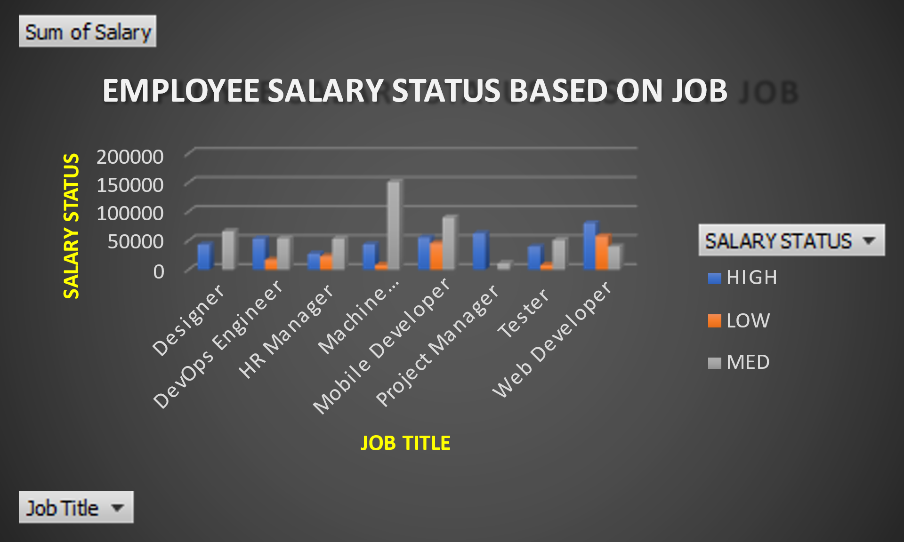
RESULTS
Sum of Salary | SALARY
JOB TITLE | HIGH | LOW | MED | Grand Total
Designer | 43000 |  | 66000 | 109000
DevOps Engineer | 53500 | 16500 | 54000 | 124000
HR Manager | 27500 | 23000 | 53500 | 104000
Machine Learning Engineer | 43500 | 8000 | 151000 | 202500
Mobile Developer | 55000 | 45500 | 90000 | 190500
Project Manager | 62500 |  | 11000 | 73500
Tester | 39500 | 8000 | 51000 | 98500
Web Developer | 80000 | 57500 | 39500 | 177000
Grand Total | 404500 | 158500 | 516000 | 1079000
10

Slide 11
Conclusion
The most common job title in the Product department is "Web Developer" while the most common job title in the Human Resource department is "HR Manager.“
The Product department has a wider range of job titles compared to the Human Resource department.
Product department has a larger overall workforce compared to the Human Resource department.

