Slide 1

Agentic SOC
An autonomous Level-1 security analyst using ensemble machine learning, OSINT threat intelligence and LLM-based reasoning
Tharun S V
M.E. Computer Science and Engineering · II Year
Notes:
Good morning. My project is Agentic SOC — a system that does the job of a Level-1 security analyst automatically: it detects an attack, explains why it is an attack, decides how to contain it, and acts, all in milliseconds, while a human stays in control.

Slide 2



Level-1 triage is the bottleneck of every SOC
THE PROBLEM
Alert overload
Slow response
Blind spots
A security operations centre receives thousands of alerts a day, and each one waits for a person to read it.
Manual triage means minutes to hours between detection and containment — time an attacker uses to spread.
Signature tools miss new and disguised attacks; ML detectors flag events without saying why, so analysts cannot trust them.
Notes:
SOC teams face thousands of alerts every day. A Level-1 analyst has to read each alert, decide if it is real, and take the first containment step. That manual step is slow. On top of that, signature-based tools miss new or disguised attacks, and pure machine-learning detectors raise alerts without explaining them, so analysts cannot act on them confidently.

Slide 3
What the system had to do
OBJECTIVES
1
Detect known attacks with an ML model trained on CIC-IDS2017
2
Catch zero-day and disguised traffic with an unsupervised model and adversarial training
3
Check every log against threat-intelligence indicators first
4
Explain each alert with SHAP and an LLM-written narrative
5
Choose and apply containment automatically: isolate, revoke or honeypot
6
Show live incidents on an analyst dashboard
7
Let analysts undo actions and correct the model
8
Feed corrections back into retraining
Notes:
These were my eight objectives: detection of known attacks, detection of unseen and disguised attacks, threat-intelligence lookup, explanation, automated containment, a live dashboard, analyst override, and learning from analyst feedback.

Slide 4
From a detection dataset to a full analyst workflow
BACKGROUND
Base paper
Research gap
Sharafaldin, Lashkari & Ghorbani, ICISSP 2018 — the CIC-IDS2017 dataset
Detection, explanation and response are studied separately
Five days of realistic benign traffic plus brute force, DoS, DDoS, web attacks, botnet and port scan
80+ flow features per connection
Random Forest among the best classifiers
Stops at detection: no explanation, no response, no threat intel
No surveyed system takes a raw log through threat-intel lookup, ensemble detection, explanation, a containment decision and an executed playbook in one automated pipeline, while letting an analyst correct it.
This project builds that pipeline.
Notes:
My base paper introduced the CIC-IDS2017 dataset and showed that Random Forest classifies its attacks well. But it stops at detection. Across the twelve papers I surveyed, detection, explanation and response are always treated as separate problems. My project closes that gap with one automated pipeline.

Slide 5







One pipeline for every log
ARCHITECTURE
Ingest
Threat intel
ML ensemble
Explain
LLM reasoning
Respond
Network + auth logs via POST /api/ingest
IOC match on IP, domain, port, hash
Random Forest + Isolation Forest
SHAP top features + probe check
Claude returns a strict JSON decision
Playbook + live dashboard
Learning loop Analysts undo actions or mark false positives → corrections queue for retrain_pipeline.py → updated models feed back into step 3. Only events flagged as anomalous reach the LLM.
Notes:
Here is the architecture. Every log goes through the same pipeline in one request: ingest, threat-intelligence lookup, the ML ensemble, SHAP explanation and an adversarial probe check, then LLM reasoning, and finally the response. Only events flagged as anomalous are sent to the LLM, which keeps cost and latency low. Analyst corrections flow back into training.

Slide 6



Threat intel first, then a two-model ensemble
DETECT
OSINT lookup
Random Forest
Source and destination are matched against known-bad IPs, C2 domains, risky ports and malware hashes. A hit sets anomaly probability to 0.99.
150 trees, depth 12. Trained on CIC-IDS2017 mapped to a common log schema — learns known attack patterns.
Isolation Forest
Adversarial training
100 trees, trained on normal traffic only. Anything far from normal is flagged, even with no label — the zero-day path.
Every training attack gets 3 disguised copies: IP spoofing, port hopping, slow-and-low transfer, off-hours shift.
Notes:
Detection happens in two steps. First the OSINT stage: if an indicator is already known to be malicious, the event is flagged immediately. Otherwise two models score it. The Random Forest catches known attack types. The Isolation Forest is trained only on normal traffic, so it flags anything unusual, which is how we cover zero-day attacks. And because attackers try to blend in, every training attack was copied three times with evasion tricks like port hopping and slow-and-low transfer, so the model learns to see through them.

Slide 7
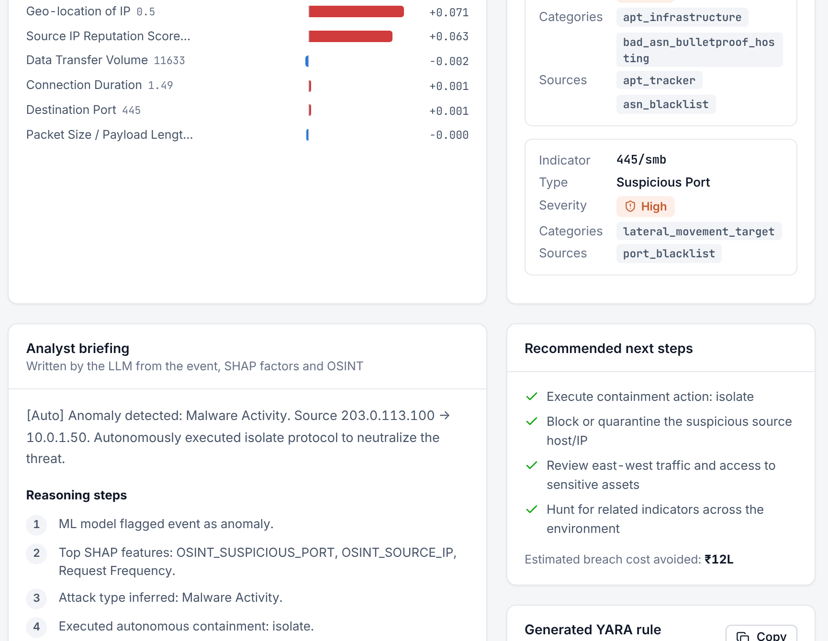
Every alert says why it was flagged
EXPLAIN
SHAP TreeExplainer ranks the features behind each decision.
Red bars push the score toward attack; blue toward normal
The top factors are passed to the LLM, so its narrative is backed by the numbers
Analysts see the evidence instead of a bare score
Notes:
A key goal was that no decision is a black box. For every alert, SHAP calculates how much each feature pushed the score toward attack or toward normal. On the dashboard, red bars push toward attack and blue toward normal. These top factors are also given to the LLM, so its explanation is grounded in the actual model output.

Slide 8
The LLM chooses the containment
DECIDE
Event + SHAP factors + OSINT hits go in. A fixed JSON decision comes out.
{
"threat_level": "high",
"attack_type": "Lateral Movement",
"containment_action": "isolate",
"key_shap_features": ["dest_port", …],
"explanation": "SMB sessions to 14 hosts…",
"recommended_soc_actions": [ … ],
"generated_yara_rule": "rule Lateral_SMB {…}",
"interrogation_log": [
"Internal-to-internal SMB",
"Port 445 high impact",
"Recommend isolate"
]
}
Isolate host lateral movement, internal-to-internal traffic
Revoke credentials stolen tokens, unusual logins
Route to honeypot suspicious but unclassified traffic
If the API fails or returns invalid JSON, a rule-based fallback decides, so containment never stalls.
Notes:
Flagged events go to the LLM, Claude. The prompt forces a strict JSON answer with fixed fields: the threat level, the attack type, the containment action, an explanation, recommended steps, a YARA rule for future detection, and its reasoning steps. The action must be one of three: isolate the host, revoke credentials, or route the traffic to a honeypot. If the API is down, a rule-based fallback makes the decision, so containment never stops.

Slide 9


Act in milliseconds, keep the analyst in control
CONTAIN AND LEARN
@echo off
:: Autoblocked by Agentic SOC
netsh advfirewall firewall add rule
name="Block_203.0.113.100" dir=in
action=block remoteip=203.0.113.100
echo Isolated 203.0.113.100
Undo
Roll back any automatic action with one click
Correct
Mark false positives or confirm threats
A firewall playbook is written for every decision (Windows netsh, PowerShell or iptables).
Retrain
Corrections feed retrain_pipeline.py
Notes:
Once the LLM decides, the system writes a firewall playbook for that action — for example a netsh rule that blocks the attacking IP in both directions. The analyst stays in control: any action can be undone, and the analyst can mark an incident as a false positive or confirm it. Those corrections go into a retraining queue, so the model keeps improving.

Slide 10
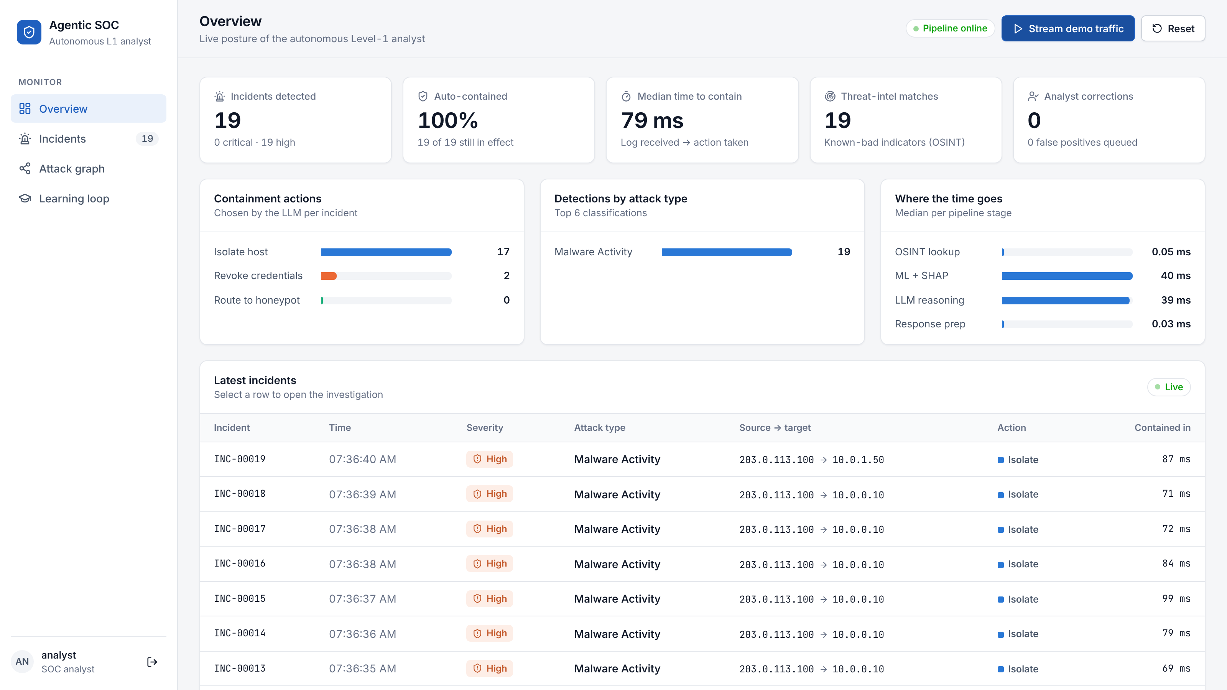
The SOC console
LIVE DEMO
Overview
Incidents, containment rate, time to contain, threat-intel matches and analyst corrections
Incidents
Full trace, SHAP chart, OSINT matches, LLM briefing, YARA rule, undo and feedback
Attack graph · Learning loop
Host map coloured by action; retraining queue and model settings
Notes:
This is the React dashboard, connected live to the Flask API. [Switch to the live demo here: click Stream demo traffic, then open an incident.] The overview shows incidents, how many are contained, the median time to contain, and where the time goes in the pipeline.

Slide 11
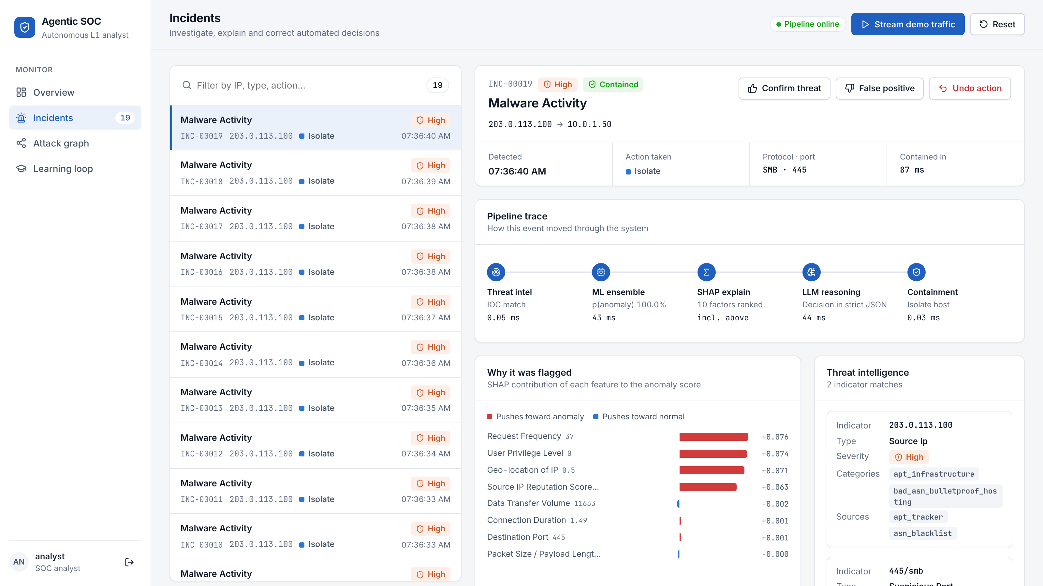
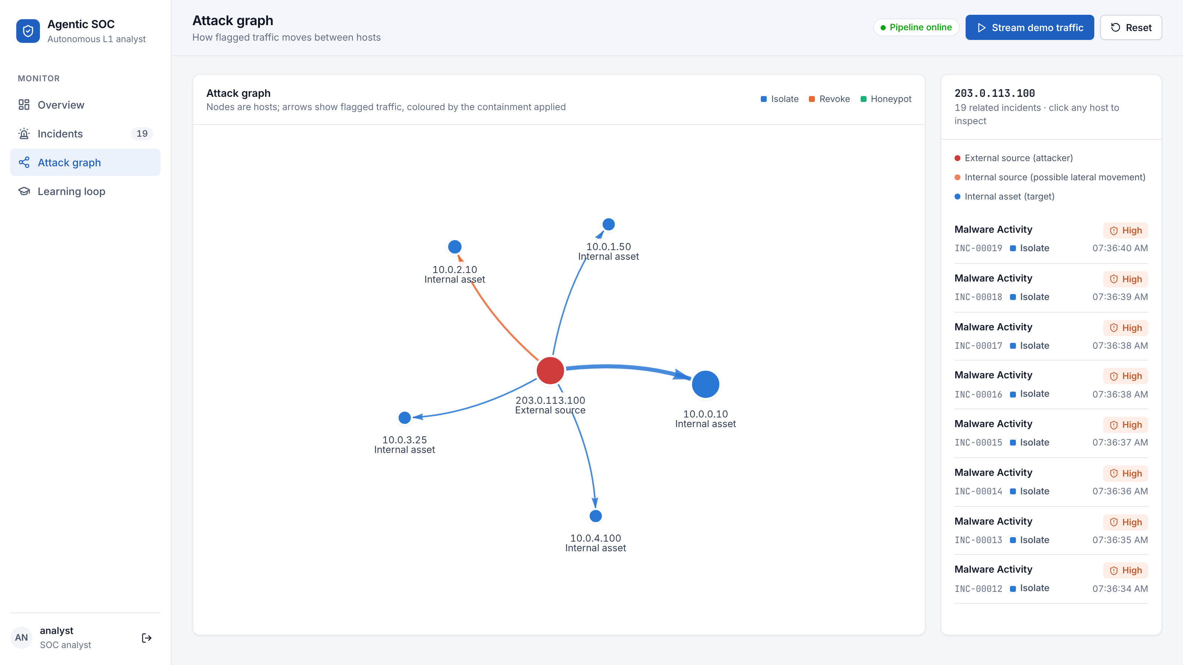
Investigating one incident
LIVE DEMO
Incident view: pipeline trace with timings, SHAP factors and threat-intel matches
Attack graph: hosts and flagged traffic, coloured by the containment applied
Notes:
Opening an incident shows the full investigation: the path through the pipeline with real timings, the SHAP factors, the threat-intelligence match, and the LLM briefing with its reasoning steps. The attack graph on the right shows which hosts were involved and what action was taken.

Slide 12

From hours to milliseconds
RESULTS
0.04 ms
27.5 ms
28.5 ms
67.4 ms
OSINT lookup
ML scoring + SHAP
Normal event, end to end
Flagged event, detected to contained*
Median over 300 events through /api/ingest on a 2-core machine. *Excludes the external LLM call, which runs only on flagged events.
Functional testing 12 test cases run against the live API: normal traffic passes, known-bad IPs raise incidents, probing is detected, the LLM fallback works and containment can be undone.
Notes:
These numbers were measured on the working system. The OSINT lookup takes four hundredths of a millisecond. Scoring plus SHAP takes about 27 milliseconds. A normal event goes through the whole pipeline in about 28 milliseconds, and a flagged event is detected, explained and contained in about 67 milliseconds, not counting the LLM call. Compare that with minutes to hours for a human. I also ran twelve functional test cases against the live API.

Slide 13
What is built and what comes next
STATUS AND NEXT STEPS
Working today
Next
CIC-IDS2017 preparation + adversarial augmentation
Random Forest + Isolation Forest ensemble
SHAP explanation for every alert
OSINT IOC lookup and probe detection
LLM reasoning with JSON output and fallback
Playbook generation, undo and analyst feedback
React SOC console
Re-evaluate on CIC-IDS2017 with its original IP addresses
Live OSINT feeds (AbuseIPDB, AlienVault OTX)
Persistent database and server-side login
Tamper-evident audit log of every action
Run playbooks in a sandbox VM
Local open-weight LLM to keep logs on premises
Notes:
To summarise where the project stands: the full pipeline works end to end, from ingestion to dashboard. The next steps are a cleaner evaluation on the original CIC-IDS2017 addresses, live threat-intelligence feeds, a persistent database with proper server-side login, a tamper-evident audit log, running playbooks inside a sandbox VM, and optionally a local LLM so that log data never leaves the organisation.

Slide 14
Detect · Explain · Contain
Agentic SOC turns hours of Level-1 triage into milliseconds, with the analyst in control. Thank you — questions are welcome.
Notes:
To conclude: Agentic SOC detects, explains and contains attacks automatically, turning hours of Level-1 triage into milliseconds, while keeping the analyst in control. Thank you. I am happy to take questions.

