Slide 1
Arrays
SUBMITTED BY
VIGNESH K M

Slide 2
What is an Array?
An array is a collection of items of same data type stored at contiguous memory locations.
This makes it easier to calculate the position of each element by simply adding an offset to a base value, i.e., the memory location of the first element of the array.
The base value is index 0 and the difference between the two indexes is the offset.

Slide 3
Types of arrays :
ONE DIMENTINAL ARRAY(1-D arrays)
2.MULTIDIMENTINAL ARRAY

Slide 4
One dimensional array (1-D arrays)
Arrays a kind of data structure that can store a fixed-size sequential collection of elements of the same type.
An array is used to store a collection of data, but it is often more useful to think of an array as a collection of variables of the same type.
Instead of declaring individual variables, such as number0, number1, ..., and number99, you declare one array variable such as numbers and use numbers[0], numbers[1], and ..., numbers[99] to represent individual variables.
A specific element in an array is accessed by an index.
All arrays consist of contiguous memory locations.
The lowest address corresponds to the first element and the highest address to the last element.

Slide 5
Declaring Arrays
To declare an array in C, a programmer specifies the type of the elements and the number of elements required by an array as follows
type arrayName [ arraySize ];
This is called a single-dimensional array. The arraySize must be an integer constant greater than zero and type can be any valid C data type. For example, to declare a 10-element array called balance of type double, use this statement −
double balance[10];
Here balance is a variable array which is sufficient to hold up to 10 double numbers.

Slide 6
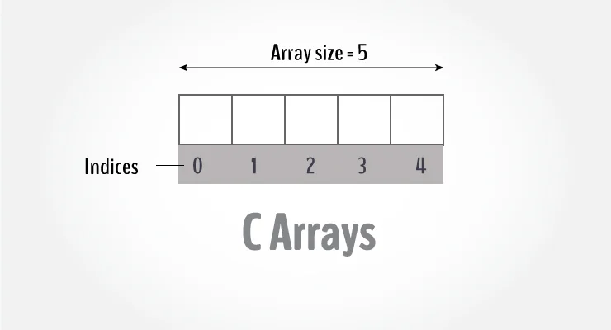
array with examples.

Slide 7
An array is a variable that can store multiple values. For example, if you want to store 100 integers, you can create an array for it.
Int data[100];
How to declare an array?
Data type array name[array size];
For example,
Float marks[5];

Slide 8
Here, we declared an array, mark, of floating-point type. And its size is 5. Meaning, it can hold 5 floating-point values.
It's important to note that the size and type of an array cannot be changed once it is declared.
Access Array Elements
You can access elements of an array by indices.
Suppose you declared an array mark as above. The first element is mark[0], the second element is mark[1] and so on.

Slide 9
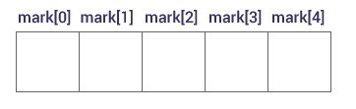
Declare an Array

Slide 10
Few keynotes:
Arrays have 0 as the first index, not 1. In this example, mark[0] is the first element.
If the size of an array is n, to access the last element, the n-1 index is used. In this example, mark[4]
Suppose the starting address of mark[0] is 2120d. Then, the address of the mark[1] will be 2124d.
Similarly, the address of mark[2] will be 2128d and so on. This is because the size of a float is 4 bytes.

Slide 11
How to initialize an array?
It is possible to initialize an array during declaration. For example,
Int marks[5]={19,10,817,9}
You can also initialize an array like this.
Int marks{19,10,8,17,9}
Here, we haven't specified the size. However, the compiler knows its size is 5 as we are initializing it with 5 elements.

Slide 12
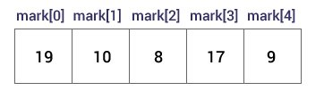
Initialize an Array

Slide 13
Advantages of an Array in C:
Random access of elements using the array index.
Use of fewer lines of code as it creates a single array of multiple elements.
Easy access to all the elements.
Traversal through the array becomes easy using a single loop.
Sorting becomes easy as it can be accomplished by writing fewer lines of code.

Slide 14
Disadvantages of an Array in C:
Allows a fixed number of elements to be entered which is decided at the time of declaration. Unlike a linked list, an array in C is not dynamic.
Insertion and deletion of elements can be costly since the elements are needed to be managed in accordance with the new memory allocation.

Slide 15
Facts about Array in C
Accessing Array Elements: Array elements are accessed by using an integer index. Array index starts with 0 and goes till the size of the array minus 1.
The name of the array is also a pointer to the first element of the array.

Slide 16
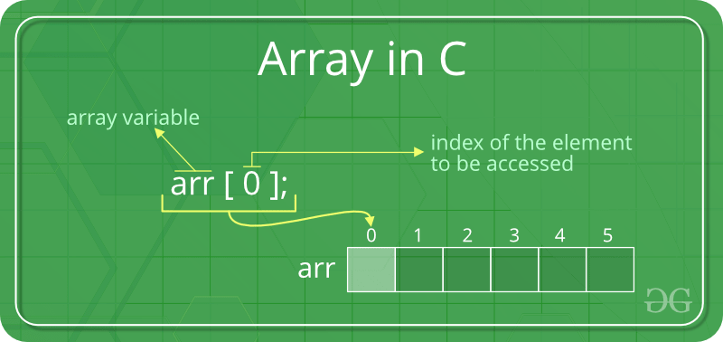

Slide 17
example
int main()
{
int arr[5];
arr[0] = 5;
arr[2] = -10;
arr[3 / 2] = 2; // this is same as arr[1] = 2
arr[3] = arr[0];
printf("%d %d %d %d", arr[0],
arr[1], arr[2], arr[3]);
return 0;
}

Slide 18
THANK YOU

