Slide 1
GPIO
SUBMITTED BY
VIGNESH

Slide 2
INTRODUCTION
A General Purpose Input/output (GPIO) is an interface available on most modern microcontrollers (MCU) to provide an ease of access to the devices internal properties.
Generally there are multiple GPIO pins on a single MCU for the use of multiple interaction so simultaneous application.
GPIOs have no predefined purpose and are unused by default.
If used, the purpose and behavior of a GPIO is defined and implemented by the designer of higher assembly-level circuitry

Slide 3
GPIO Ports
A GPIO (general-purpose input/output) port handles both incoming and outgoing digital signals.
As an input port, it can be used to communicate to the CPU the ON/OFF signals received from switches, or the digital readings received from sensors.
As an output port, it can be used to drive outside operations based on CPU instructions and calculation results—for example, to drive an LED display based on calculation results, or to output drive signals to a motor.
The GPIO is referred to as "general purpose" because each pin can be freely set to function as either an input or an output.

Slide 4
Peripheral: GPIO
GPIO
Buzzer
LED
Buttons
LCD
7 SEG
Wearable devices etc.

Slide 5
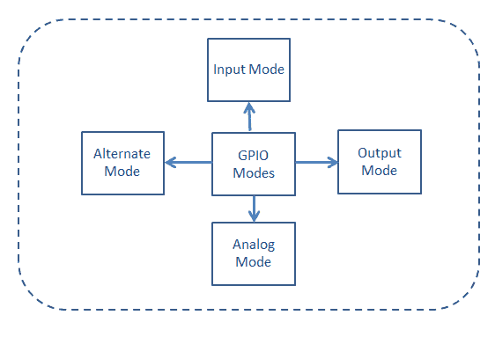
BLOCK GIAGRAM

Slide 6
GPIO registers
GPIO port mode register
GPIO port output type register
GPIO port pull-up/pull-down register
GPIO port input data register
GPIO port output data register
GPIO port configuration lock register
GPIO alternate function low register

Slide 7
GPIO port mode register
GPIO port mode register (GPIOx_MODER) (x = A..E and H)
Address offset: 0x00
Reset values: 0xA800 0000 for port A
0x0000 0280 for port B
0x0000 0000 for other ports
00: Input (reset state)
01: General purpose output mode
10: Alternate function mode
11: Analog mode

Slide 8
GPIO port output type register
GPIO port output type register (GPIOx_OTYPER) (x = A..E and H)
Address offset: 0x04
Reset value: 0x0000 0000
OTy: Port x configuration bits (y = 0..15)
0: Output push-pull (reset state)
1: Output open-drain

Slide 9
GPIO port output speed register
GPIO port pull-up/pull-down register (GPIOx_PUPDR) (x = A..E and H)
Address offset: 0x0C
Reset values: 0x6400 0000 for port A
0x0000 0100 for port B
0x0000 0000 for other ports
PUPDRy[1:0]: Port x configuration bits (y = 0..15)
00: No pull-up, pull-down
01: Pull-up
10: Pull-down
11: Reserved

Slide 10
GPIO port pull-up/pull-down register
GPIO port pull-up/pull-down register (GPIOx_PUPDR) (x = A..E &H)
Address offset: 0x0C
Reset values: 0x6400 0000 for port A
0x0000 0100 for port B
0x0000 0000 for other ports
PUPDRy[1:0]: Port x configuration bits (y = 0..15)
00: No pull-up, pull-down
01: Pull-up
10: Pull-down
11: Reserved

Slide 11
GPIO port input data register
GPIO port input data register (GPIOx_IDR) (x = A..E and H)
Address offset: 0x10
Reset value: 0x0000 XXXX (where X means undefined)
IDRy: Port input data (y = 0..15)
These bits are read-only and can be accessed in word mode only.
They contain the input value of the corresponding I/O port.

Slide 12
GPIO port output data register
GPIO port output data register (GPIOx_ODR) (x = A..E and H)
Address offset: 0x14
Reset value: 0x0000 0000
ODRy: Port output data (y = 0..15)
These bits can be read and written by software.

Slide 13
GPIO port bit set/reset register
GPIO port bit set/reset register (GPIOx_BSRR) (x = A..E and H)
Address offset: 0x18
Reset value: 0x0000 0000
BRy: Port x reset bit y (y = 0..15)
These bits are write-only and can be accessed in word, half-word or byte mode.
A read to these bits returns the value 0x0000. 0: No action on the corresponding ODRx bit 1:
Resets the corresponding ODRx bit

Slide 14
GPIO port configuration lock register
GPIO port configuration lock register (GPIOx_LCKR) (x = A..E and H)
This register is used to lock the configuration of the port bits
when a correct write sequence is applied to bit 16 (LCKK).
The value of bits [15:0] is used to lock the configuration of the GPIO.
During the write sequence, the value of LCKR[15:0] must not change.
When the LOCK sequence has been applied on a port bit, the value of this port bit can no longer be modified until the next MCU or peripheral reset

Slide 15
GPIO alternate function low register
GPIO alternate function low register (GPIOx_AFRL) (x = A..E and H)
Address offset: 0x20
Reset value: 0x0000 0000
GPIO alternate function high register (GPIOx_AFRH) (x = A..E and H)
Address offset: 0x24
Reset value: 0x0000 0000

Slide 16
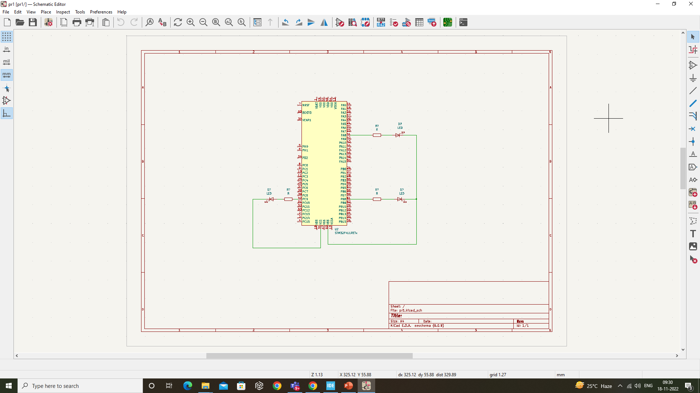
Circuit Diagram of LED

Slide 17
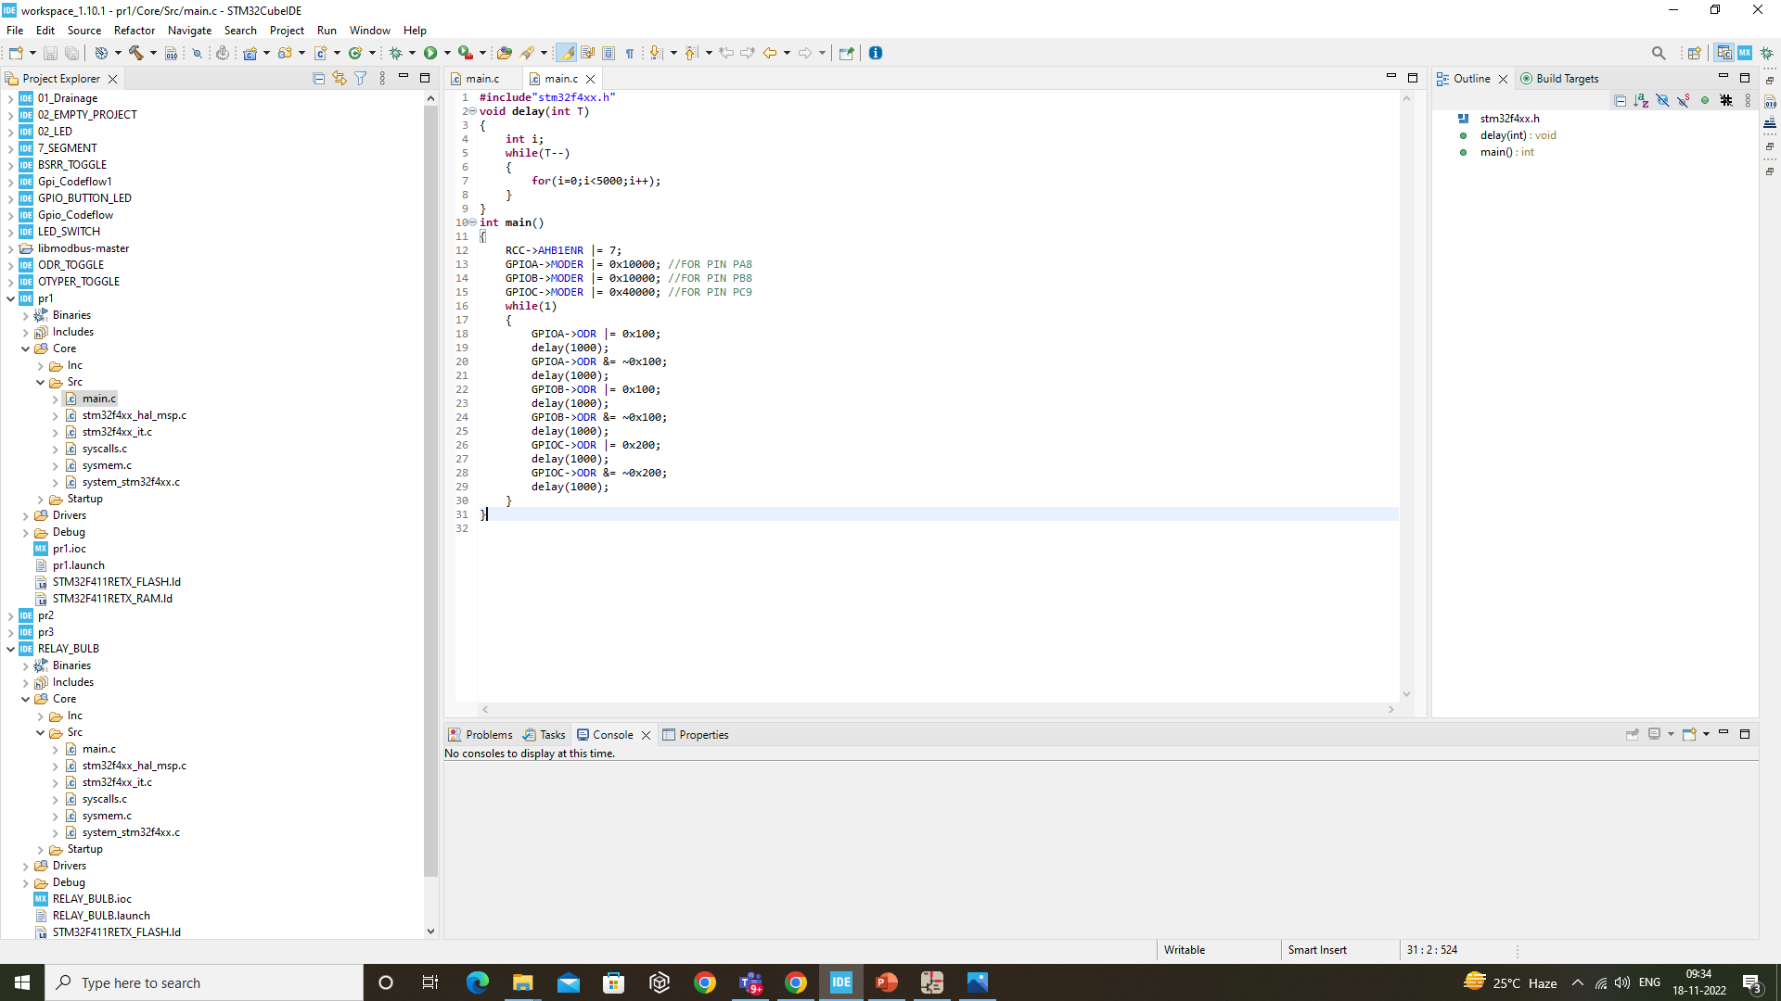
Code For three led’s

Slide 18
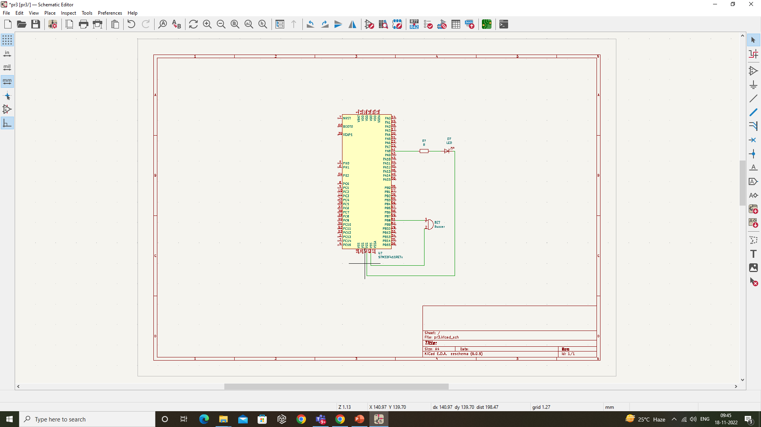
Circuit Diagram of buzzer

Slide 19
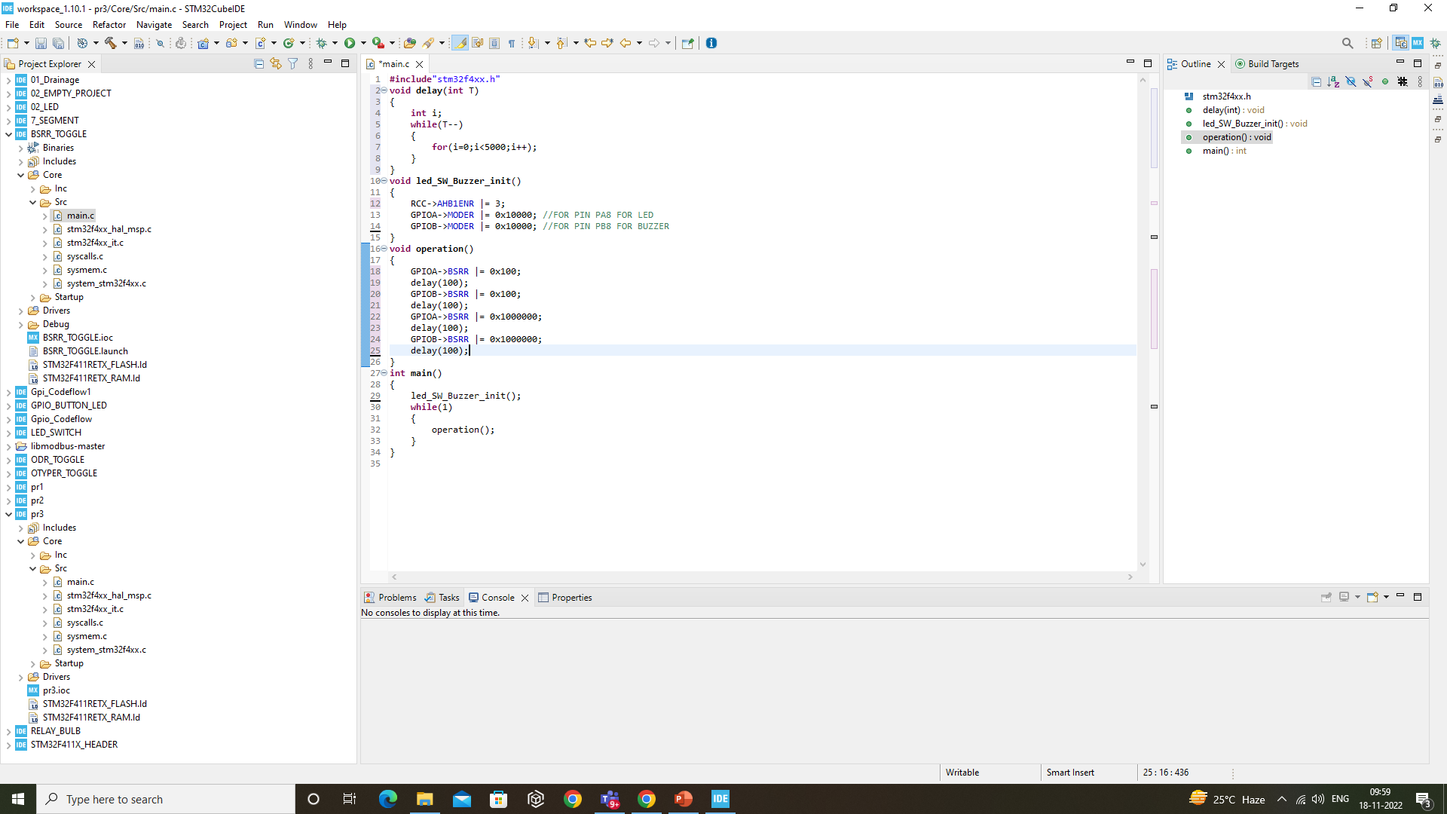
Code for an led and a buzzer

Slide 20
THANK YOU

