Slide 1
POINTERS
SUBMITTED BY
VIGNESH KM

Slide 2
Pointer
type *var-name;
type *var-name;
A pointer is a variable whose value is the address of another variable, i.e., direct address of the memory location. Like any variable or constant, you must declare a pointer before using it to store any variable address.
The general form of a pointer variable declaration is −
Data Type *var-name;

Slide 3
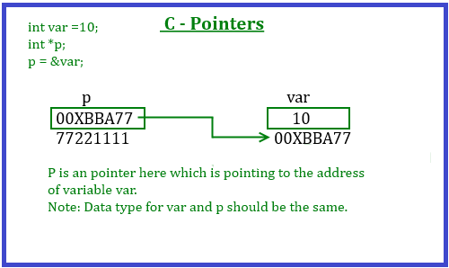
Pointer

Slide 4
Example
#include<stdio.h>
int main()
{
int a=5;
int *ptr;
ptr=&a;
printf(“Direct Access, a=%d\n”, a);
printf(“Indirect Access, a=%d\n”,*ptr);
return 0;
}

Slide 5
Null pointers
A Null Pointer is a pointer that does not point to any memory location.
It stores the base address of the segment.
The null pointer basically stores the Null value while void is the type of the pointer.
The NULL pointer is a constant with a value of zero defined in several standard libraries.
Syntax:
Data type * var-name=null

Slide 6
Example:
#include <stdio.h>
int main () {
int *ptr = NULL;
printf("The value of ptr is : %x\n", ptr );
return 0;

Slide 7
Void Pointer
In void pointer is also called as a generic pointer.
It does not have any standard data type.
A void pointer is created by using the keyword void.
It can be used to store an address of any variable.
SYNTAX:
void * var-name

Slide 8
Following program illustrates the use of a void pointer:
int main()
{
int a = 10;
char b = 'x';
void* p = &a;// void pointer holds address of int 'a'
p = &b; // void pointer holds address of char 'b'

Slide 9
The following example makes use of these operations −
#include <stdio.h>
int main () {
int var = 20; /* actual variable declaration */
int *ip; /* pointer variable declaration */
ip = &var; /* store address of var in pointer variable*/
printf("Address of var variable: %x\n", &var );

Slide 10
/* address stored in pointer variable */
printf("Address stored in ip variable:
%x\n", ip );
/* access the value using the pointer */
printf("Value of *ip variable: %d\n", *ip );
return 0;
}

Slide 11
Thank you

