Slide 1
STRINGS
Submitted by
Vignesh K M

Slide 2
WHAT IS STRINGS
Strings are array of character i.e they are characters arranged one after another in memory thus a character array is called string.
Each character within the string is stored within one elements of the array successively.
A string is always terminated by a null character(i.e slash \0).

Slide 3
A string variable is declared as an array of character
Syntax is :
Char string_name[size]
Ex: char name[20]
When the compiler assigns a character string to a character array it automatically supplies a null character(‘\0’) at end the end of the string.

Slide 4
Initializing string variable
Strings are initialized in either of the following two forms:
Char name[4]={‘R’,’A’,’M’,’\0’};
Char name[] ={‘R’,’A’,’M’,’\0’};
Char name[4]=“RAM”;
Char name[]=“RAM”;
R | A | M | \0
Name[0] | Name[1] | Name[2] | Name[3]

Slide 5
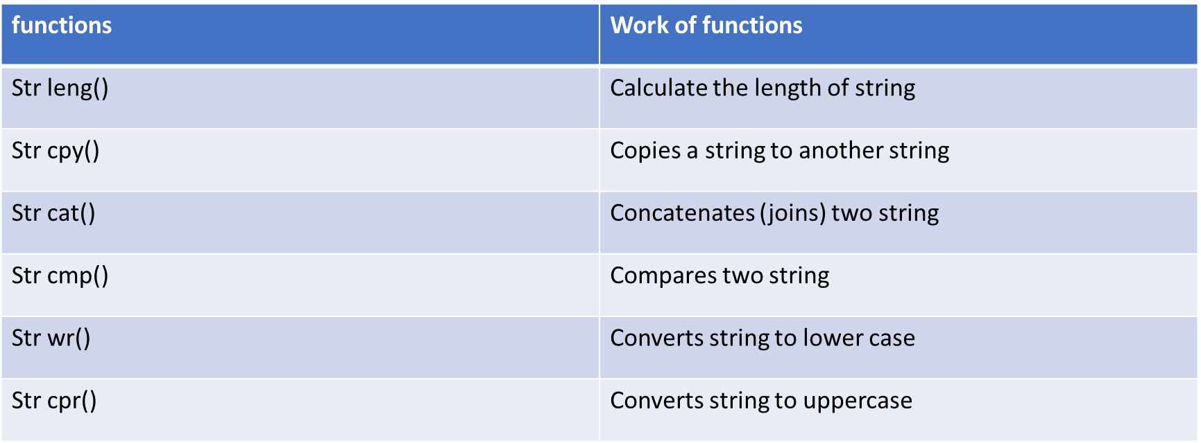
There are various string handling functions define in string.h some of them are:

Slide 6
Operations performed on character strings include:
Reading and writing strings
Copying one string to another
Combination strings together
Comparing strings for equality
Extracting a portion of strings

Slide 7
Reading and displaying string
#include <stdio.h>
int main(){
char character;
char string[500];
char sentence[500];
scanf("%c", &character);
scanf("%s", string);
fflush(stdin);

Slide 8
fgets(sentence, 500, stdin);
printf("Your character: %c", character);
printf("Your string: %s", string);
printf("Your sentence: %s", sentence);
}

Slide 9
Copying one string to another
#include<stdio.h>
#include<conio.h>
#include<string.h>
int main() {
char str1[20], str2[20];
printf("Enter the string: ");
gets(str1);
printf("\nString 1 = %s", str1);
strcpy(str2, str1);
printf("\nString 2 = %s", str2);
getch();
return 0;
}

Slide 10
Combination strings together
#include <stdio.h> #include <string.h>
int main() { char a[1000], b[1000];
printf("Enter the first string\n"); gets(a);
printf("Enter the second string\n"); gets(b);
strcat(a, b);
printf("String obtained on concatenation: %s\n", a);
return 0; }

Slide 11
Comparing strings for equality
#include <stdio.h>
#include<string.h>
int main()
{
char str1[20]; // declaration of char array
char str2[20]; // declaration of char array
int value; // declaration of integer variable
printf("Enter the first string : ");
scanf("%s",str1);

Slide 12
scanf("%s",str1);
printf("Enter the second string : ");
scanf("%s",str2);
// comparing both the strings using strcmp() function
value=strcmp(str1,str2);
if(value==0)
printf("strings are same");
else
printf("strings are not same");
return 0;
}

Slide 13
Extracting a portion of strings
#include <stdio.h> int main() { char string[1000], sub[1000]; int position, length, c = 0; printf("Input a string\n"); gets(string);

Slide 14
printf("Enter the position and length of substring\n");
scanf("%d%d", &position, &length); while (c < length) {
sub[c] = string[position+c-1]; c++; } sub[c] = '\0'; printf("Required substring is \"%s\"\n", sub); // '\"' to print " return 0; }

Slide 15
Arrays of strings
Strings is arrays character
Thus an array of string is 2D array of character
Ex:
Char name[5][10];
Here, name[5][10] means 5 names having 10 characters each.

Slide 16
Passing string to function
#include<stdio.h>
Void display(char ch[]);
Int main(){
Char c[50];
Printf(“enter string:”);
gets©;
Display©;
Return 0;
}
Void display(char ch[]){
Printf(“string output”);
Puts(ch);
}

Slide 17
Counting length of the string
#include<stdio.h>
Void main()
{
Char input_string[50];
Int i=0,length=0;
Clrscr();
Printf(“\n enter your text\t”);
gets(input_string);
While(input_string[i]!=‘\0’);
{
Length++;
}
Printf(\n the length of your text is: %d character(s) length);
gets();
}

