Slide 1

INPUT HANDLING
AND
BASIC FUNCTIONALITY

Slide 2


OBJECTIVE
Handle user inputs and basic functionality

Slide 3
TASK
Develop test cases to validate correct replacement of placeholders with given hostname and IP address.

Slide 4
TEST SCENARIOS
1. Valid Hostname and IP Address
2. Empty Hostname
3. Empty IP Address

Slide 5
PROGRAM
import java.util.Scanner;
public class PlaceholderReplacer {
public static String replacePlaceholders(String template, String hostname, String ipAddress) {return template.replace("{hostname}", hostname).replace("{ip_address}", ipAddress);}
public static boolean isValidIP(String ipAddress) {
if (ipAddress.isEmpty()) return false;
String[] parts = ipAddress.split("\\.");
if (parts.length != 4) return false;
for (String part : parts) {
int num;
try {num = Integer.parseInt(part);
} catch (NumberFormatException e) {
return false;}

Slide 6
public static boolean isValidHostname(String hostname) {
// Ensure hostname is not empty and matches valid characters (letters, numbers, dots, or hyphens)
return !hostname.isEmpty() && hostname.matches("[a-zA-Z0-9.-]+");
} public static void main(String[] args) {
Scanner scanner = new Scanner(System.in);
System.out.print("Enter hostname: ");
String hostname = scanner.nextLine().trim();
if (!isValidHostname(hostname)) {
System.out.println("Error: Invalid hostname. It should contain only letters, numbers, dots, or hyphens.");
return;
}
System.out.print("Enter IP address: ");
String ipAddress = scanner.nextLine().trim();

Slide 7
if (!isValidIP(ipAddress)) {
System.out.println("Error: Invalid IP address. It should be in the format x.x.x.x, where each x is 0-255.");
return;
}
String template = "Connect to {hostname} at {ip_address}";
String result = replacePlaceholders(template, hostname, ipAddress);
System.out.println(result);
scanner.close();
}
}

Slide 8
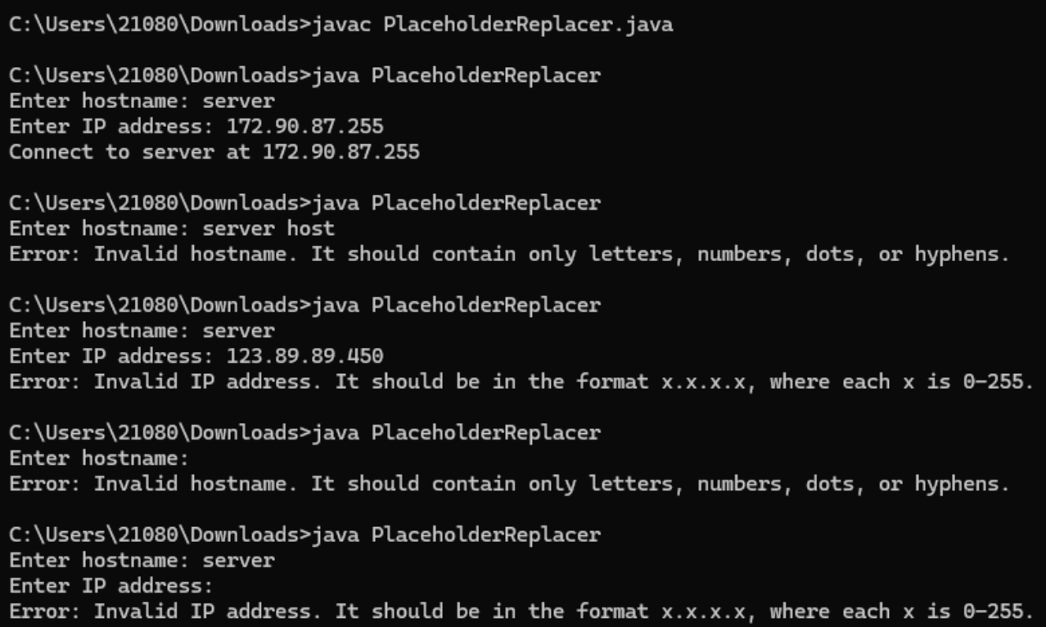
OUTPUT

