Slide 1

Project on Employee Burnout Analysis using
AI And ML

Slide 2
STUDENT DETAILS
STUDENT NAME : VIGNESHWAR REDDY MEKALA
SKILLS BUILD MAIL ID : 20AM1A3155@SVREC.AC.IN
COLLEGE NAME : SVR ENGINEERING COLLEGE
COLLEGE STATE : ANDHRA PRADESH
INTERNSHIP DOMAIN : ARTIFICIAL INTELLIGENCE
INTERNSHIP START DATE : 05 /06 /2023
INTERNSHIP END DATE : 15/07/2023

Slide 3
PROJECT TITLE/PROBLEM STATEMENT
PROJECT TITLE : EMPLOYEE BURNOUT PREDICTION ANALYSIS USING MACHINE LEARNING
PROBLEM STATEMENT: DEVELOPE A MODEL TO PREDICT EMPLOYEE BURNOUT RATE BASED ON VARIOUS FACTORS AND EXPLORE POTENTIAL SOLUTIONS TO MITIGATE BURNOUT RISKS AND TO CARRY OUT THIS TASK.THE EMPLOYEE BURNOUT DATA SHOULD BE CONSUDERED

Slide 4
AGENDA
INTRODUCTION
PROJECT OVERVIEW
END USERS OF THE PROJECT
SOLUTION AND VALUE PROPOSITION
CUSTUMIZATION OF PROJECT
MODELLING APROACH
RESULT ANALYSIS
CONCLUSION AND FUTURE WORK

Slide 5
PROJECT OVERVIEW
Project Overview: The Employee Burnout Prediction project aims to develop a model that can accurately predict employee burnout rate based on various factors. Burnout is a prevalent issue in modern workplaces, leading to decreased productivity, increased turnover rates, and negative impacts on employees' mental and physical well-being. By identifying the early signs of burnout, organizations can take proactive measures to mitigate its effects and promote a healthier work environment.
Scope :The project focuses on analyzing a dataset that includes various factors known to contribute to employee burnout, such as workload, work-life balance, interpersonal relationships, and individual characteristics. The dataset is used to train and evaluate machine learning models, including Linear Regression, Gradient Boosting Regressor, and Random Forest Regressor, to predict employee burnout levels
OBJECTIVES :
1. Predicting Burnout : The primary objective is to develop a predictive model that accurately forecasts employee burnout levels.
2.Enhancing Decision-Making : The project aims to provide HR managers and team leaders with valuable information to make informed decisions.
3.Performance Evaluation : The objective is to identify the most effective model in predicting employee burnout levels based on the given dataset.
4.Impact Assessment : The project intends to assess the potential impact of accurately predicting employee burnout.
5.Empower Employees : The project seeks to empower employees to assess their own burnout risks and take proactive steps to manage their well-being.

Slide 6

YOUR SOLUTION AND ITS VALUE PROPOSITION
Solution Presentation:
The Employee Burnout Prediction model, addresses the needs of the end users, including HR Managers, Team Leaders, and Employees, by providing accurate insights into burnout risks and enabling proactive measures to prevent and manage burnout.
Since I had used the Linear regression model which used to predict one output value by learning one or more multiple features. In this dataset by using features like Mental Fatigue Rate , WFH setup Available , Designation and Resource Allocation. The model is developed to learn these features and accordingly it should predict the Burnout Rate.
And at the same time the predicted values are measured by the some metrics like accuracy and we can also identify the Mean squared error also.
The models I used to identify or predict the Burnout Rate are Linear Regression, Gradient Boosting Regressor and Random Forest Regressor.
Needs of End Users:
It will satisfy the needs of mainly HR Managers, Team Leaders and Employees.
Value proposition:
Employee Burnout Prediction solution addresses the needs of HR Managers, Team Leaders, and Employees by providing accurate predictions of burnout risks and enabling proactive measures. The value it brings includes improved employee well-being, enhanced decision-making, optimized resource allocation, reduced burnout risks, increased productivity, and a positive work culture.

Slide 7

HOW DID YOU CUSTOMIZE THE PROJECT AND MAKE IT YOUR OWN
I had Customized my project in such a way , that its looks bit different from others such as in encoding, scaling the features and the Model Implementation.
In the Encoding Part ,I used the Binary Encoder which would be esay to handle and can represent the categorical data esaily.
InScaling the features , I used the Standard Scaler Before PCA , So that I could scale the feature I like manually. Which represent the data with better features followed by that PCA is used.
In Model Implementation ,I used models such as Linear Regression , Gradient Boosting Regressor and the Random Forest Regressor. In order to showcase the different Accuracies obtained by the models with same data and would prefer the model who has highest accuracy. And for determining the accuracy I used the “r2_score” function

Slide 8
MODELLING
Modeling Techniques: I used the Models : Linear Regression, Gradient Boosting Regressor and Random Forest Regressor. The methods such as ‘r2_score’ is used in these models to identify the Accuracy obtained on predicting the data after training.
Frameworks: I used some popular and must required frameworks such as ---Numpy , Pandas, Matplotlib, Seaborn and Plotly .
Numpy : which is used to handle the numerical computations of data that is present in the dataset.
Pandas : which is used to handle with the dataset read,open,write operations along with some data manipulation.
Matplotlib : which is used for basic plotting between the features for better understanding of there stats.
Plotly : which is used for interactive and advanced visualizations
Seaborn : which is used for statistical visualization of the features and their relationships.
Usage of these Technologies: Numpy is used for some basic numerical calculations. Pandas is used for reading the dataset and for converting the data into multidimensional Dataframes and for converting the datetime column. Matplotlib ,Seaborn and Plotly are used as count plot for Gender , Company Type and WFH setup available , plot disturbution for burnrate over Gender, designation. For visualisation of correlation also. And atlast disturbution of Mental Fatigue vs Designation as per Company Type , Burnrate and Gender.

Slide 9
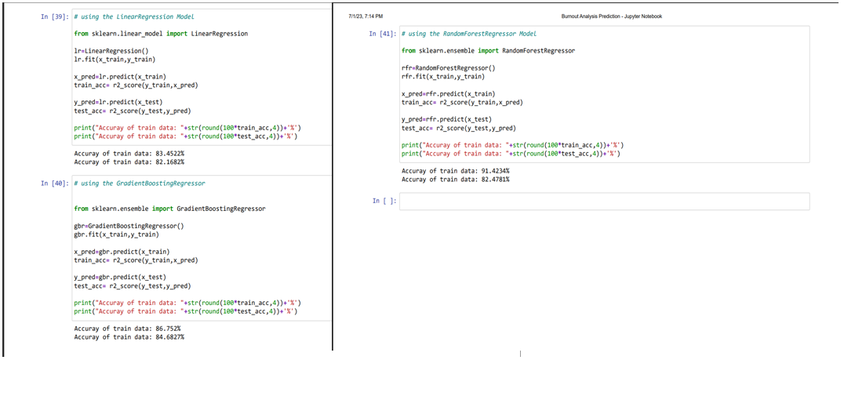
RESULTS
ACCURACY OBTAINED BY THE MODEL

Slide 10
LINKS
LINK FOR CODE : https://github.com/VIGNESHWAR-1005/VIGNESHWAR/blob/46045d750bc854ef24b98cc2ab0029e8b412fb4d/EMPLOYEE_BURNOUT_ANALYSIS.ipynb
LINK FOR DATASET :
https://github.com/VIGNESHWAR-1005/VR/blob/a085e30d8ad2773acdc9ebf65dda7925df24e648/employee_burnout_analysis1.csv

Slide 11
THANK YOU

