Slide 1


Department of
Computer Science & Engineering
Adaptive Temporal-Relational Intrusion Detection for Evolving Network Traffic: Investigating Classical, Quantum, and Continual Learning Approaches
Amrita School of Computing
Amrita Vishwa Vidyapeetham, Chennai Campus
Student Members [BATCH ID: 04]
1: D Sai Raman – CH.SC.U4AIE23010
2: Vigneshwarran S – CH.SC.U4AIE23061
Guide Details
Dr. S. Baghavathi Priya

Slide 2

Problem Statement
Problem Statement
Core Focus
Architecture
Methodology
Evaluation
Phase 0
Phase 1
Phase 2
Gantt chart
Cyber attacks are increasingly complex and evolving, making conventional IDS difficult to adapt. Existing approaches often fail to jointly capture temporal and relational network behaviour and are largely evaluated on fixed datasets. This limits their ability to handle evolving attack patterns and changing network behaviour. Therefore, this study focuses on investigating temporal–relational fusion techniques for adaptive intrusion detection.

Slide 3
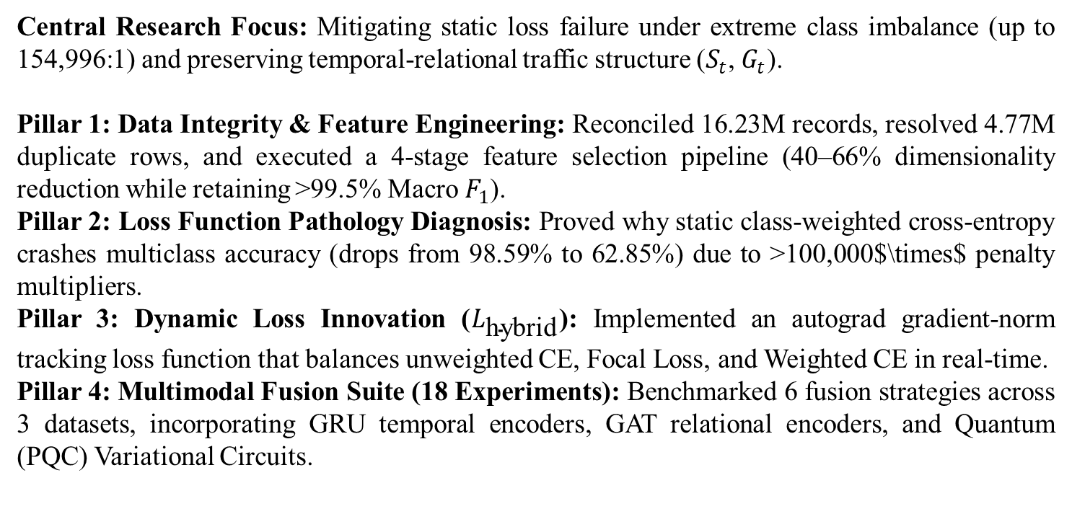
Core Focus
Problem Statement
Core Focus
Architecture
Methodology
Evaluation
Phase 0
Phase 1
Phase 2
Gantt chart
Central Research Focus: Mitigating static loss failure under extreme class imbalance (up to 154,996:1) and preserving temporal-relational traffic structure ($S_{t}$, $G_{t}$).
Pillar 1: Data Integrity & Feature Engineering: Reconciled 16.23M records, resolved 4.77M duplicate rows, and executed a 4-stage feature selection pipeline (40–66% dimensionality reduction while retaining >99.5% Macro $F_{1}$).
Pillar 2: Loss Function Pathology Diagnosis: Proved why static class-weighted cross-entropy crashes multiclass accuracy (drops from 98.59% to 62.85%) due to >100,000$\times$ penalty multipliers.
Pillar 3: Dynamic Loss Innovation ($L_{\text{hybrid}}$): Implemented an autograd gradient-norm tracking loss function that balances unweighted CE, Focal Loss, and Weighted CE in real-time.
Pillar 4: Multimodal Fusion Suite (18 Experiments): Benchmarked 6 fusion strategies across 3 datasets, incorporating GRU temporal encoders, GAT relational encoders, and Quantum (PQC) Variational Circuits.
3

Slide 4
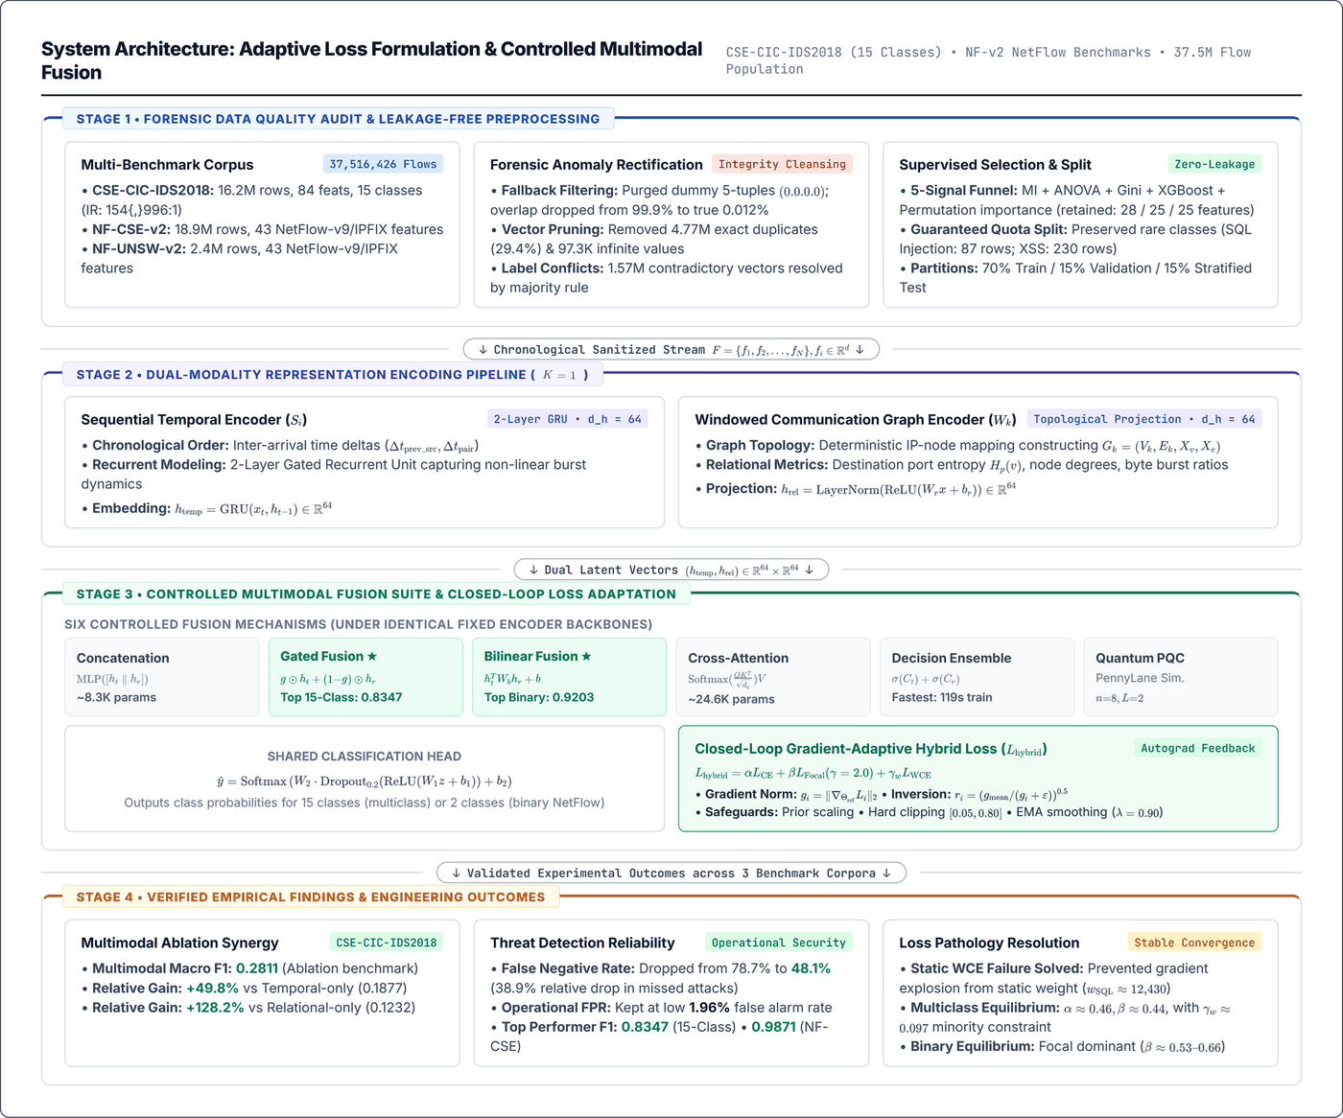
Architecture
Problem Statement
Core Focus
Architecture
Methodology
Evaluation
Phase 0
Phase 1
Phase 2
Gantt chart

Slide 5
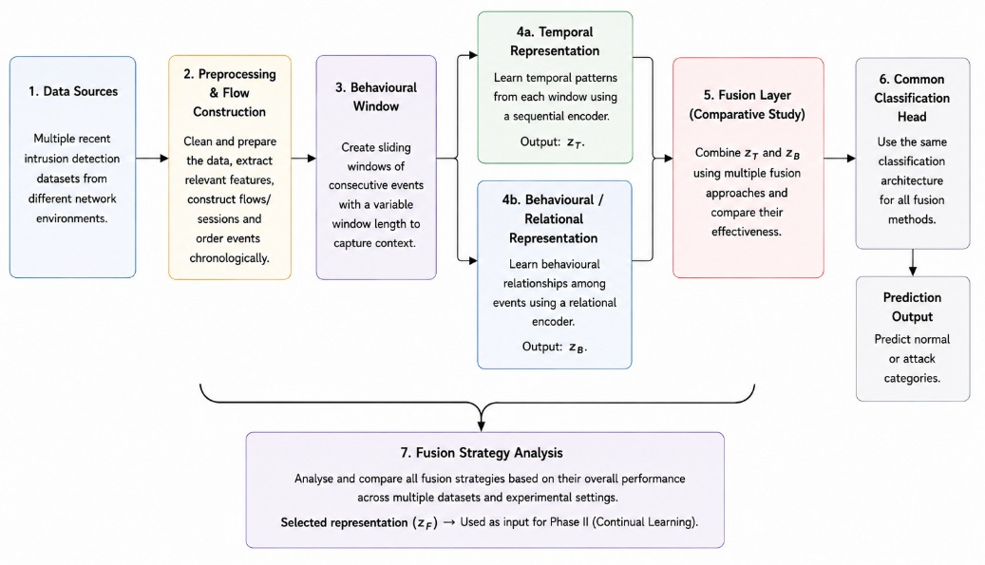
Methodology
Problem Statement
Core Focus
Architecture
Methodology
Evaluation
Phase 0
Phase 1
Phase 2
Gantt chart

Slide 6
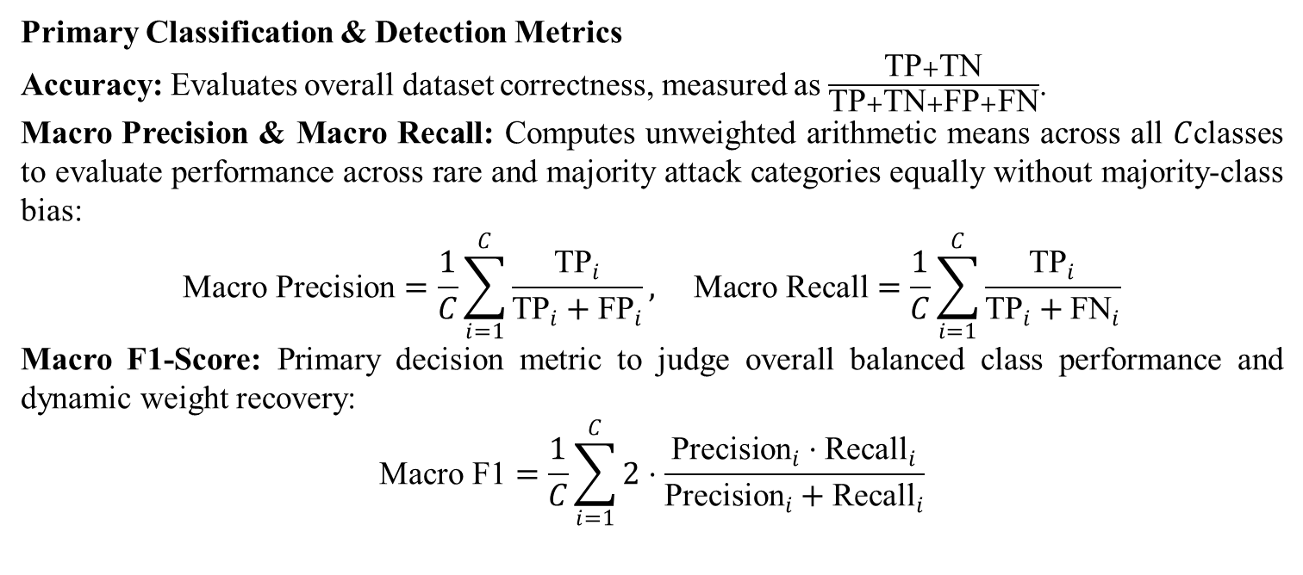
Evaluation
Problem Statement
Core Focus
Architecture
Methodology
Evaluation
Phase 0
Phase 1
Phase 2
Gantt chart
Primary Classification & Detection Metrics
Accuracy: Evaluates overall dataset correctness, measured as $\frac{\text{TP}+\text{TN}}{\text{TP}+\text{TN}+\text{FP}+\text{FN}}$.
Macro Precision & Macro Recall: Computes unweighted arithmetic means across all $C$classes to evaluate performance across rare and majority attack categories equally without majority-class bias:
$$\text{Macro Precision}=\frac{1}{C}\sum_{i=1}^{C}{\frac{{\text{TP}}_{i}}{{\text{TP}}_{i}+{\text{FP}}_{i}}}, \text{Macro Recall}=\frac{1}{C}\sum_{i=1}^{C}{\frac{{\text{TP}}_{i}}{{\text{TP}}_{i}+{\text{FN}}_{i}}}$$
Macro F1-Score: Primary decision metric to judge overall balanced class performance and dynamic weight recovery:
$$\text{Macro F1}=\frac{1}{C}\sum_{i=1}^{C}{2}⋅\frac{{\text{Precision}}_{i}⋅{\text{Recall}}_{i}}{{\text{Precision}}_{i}+{\text{Recall}}_{i}}$$
6

Slide 7
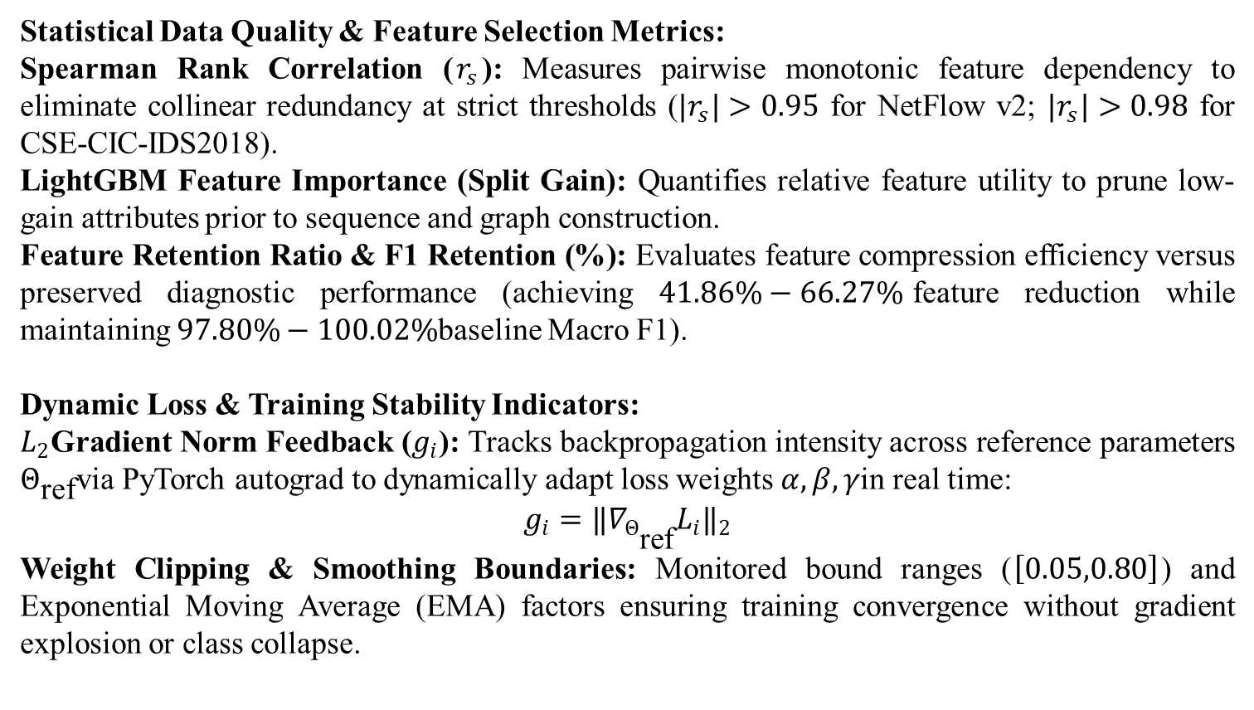
Evaluation
Problem Statement
Core Focus
Architecture
Methodology
Evaluation
Phase 0
Phase 1
Phase 2
Gantt chart
Statistical Data Quality & Feature Selection Metrics:
Spearman Rank Correlation ($r_{s}$): Measures pairwise monotonic feature dependency to eliminate collinear redundancy at strict thresholds ($|r_{s}|>0.95$ for NetFlow v2; $|r_{s}|>0.98$ for CSE-CIC-IDS2018).
LightGBM Feature Importance (Split Gain): Quantifies relative feature utility to prune low-gain attributes prior to sequence and graph construction.
Feature Retention Ratio & F1 Retention (%): Evaluates feature compression efficiency versus preserved diagnostic performance (achieving $41.86\%−66.27\%$feature reduction while maintaining $97.80\%−100.02\%$baseline Macro F1).
Dynamic Loss & Training Stability Indicators:
$L_{2}$Gradient Norm Feedback ($g_{i}$): Tracks backpropagation intensity across reference parameters $Θ_{\text{ref}}$via PyTorch autograd to dynamically adapt loss weights $α,β,γ$in real time:
$$g_{i}=‖∇_{Θ_{\text{ref}}}L_{i}‖​_{2}$$
Weight Clipping & Smoothing Boundaries: Monitored bound ranges ($\left[0.05,0.80\right]$) and Exponential Moving Average (EMA) factors ensuring training convergence without gradient explosion or class collapse.
7

Slide 8
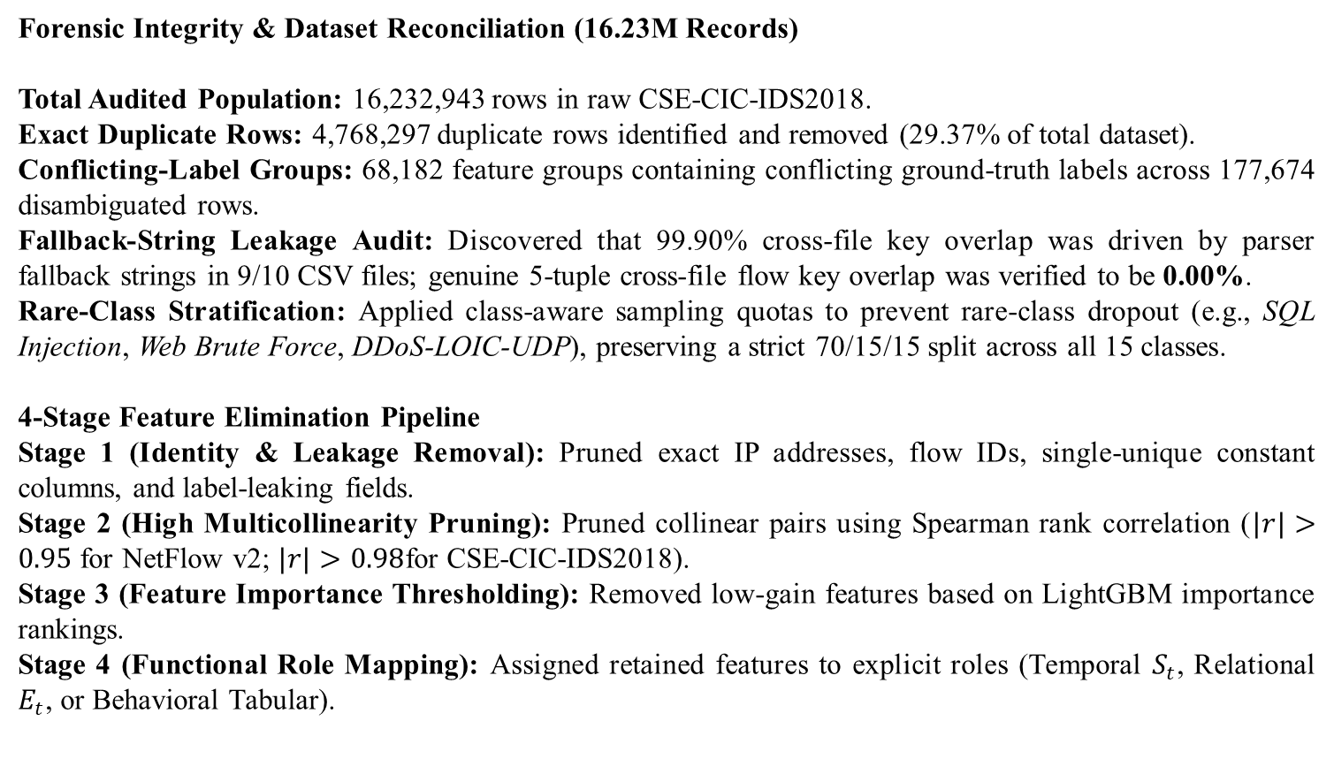
Phase 0
Problem Statement
Core Focus
Architecture
Methodology
Evaluation
Phase 0
Phase 1
Phase 2
Gantt chart
Forensic Integrity & Dataset Reconciliation (16.23M Records)
Total Audited Population: 16,232,943 rows in raw CSE-CIC-IDS2018.
Exact Duplicate Rows: 4,768,297 duplicate rows identified and removed (29.37% of total dataset).
Conflicting-Label Groups: 68,182 feature groups containing conflicting ground-truth labels across 177,674 disambiguated rows.
Fallback-String Leakage Audit: Discovered that 99.90% cross-file key overlap was driven by parser fallback strings in 9/10 CSV files; genuine 5-tuple cross-file flow key overlap was verified to be 0.00%.
Rare-Class Stratification: Applied class-aware sampling quotas to prevent rare-class dropout (e.g., SQL Injection, Web Brute Force, DDoS-LOIC-UDP), preserving a strict 70/15/15 split across all 15 classes.
4-Stage Feature Elimination Pipeline
Stage 1 (Identity & Leakage Removal): Pruned exact IP addresses, flow IDs, single-unique constant columns, and label-leaking fields.
Stage 2 (High Multicollinearity Pruning): Pruned collinear pairs using Spearman rank correlation ($|r|>0.95$ for NetFlow v2; $|r|>0.98$for CSE-CIC-IDS2018).
Stage 3 (Feature Importance Thresholding): Removed low-gain features based on LightGBM importance rankings.
Stage 4 (Functional Role Mapping): Assigned retained features to explicit roles (Temporal $S_{t}$, Relational $E_{t}$, or Behavioral Tabular).
8

Slide 9
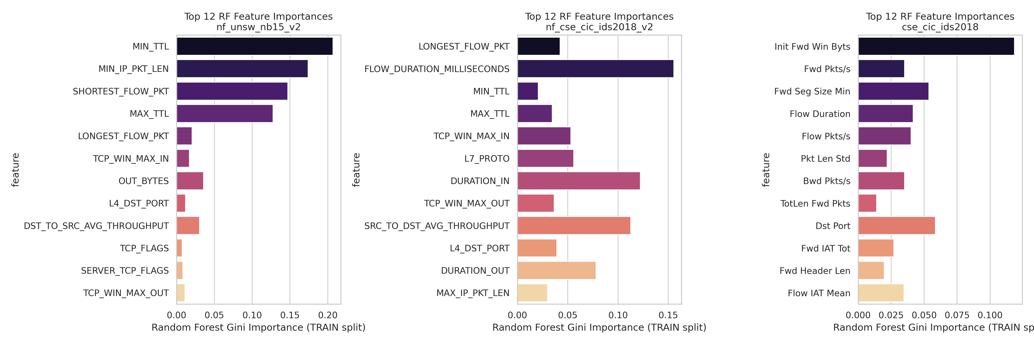
Phase 0
Problem Statement
Core Focus
Architecture
Methodology
Evaluation
Phase 0
Phase 1
Phase 2
Gantt chart
9

Slide 10
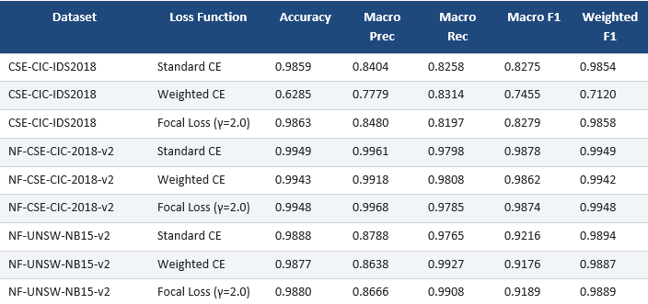
Phase 1
Problem Statement
Core Focus
Architecture
Methodology
Evaluation
Phase 0
Phase 1
Phase 2
Gantt chart
10

Slide 11
Phase 1
Problem Statement
Core Focus
Architecture
Methodology
Evaluation
Phase 0
Phase 1
Phase 2
Gantt chart
Deep Failure Diagnosis: Pathology of Static Weighting
Root Cause of Collapse: Under extreme class imbalance ratios (up to 154,996:1), static inverse-frequency weighting generates penalty multipliers exceeding 100,000x for rare classes (such as SQL Injection and Web Brute Force).
Mechanism: During backpropagation, minor gradient noise on rare-class misclassifications completely overwhelmed the gradients of dominant benign traffic.
Impact: Forced the classifier to over-predict rare attack classes to minimize loss penalties, triggering a massive wave of false positives that collapsed overall accuracy from 98.59% to 62.85%.
11

Slide 12
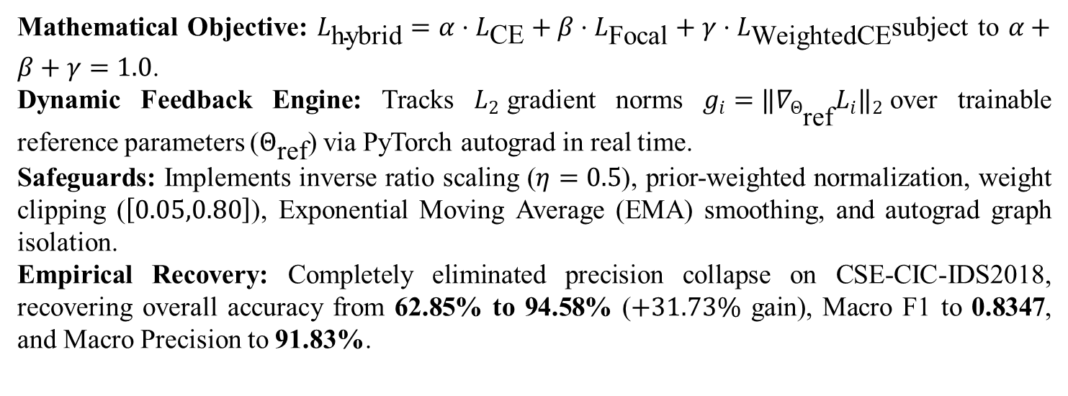
Phase 2
Problem Statement
Core Focus
Architecture
Methodology
Evaluation
Phase 0
Phase 1
Phase 2
Gantt chart
Mathematical Objective: $L_{\text{hybrid}}=α⋅L_{\text{CE}}+β⋅L_{\text{Focal}}+γ⋅L_{\text{WeightedCE}}$subject to $α+β+γ=1.0$.
Dynamic Feedback Engine: Tracks $L_{2}$gradient norms $g_{i}=‖∇_{Θ_{\text{ref}}}L_{i}‖​_{2}$over trainable reference parameters ($Θ_{\text{ref}}$) via PyTorch autograd in real time.
Safeguards: Implements inverse ratio scaling ($η=0.5$), prior-weighted normalization, weight clipping ($\left[0.05,0.80\right]$), Exponential Moving Average (EMA) smoothing, and autograd graph isolation.
Empirical Recovery: Completely eliminated precision collapse on CSE-CIC-IDS2018, recovering overall accuracy from 62.85% to 94.58% ($+31.73\%$ gain), Macro F1 to 0.8347, and Macro Precision to 91.83%.
12

Slide 13
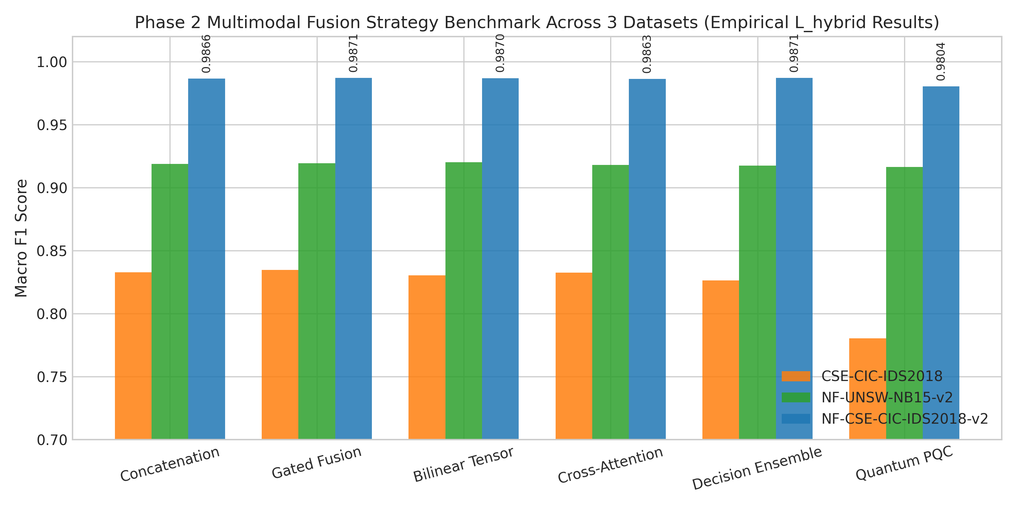
Phase 2
Problem Statement
Core Focus
Architecture
Methodology
Evaluation
Phase 0
Phase 1
Phase 2
Gantt chart
13

Slide 14
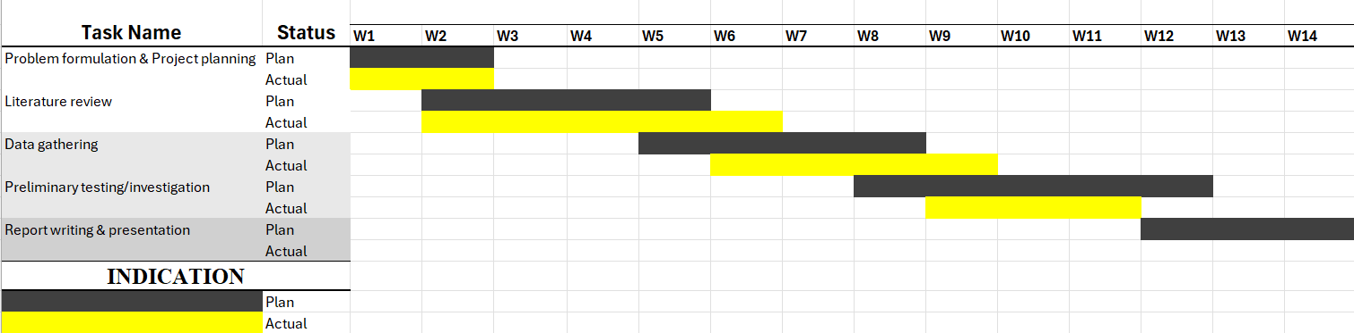
Gantt Chart
Problem Statement
Core Focus
Architecture
Methodology
Evaluation
Phase 0
Phase 1
Phase 2
Proposed Time Line For the Events in Project Phase 1

Slide 15
Reference
Problem Statement
Core Focus
Architecture
Methodology
Evaluation
Phase 0
Phase 1
Phase 2
References
K. Karimullah, K. K. Butt, R. Naveed, M. Tariq, and K. Javed, “A Hybrid CNN–LSTM-Based Intrusion Detection System Trained on UNSW-NB15 for Accurate Cyber Threat Detection,” Journal of Computing & Biomedical Informatics, 2025, doi: 10.56979/1001/2025/1129.
Z. Moczkodan and H. Ragab, “Do Transformers Actually Help Intrusion Detection? A Temporal Sequence Evaluation on CIC-IDS2017,” arXiv preprint arXiv:2606.11098, 2026, doi: 10.48550/arXiv.2606.11098.
A. Pandey, A. K. Agrawal, A. Shukla, G. Keswani, P. N. Bokoro, and P. Dubey, “From Signature to Attention: Transformer-Powered Intrusion Detection Systems for Cybersecurity,” Future Internet, vol. 18, no. 8, p. 398, 2026, doi: 10.3390/fi18080398.
R. H. H. Subroto and K. Ramli, “Reinforcement Learning-Based Adaptive Threshold Optimization for Federated Sequence-to-Sequence Anomaly Detection in IoT Network Traffic,” Journal of Vocational, Informatics and Computer Education, vol. 4, no. 2, pp. 387–403, 2026, doi: 10.66053/voice.v4i2.946.
C. Wu, J. Sun, J. Chen, M. Alazab, Y. Liu, and Y. Xiang, “TCG-IDS: Robust Network Intrusion Detection via Temporal Contrastive Graph Learning,” IEEE Transactions on Information Forensics and Security, vol. 20, pp. 1475–1486, 2025, doi: 10.1109/TIFS.2025.3530702.
L. Idouglid, S. Tkatek, and K. Elfayq, “Performance Evaluation of Deep Learning Models for Sequence-Based Intrusion Detection,” International Journal on Electrical Engineering and Informatics, vol. 17, no. 1, 2025.
Y. Kim, S. Y. Hong, S. Park, and H. K. Kim, “Reinforcement Learning-Based Generative Security Framework for Host Intrusion Detection,” IEEE Access, vol. 13, pp. 15346–15362, 2025, doi: 10.1109/ACCESS.2025.3532353.
M. Luay, S. Layeghy, N. Noorbin, M. Sarhan, G. Kulatilleke, N. Moustafa, and M. Portmann, “Time Matters: Temporal NetFlow Features for ML-Based Network Intrusion Detection,” IEEE Access, vol. 14, pp. 66899–66913, 2026, doi: 10.1109/ACCESS.2026.3688204.

Slide 16
Reference
Problem Statement
Core Focus
Architecture
Methodology
Evaluation
Phase 0
Phase 1
Phase 2
References
C. M. Nalayini, T. R. Soumya, S. D. Lalitha, and R. Tamijetchelvy, “A Novel Adaptive Transformer Based Quantum Intrusion Detection System for Software Defined Networks,” Scientific Reports, vol. 15, no. 1, p. 36505, 2025, doi: 10.1038/s41598-025-20356-4.
M. Shahzad, M. H. Saleh, and R. Ujjan, “An Autonomous AI-Driven Framework for Adaptive Cyber Deception with Real-Time Threat Detection and Behaviour-Based Attribution,” Computers, 2026.
M. Antunes, L. Oliveira, A. Seguro, J. Veríssimo, R. Salgado, and T. Murteira, “Benchmarking Deep Learning Methods for Behaviour-Based Network Intrusion Detection,” Informatics, vol. 9, no. 1, p. 29, 2022, doi: 10.3390/informatics9010029.
Z. Sun, A. M. H. Teixeira, and S. Toor, “GNN-IDS: Graph Neural Network Based Intrusion Detection System,” in ARES 2024 – International Conference on Availability, Reliability and Security, 2024.
W. Villegas-Ch, J. Govea, A. Maldonado Navarro, and P. Palacios Játiva, “Intrusion Detection in IoT Networks Using Dynamic Graph Modeling and Graph-Based Neural Networks,” IEEE Access, vol. 13, pp. 65356–65375, 2025, doi: 10.1109/ACCESS.2025.3559325.
S. M. Tripathi, H. Upadhyay, and J. Soni, “A Quantum LSTM-Based Approach to Cyber Threat Detection in Virtual Environment,” The Journal of Supercomputing, 2025.
R. Bhatnagar, N. Innan, A. A. Jothi J., and M. Shafique, “Meta-Quantum Ensemble Framework for Robust Network Intrusion Detection,” arXiv preprint arXiv:2605.28879, 2026.
D. Abreu, C. E. Rothenberg, and A. Abelém, “QML-IDS: Quantum Machine Learning Intrusion Detection System,” in 2024 IEEE Symposium on Computers and Communications (ISCC), pp. 1–6, 2024.

Slide 17
Reference
Problem Statement
Core Focus
Architecture
Methodology
Evaluation
Phase 0
Phase 1
Phase 2
References
17. W. A. Malwi, F. Asiri, and M. S. Khan, “Quantum-Enhanced Intrusion Detection Using Quantum Circuit Born Machines for Zero-Day Attack Detection,” Computers, Materials & Continua, vol. 88, no. 1, p. 36, 2026, doi: 10.32604/cmc.2026.075326.
18. J. Reed et al., “Continual Learning for Evolving Cyber Threat Landscapes,” 2024.
19. S. Fuhrman, O. Gungor, and T. Rosing, “ACORN-IDS: Adaptive Continual Novelty Detection for Intrusion Detection Systems,” arXiv preprint arXiv:2602.07291, 2026.
20. S. Prasath, K. Sethi, D. Mohanty, P. Bera, and S. R. Samantaray, “Analysis of Continual Learning Models for Intrusion Detection System,” IEEE Access, vol. 10, pp. 121444–121464, 2022, doi: 10.1109/ACCESS.2022.3222715.
21. H. Park, T. Kim, H. Lee, D. Shin, D. Shin, and M. Park, “A Continual Learning Process to Detect Both Previously Learned and Newly Emerging Attack,” Applied Sciences, vol. 15, no. 18, p. 10034, 2025.
22. E. D. Erigha, E. Obuse, N. Ayanbode, E. Cadet, and E. D. Etim, “Self-Learning Autonomous Cyber Defense Agents in AI-Empowered Security Operations,” Computer Science & IT Research Journal, vol. 6, no. 8, pp. 475–505, 2025, doi: 10.51594/csitrj.v6i8.2011.
23. Y. Hu and L. Duan, “Theory of Continual Learning Against Data Poisoning Attacks,” arXiv preprint arXiv:2606.29841, 2026.
24. J. Zhao, D. Zhang, Q. He, M. Lin, and Y. Yang, “DMSTG-AD: An SDN Intrusion Detection Method Based on Dynamic Multi-Scale Spatio-Temporal Graph Neural Network,” Scientific Reports, vol. 16, p. 14528, 2026, doi: 10.1038/s41598-026-44360-4.
25. J. Fu, L. Wang, J. Ke, K. Yang, and R. Yu, “TSIDS: Spatial-Temporal Fusion Gating Multilayer Perceptron for Network Intrusion Detection,” Expert Systems with Applications, vol. 263, p. 125687, 2025, doi: 10.1016/j.eswa.2024.125687.

