Slide 1
ELEVATE
Electronic School
C++ Programming Basics | IX Grade | 2025/2026
Professional Gymnasium for Computer Programming & Innovations — Burgas

Slide 2
What is Elevate?
Elevate is a C++ console application that functions as an interactive Electronic School for learning C++ Programming Basics. It combines structured learning content, randomized testing, and student statistics in one program.
Study Mode
Test Mode
Statistics
Browse all 30 questions
with correct answers
shown per category
20 randomly generated
questions graded on
the Bulgarian 2-6 scale
Track scores, averages,
best/worst students
and category performance

Slide 3

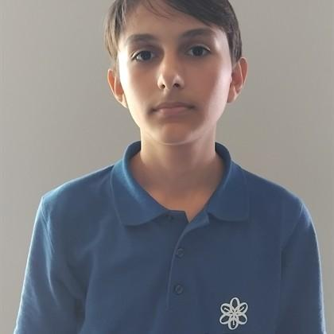


Our team:
Vilian Ivanov
Todor Neshev
Dara Sokrateva
Mihail Mavrodiev

Slide 4
Technology & File Structure
Built With
Source Files
Language
C++ (C++17 standard)
main.cpp
Entry point, game loop
globals.h
Structs & constants
Graphics
Raylib 5.0
questions.h/.cpp
30-question bank
IDE
Visual Studio 2022
accounts.h/.cpp
Login & password hash
test.h/.cpp
Test generation & scoring
Version Control
Git & GitHub
statistics.h/.cpp
Results & analytics
renderer.h/.cpp
All Raylib UI code
utils.h/.cpp
Utilities & grading

Slide 5
C++ Concepts Used
Functions
Recursion
Strings
Separate functions for input, output,
and data processing. Function overloading
and default parameters used throughout.
Fisher-Yates shuffle uses recursion
for random index swapping. Password
hashing iterates recursively over chars.
std::string class used for all text.
Methods: substr, find, size, erase,
concatenation with + operator.
Structs
Arrays & 2D
Bitwise / Hashing
Question and StudentResult structs
store all data. Arrays of structs used
for the question bank and results.
Question bank is a fixed array[30].
categoryCorrect[NUM_CATEGORIES] is a
2D-like array inside each struct.
Password hashing uses XOR (^) bitwise
operator on each character combined
with position-based salt value.

Slide 6
Account System & Password Hashing
How It Works
Hash Algorithm
1. User registers with username + password
for each char in password:
2. Password is hashed using XOR + hex string algorithm
mixed = (char XOR (pos+7))
+ (pos * 3)) % 256
3. Only the hash is stored — never the plain text
hex += hexChars[mixed/16]
4. On login, the entered password is hashed again
hex += hexChars[mixed%16]
5. Hashes are compared using string equality (==)
checksum = sum(all chars) % 65536
6. First registered account automatically becomes Admin
hash = "L{len}-{hex}-{checksum}"

Slide 7
Test System & Grading Scale
Question Bank Structure
Bulgarian Grading Scale
Category
Total
In Test
Points Each
Max Points
Grade 6
>= 90%
Variables & Data Types
10
6
1 pt
6 pts
Grade 5
>= 75%
Control Flow
10
7
1 pt
7 pts
Functions & Strings
10
7
2 pts
14 pts
Grade 4
>= 62%
TOTAL
30
20
—
27 pts
Grade 3
>= 50%
Grade 2
< 50%

Slide 8
Raylib — Graphical Interface
All graphical code is isolated in renderer.cpp / renderer.h. The C++ logic (grading, hashing, test generation) is completely separate and unchanged. Every Raylib function call is commented to explain what it does.
Login
Register
Main Menu
Username/password input
with text cursor & masking
Account creation with
password confirmation
4 clickable cards,
full-screen responsive
Study Mode
Test
Statistics
Scrollable lesson view
with correct answers
Progress bar, answer
feedback with timer
Scrollable table,
category bar charts

Slide 9
GitHub & Project Management
Repository Structure
Git Workflow
ElevateFinal/
git add .
elevate.sln
Stage all changes
.gitignore
raylib/
git commit -m "message"
include/ (raylib.h, rlgl.h ...)
Commit with description
lib/ (raylibdll.lib)
git push
elevate/
Push to GitHub
elevate.vcxproj
*.cpp *.h
.gitignore
x64/Debug/raylib.dll
Excludes x64/, .vs/, *.exe

Slide 10
Thank You
Questions & Discussion
30
8
100%
2026
Questions
Source Files
C++
IX Grade
Professional Gymnasium for Computer Programming & Innovations — Burgas | 2025/2026

