Slide 1

Gen-Z Social Media Usage Analysis
A comprehensive end-to-end analytics project studying social media engagement, behavioral trends, addiction levels, and mental health insights among Gen-Z users — built with Excel, Python, PostgreSQL, and Power BI.

Slide 2
Project Objectives
Usage Patterns
Mental Health
Analyze social media habits and platform engagement trends among Gen-Z users.
Study the relationship between screen time and emotional wellness.
Addiction Behavior
Actionable Insights
Identify addiction patterns and their impact on user behavior.
Transform raw data into interactive dashboards for analytical storytelling.

Slide 3
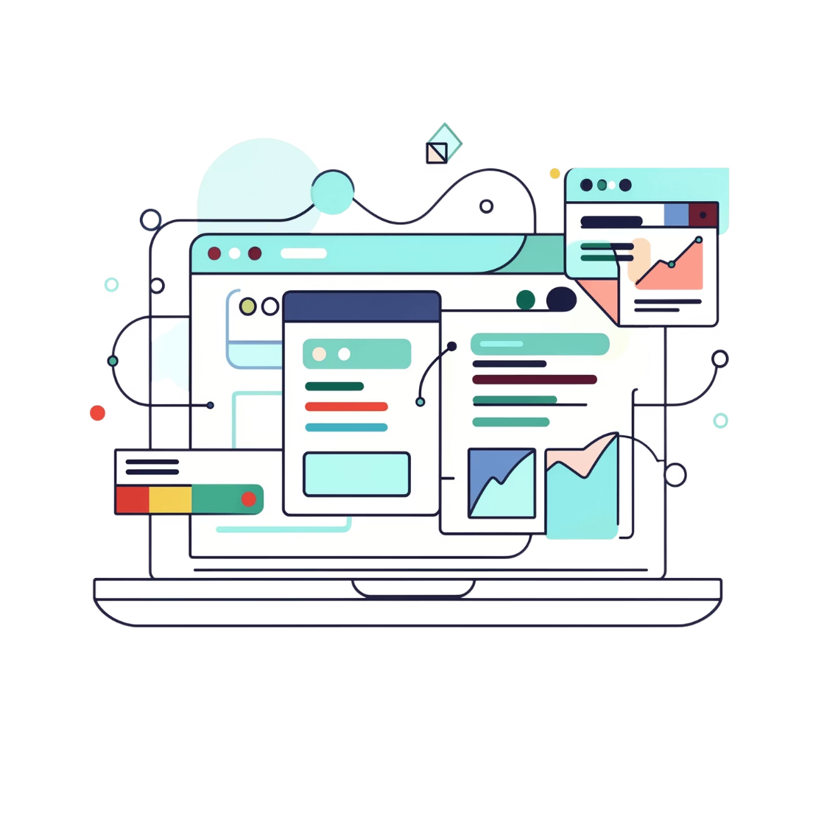
Technology Stack
Microsoft Excel
Python
Data cleaning and preprocessing
Analysis with Pandas, NumPy, Matplotlib, Seaborn
PostgreSQL
Power BI + DAX
Database storage and SQL querying
Interactive dashboard visualization and KPI reporting

Slide 4

Data Pipeline: From Raw to Ready
Excel Preprocessing
PostgreSQL Storage
Python EDA
A 1,000,000-row dataset was processed through this end-to-end workflow — zero null values after cleaning, with structured storage enabling seamless Power BI integration.

Slide 5
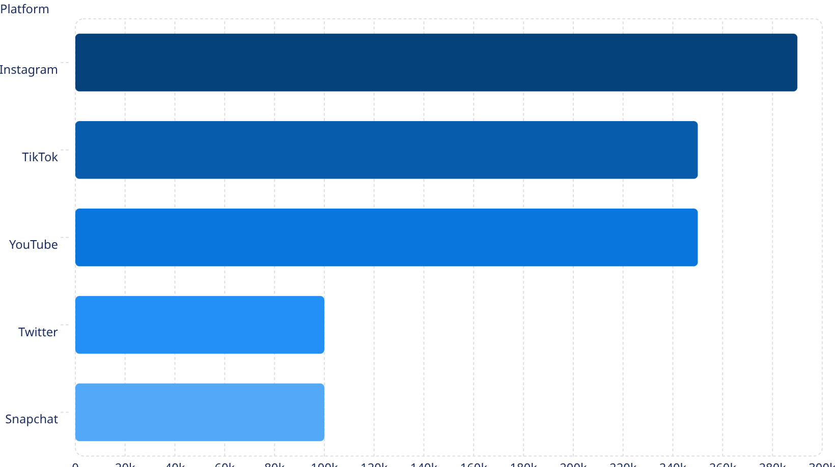
Python Analysis: Key Findings
Analytical Insights
Instagram led platform usage (~290K users), followed by TikTok and YouTube (~250K each).
Key correlations discovered:
Higher screen time → lower mental health scores (r = −0.76)
Medium addiction users formed the largest segment (~580K)
Working Gen-Z and Young Adults showed highest engagement

Slide 6
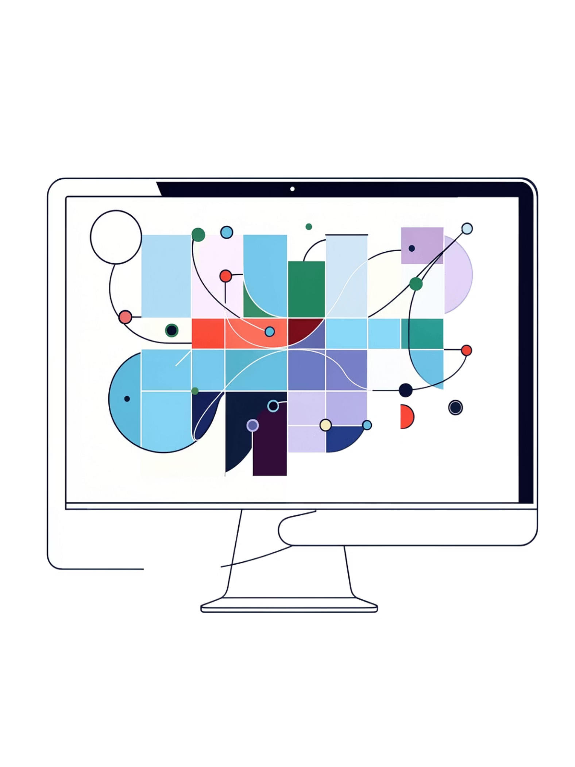
The Critical Correlation
−0.76
Poor → Higher Usage
Strong negative correlation between daily usage hours and mental health score
Median daily usage rises from 3.8 hrs (Average health) to 4.5 hrs (Poor health)
3.5 hrs
Consistent average daily usage across all 7 countries studied

Slide 7
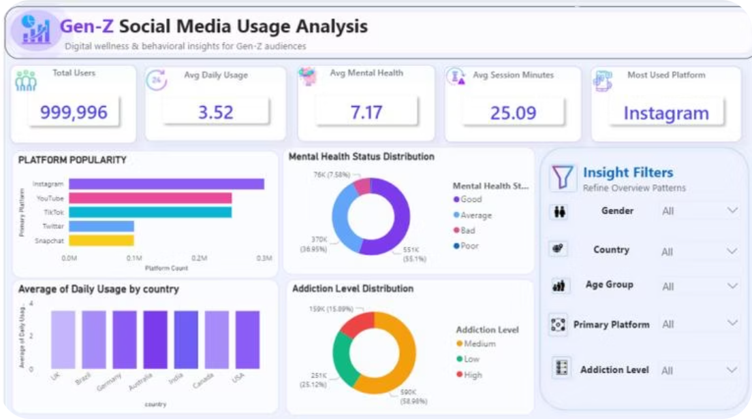
Power BI: Overview Dashboard
KPIS
Most used platform: Instagram. Features KPI cards, bar charts, doughnut charts, and interactive slicers.
999,996
3.52 hrs
7.17
25.09 min
Total Users
Avg Daily Usage
Avg Mental Health Score
Avg Session Minutes

Slide 8
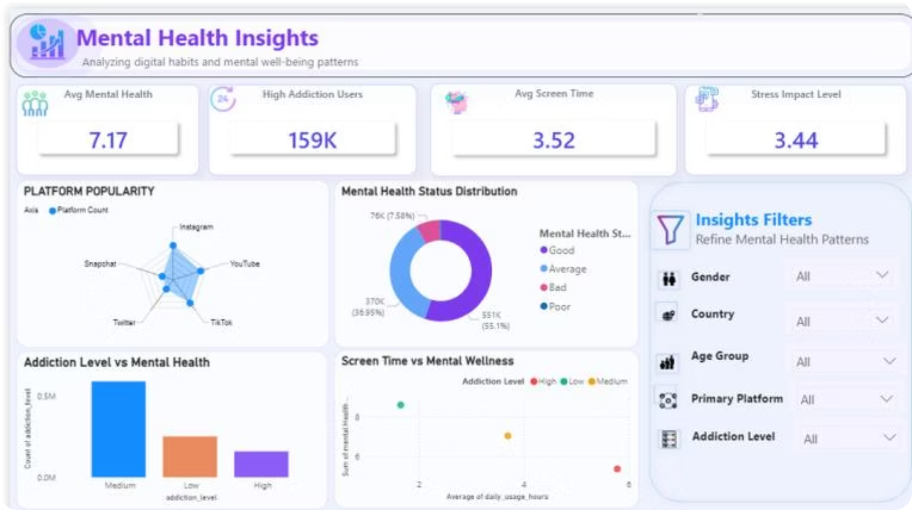
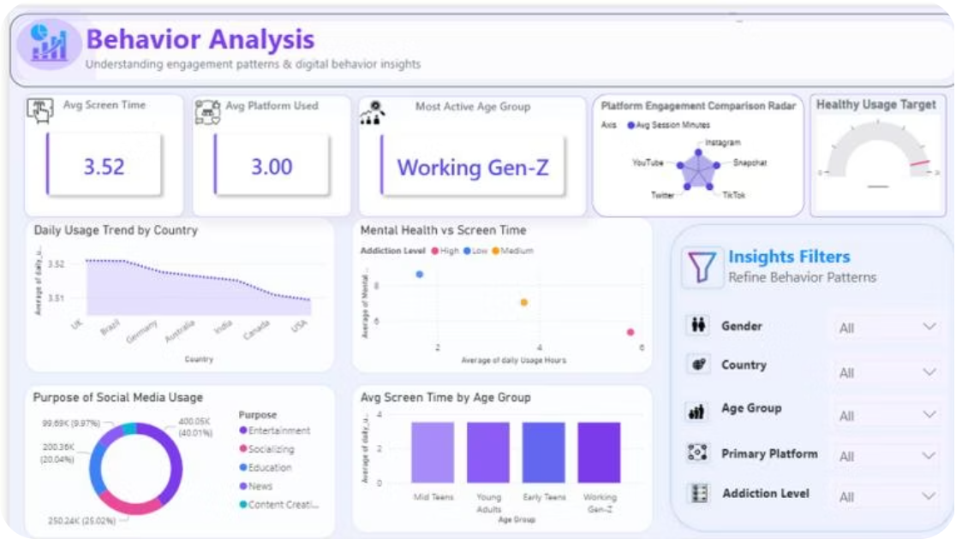
Behavior & Mental Health Dashboards
Behavior Analysis — Entertainment was the #1 usage purpose (40%); Working Gen-Z most active age group.
Mental Health Insights — 159K high-addiction users; 55% of users rated "Bad" mental health status.

Slide 9
DAX Measures & Dashboard Design
Key DAX Measures
UI Design Principles
Soft lavender analytics background with rounded KPI cards
Custom icons, interactive slicers, and filter panels
Consistent visual hierarchy across all 3 dashboard pages
Modern enterprise-style layout with balanced chart placement
Avg Screen Time
High Risk Users
AVERAGE(daily_usage_hours)
mental_health_score ≤ 4
Stress Impact Level
(AvgUsage × 2) − (AvgMental / 2) = 3.44

Slide 10
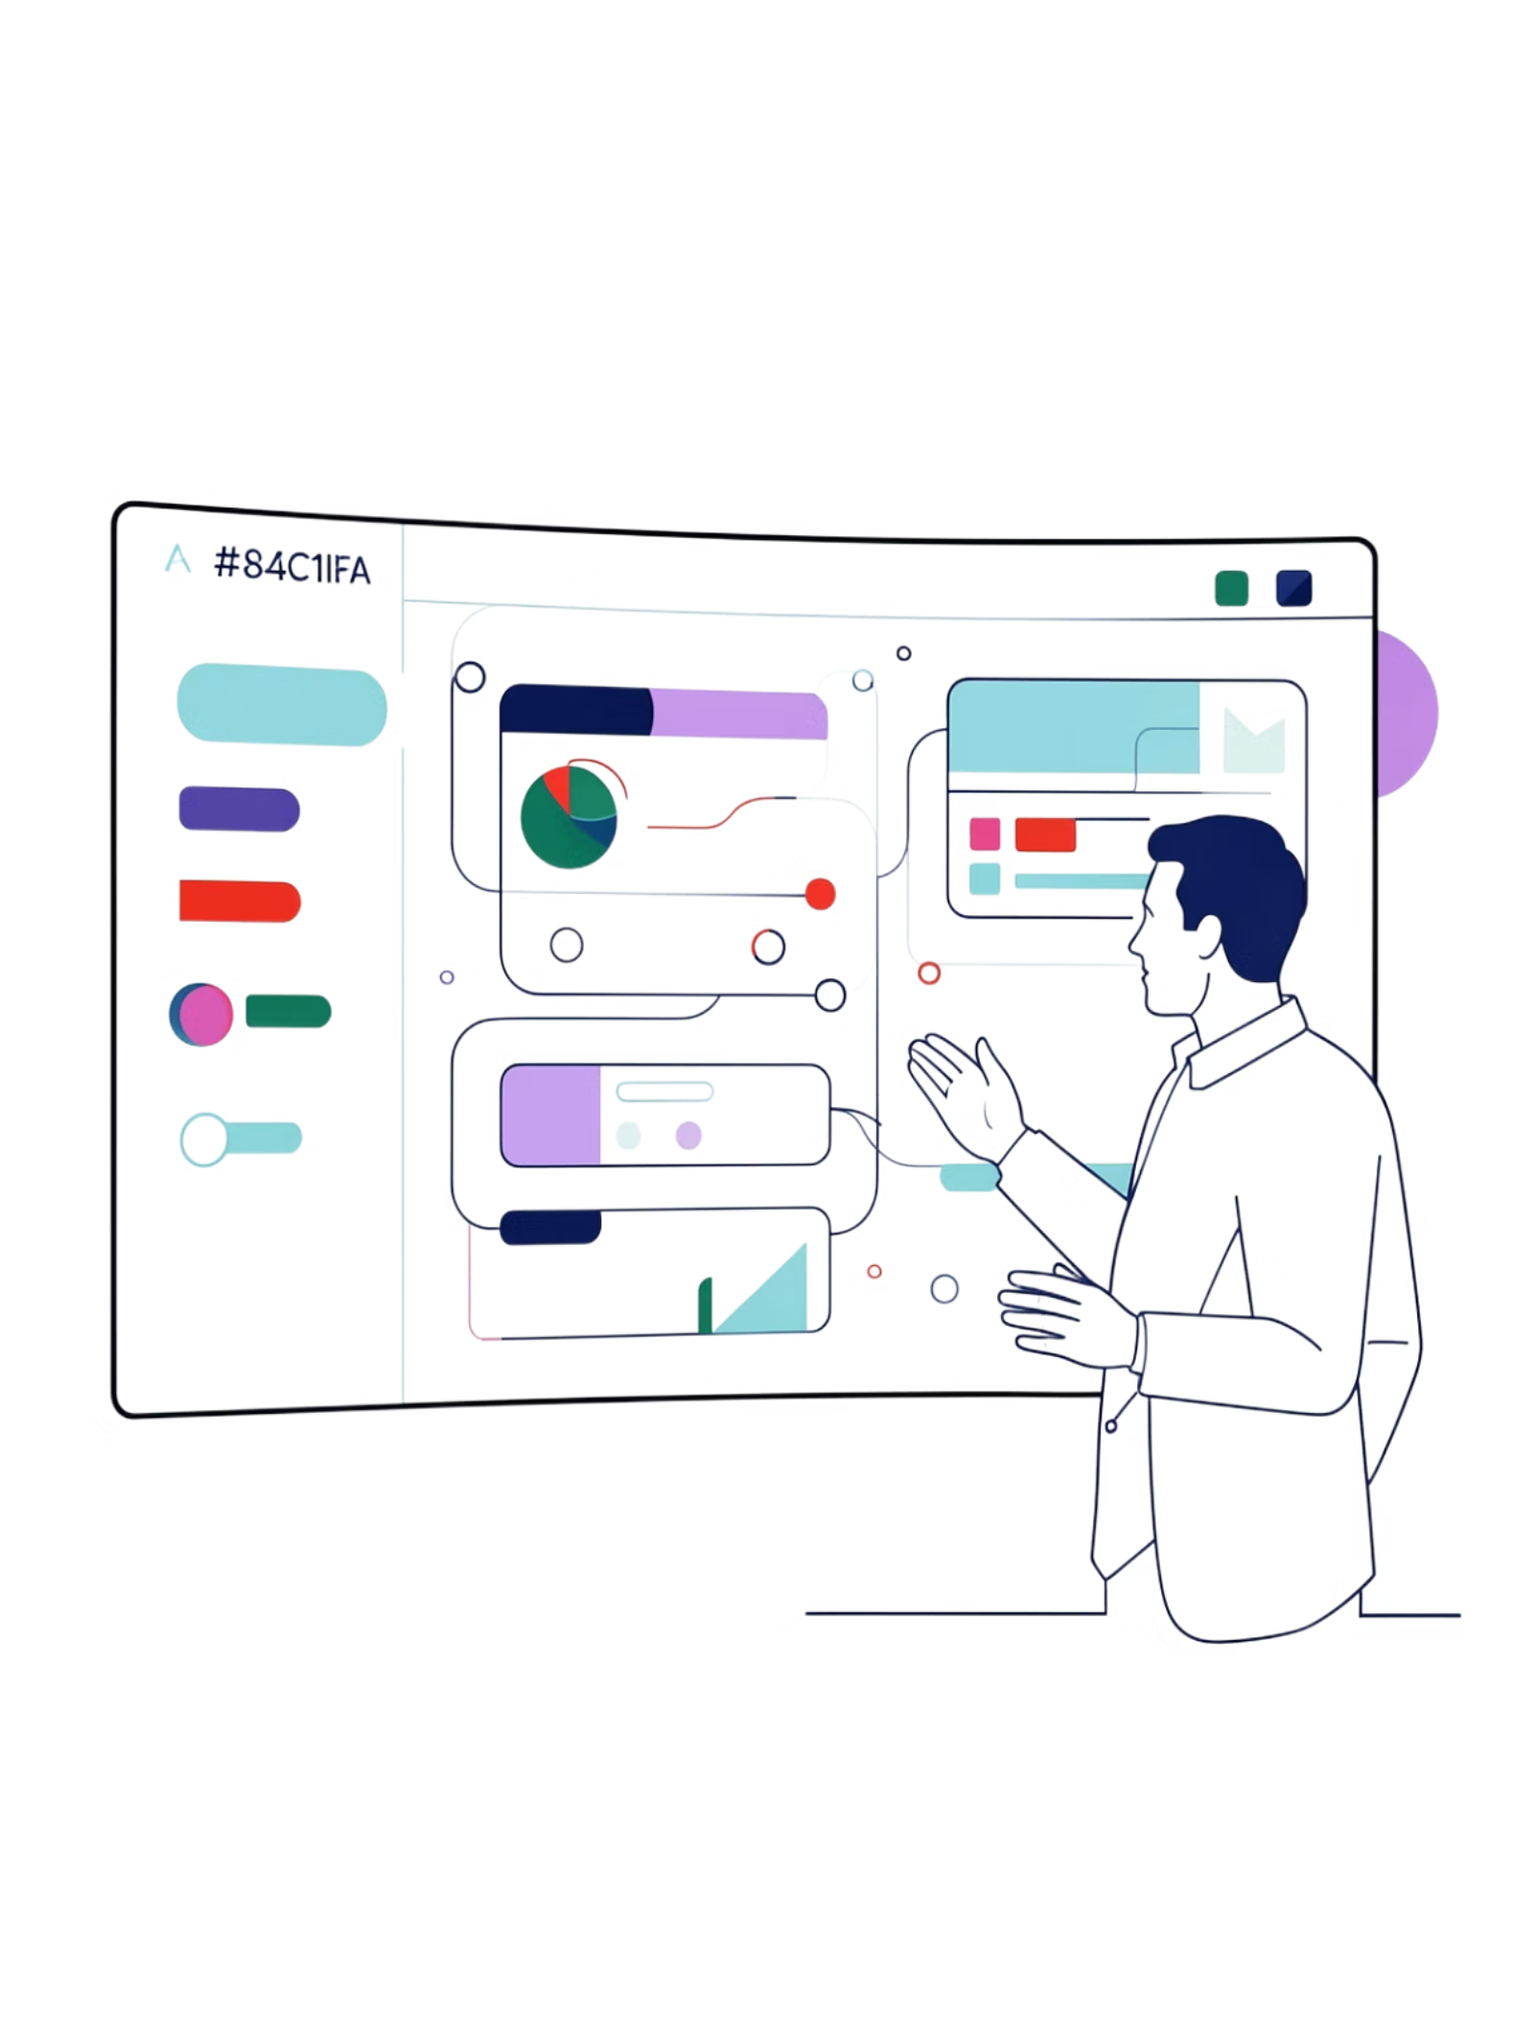

Outcomes & Future Enhancements
Project Outcomes
Future Enhancements
Professional multi-page Power BI dashboards
End-to-end analytics workflow: Excel → Python → PostgreSQL → Power BI
Skills gained in data cleaning, SQL, DAX, BI reporting, and UI/UX design
Portfolio-ready business intelligence project
Real-time data integration
AI-powered predictive analytics
Sentiment analysis using NLP
Mobile-responsive dashboard version
Advanced forecasting and recommendation systems
Supports digital wellness research, mental health analysis, and data-driven decision-making.

