Slide 1


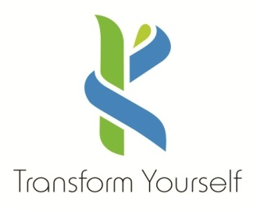



KONGU ENGINEERING COLLEGE
PERUNDURAI ERODE-638060
DEPARTMENT OF AI & DS
Medical ChatBot with RAG System
& Longchain
In association with:
Team Lead: DEEPANRAJ S (21ADR010)
Team Members: VIJAYAKUMARAN S ( 21ADR061)
VEENAS KUMAR S( 21ADR058)

Slide 2

The Problem
Many patients lack easy access to accurate and trustworthy medical information.
Difficulty navigating complex medical websites and understanding technical jargon.
Potential for misinformation and self-diagnoses based on unreliable sources.
Relying on inaccurate or incomplete information obtained from unreliable sources can lead to delays in seeking appropriate medical care or choosing ineffective treatments

Slide 3
The Solution
Develop a medical chatbot powered by a Retrieval-Augmented Generation (RAG) system.
Utilize Langchain for information retrieval, conversation management, and potentially chaining LLMs.
Chatbot will access a curated database of reliable medical resources (journals, textbooks).
Users can ask questions in natural language and receive clear, informative responses.

Slide 4
Flowchart / Product workflow
Source data
Web scrap
Raw data
Chunks
Sentence Embedding
Web search
(links)
Sentence embedding as vectors
Prompt
Binded with FAISS
Output
Mistral LLM
K sentence embedding

Slide 5
Technology Stacks Used
Programming Language: Python (widely used in AI and chatbot development)
Framework: TensorFlow or PyTorch (leading deep learning frameworks for LLM development)
Langchain: Enables modular chatbot architecture, information retrieval, and potentially LLM chaining.
Medical Information Database: Curated collection of trusted medical resources (e.g., PubMed Central)

Slide 6
Thank You !!

