Slide 1
Best Buddy
Team 15
Yeruva, Vijaya Kumari(Id: 47)
Junaid, Sidrah(Id: 15)
Goudarzvand, Saria(Id: 48)

Slide 2
Problem Statement:
An understanding of the development of emotional knowledge can help us determine which mood other people are. Nowadays finding people that are like you in terms of emotional aspect is hard. This application can assist us detecting people that have the same emotions. We are doing this with analyzing twitter data.

Slide 3
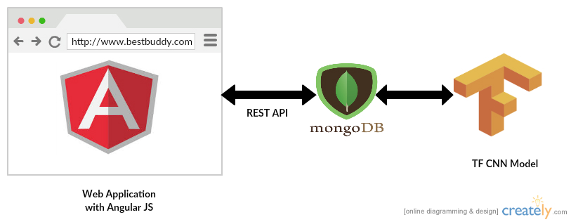
Architecture:

Slide 4
About Technologies, Data Set and Model
Angular JS for web application development
MongoDB to store the data
Python and Tensor Flow for building the Deep Learning Model
Trained the model with Twitter Data having two categories - Happy and Un happy
Training Data – 90% , Testing Data – 10% (cross validation)
Accuracy – 73. 0769
Implemented the CNN deep learning model

Slide 5
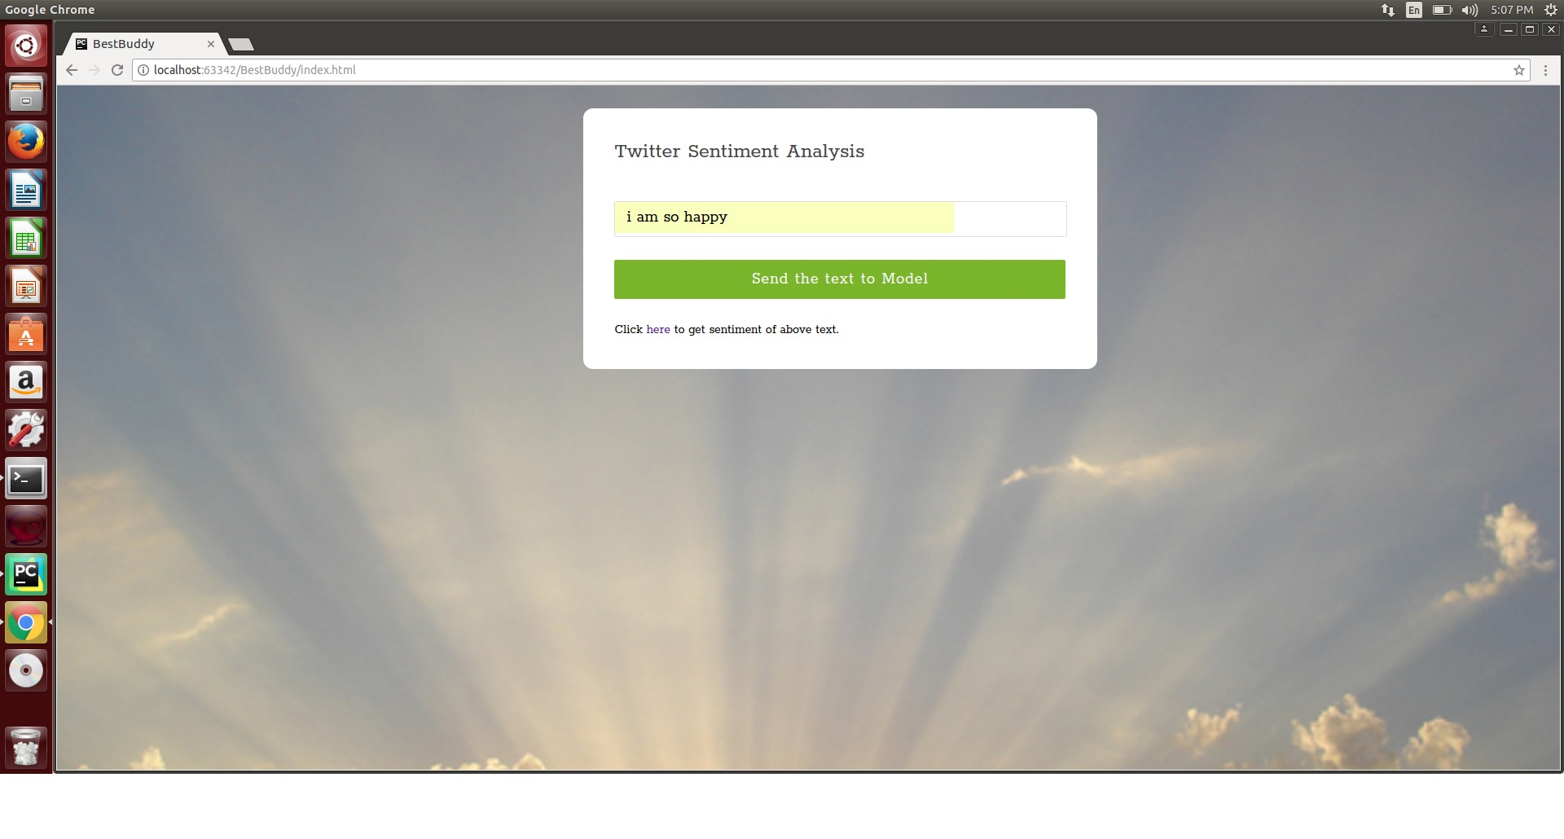
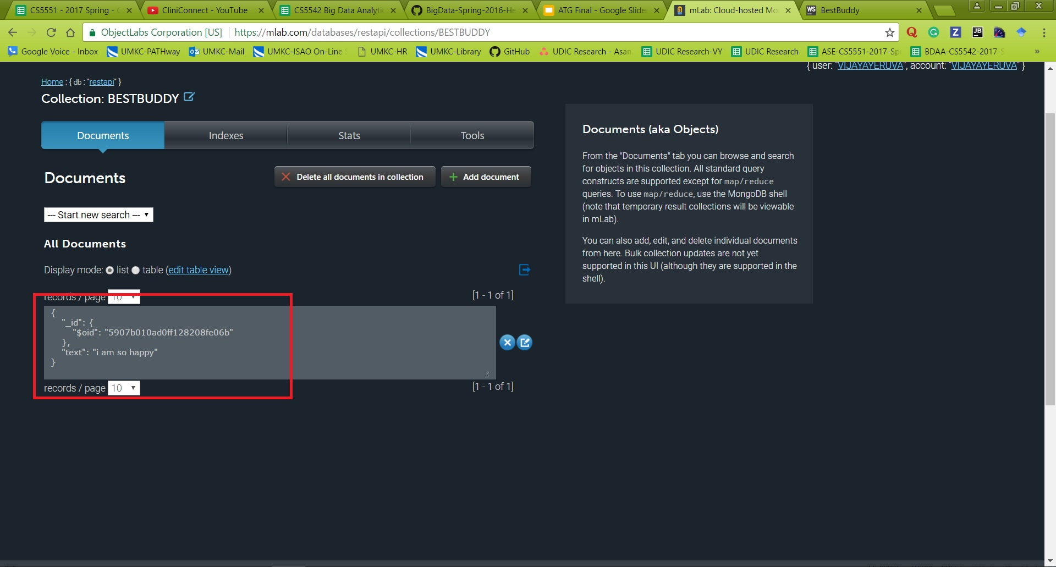
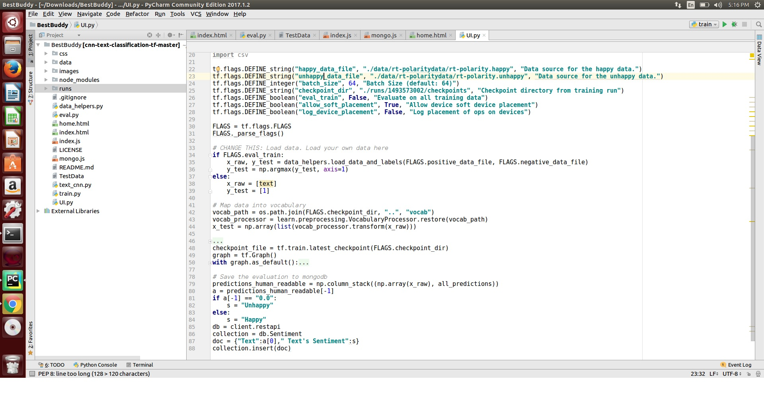
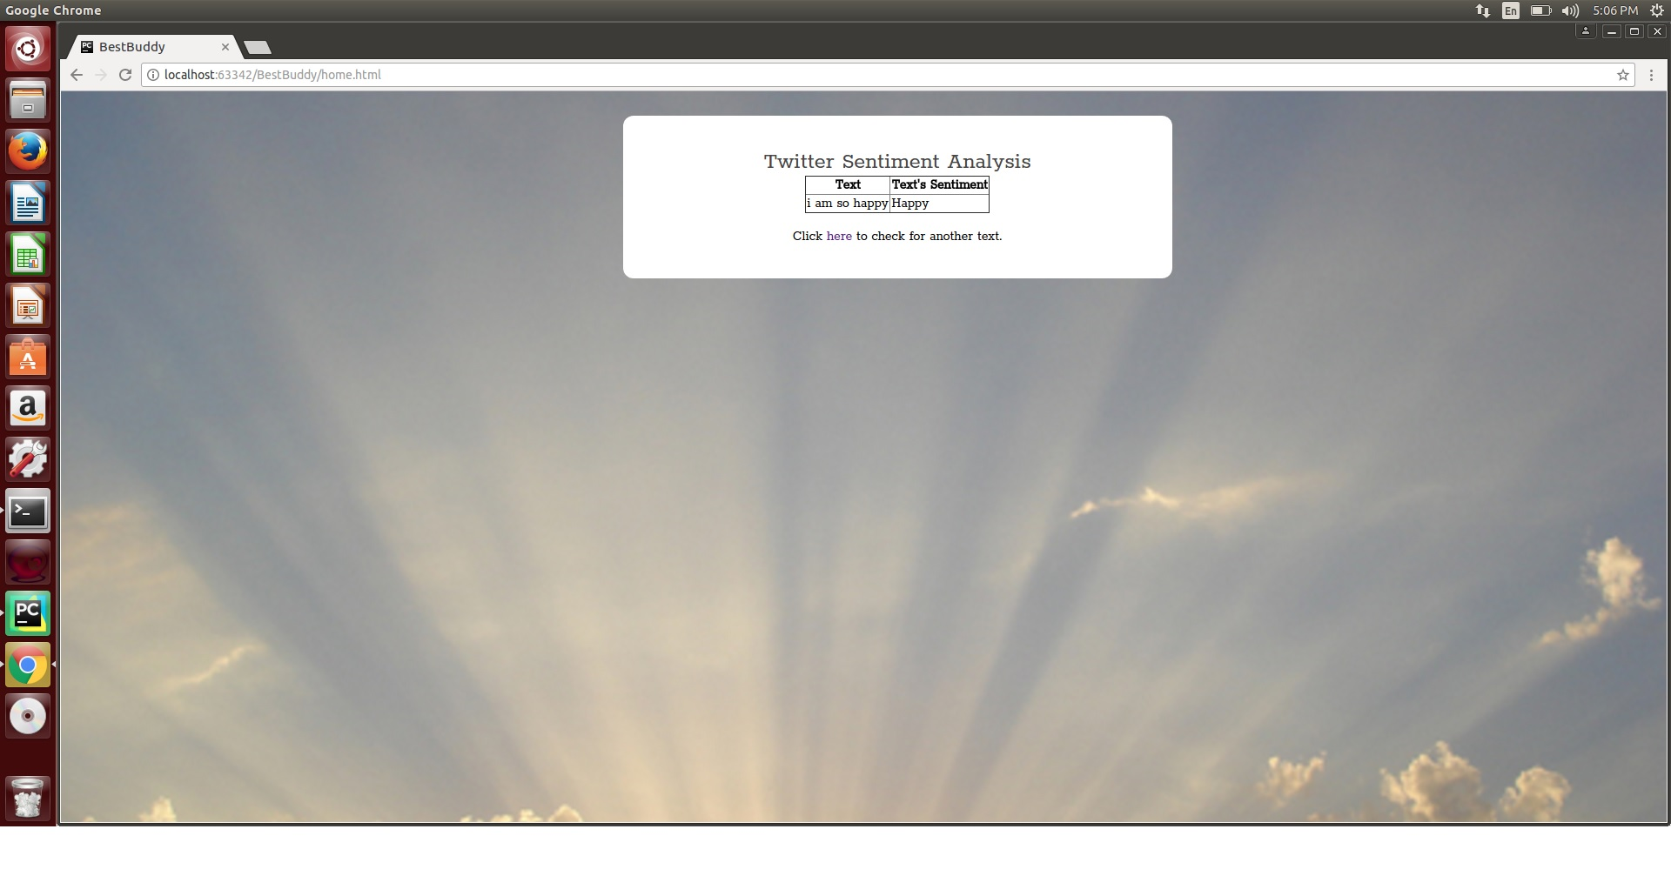
Implementation

Slide 6
Credits
This work was done in partial fulfillment of the requirements of CS5542: Big Data Analytics and Apps, CSEE Department, University of Missouri – Kansas City (Spring 2017). Instructors: Dr. Yugyung Lee, Chandra Shekar, Mayanka, TAs: Maddula, Manikanta, Peddinti, Sudhakar Reddy, Vadlamudi, Naga K.

