Slide 1
Character and Face Recognition
Using Back Propagation Algorithm
BY,
VIGNESH AND RAVI

Slide 2
INTRODUCTION
NEURAL NETWORKS !!!!!

Slide 3



Slide 4


Slide 5
HUMAN BRAIN – PRIMARY VISUAL CORTEX-CONTAINS 140 MILLION NEURON – SUPERCOMPUTER – TUNED BY EVOLUION OVER MILLIONS OF YEARS!

Slide 6


Slide 7
ITS YOUR B’DAY AND YOUR CHILDHOOD FRIEND WHO YOU HAVE NOT SEEN IN YEARS SUDDENLY APPRERS BEFORE YOU SHOUTING “SURPRISE !!!!HAPPY BDAY MACHAAAA!!! “
WILL YOU ASK “ DUDE WHO ARE YOU ? ”
OR WILL YOU TELL “MACHAAA!!! THANKS DA”

Slide 8

HOW IS OUR BRAIN ABLE TO DO THAT?

Slide 9
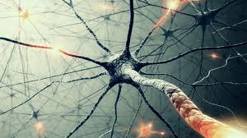
ANS IS NEUROOOONNNN!!!! (DON’T TELL ABOUT WEIGHTS AND BIAS NOW )

Slide 10
HOW CAN WE MAKE A COMPUTER DO THAT ?
SIMPLE YAR !!!! TYPE 100 LINES OF COMPUTER CODE AND IT WILL FIGURE OUT WHATEVER YOU WANT ;)
BUT ……….
The difficulty of visual pattern recognition becomes apparent if you “ATTEMPT” to write a computer program to recognize digits like those BELOW.

Slide 11
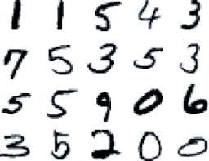

Slide 12
NEURAL NETWORKS
Neural networks approach the problem in a different way. The idea is to take a large number of handwritten digits, known as training examples and then develop a system which can learn from those training examples. In other words, the neural network uses the examples to automatically infer rules for recognizing handwritten digits.

Slide 13
SO IF OUR OBJECTIVE IS only to write a computer program to recognize handwritten digits, then the WORKSHOP would be much shorter! But along the way we'll develop many key ideas about neural networks, including two important types of artificial neuron (the perceptron and the sigmoid neuron), and the standard learning algorithm for neural networks, known as stochastic gradient descent.

Slide 14
PERCEPTRON ,WEIGHTS AND BIAS ☺

Slide 15
WHAT IS A PERCEPTRON? HOW DO PERCEPTRONS WORK ?
PERCEPTRON IS A ARTIFICIAL NEURON .
A perceptron takes several binary inputs, x1,x2,…x1,x2,…, and produces a single binary output:

Slide 16
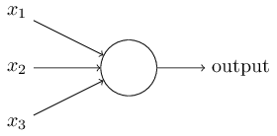

Slide 17
In the example shown the perceptron has three inputs, x1,x2,x3
The neuron's output, 0 or 1, is determined by whether the weighted sum ∑jwjxj is less than or greater than some threshold value.
output={ 0 if ∑jwjxj≤ threshold,
1 if ∑jwjxj> threshold.
WAIT WAIT WAIT !!!! WILL I REMEMBER IT AFTER SOME DAYS ?
UMMM ……I MIGHT FORGET ☹

Slide 18
the WEEKEND is coming up, and you've heard that there's going to be a PROBE in NITT. You are trying to decide whether or not ????
You MIGHT make your decision by weighing up three factors:
WILL IT BE USEFUL?Learn something new?
Does your BF or GF or FRIENDS want to accompany you?
HAVE A MORE IMPORTANT WORK THAN THIS ??

Slide 19




Slide 20
Now, suppose you absolutely adore PROBE, so much so that you're happy to go to the festival even if your boyfriend or girlfriend is uninterested.. But perhaps you IF YOU realLY HAVE SOME OTHER IMPORTANT WORK, and there's no way you'd go to NIT, THE PLAN HAS TO BE DROPPED.
One way to do this is to choose a weight w1=3, and w2=2 and w3=5 for the other conditions.
Finally, suppose you choose a threshold of 5 for the perceptron.

Slide 21
LEARNING
HOW CAN YOU MAKE A MACHINE LEARN ????
In fact, a small change in the weights or bias of any single perceptron (CONSIDER THE ABOVE EXAMPLE ,ITS LIKE DIGITAL MARKING )in the network can sometimes cause the output of that perceptron to completely flip, say from 0 to 1.
That makes it difficult to see how to gradually modify the weights so that the network gets closer to the desired behaviour.

Slide 22
We can overcome this problem by introducing a new type of artificial neuron called a sigmoid neuron,similar to perceptrons(THEY HAVE MULTIPLE INPUTS AND A SINGLE OUTPUT)

Slide 23
SIGMOID NEURON
Just like a perceptron, the sigmoid neuron has inputs, x1,x2,…x1,x2,…. But instead of being just 0 or 1, these inputs can also take on any values between 0 and 1.
σ(z)≡1/1+e−z
Where (z=w.x+b )
we will come back to this while learning MNIST DATABASE.

Slide 24
SUMMARY AS OF NOW ….
SO NOW YOU WOULD GOT A GENERAL OUT LINE OF WHAT WE ARE TRYING TO DO HERE WITH SOME PROCCESS CONNECTING ALL THE TOPICS DISCUSSED ABOVE .

Slide 25
SOME COMMON TERMS WE WILL BE USING HEREAFTER…
INPUT ,HIDDEN ,OUTPUT LAYER – INPUT IMAGE VECTOR – OUTPUT VECTOR
NO OF UNITS IN THE INPUT LAYER – NO OF HIDDEN UNITS - WEIGHTS
FEED FORWARD MECHANISM -BACK PROPAGATION
ETC…..
DON’T BE AFRAID THESE ARE SIMPLE TO LEARN !☺

Slide 26
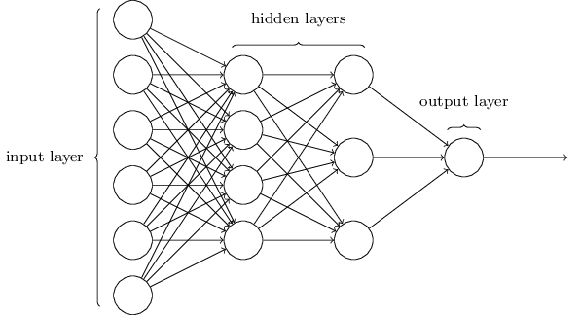
ARCHITECTURE OF NEURAL NETWORK
the leftmost layer in this network is called the input layer, and the neurons within the layer are called input neurons.
The rightmost or output layer contains the output neurons, or, as in this case, a single output neuron.
The middle layer is called a hidden layer, since the neurons in this layer are neither inputs nor outputs.
These multiple layer networks are sometimes called multilayer perceptrons

Slide 27
MNIST DATABASE
The MNIST database (Mixed National Institute of Standards and Technology database) is a large database of handwritten digits
It contains 60,000 training images and 10,000 testing images.
Wherein each image in the database has a resolution of 28 x 28 pixels.
You will come to know the importance of this resolution in sometime.

Slide 28
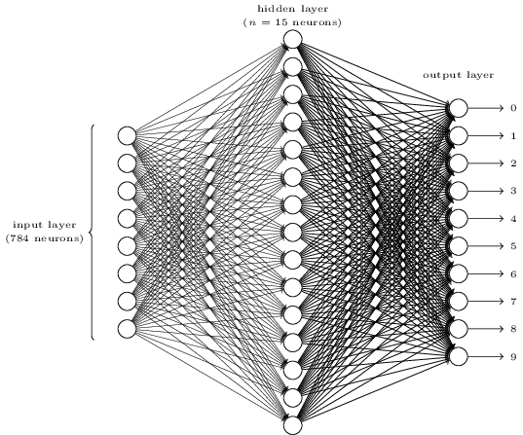
NEURAL NETWORK FOR CLASSIFICATION OF HANDWRITTEN DIGITS

Slide 29
CLASSIFICATION OF HANDWRITTEN DIGITS
The input layer of the network contains neurons encoding the values of the input pixels.
Since the resolutions of each image in the database is 28x28(=784) , there are 784 neurons in the input layer.
The second layer of the network is a hidden layer. We denote the number of neurons in this hidden layer by n, and we'll experiment with different values for n.

Slide 30
The output layer of the network contains 10 neurons. If the first neuron fires, i.e., has an output ≈1, then that will indicate that the network thinks the digit is a 0.
If the second neuron fires then that will indicate that the network thinks the digit is a 1. And so on…….
You might wonder why we use 10 output neurons. After all, the goal of the network is to tell us which digit (0,1,2,…,9) corresponds to the input image.

Slide 31
LEARNING WITH GRADIENT DESCENT
Now that we have a design for our neural network, how can it learn to recognize digits? The first thing we'll need is a data set to learn from - a so-called training data set.
TO START OF WE WILL FIRST DEFINE WHAT IS A
COST FUNCTION.
C(w,b)≡1/2n{∑x∥y(x)−a∥^2}
Where n is the total number of training images.
y(x) is the output of the neural network for a given input x.
“a” is the expected output.

Slide 32
So the cost function is also known as the mean squared error.
we want to find a set of weights and biases which make the cost as small as possible. We'll do that using an algorithm known as gradient descent.
In order to minimize the cost function, weights need to be updated.
Final Weight=Initial Weight-learning rate*(rate of change of cost function with respect to weights)
Error in any layer is defined as the rate of change of cost function with input.Denoted by δ(l).

Slide 33
Where w(l+1) is the weight matrix in the l+1-th layer .
δ(l) is the error in the L-th layer .
δ(l+1) is the error in the L+1 th layer .
So in order to find the error in the L-th layer , we need to first find the error in the L+1th layer.
So we need to back propagate to update the weights in order to minimize the cost function.
THIS IS BACK PROPAGATION ALGORITHM.

Slide 34
LETS MOVE ON TO MATLAB…..

Slide 35
TASKS
TASK 1:
CHANGE THE NUMBER OF HIDDEN UNITS FROM 300 TO 150
WHAT IS THE CLASSIFICATION ACCURACY????
CLASSIFICATION ACCURACY IS 90.72%
TASK2:
CHANGE THE NUMBER OF HIDDEN UNITS TO 400
WHAT DO YOU INFER???
CLASSIFICATION ACCURACY IS 89.79%

Slide 36

TASK 3:
CHANGE THE NUMBER OF EPOCHS FROM
15000 TO 1500(for batch size of 100)
WHAT IS THE CLASSIFICATION ACCURACY????
CLASSIFICATION ACCURACY IS 11.35%
NOW YOU KNOW THE IMPORTANCE OF EPOCHS
TASK4:
CHANGE THE NUMBER OF EPOCHS TO 50000(for batch
size of 100)
WHAT DO YOU INFER???
CLASSIFICATION ACCURACY IS 93.9%

Slide 37
FINAL TASK:
CHANGE THE BATCH SIZE TO 50 AND EPOCHS TO 50000
WHAT IS THE CLASSIFICATION ACCURACY???
WE GET 94.13%!!!!!!!!!!!
IS THIS THE MAXIMUM ACCURACY THAT CAN BE OBTAINED???

Slide 38
TRY TO CHANGE
LEARNING RATE
NUMBER OF HIDDEN UNITS
BATCH SIZE
EPOCHS
TO GET THE MAXIMUM ACCURACY?

