Slide 1
Sentiment Analysis for Stock Prediction
Efrain Galarza,
Vijay Gandhi,
Durga Kasireddy

Slide 2
Introduction & Motivation for the Problem
Stock market investment plays in a key role in the finance sector. However, the complexity of the stock market makes it very hard to predict
Sentiment of traders and investors is an important factor on stock price movements
Analyzing sentiment from news articles related to the stock market can hopefully help us determine whether a stock price will go up or down
In this project we will use the BERT model to predict the sentiment of news articles headlines and use that as a predictor for stock price movements

Slide 3
Description of the Dataset
For training of the BERT model:
We used a finance news dataset, obtained from Kaggle, that included financial news text and their sentiment labels (positive, neutral, negative) from investors’ perspectives.
For testing of the model:
We used a Reddit News Headlines dataset from Kaggle from 2006 to 2016. It included the top 25 headlines for Apple for every day in that date range. We grouped all the headlines into a single text feature. We also obtained daily stock information from Yahoo Finance within the same date range and calculated the price change for each day for Apple. We normalized this change by subtracting the price change for the S&P 500 for the same day. We then labeled whether Apple’s stock went up that day (normalized change > 0%) or went down (normalized change < 0%)
https://www.kaggle.com/ankurzing/sentiment-analysis-for-financial-news
https://www.kaggle.com/aaron7sun/stocknews?select=RedditNews.csv

Slide 4
Details of the Model
We tried random forest classifier using Tf-Idf vectorisation technique. But we achieved a very low accuracy on training set that we switched to a neural network model.
We use the standard BERT model to analyse the sentiment of the text. We added two layers at the end, a linear layer and a softmax layer which gives 2 outputs. 1 for positive or neutral news. 0 for negative news.
We fine tuned the model on finance news dataset to find optimal hyperparameters. In our case, the learning rate is 3e-05, max sequence length is 160, batch size is 16, epochs are 15

Slide 5

Positive Sentiment WordCloud

Slide 6

Negative Sentiment WordCloud

Slide 7
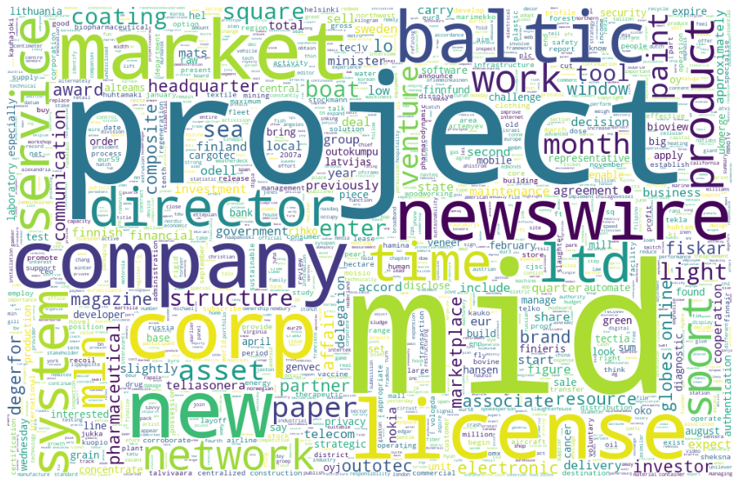
Neutral Sentiment WordCloud

Slide 8
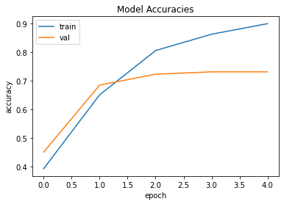
Training the BERT Model
BERT model is trained on financial news analysis dataset for predicting the sentiment of the news (positive, negative or neutral).
Financial news dataset source: https://www.kaggle.com/charlessamuel/financial-news-analysis-bert
The dataset contains 4832 financial news headlines from retail investor’s perspective and its sentiment.
BERT model training and validation accuracies vs epochs

Slide 9
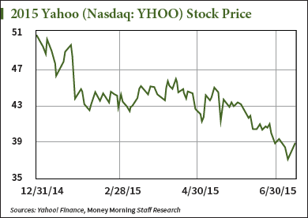
Stock Movement Prediction using BERT
For predicting the stock prices, we used Yahoo finance API that has opening and closing prices of the stocks for each date.
We also scraped the Reddit news headlines for each day, predicted the sentiment using BERT and compared it with labels obtained from Yahoo finance.

Slide 10
Stock Movement Prediction Results
We managed to achieve 53.8% accuracy for the prediction of stock movement.
The low accuracy isn’t surprising because of the complexity of the problem we are dealing with. Predicting the stock price movement is still a open unsolved problem. It is especially difficult because of the large number of factors the stocks depends on.
In this project, we considered just one but an important factor of Sentiment to tackle the problem.

Slide 11
Future work
Use other contextual information features in addition to sentiment to improve the model accuracy.
Train a LSTM model that accepts multiple input features to achieve high accuracy.

