Slide 1
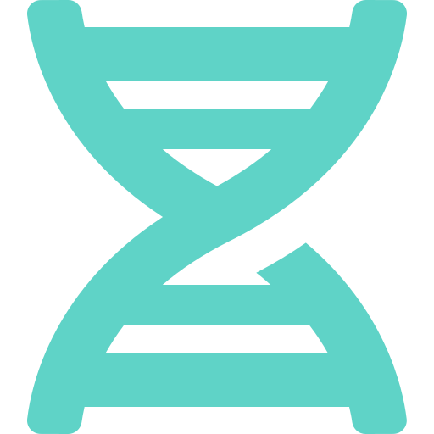
Advance Genome Disorder Prediction Model Empowered With Deep Learning
GeneScope: predicting genetic diseases from lab tests and genetic markers
Presented by: Your Name
Guide: Supervisor Name
Notes:
Good morning. Our project is an advanced genome disorder prediction model powered by deep learning. We call the system GeneScope. It predicts which genetic disease a patient most likely has, using blood tests and genetic markers.

Slide 2



Problem statement
Genetic diseases are common
Many tests, hard to read together
Early screening saves time
Thalassemia, sickle cell and cystic fibrosis affect millions of people and are often found late.
Doctors must combine blood values and genetic markers by hand to reach a diagnosis.
A fast first estimate helps decide which confirmatory test to order next.
Notes:
Genetic diseases are common, but they are often diagnosed late. A doctor has to look at many blood values and genetic markers together. Our idea is to support early screening with a model that gives a fast first estimate.

Slide 3





Project objectives
Use a clean genetic disease dataset
Patients with lab results and genetic markers for 5 diseases
Build a deep learning model
Goal
A neural network that learns the pattern of each disease
Predict which of 5 genetic diseases a patient most likely has, accurately and honestly measured on patients the model has never seen.
Compare it fairly
Against 5 machine-learning models, tested on unseen patients
Make it usable
A web app: enter test results and get the prediction with a confidence score
Notes:
We had four objectives: use a clean dataset, build a deep learning model, compare it fairly with classic machine-learning models, and make it usable through a web app.

Slide 4
Our journey to a better dataset
62%
Data
96%
Step 1
Step 2
Step 3
Original dataset
Analysed the problem
Better dataset + deep learning
22,000 records (HackerEarth). Mostly random columns; best honest accuracy was 62%.
Found the data itself was the limit: noise cannot be fixed by a better model.
Clean genetic disease dataset and a PyTorch neural network.
Notes:
We first worked on the original dataset of about 22,000 records. After analysis we found most columns were random, so even the best honest model reached only 62 percent. So we moved to a cleaner genetic disease dataset and built a deep learning model, which reached 96 percent.

Slide 5
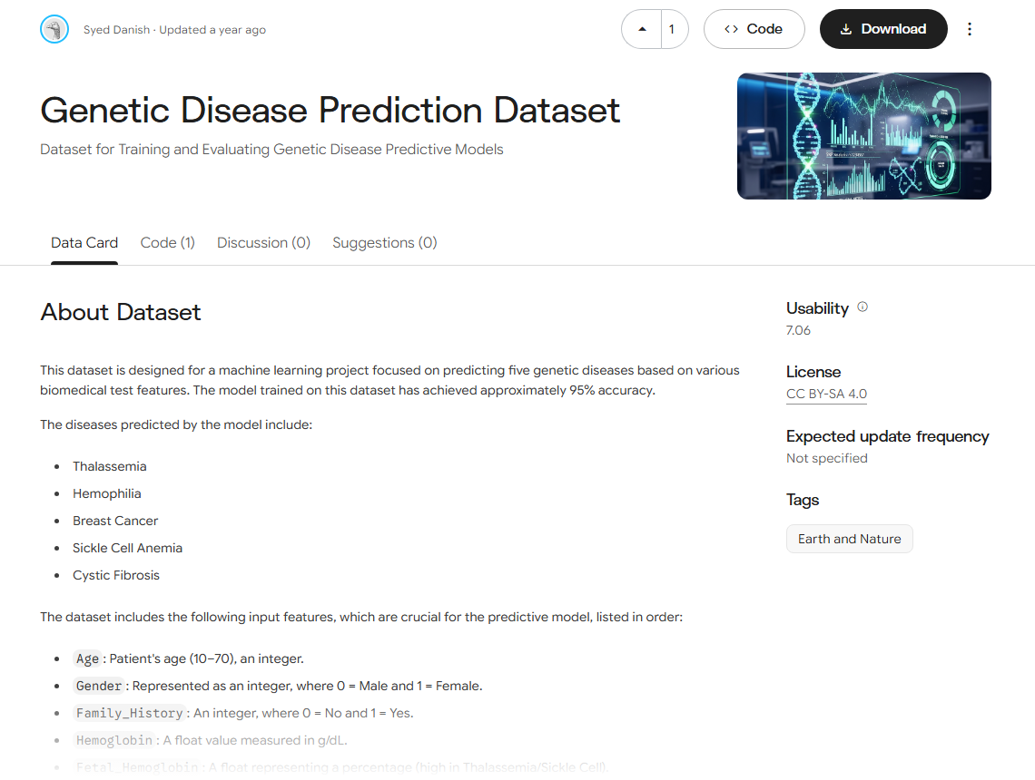
Dataset: Genetic Disease Prediction Dataset
1,000
patients
5
genetic diseases
12
input features
200
patients per disease
Source: kaggle.com/datasets/syeddanish5/genetic-disease-prediction-dataset (CC BY-SA 4.0)
Notes:
We used the Genetic Disease Prediction Dataset from Kaggle. It has 1,000 patients, 5 genetic diseases with 200 patients each, and 12 input features from blood tests and genetic markers.

Slide 6
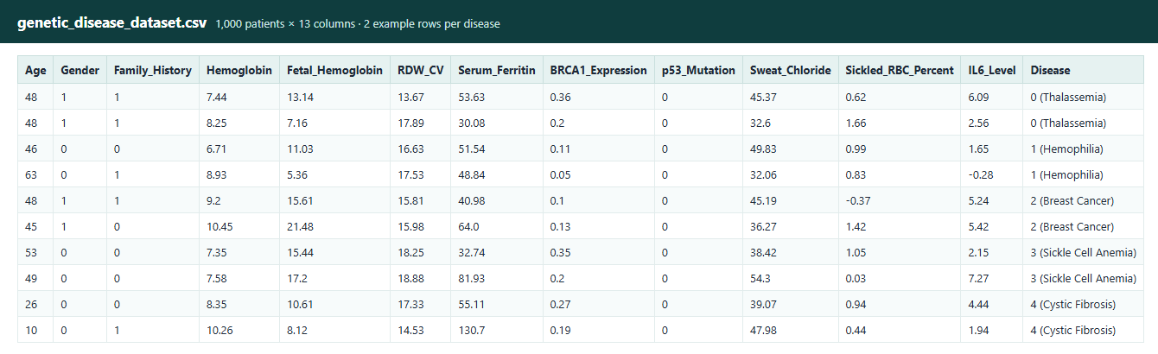




What the data looks like
Patient
Blood tests
Genetic markers
Other tests
Age, Gender, Family history
Hemoglobin, HbF, RDW-CV, Ferritin, Sickled RBC
BRCA1 expression, p53 (TP53) mutation
Sweat chloride, IL-6 level
Notes:
Here are real rows from the dataset. Each row is one patient. The 12 inputs fall into four groups: patient details, blood tests, genetic markers and other tests. The last column is the disease.

Slide 7




The 5 genetic diseases we predict
Thalassemia
Hemophilia
Breast Cancer
Sickle Cell Anemia
Cystic Fibrosis
Key sign
Key sign
Key sign
Key sign
Key sign
Low hemoglobin, high fetal hemoglobin (HbF)
Inherited clotting-factor disorder; blood does not clot properly
High BRCA1 expression, p53 (TP53) mutation
High share of sickled red blood cells
High sweat chloride (60 mmol/L or more)
Notes:
The model predicts five genetic diseases. Each has a typical sign in the data: thalassemia shows low hemoglobin and high fetal hemoglobin, breast cancer shows high BRCA1 and p53 mutation, sickle cell shows sickled red cells, and cystic fibrosis shows high sweat chloride.

Slide 8





System pipeline
1
2
3
4
5
6
Ingestion
Validation
Preprocessing
Training
Evaluation
Web app
Original file kept safe; a working copy is used
Missing values, duplicates, labels checked
Cleaning and an 80 / 20 train-test split
Deep neural network + 5 ML models, 5-fold CV
Scores on 200 unseen patients
FastAPI backend + HTML/CSS/JS frontend
Built in Python with pandas, scikit-learn, XGBoost and PyTorch.
Notes:
The system has six steps: data ingestion, validation, preprocessing with an 80/20 split, training, evaluation on unseen patients, and finally a web app. Everything is written in Python.

Slide 9
Deep learning model (PyTorch)
128
How it is trained
64
12
32
Adam optimizer, cross-entropy loss
Mini-batches of 32 patients
15% of training data used for validation
Early stopping: training stops when validation loss stops improving; best weights kept
Dropout + BatchNorm prevent overfitting
5
Input
Dense 128
Dense 64
Dense 32
Output
12 features
BatchNorm · ReLU · Dropout
BatchNorm · ReLU · Dropout
BatchNorm · ReLU · Dropout
5 diseases (softmax)
Notes:
Our deep learning model is a fully connected neural network built with PyTorch. It has three hidden layers of 128, 64 and 32 neurons, each with batch normalisation, ReLU activation and dropout. The output layer gives a probability for each of the five diseases. It is trained with the Adam optimizer and early stopping.

Slide 10

Deep learning vs machine-learning models
Selected: Deep Neural Network
Most reliable probabilities of all models (lowest log loss), so its confidence scores can be trusted
96.0% accuracy on the 200 unseen patients, the best final score
Train 95.6% ≈ test 96.0%: no overfitting
Notes:
We compared the neural network with five machine-learning models using 5-fold cross-validation. All models are close, around 94 to 95 percent, which shows the dataset is clean. The neural network was selected because it gives the most reliable probabilities, and it reached 96 percent on the unseen test patients.

Slide 11
Results on 200 unseen patients
96.0%
0.960
0.979
97.5%
Accuracy
F1 score
AUC
Top-2 accuracy
Precision 96.1% · Recall 96.0% · Random guessing would score only 20.5%
The test patients were held back before training, so these scores show how the model performs on new patients.
Notes:
On 200 patients the model never saw, it reached 96 percent accuracy, an F1 score of 0.96 and an AUC of 0.979. The correct disease is in its top two answers 97.5 percent of the time. Random guessing would only get about 20 percent.

Slide 12
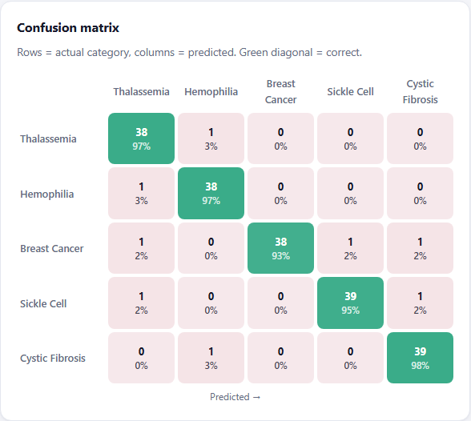
Every disease is predicted well
Confusion matrix: 192 of 200 test patients correct (green diagonal).
Notes:
All five diseases score between 95 and 96 percent F1. The confusion matrix shows 192 of the 200 test patients were classified correctly; only 8 were mixed up.

Slide 13

Which tests matter most
The model learned real medical signs
Sickled red cells → Sickle cell anemia
BRCA1 → Breast cancer
Sweat chloride → Cystic fibrosis
Ferritin and fetal hemoglobin → Thalassemia
Notes:
To check what the model relies on, we shuffled each test and measured the drop in accuracy. The most important tests are exactly the known medical markers: sickled red cells, BRCA1 and sweat chloride. So the model learned real medical patterns.

Slide 14
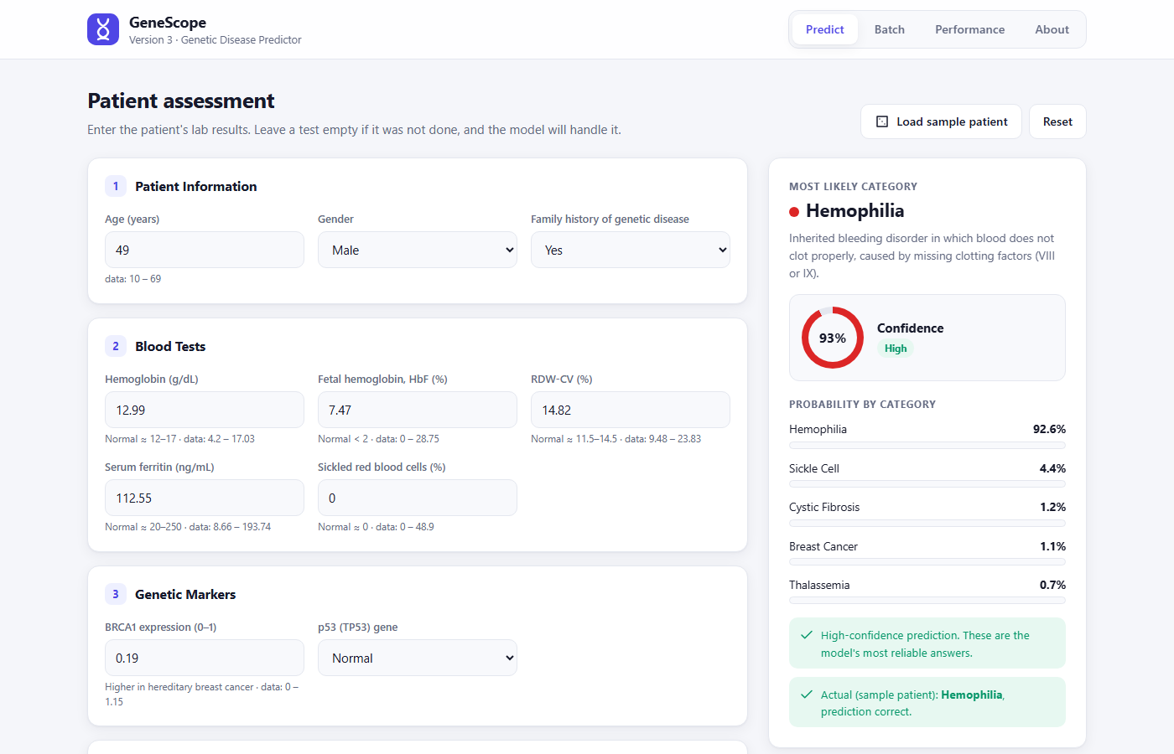
Web application: predict a patient
Enter lab results and genetic markers
Shows the predicted disease with a short explanation
Confidence ring and probability for every disease
Load sample patient: a real unseen patient with the correct answer shown
Batch page: upload a CSV for many patients
Notes:
This is our web app. The user enters the lab results, and the app shows the predicted disease, a short explanation, a confidence score and the probability for every disease. There is also a batch page to upload many patients at once.

Slide 15
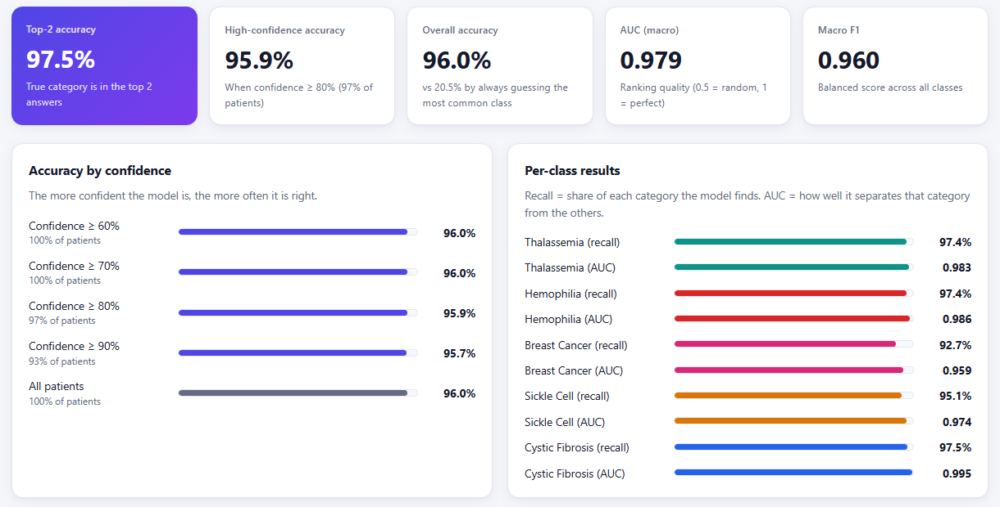
Web application: model performance page
Notes:
The app also has a performance page showing all the results live: accuracy, F1, AUC, accuracy by confidence level and results for each disease.

Slide 16


Limitations and future work
Limitations
Future work
The dataset is synthetic but realistic (as stated by its author)
1,000 patients is a small dataset
Every patient has one of the 5 diseases, so the model cannot predict "healthy"
Educational project, not a clinical tool
Train on real hospital patient records
Add a "healthy" class and more diseases
Use DNA sequence data with deeper models (CNN / Transformer)
Deploy online for doctors to test
Notes:
Our main limitations are that the dataset is synthetic and small, and the model cannot say a patient is healthy. In future we would like to use real hospital data, add a healthy class and more diseases, and try DNA sequence data with deeper models.

Slide 17
Thank you
Deep learning predicts 5 genetic diseases with 96% accuracy on unseen patients. Questions?
Notes:
To conclude: by moving to a clean dataset and building a deep learning model, we predict five genetic diseases with 96 percent accuracy on unseen patients, and we built a working web app around it. Thank you. We are happy to take questions.

