Slide 1

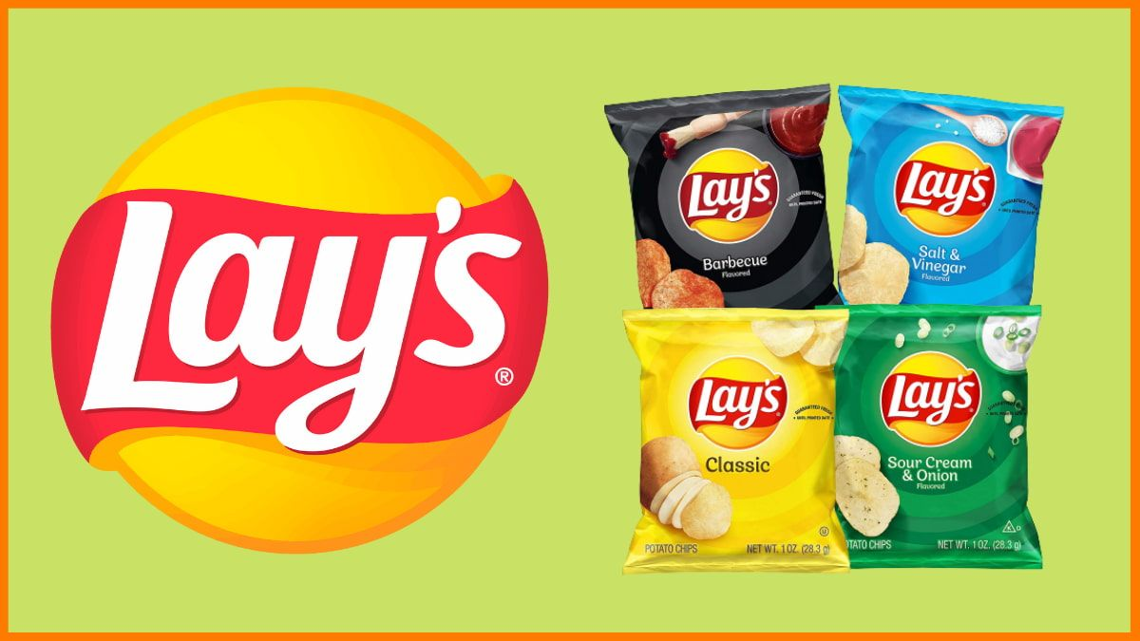
Reverse Engineering on a Advertisement
(Hypothesis Test in Lays Ad)
By:
Vijaykumar D

Slide 2

Advertisement from Lays
Lays - Target Audience
Lays target every segment of society which includes every age group and every gender. It's the snack that is everyone's favorite. Its various flavors help its diverse audience to choose from a varying number of options.
As chips was a staple diet in America, it soon started to be eaten by all. In other countries, chips soon became a tea-time snack and were loved by everyone

Slide 3
Data
We take seven month data of two age group
63
54
Age between 5 to 25
Age between 25 to 45
62
52
61
33
74
71
49
21
55
22
88
43
Pvalue = 0.021718443

Slide 4
Hypothesis
Hypothesis for an age group between 5-25 and age group between 25-45 is
  P = 0.021718443
Which is less than 0.05 Thatis alpha

Slide 5
Conclusion
In business, success comes when one sticks to a proper marketing strategy and an intelligent market mix. Lays as a brand has it all. It is the favorite of children, adults and old age people.
Its production and distribution are high along with its demand. It makes this brand a true success.

