Slide 1
Sales Performance & Business Insights
Task 4 – Data Analyst Internship
Power BI-style dashboard prototype
Dataset: Sample Superstore (synthetic demo data)
Prepared by: Vikas Purbia

Slide 2
Dashboard Features
• KPI cards: Sales, Profit, Profit Margin, Growth and Order Volume
• Filter controls: Year, Region, Category and Segment
• Monthly time-series analysis
• Regional and category comparisons
• Navigation tabs and consistent colour theme

Slide 3
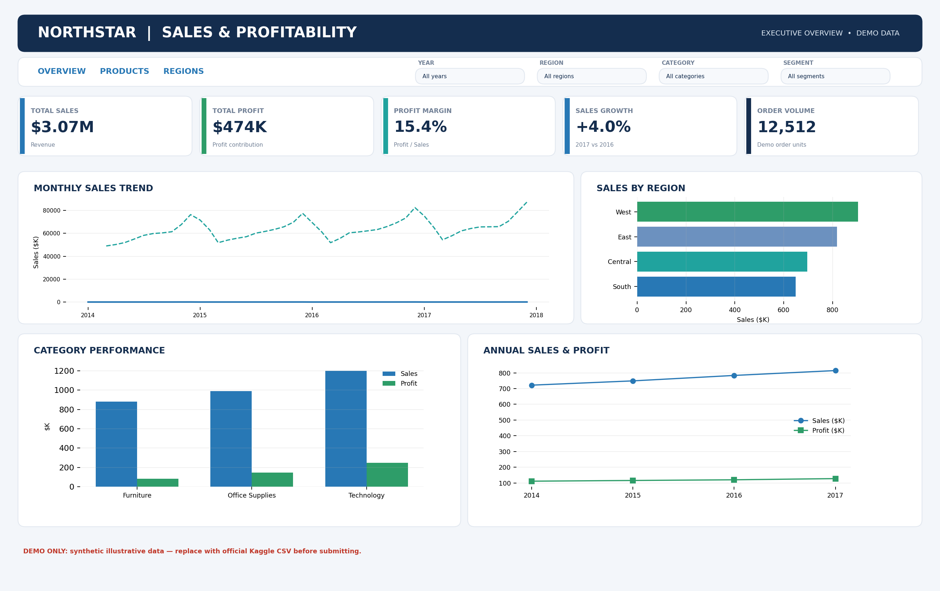
Executive Dashboard

Slide 4
KPI Definitions
Total Sales = SUM(Sales)
Total Profit = SUM(Profit)
Profit Margin = Total Profit / Total Sales
Sales Growth = (Current Year Sales – Previous Year Sales) / Previous Year Sales
Order Volume = Sum of demo order units

Slide 5
Data Preparation
• Import CSV into Power BI Desktop
• Set dates and numeric data types
• Inspect missing values, errors and exact duplicates
• Create a calendar table and date relationship
• Implement DAX measures

Slide 6
Insights & Recommendations
The included dashboard uses generated illustrative data. Validate the highest-performing region, category, profit margin and growth using the official Kaggle dataset before reporting findings.

Slide 7
Important Validation Note
This package contains a realistic dashboard design preview and synthetic demonstration data, not the official Kaggle dataset or a native PBIX file. The filters and navigation shown are visual mock-ups. Rebuild them as interactive Power BI visuals before submission.

