Slide 1
COMPILER DESIGN PROJECT GROUP 2 TEAM MENTOR: Prof. Gagan Vishwakarma

Slide 2
Group Members:-
1. Raj Pratap Singh Tomar - 181112049
2. Shubham Yadav - 181112029
3. Vikas Sao - 181112051
4. Vijay Yadav - 181112074
5. Jitendra Patel - 181112073

Slide 3
Contents
Problem Statement
Intro to LEX and YACC
MIPS
Our Approach
1. Function call
2. Declaration
3. Constant Expression
Our Solution
File structure of project
Software's Used
References

Slide 4
Using the compiler generation tools LEX ans YACC for generating MIPS code for the following language features Function call Declaration Constant Expression
Problem Statement

Slide 5
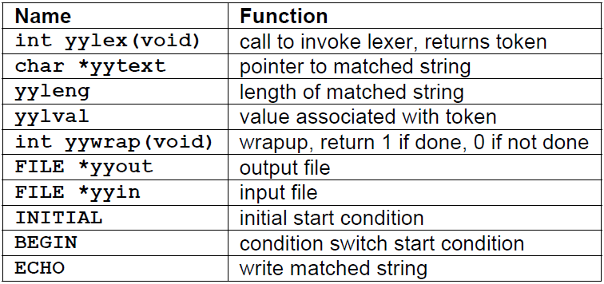
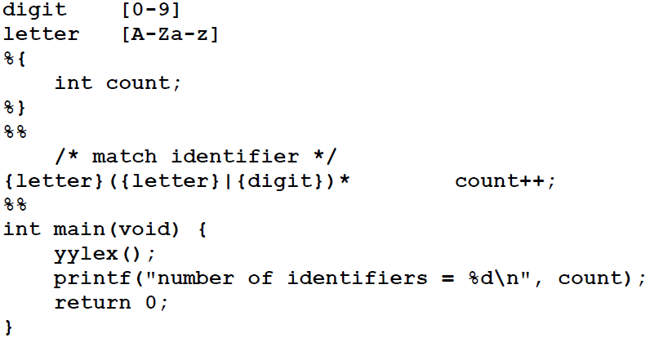
Lex
Whitespace must separate the defining term and the associated expression.
Code in the definitions section is simply copied as-is to the top of the generated C file and must be bracketed with “%{“ and “%}” markers.
substitutions in the rules section are surrounded by braces ({letter}) to distinguish them from literals.

Slide 6
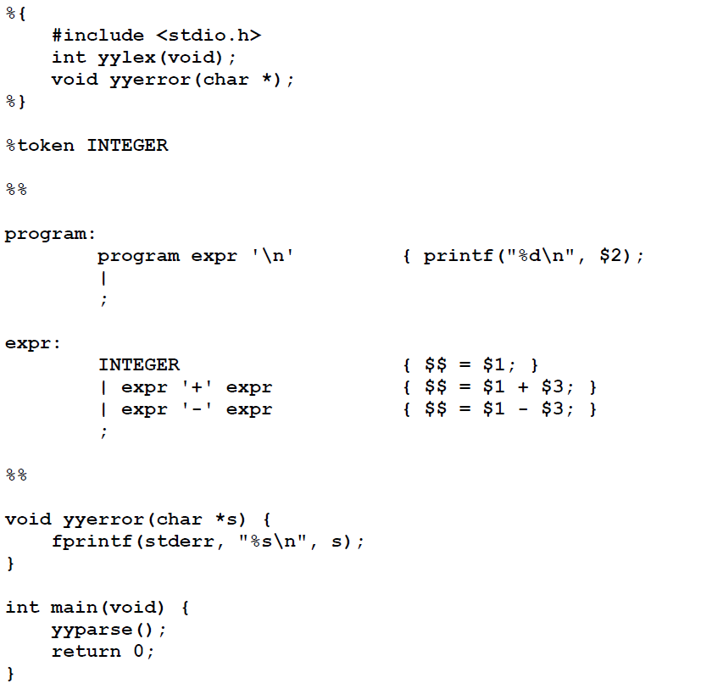
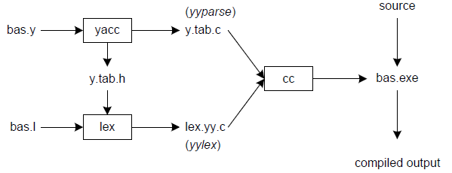
Yacc
Input to yacc is divided into three sections.
... definitions ...
%%
... rules ...
%%
... subroutines ...
1. The definitions section consists of:
token declarations .
C code bracketed by “%{“ and “%}”.
the rules section consists of:
BNF grammar .
2. the subroutines section consists of:
user subroutines .

Slide 7
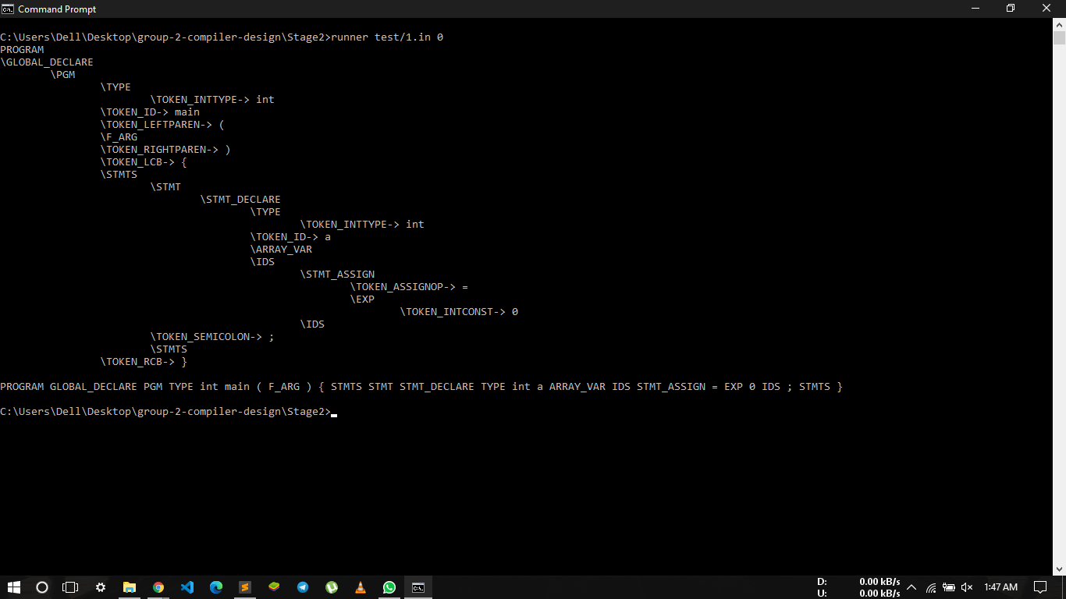
Output of AST(abstract syntax tree)

Slide 8
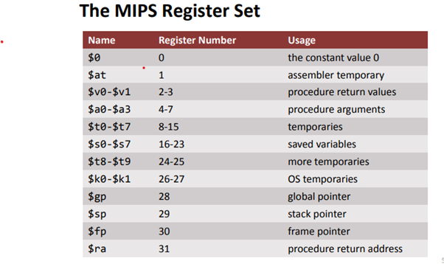
WHAT IS MIPS
MIPS is an assembly language which employs a convention for use of registers. This convention is not enforced by the assembler or the hardware, but it must be followed by all MIPS assembly language programmers in order to avoid unexpected behaviour of modules written by different people.

Slide 9
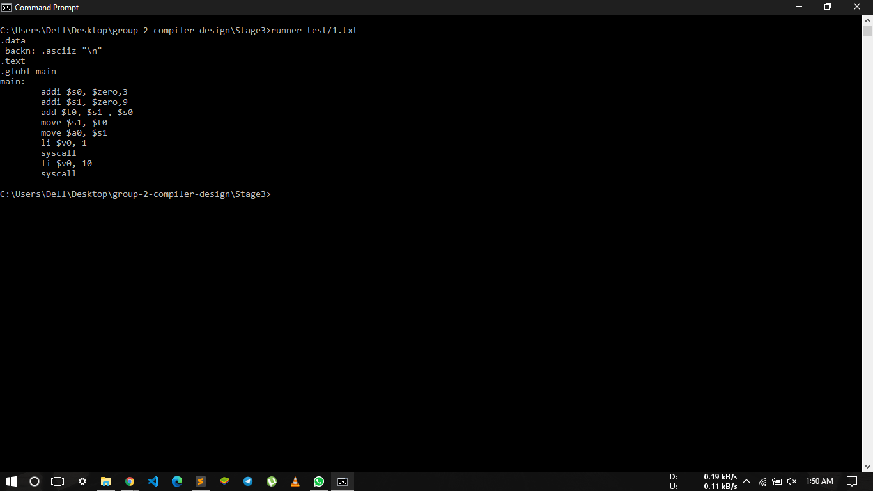
Output of generated MIPS code

Slide 10
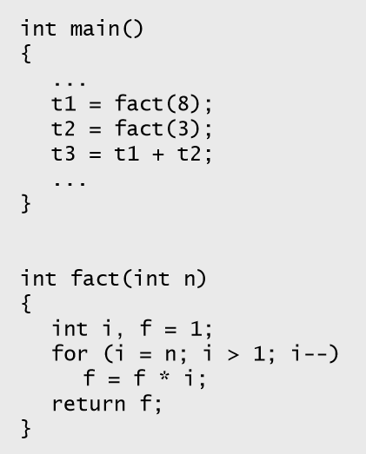
Function call in C ▪ Invoking a function changes the control flow of a program twice. 1. Calling the function 2. Returning from the function ▪ In this example the main function calls fact twice, and fact returns twice—but to different locations in main. ▪ Each time fact is called, the CPU has to remember the appropriate return address. ▪ Notice that main itself is also a function! It is called by the operating system when you run the program.
Function Call :-
A function call is a request made by a program or script that performs a predetermined function. In the example below, a batch file clears the screen and then calls another batch file.

Slide 11
1. MIPS uses the jump-and-link instruction jal to call functions. — The jal saves the return address (the address of the next instruction) in the dedicated register $ra, before jumping to the function. — jal is the only MIPS instruction that can access the value of the program counter, so it can store the return address PC+4 in $ra. jal Fact 2. To transfer control back to the caller, the function just has to jump to the address that was stored in $ra. jr $ra 3. Let’s now add the jal and jr instructions that are necessary for our factorial example.
Function Control Flow MIPS

Slide 12
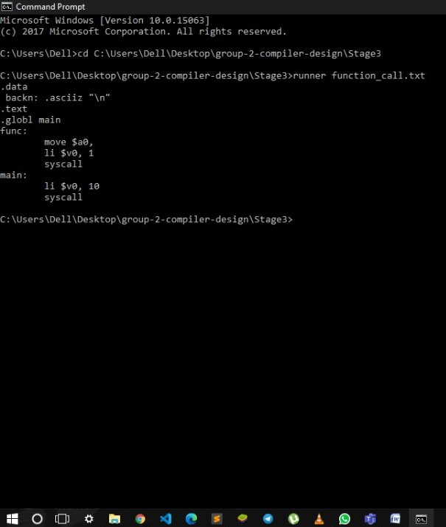
Example:-
C code –:
int fun(int x){
print(x);
}
int main(){
fun(1);
return 0;
}
MIPS - CODE

Slide 13
A declaration is a C language construct that introduces one or more identifiers into the program and specifies their meaning and properties. Declarations may appear in any scope. Each declaration ends with a semicolon (just like a statement) and consists of two distinct parts . Variable Declarations : Placed in section of program identified with assembler directive . Data declares variable names used in program . Storage allocated in main memory (RAM) . Ex- float a,b,c; // variable declaration int a[12]; // array declaration
Declaration :-

Slide 14
Example:-
simple expression,
int f, g, h, i, j; //variable declaration | Assign value to register
f = (g + h) - (i + j); // $s0 (g + h) - (i + j)
$s1 i + j
$s2 h
$s3 I
$s4 j
assume variables are assigned to $s0, $s1, $s2, $s3, $s4 respectively.
add $s0, $s1, $s2 # $s0 = g + h add $s1, $s3, $s4 # $s1 = i + j sub $s0, $s0, $s1 # f = (g + h) - (i + j)

Slide 15
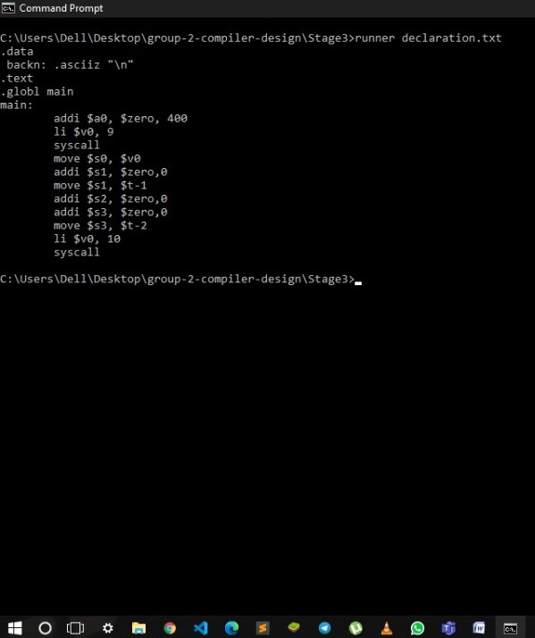
Example:-
C code –:
int main(){
int a[100] , b , c ;
float x ;
x = 12.10 ;
double xx ;
char ch ;
ch = 'a’;
}
MIPS CODE

Slide 16
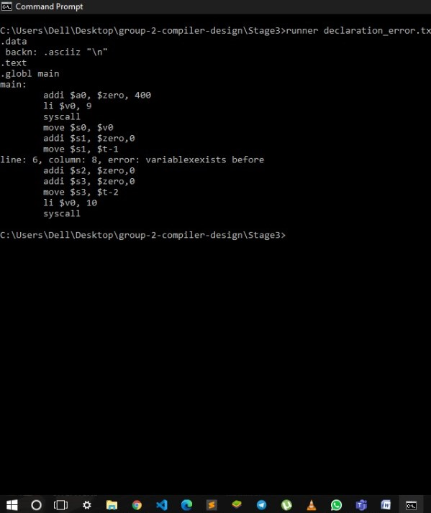
Example:-
C code –:
int main(){
int a[100] , b , c ;
float x ;
x = 12.10 ;
double x ;// error
char ch ;
ch = 'a';
}
MIPS CODE

Slide 17
A constant expression can be evaluated at compile time. That means it has no variables in it. For example: 5 + 7 / 3 is a constant expression. Something like: 5 + some Number / 3 is not, assuming some Number is a variable ( ie , not itself a compile-time constant).
Constant Expression :-

Slide 18
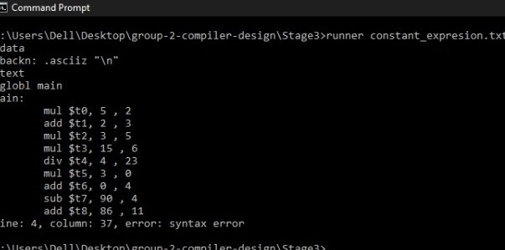
Example:-
C code –:
int main(){
int x= 5*2+(3* (2+3)*6- (3*(4/23)+4)+11+ );
}
MIPS CODE

Slide 19
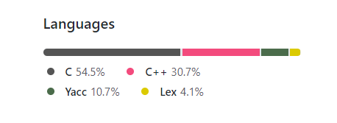
Our Solution
Link - https://github.com/VIKAS-SAO/CSE1_group2_compiler_design

Slide 20
FILE STRUCTURE OF PROJECT :-
exe file This exe file for our Compiler.
Lex_Rule This file is lexical analysis for expressions. (Written in lex)
Bison_Rule.tab This file is generated by Bison_Rule file(Parser) (Written in C)
Bison_Rule.tab.hThis file is generated by Bison_Rule file (header file)
Bison_Rule.y This file have Grammar Section (Written in Yacc)
lex.yy.c This file is generated by Bison_Rule file (Written in C)
runner This file is Default Output file for program (Assembly language)

Slide 21
1. Command Prompt 2. Flex 3. Bison UBUNTU TERMINAL MIPS ASSEMBLER and RUNTIME SIMULATOR(MARS)u
SOFTWARE'S TO BE USED :-

Slide 22
WHY FLEX :-
Flex (fast lexical analyzer generator) is a free and open-source software alternative to lex.
It is a computer program that generates lexical analyzers (also known as "scanners" or "lexers").
It is frequently used as the lex implementation together with Berkeley Yacc parser generator on BSD-derived operating systems (as both lex and yacc are part of POSIX),or together with GNU bison (a version of yacc) in *BSD ports and in Linux distributions.
Unlike Bison, flex is not part of the GNU Project and is not released under the GNU General Public License, although a manual for Flex was produced and published by the Free Software Foundation

Slide 23
WHY BISON :-
1. GNU Bison, commonly known as Bison.
2. It is a parser generator that is part of the GNU Project. Bison reads a specification of a context-free language, warns about any parsing ambiguities.
3. generates a parser (either in C, C++, or Java) which reads sequences of tokens and decides whether the sequence conforms to the syntax specified by the grammar.
4. The generated parsers are portable: they do not require any specific compilers. Bison by default generates LALR(1) parsers but it can also generate canonical LR, IELR(1) and GLR parsers.

Slide 24
References :-
1.Lex-https://www.tutorialspoint.com/compiler_design/compiler_design_lexical_analysis.htm
2.Yacc-https://cse.iitkgp.ac.in/~bivasm/notes/LexAndYaccTutorial.pdf
3.MIPS- https://www.cse.unsw.edu.au/~cs1521/18s2/notes/C/notes.html

Slide 25
Thanks…

