Slide 1

Department of Artificial Intelligence and Data Science
Real-Time Weapon Detection and Alert System Using Custom YOLO v10 Model
Mrs.Selvarani K
Asst. Professor
Benjamin Nicolas-221801005
Charless Binny K -221801007
Vikashini S -221801062

Slide 2
Problem Statement and Motivation
Conventional surveillance methods like CCTV monitoring and metal detectors are limited, as manual monitoring is error-prone and slow, while metal detectors only detect metallic weapons at fixed checkpoints, missing threats like ceramic knives or 3D-printed firearms. Face-based identification also fails when faces are obscured.
Hence, there is a need for a real-time AI-powered system that can detect both metallic and non-metallic weapons, identify missing persons using faces and attributes, and instantly alert authorities to enhance safety in crowded public events.

Slide 3
Objectives
To develop an AI-powered surveillance system capable of detecting both metallic and non-metallic weapons in real time using a custom-trained YOLO model.
To identify missing persons in live video streams through facial recognition and attribute-based matching (clothing, accessories, etc.).
To provide instant automated alerts through buzzer, SMS, email, or dashboard notifications when a threat or missing person is detected.
To build a centralized web dashboard for multi-camera monitoring, detection logs, and real-time status visualization.

Slide 4
Abstract
Public safety in large gatherings is often compromised by the limitations of manual CCTV monitoring and metal detectors, which are slow, error-prone, and unable to detect non-metallic threats. This project presents an AI-powered surveillance system using custom YOLO models for real-time weapon detection and missing person identification. The system combines face recognition with attribute-based matching, supports multi-camera integration, and provides instant alerts through a centralized dashboard. By leveraging deep learning and edge computing, it enhances accuracy, reduces response time, and strengthens security in crowded public spaces.

Slide 5
Existing System
S.no | Model/Technique Used | Author(s) | Description | Outcome
1. | HOG + SVM | Dalal & Triggs | Proposed the Histogram of Oriented Gradients (HOG) feature extraction method with Support Vector Machine (SVM) classifier for pedestrian detection. HOG captures edge/gradient information, and SVM classifies the detected regions. | Achieved good accuracy for human detection in static images, but computationally expensive and slow for real-time video.
2. | Haar Cascades | Viola & Jones (2001) | Introduced a rapid object detection method using Haar-like features and AdaBoost classifiers in a cascade structure. Widely used for face detection. | Very fast for frontal face detection but not robust to varying lighting, pose, and small object sizes; high false positives in complex scenes.
3. | Faster R-CNN | Ren et al. | Developed a two-stage deep learning approach where a Region Proposal Network (RPN) generates candidate bounding boxes, and a CNN classifies and refines them. | High detection accuracy for various object categories but significantly slower than YOLO for real-time applications.

Slide 6
Limitations of Existing System
Manual CCTV monitoring is slow, error-prone, and depends fully on human attention, causing delayed threat detection.
Metal detectors identify only metallic weapons, failing to detect non-metallic and 3D-printed weapons.
Traditional face recognition systems fail when the face is obscured, turned away, or partially covered.
Security response is not automated, requiring manual alerting and communication — causing delayed emergency action.

Slide 7
Proposed System
The proposed system uses YOLO-based real-time object detection to identify both metallic and non-metallic weapons from live CCTV/IP camera footage.
A face recognition and attribute-matching module is integrated to identify missing persons even when the face is partially covered.
A centralized surveillance dashboard enables multi-camera monitoring, live video streaming, and alert visualization for security teams.
An automated alert mechanism triggers buzzer, SMS, email, and dashboard notifications instantly when a threat or missing person is detected.

Slide 8
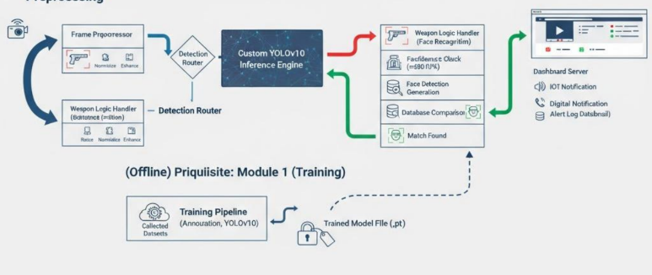
Proposed System

Slide 9
Module 1 : Person Re-identification
Captures live video frames from CCTV/IP cameras and detects human faces in real time.
Extracts facial embeddings using a deep learning model. Compares extracted embeddings with the missing persons database using similarity matching.
Identifies individuals even under varying lighting, pose, or partial face visibility and produce alert sound
Sends automatic alerts to the surveillance dashboard upon positive identification of a missing person.

Slide 10
Overall Description
System Layers:
Frontend → Web Dashboard + Live Video Feed Interface.
Backend → Flask/Django + YOLO v10 (weapon & person detection).
Database → SQL/NoSQL (alerts, logs, missing persons database)
Features:
Real-time detection of metallic & non-metallic weapons
Missing person identification via face + attribute matching
Instant alerts through buzzer, email, or SMS

Slide 11
Algorithms
Weapon Detection:
Custom-trained YOLO v10 model.
Detects both metallic & non-metallic weapons (guns, knives, 3D-printed arms).
Bounding boxes with confidence scores.
Missing Person Identification:
Face recognition against database.
Attribute-based matching (clothing color/pattern, accessories).

Slide 12
System Features
Cameras → Capture live video feed (Raspberry Pi / CCTV / Jetson).
YOLO v10 Model → Detect weapons (metallic & non-metallic) + persons in real-time.
Matching Module → Face recognition + attribute-based matching (clothes, accessories).
Alert System → Triggers buzzer, email, SMS for detected threats/missing persons.
Web Dashboard → Multi-camera monitoring, alerts history, logs, live feed visualization.
Database → Stores missing persons data, detection logs, and alerts for analysis.

Slide 13
External Interfaces
Alert System:
Real-time alerts via buzzer, SMS, or email.
Centralized dashboard for live feed + alert logs.
Multi-camera integration for large-scale events.
Scalability & Storage:
Edge devices (Raspberry Pi / Jetson) for real-time processing.
Cloud backend for storage, analytics, and centralized monitoring.

Slide 14
System Requirements
System Requirements
Hardware Requirements:
  Minimum: 4 GB RAM, Dual-core CPU, 2 Mbps Internet, Camera Module
  Recommended: 8 GB RAM, Quad-core CPU, SSD, Stable broadband, 5MP+ CCTV/IP camera
Software Requirements:
  OS: Windows/Linux/Mac
  Python 3.10+, Flask/Django, OpenCV, YOLO v10, MongoDB
  Chrome browser with extension enabled

Slide 15
Non Functional Requirements
Performance: Real-time detection with alerts triggered in <2 seconds.
Security: Secure login for dashboard, encrypted storage of person data and logs.
Scalability: Supports multiple cameras, large datasets, and multi-user monitoring.
Portability: Works across Raspberry Pi, Jetson, and cloud servers with web dashboard accessible via browsers.
Maintainability: Modular architecture with separate detection, alert, and dashboard modules for easy updates and improvements.

Slide 16
Future Scope
Collaborative Monitoring → Allows multiple security personnel to access and respond to the same dashboard simultaneously.
Integration with Security Systems → Can be linked with existing CCTV infrastructure, alarm systems, and emergency communication networks.
Data Analytics for Research → Collects anonymized detection data to analyze threat patterns, crowd behavior, and improve model accuracy over time.

Slide 17
Thank You

