Slide 1

Monitoring of Sanitation in Water Resources
MONITORING OF SANITATION IN WATER RESOURCES
SUPERVISOR:
Dr.G.VINOTH CHAKKARAVARTHY
Associate Professor
TEAM MEMBERS:
1) SAILENDRI G R
2) VIKASHINI T P
3) NANTHINI E

Slide 2
Objective
To check whether the river water can be used for drinking or not.

Slide 3
Literature survey
Cloete, Malekain and Nair [43] - In their paper they designed and developed a water quality monitoring system which measures the physicochemical parameters of water such as flow, temperature, ph, conductivity, and the oxidation reduction potential. They detect the contamination of water by measuring the parameters and then send notification to the user. Sensors are connected to a microcontroller- based measuring node which processes and analyzes the data. In their paper, they used a zigbee transmitter and receiver module for communication between the measuring and notification nodes.

Slide 4
Literature survey
Barabde and Danve (2015) [20] paper presented three layers of system architecture of water quality monitoring system. Those three are nodes for data monitorization, a base station and a remote station. They connected all the layers with wireless communication protocol and data being send to the base station from data monitoring nodes via microcontroller. Collected data was displayed on a local host PC. Matlab was used to create a GUI (graphical User Interface) for data visualization and water parameters such as ph, turbidity, conductivity were displayed. If the compared value exceeds standard value a SMS will be sent to the client.

Slide 5
Literature survey
Bishwajit Paul worked on developing an automated arduino based water quality monitoring system. They proposed a model where sensors are connected to arduino. Thus sensor values are sent to a core micro controller and displayed on a LCD. Arduino is also interface with GSM module in order to send text notification to user.

Slide 6
Existing solution:
In Current trend, there are a number of different possibilities that could suggest a waterborne outbreak:
Complaints about water quality.
An increase of AGI in the community, in general practices, or in hospitals (clinical surveillance).
An increase of positive laboratory results indicating possible waterborne agents (laboratory surveillance).
There is no technique that could detect the contamination in earlier stages. And contamination /dumping of waste in water bodies is un-notified.

Slide 7
Proposed solution:
Rapid recognition of the possibility of an outbreak and a timely start to the investigation greatly increase the likelihood of determining cause. Data (water quality parameters) collection will be done using appropriate sensors and which is transmitted to the control station. Data collected from water is given as input to our machine learning model which will upshot the quality of water.

Slide 8
Module Description
MODULE 1
In the module first the ph and ldr values from the water given by the people are taken.These values are stored in the excel sheet.It is used as a database for further classification process.

Slide 9
MODULE 2
In the second module, dataset is given to the naïve bayes classifier to predict the purity of water and it finally predicts whether water is pure(yes) or not(no).An advantage of Naive Bayes is that it only requires a small amount of training data to estimate the parameters (means and variances of the variables) necessary for classification.

Slide 10
Gathering of the required sensors
Collection of data from the sensor
Analysis of the data from the sensor
Construction of a machine learning model
Deployment of the machine learning model
Methodology

Slide 11
Methodology with milestones
2019
Dec
2020
Feb
Mar
2020
Today
0%
Gathering of the required sensors
25 days
19 Dec - 22 Jan
0%
Collection of data from the sensors
15 days
23 Jan - 12 Feb
0%
Analysis of data from the sensor
5 days
13 Feb - 19 Feb
0%
Construction of machine learning model
10 days
20 Feb - 4 Mar
0%
Deployment of the machine learning model
2 days
4 Mar - 5 Mar

Slide 12
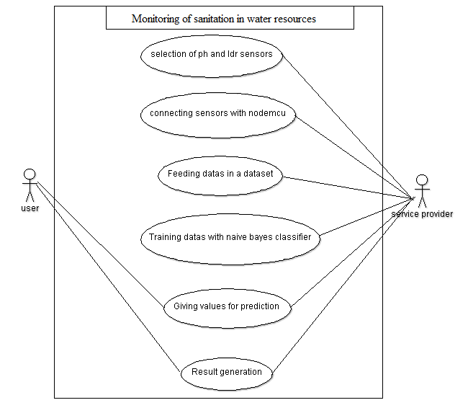
USECASE DIAGRAM

Slide 13
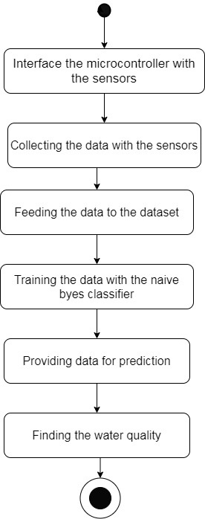
STATE CHART DIAGRAM

Slide 14
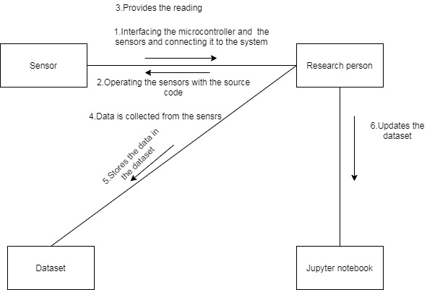
COLLOBORATION DIAGRAM

Slide 15
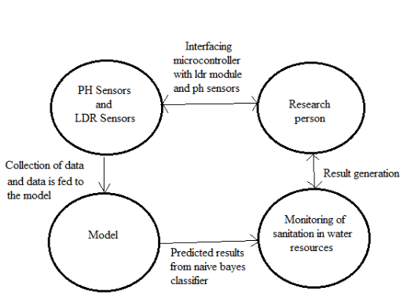
DATA FLOW DIAGRAM LEVEL 0

Slide 16
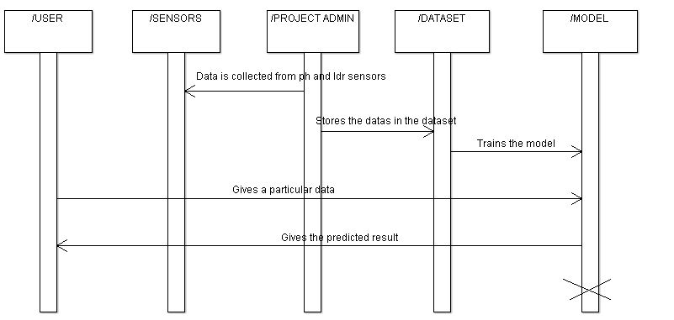
SEQUENCE DIAGRAM

Slide 17
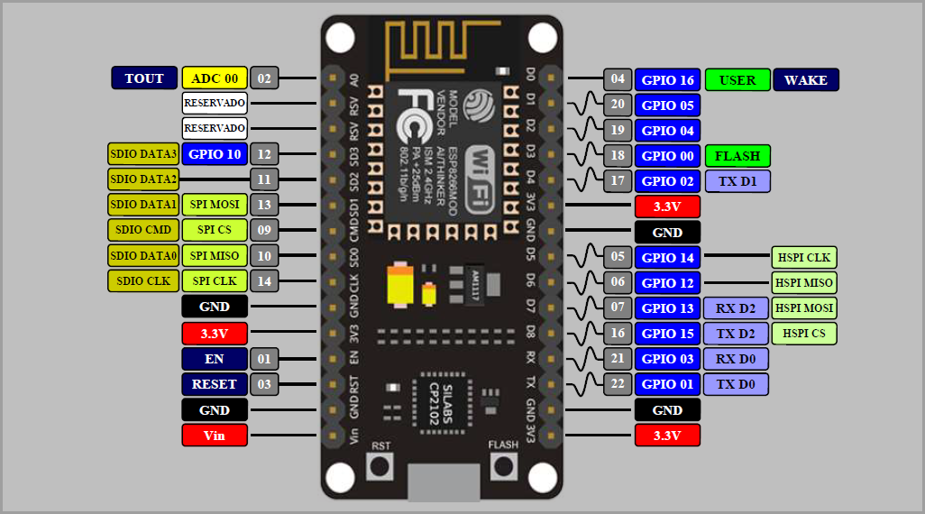
Implementation

Slide 18
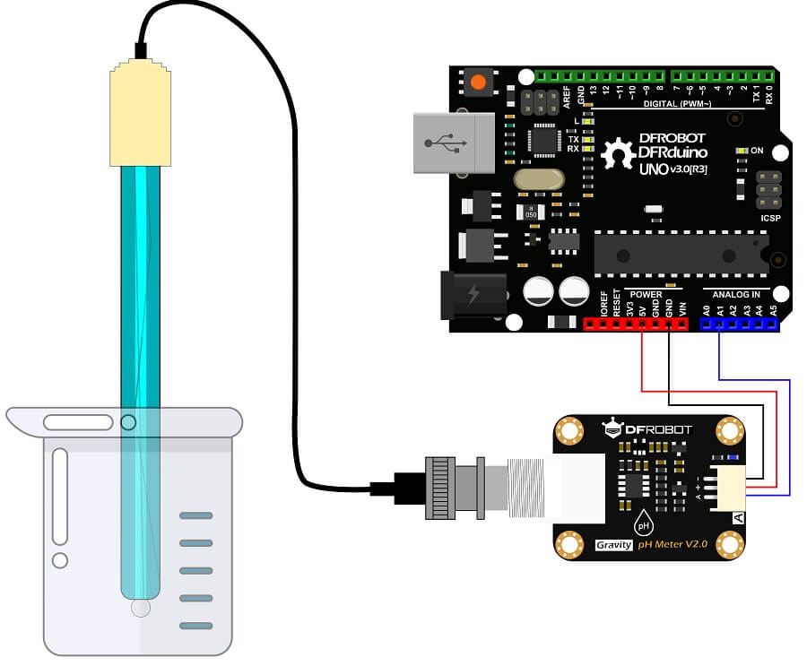
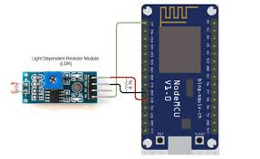
Implementation

Slide 19
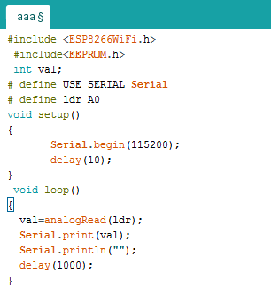
Implementation

Slide 20
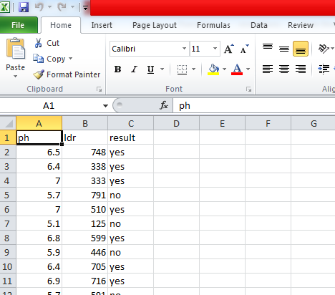
Implementation

Slide 21
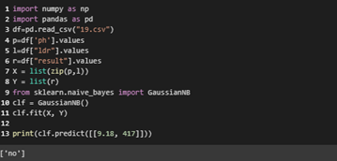
Implementation

Slide 22
Methodology with milestones
2019
Dec
2020
Feb
Mar
2020
Today
0%
Gathering of the required sensors
25 days
19 Dec - 22 Jan
0%
Collection of data from the sensors
15 days
23 Jan - 12 Feb
0%
Analysis of data from the sensor
5 days
13 Feb - 19 Feb
0%
Construction of machine learning model
10 days
20 Feb - 4 Mar
0%
Deployment of the machine learning model
2 days
4 Mar - 5 Mar

Slide 23
Challenges
To read the accurate value from the sensors.
Protecting the sensors from getting damaged.
Using proper training dataset for the machine learning model is mandatory.

Slide 24
Scope
This project involves node mcu as core controller and various sensors to monitor the water quality. The micro controller will access the data from different sensors and then processes the data. The data gets analyzed. Once the data is collected, the data is fed into machine learning model. Model is trained using machine learning algorithms (GaussianNB) . Productive decision can be made out of the results from the model.

Slide 25
Conclusions
Thus this system will help to identify the sanitation of water resources at the earliest

Slide 26
Future Enhancements
Data can be collected and analyzed directly in the cloud platform.
Model will be trained using the other parameters such as Temperature, Dissolved Oxygen(D.O.), pH, Conductivity, Biochemical Oxygen Demand(B.O.D), Nitrate-N and Nitrite-N, Fecal Coliform and Total Coliform.
Drones will be made to detect debris in the water and nearby areas. Once the wastes are detected, Photo of the place with its location is sent to the control station. Hence rescue team can act accordingly and remove them as soon as possible.

Slide 27
References
https://www.youtube.com/watch?v=dfoH5iPWkwo
https://www.youtube.com/watch?v=AkBrEsSnx74&t=399s
https://www.youtube.com/watch?v=kXtvpu2XM-I&t=467s
https://www.youtube.com/watch?v=NEo1WsT5T7s
https://www.youtube.com/watch?v=p06NNRq5NTU

Slide 28


