Slide 1



SMART INDIA HACKATHON 2026
TITLE PAGE
Problem Statement ID –26054
Problem Statement Title- AI-Enabled Real-Time Digital Twin System for Health Monitoring, Fault Prediction and Mission Reliability Enhancement of Aero Piston Engines used in MALE UAVs.
Theme-Robotics and Drones
PS Category- Software
Team ID-
Team Name-Innovexa
Demo Video
Git Repository

Slide 2
AI-Enabled Real-Time Digital Twin System for Health Monitoring, Fault Prediction and Mission Reliability Enhancement of Aero Piston Engines used in MALE UAVs.
Innovexa
Problem Statement Description:
Develop an AI-enabled real-time Digital Twin for health monitoring, fault prediction, and Remaining Useful Life (RUL) estimation of aero piston engines used in MALE UAVs.The system should combine live engine telemetry, anomaly/fault detection, degradation tracking, and predictive maintenance to improve engine reliability, mission readiness, and operational safety.
Innovation & Uniqueness
Physics + AI Digital Twin — thermodynamic residuals + temporal features for context-aware engine health estimation.
End-to-End Prognostics — Anomaly → Fault → Degradation → RUL with uncertainty bounds.
Explainable AI — TreeSHAP + Counterfactuals for sensor-level root-cause attribution and maintenance advisories.
What-If & Mission Replay — real-time fault injection, simulation and historical mission playback for diagnostic validation.
GCS-Ready Architecture — CAN 2.0B/DBC + FastAPI/WebSockets + MongoDB + React GCS, enabling real-time telemetry, analytics and visualization.
Proposed Solution:
A real-time, physics-informed Digital Twin synchronizing CAN/ECU telemetry with a virtual engine state for anomaly, fault, degradation and RUL prediction. TreeSHAP + counterfactual XAI provides root-cause explanations and maintenance advisories, while the React GCS dashboard delivers real-time health, telemetry, faults, RUL and mission visualization.
Resolving the issue:
CAN Telemetry → Physics Residuals → Anomaly → Fault → Degradation → RUL → XAI → Maintenance Advisory
Enables real-time monitoring, mission replay, fault injection, simulation, and historical health analysis through the integrated WebSocket + MongoDB + React GCS architecture.

Slide 3
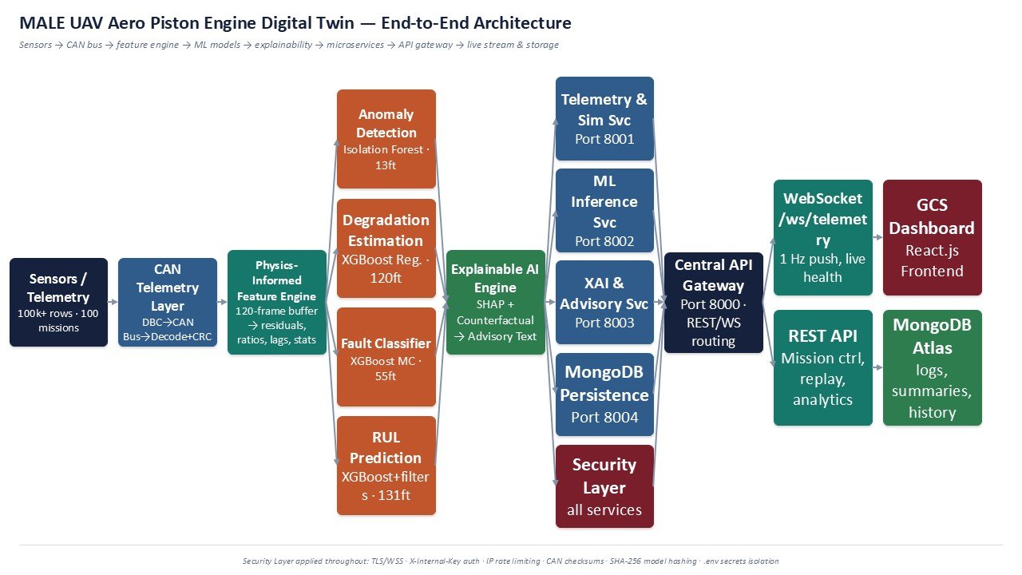
METHODOLOGY
Innovexa
Architecture Diagram

Slide 4
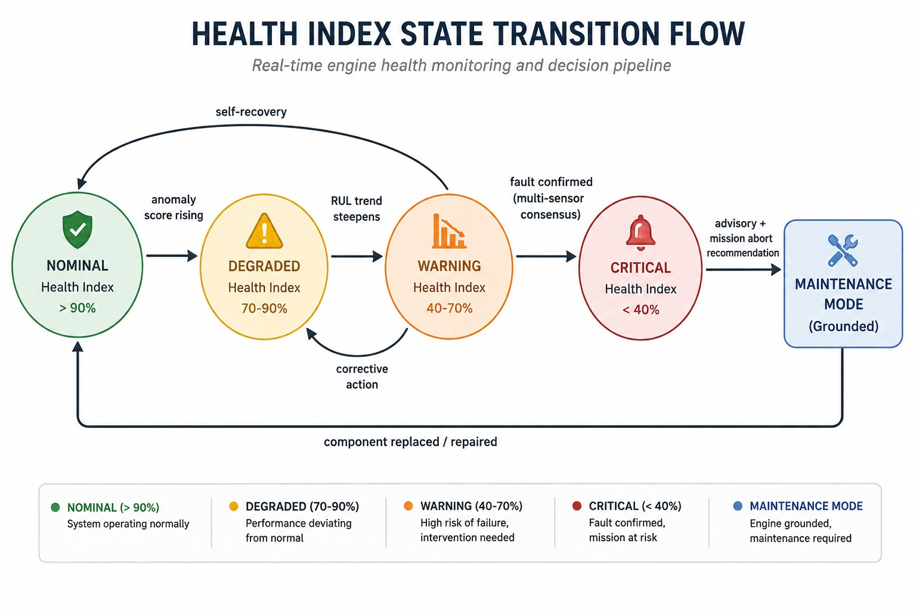









METHODOLOGY
Innovexa
Engine Health FSM
Technology Stack

Slide 5
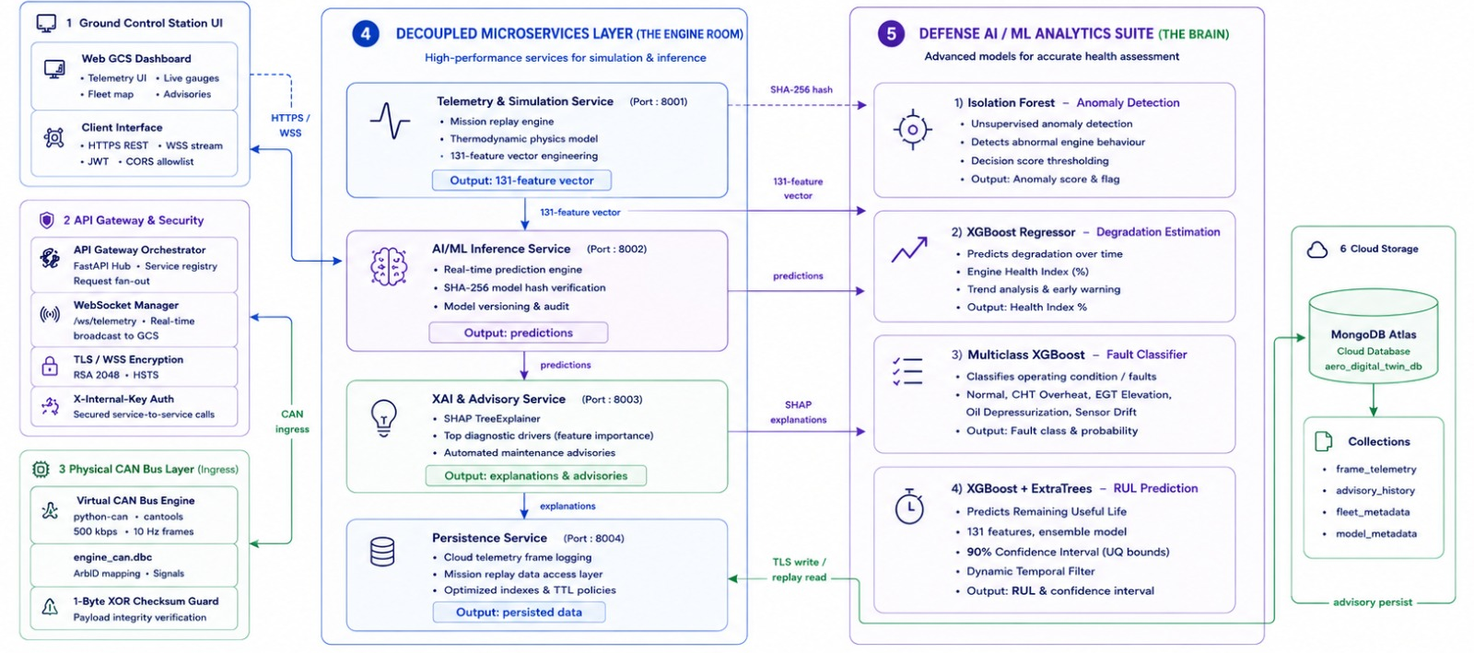
TECHNICAL APPROACH
Innovexa
Microservices Workflow
Telemetry → Secure Microservices → AI/ML Analytics → XAI → Maintenance Advisory → Cloud Storage

Slide 6
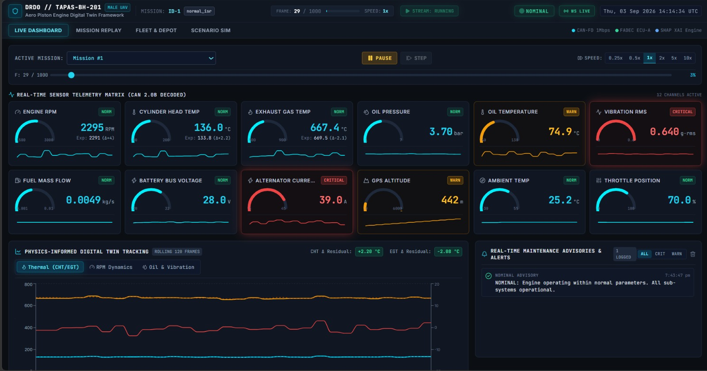
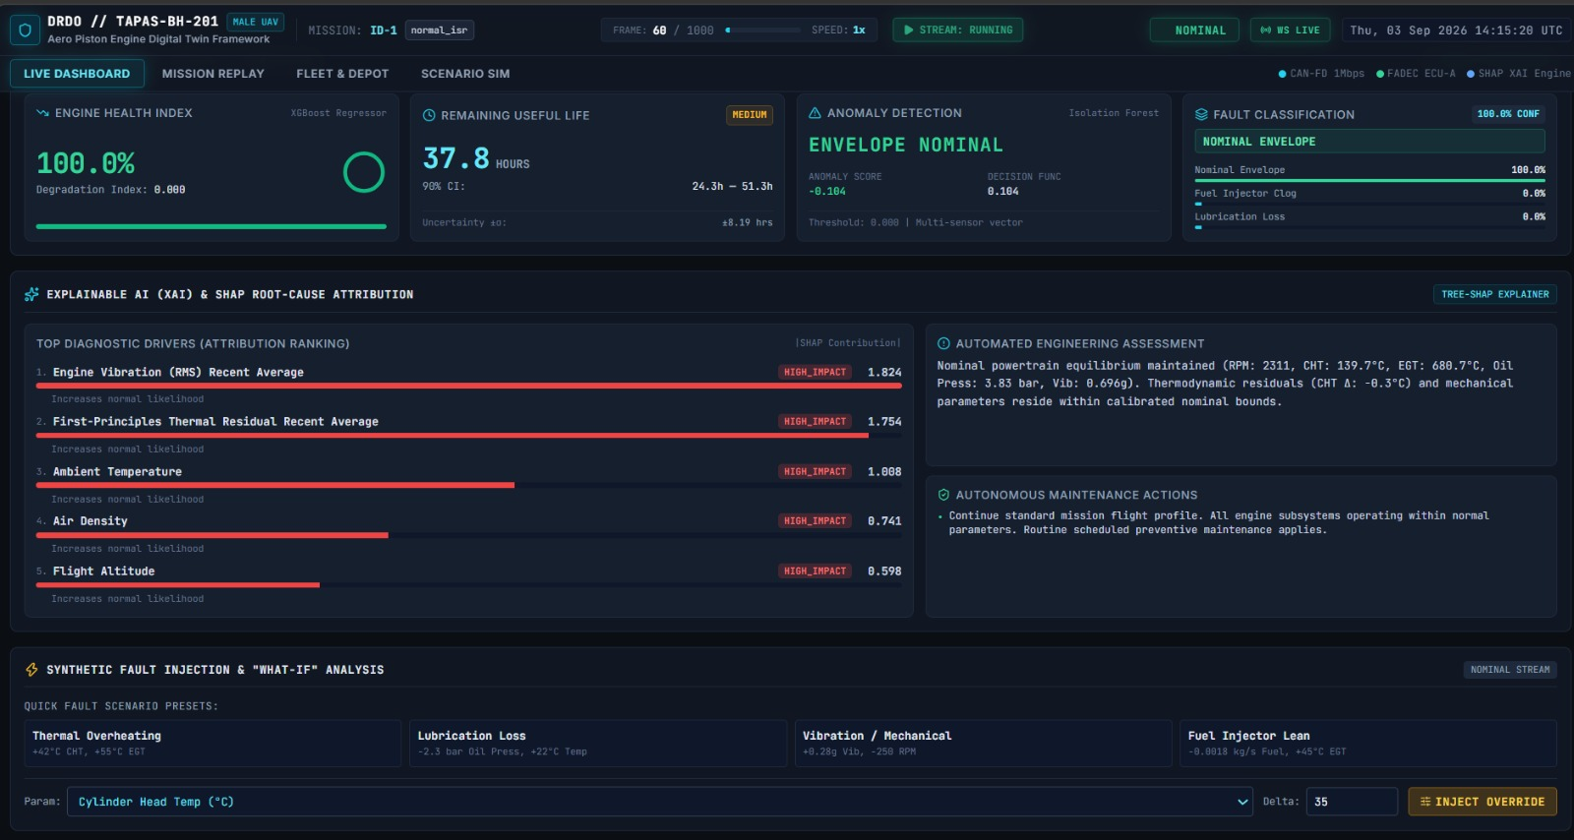
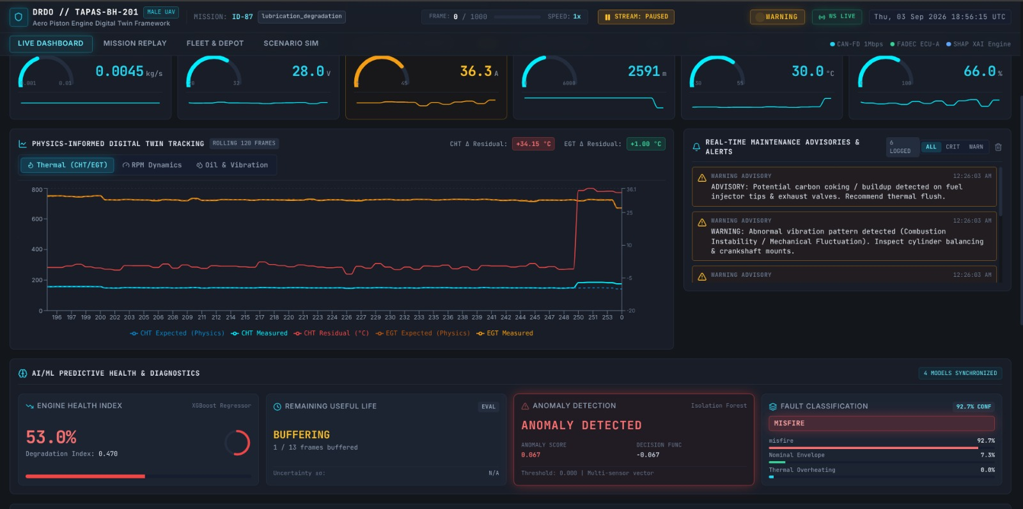
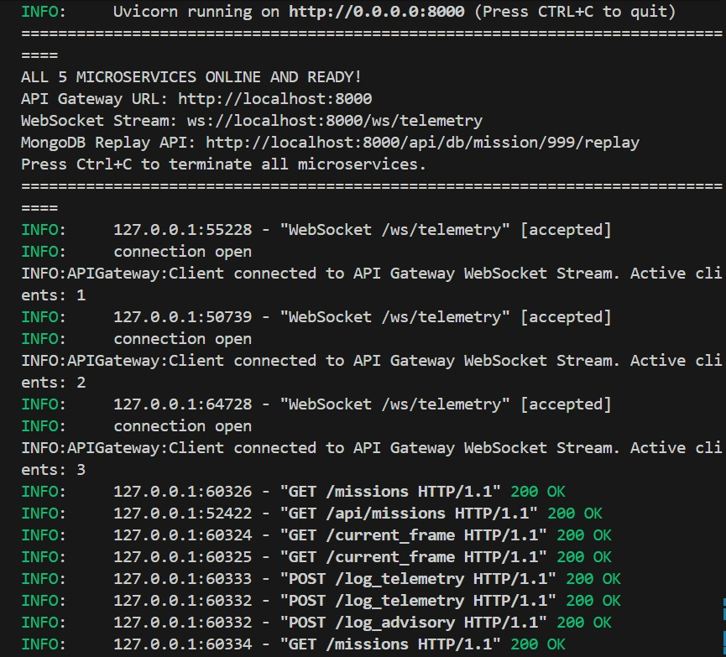
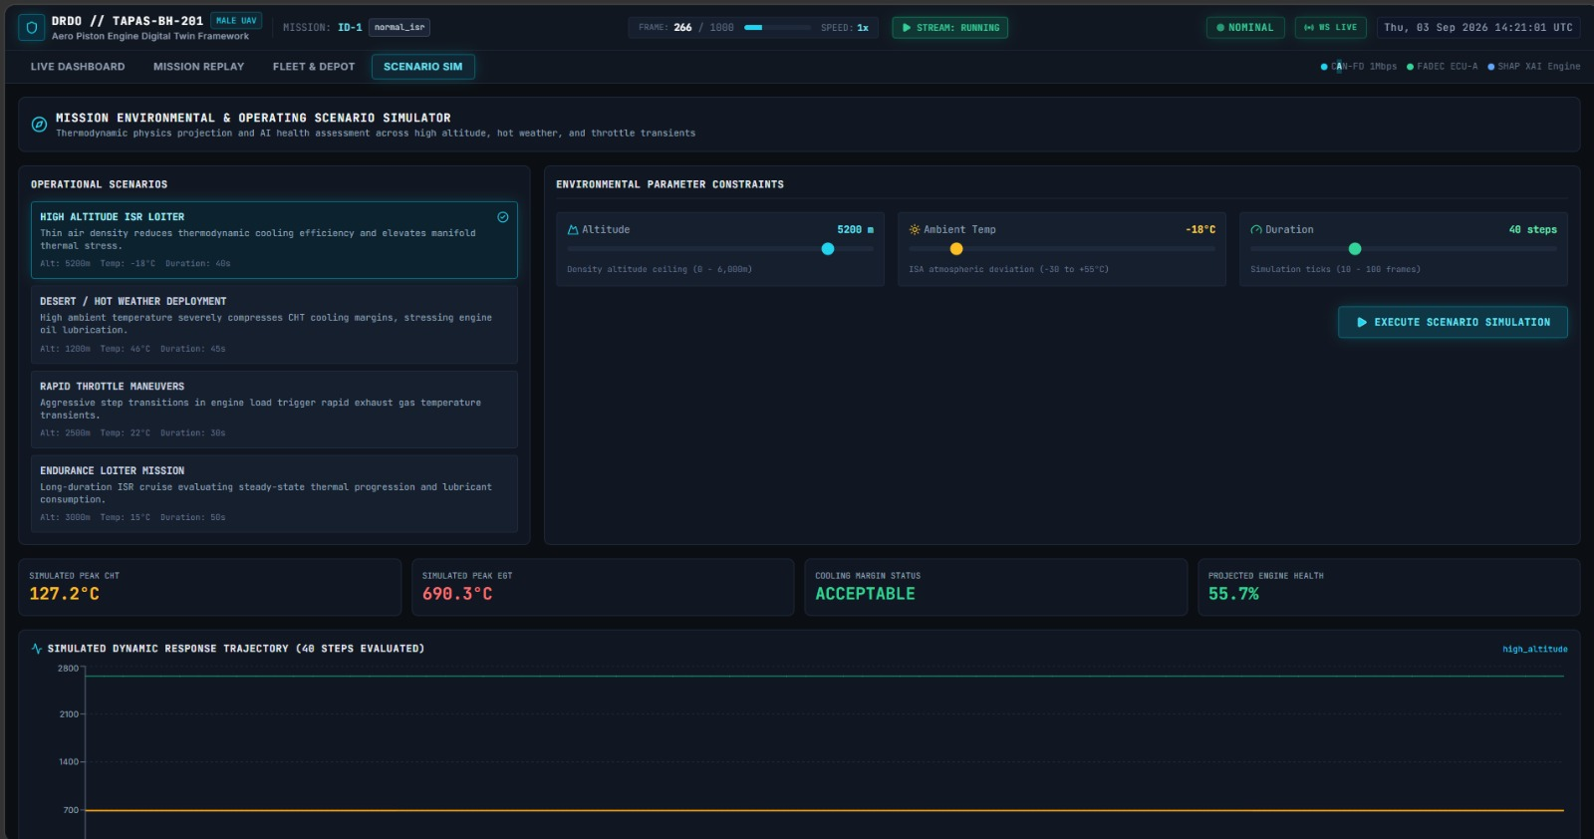
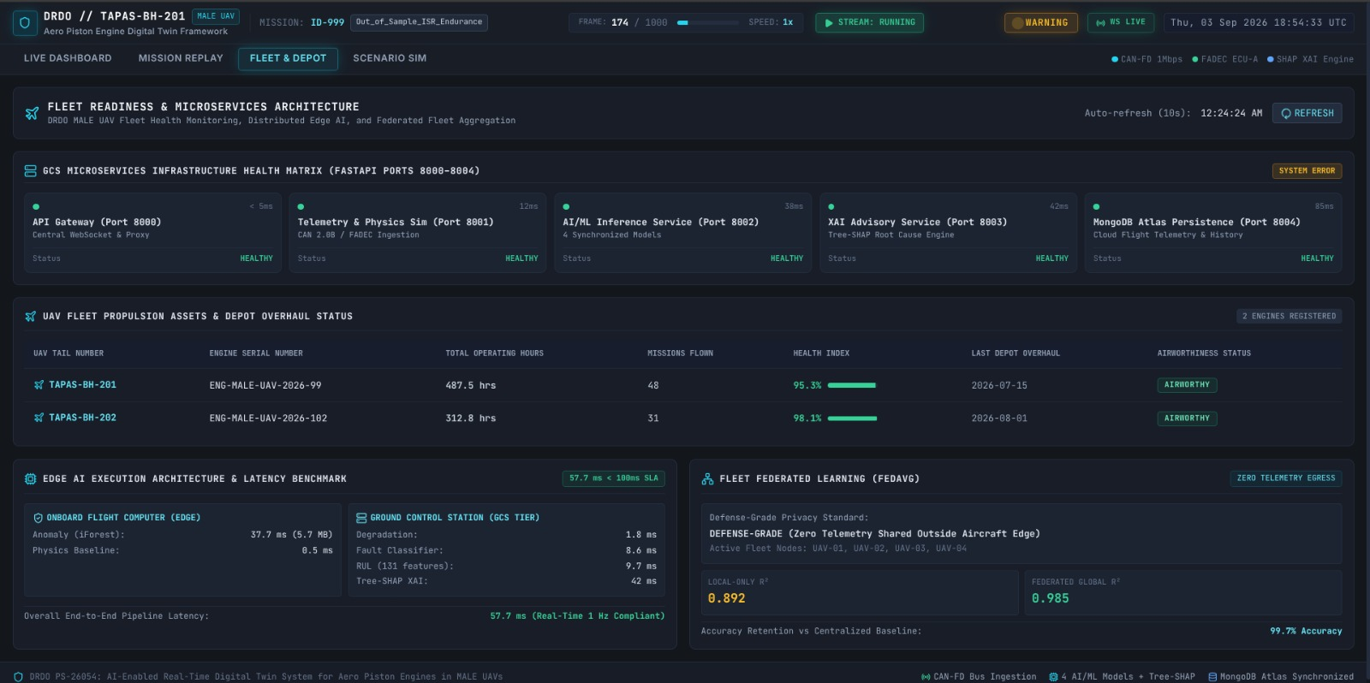
RESULTS
Innovexa
Abnormal Vibration Detected
XAI Recommendations
Misfire Detected
Scenario simulator
Fleet and Depot
Microservices Checkpoints

Slide 7
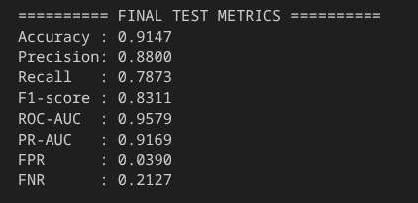
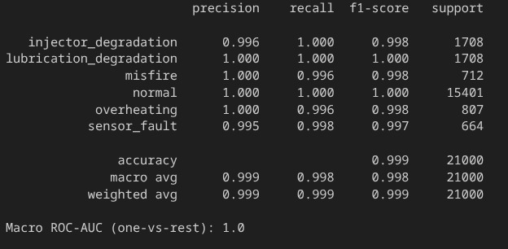
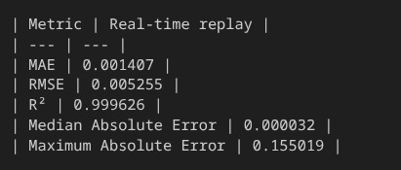
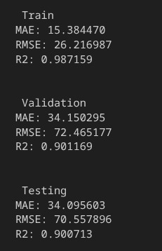
RESULTS
Innovexa
Anomaly Detection
Fault Detection
Degradation Detection
RUL
Technical Area | Dataset | Fault classification | Anomaly detection | Temporal early warning | Degradation estimation | RUL estimation | Explainability
Result Obtained | 100 missions · 100,000 telemetry frames · 5 fault modes | 99.9% accuracy · 0.998 macro-F1 · 1.000 macro ROC-AUC | 91.47% accuracy · 83.11% F1 · 3.90% false-positive rate | 5-frame confirmation logic · 3,673 confirmed anomalies on 21,000 test samples | MAE 0.00141 · RMSE 0.00525 · R² 0.99963 | MAE 34.10 h · RMSE 70.56 h · R² 0.9007 | Class-specific SHAP feature attribution demonstrated for fault diagnosis

Slide 8
FEASIBILITY AND VIABILITY
Innovexa
Analysis of Feasibility
Uses existing UAV engine sensors, CAN/SocketCAN and telemetry data, making deployment technically feasible.
Combines physics-based features with lightweight ML models for real-time inference.
Modular architecture with FastAPI, WebSockets and MongoDB supports scalable integration.
Digital twin supports real-time monitoring, simulation, mission replay and fault injection.
Potential Challenges & Risks
Sensor noise, drift and missing/incorrect telemetry can affect predictions.
Limited onboard computing resources may constrain real-time AI processing.
Insufficient real-world engine failure data can reduce model generalization.
Cybersecurity and communication failures may affect telemetry reliability.
False alarms or inaccurate RUL predictions could impact maintenance decisions.
Strategies to Overcome Challenges
Apply sensor validation, filtering and physics-based consistency checks.
Use lightweight tree-based models and edge-optimized inference.
Combine simulation data with real flight/engine data and continuously retrain models.
Implement secure authenticated communication and integrity checks.
Use XAI, confidence scores and uncertainty bounds to support human decision-making.
Validate the complete system through mission replay and controlled fault injection.

Slide 9
IMPACT AND BENEFITS
Innovexa
Impact
UAV operators: Real-time visibility of engine health, faults and mission reliability.
Maintenance teams: Early fault detection and predictive maintenance advisories.
Benefits
Safety: Detects anomalies and predicts potential failures before critical conditions.
Economic: Reduces unscheduled maintenance, downtime and component replacement costs.
Fleet managers: Fleet-wide health tracking and post-flight analysis.
Defence organizations: Improved mission readiness and reduced risk of engine-related mission failure.
Predictive Maintenance: Uses degradation trends and RUL estimation to support condition-based maintenance.
Scalability: Can be extended across multiple UAVs, missions and engine configurations.
Business Model
Target Customers: Defence organizations, UAV manufacturers, engine manufacturers, and fleet operators(DRDO).
Value Proposition: Provides real-time engine health monitoring, early fault prediction, and predictive maintenance to improve mission reliability.
Revenue Model: Annual per-UAV/fleet subscription combined with enterprise deployment and customization fees.
Go-to-Market Strategy: Start with pilot deployments and scale through defence contracts and partnerships with UAV/engine manufacturers.
Key Cost Components: AI/ML development, cloud infrastructure, edge deployment, cybersecurity, system integration, and technical support.

Slide 10


RESEARCH AND REFERENCES
Innovexa
[1] An improved deep autoencoder framework for aviation piston engine unsupervised anomaly detection considering the real-life data characteristics
https://www.cambridge.org/core/journals/aeronautical-journal/article/abs/an-improved-deep-autoencoder-framework-for-aviation-piston-engine-unsupervised-anomaly-detection-considering-the-reallife-data-characteristics/5CEDFA8C7CA73DC4984E00EEE760AF63
Proposes an improved deep autoencoder approach for detecting anomalies in aviation piston-engine data.
[2] Study of Fuel-Controlled Aircraft Engine for Fuel-Powered Unmanned Aerial Vehicle: Energy Conversion Analysis and Optimization
https://www.researchgate.net/publication/334755025_Study_of_Fuel-Controlled_Aircraft_Engine_for_Fuel-Powered_Unmanned_Aerial_Vehicle_Energy_Conversion_Analysis_and_Optimization
Studies fuel-controlled aircraft engines for UAVs, focusing on energy conversion and performance optimization
[3] Virtual Sensors for Aero Gas Turbine Engine Health Monitoring System
https://www.drdo.gov.in/drdo/sites/default/files/technology-focus-documrnt/TF_MayJune2025.pdf
DRDO describes an AI/ML-based comprehensive engine diagnostic and health-monitoring system using virtual sensors, operational assessment and Digital Twin technology, aimed at improving engine reliability and longevity.
[4] Fast API Documentation- https://fastapi.tiangolo.com/
[5] Microservice in Python using FastAPI - GeeksforGeeks
https://www.geeksforgeeks.org/python/microservice-in-python-using-fastapi/
Git Repository
Demo Video
Technical Documentation
Deployment Documentation

