Slide 1
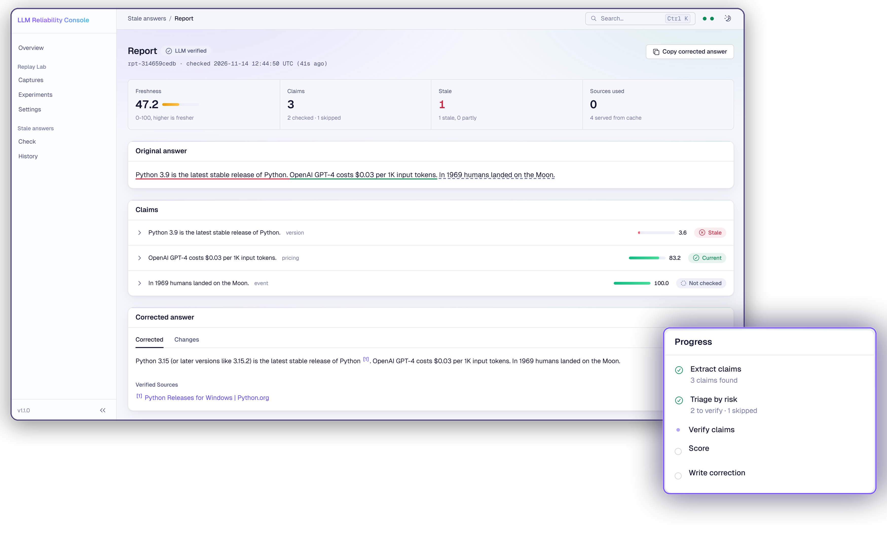
LLM RELIABILITY
LLM Reliability
Is the cheaper model safe?
Is this answer still true?
Two production checks for LLM apps, one console:
Bifrost Replay Lab and the Stale-Answer Detector.
Bifrost track + Tavily track | November 2026
llm-reliability-console.vercel.app

Slide 2
LLM RELIABILITY
GEEK ROOM GLOBAL AI HACKATHON 2026
Teams guess on cost and on freshness today
The two failure modes we target, and what each one costs.
01
02
Overpaying for models
Stale answers
Teams stay on a flagship model
because nobody can prove a cheaper
one is safe on their own traffic.
Models state prices, versions and
CEOs from training data, with full
confidence, long after they change.
Cost: the gap between tiers, every month.
Cost: user trust, one wrong fact at a time.
Both need evidence, not opinion: your own traffic, and the live web.
Bifrost track + Tavily track · github.com/VIKI7-HUB/llm-reliability
02

Slide 3
LLM RELIABILITY
01
Bifrost Replay Lab
A switch verdict from your own production traffic.
03

Slide 4
LLM RELIABILITY
GEEK ROOM GLOBAL AI HACKATHON 2026
Replay Lab turns recorded traffic into a verdict
Native Bifrost plugin (LLMPlugin + HTTPTransportPlugin), or a sidecar proxy.
Capture
Protect
Replay
Decide
Off the hot path;
a full buffer drops
the capture, never
slows the request.
Emails, phones, cards
and tokens redacted
before disk.
Same params, temp 0,
against cheaper
candidates.
JSON contract,
similarity, p50/p95,
errors, cost.
Hard budget cap
Projected cost checked before every call • stops with partial results • dry-run estimate first
Output: SAFE_TO_SWITCH, SWITCH_WITH_CAUTION or DO_NOT_SWITCH.
Bifrost track + Tavily track · github.com/VIKI7-HUB/llm-reliability
04

Slide 5
LLM RELIABILITY
GEEK ROOM GLOBAL AI HACKATHON 2026
gpt-4o-mini kept 94.7 quality at 94.1% lower cost
Demo run: 200 gpt-4o requests captured, 50 replayed per candidate (mock provider).
Verdicts
gpt-4o-mini: safe to switch
claude-3-haiku: switch with caution
llama-3.1-8b: do not switch (50% valid JSON)
The cheapest model is not the answer; the verdict says which one is.
Replay Lab README, run_experiment output. Deterministic mock provider; live Gemini run: 5/5 replays, 0 errors.
05

Slide 6
LLM RELIABILITY
02
Stale-Answer Detector
Every claim, checked against the live web with Tavily.
06

Slide 7
LLM RELIABILITY
GEEK ROOM GLOBAL AI HACKATHON 2026
Only claims that can go stale cost a search
Five stages, streamed live to the console over SSE.
Extract
Triage
Verify
Score
Correct
Atomic claims
with character
spans.
Pricing 0.88 risk,
versions 0.82,
timeless 0.05:
skipped.
Tavily search on
official domains,
then /extract the
vendor page.
0–100 with every
component shown.
Rewritten answer
with numbered
citations.
Web evidence is fenced as untrusted, so pages cannot inject instructions.
Bifrost track + Tavily track · github.com/VIKI7-HUB/llm-reliability
07

Slide 8
LLM RELIABILITY
GEEK ROOM GLOBAL AI HACKATHON 2026
score = verdict × (0.35·agreement + 0.30·authority
+ 0.20·recency + 0.15·relevance)
Freshness score: deterministic and explainable, every term returned in score_breakdown
Bifrost track + Tavily track · github.com/VIKI7-HUB/llm-reliability
08

Slide 9
LLM RELIABILITY
GEEK ROOM GLOBAL AI HACKATHON 2026
100% precision on 30 labelled claims, 28 credits
Benchmark run live against the deployed API, LLM verification mode.
100%
73.3%
28
Precision
Recall
Tavily credits
11 stale claims caught,
0 false positives
4 misses; every miss
was an abstention
for 30 claims; 8 skipped
by triage at zero cost
When there is no evidence it answers UNVERIFIABLE instead of guessing.
Precision over recall: a false alarm costs more trust than a miss.
backend/stale/benchmark/remote_results.json (30 labelled claims).
09

Slide 10
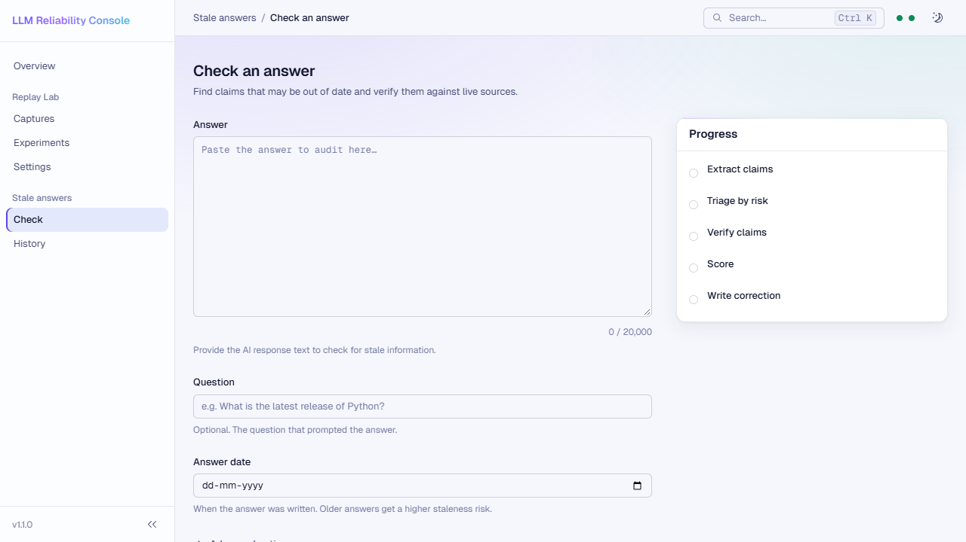
LLM RELIABILITY
GEEK ROOM GLOBAL AI HACKATHON 2026
Both tools live in one console
React + Vite + TypeScript, deployed on Vercel.
From paste to corrected answer
Paste an answer, watch claims extracted and verified live, then read the score, evidence and correction.
Replay Lab: captures, experiments, verdicts
Stale answers: check and history
Works on phone and tablet
Check an answer: progress streams stage by stage.
Try it: llm-reliability-console.vercel.app
Bifrost track + Tavily track · github.com/VIKI7-HUB/llm-reliability
10

Slide 11
LLM RELIABILITY
GEEK ROOM GLOBAL AI HACKATHON 2026
Three services, each deployed only after CI passes
One repo; main is protected by five required checks.
Piece
Stack
Where it runs
Console
React, Vite, TypeScript
Vercel
Replay Lab gateway
Go, Bifrost core v1.15.1
Render (Docker)
Stale Detector API
Python, FastAPI, Tavily
Render
Contract check
Real backends vs console zod schemas
GitHub Actions, every PR
A change that breaks the console's reading of the API cannot merge.
Bifrost track + Tavily track · github.com/VIKI7-HUB/llm-reliability
11

Slide 12
LLM RELIABILITY
Try both checks on your own traffic
Everything runs without keys on mock providers,
and live with Gemini and Tavily.
Open the console
Check an answer
Read the code
Send sample traffic,
run an experiment.
Load the example and
watch it get corrected.
Go plugin, FastAPI
service, React console.
First request may take ~1 min (free tier wakes up).
Live Tavily search, ~4 s per claim.
github.com/VIKI7-HUB/llm-reliability
Ship the cheaper model with proof. Ship answers that are still true.
NEXT |
12

Slide 13

LLM RELIABILITY
Don't take our word for it.
Check it live.
Scan the code, paste any LLM answer, and watch
a stale fact get caught and corrected in seconds.
llm-reliability-console.vercel.app
github.com/VIKI7-HUB/llm-reliability · Thank you, judges
Scan to open the live console
13

