Slide 1

YOUR FINANCE ESCORT
Presented by : Vikram and Kanishka

Slide 2

Problem Statement
Managing personal finances can be challenging, particularly for individuals who lack financial literacy or struggle with impulse spending. For example, a young professional might find it difficult to stick to a budget, save for future goals, and avoid accumulating debt. Traditional budgeting tools often require manual input and offer limited insights, leaving users feeling overwhelmed and unsure of how to improve their financial situation. Without clear visibility into their spending habits and financial health, users may struggle to make informed decisions about their money.

Slide 3

LIMITATIONS OF EXISTING
Manual Data Entry
📉 Human errors in expense categorization
⏳ Time-consuming manual transaction logging
🔄 No real-time sync with Multiple bank accounts
Generic Budgeting No spending pattern analysis
No Customized budgeting
🚫 Inflexible to life changes

Slide 4
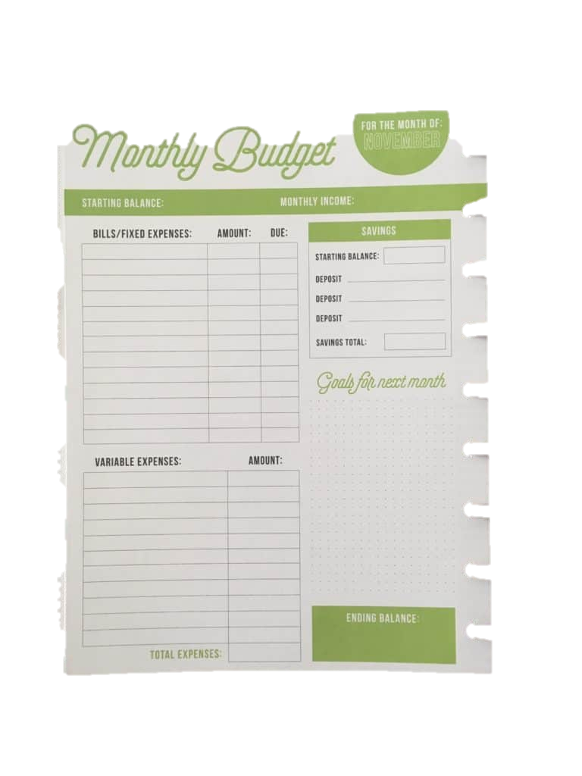
Key Features
Automated bank sync via Plaid
Expense tracking
Budget optimization
Customized savings recommendation
Modular microservices
Notifications (through Admin)

Slide 5
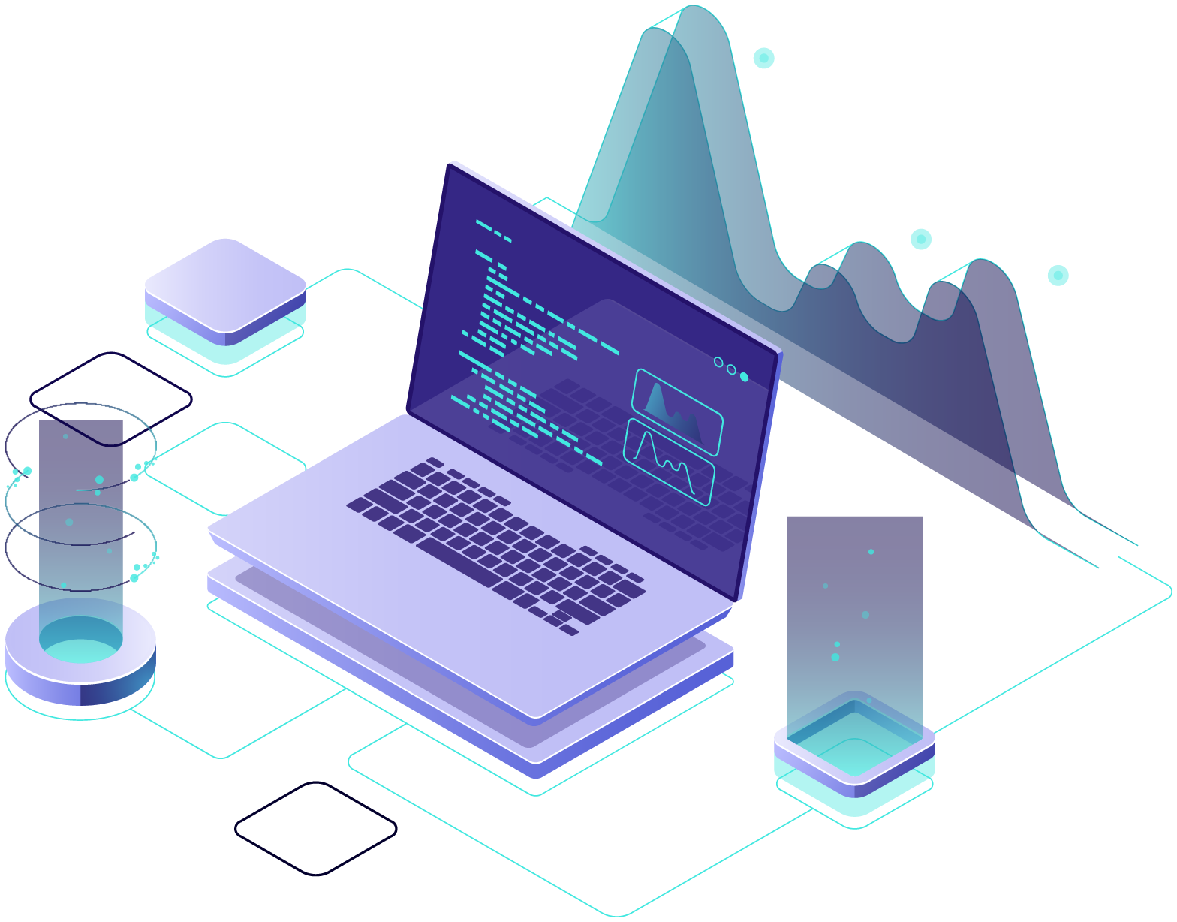
Tech Stack Used
FrontEnd : Angular Integeration : Entity Framework BackEnd : .NET, ASP .NET WEB API Storage : SQLServer

Slide 6
Microservices
Auth
01
Plaid (Global)
02
Analytics
03
Expenses
04
Budget
05
SavingsGoal
06
Notification (Settings)
07

Slide 7
Auth API Handles user authentication and authorization.
Supports login, registration, and token-based authentication.
Manages user roles and permissions securely.
Plaid API (Global) Integrates with the Plaid API to fetch real-time financial data.
Retrieves bank transactions, account balances, and institution info.
Acts as the backbone for connecting user accounts with financial institutions.
Analytics Microservice
Processes and analyzes financial data to generate insights.
Calculates spending patterns, category-wise expenses, and trends.
Expenses Microservice
Performs CRUD operations for user expenses.
Allows users to add, update, delete, and view expense records. Budget Microservice
Enables users to set and manage monthly budgets.
CRUD for budget creation and tracking per category.
SavingsGoal Microservice
Manages user-defined savings goals.
CRUD for creating and tracking saving targets.

Slide 8
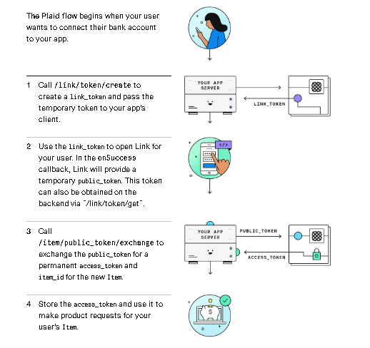
How Plaid Works ?!

Slide 9
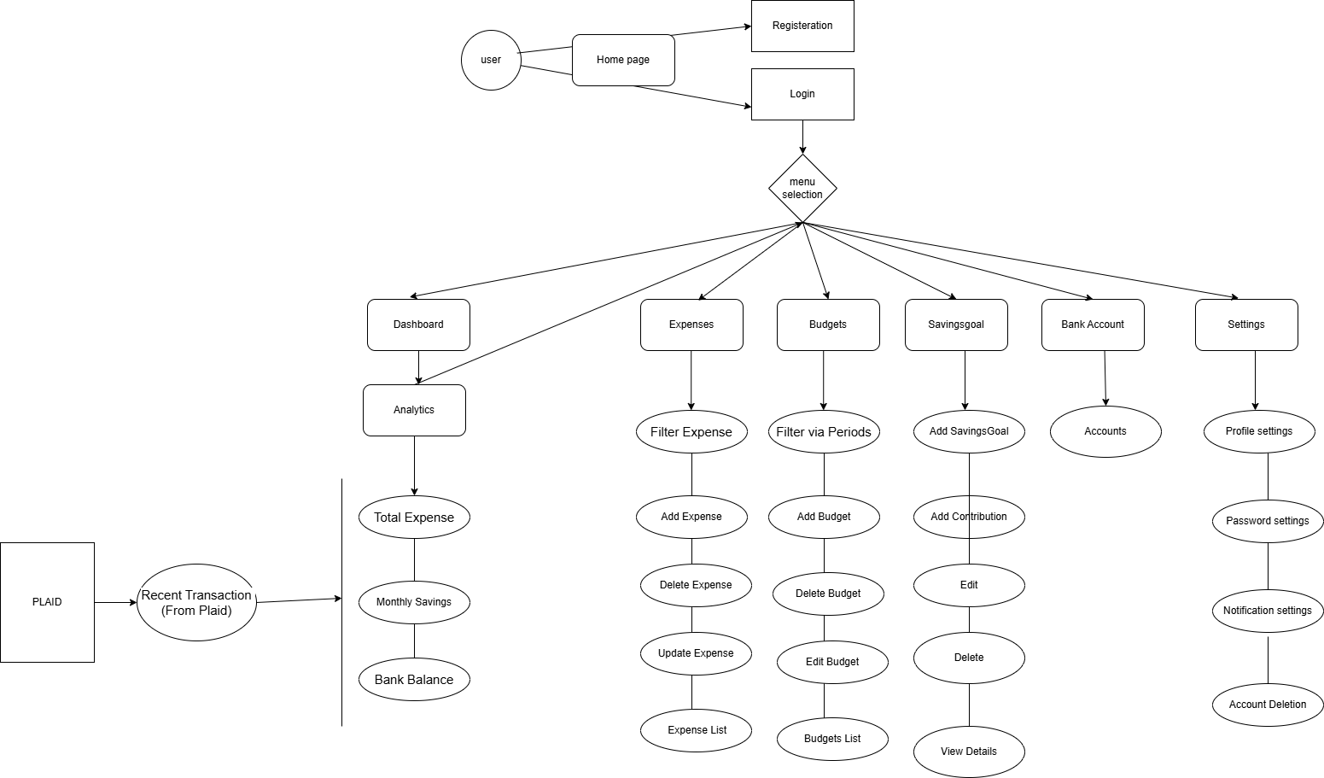
Workflow Diagram

Slide 10

Conclusion
✅ Microservice Architecture:
Independent scaling of features
99.9% uptime with fault isolation
✅ Smart Automation:
Budget suggestions
Plaid-powered real-time bank sync from
Multiple bank accounts
✅ User-Centric Design:
Unified dashboard
(expenses/budgets/savings)
Customizable notifications through Whatsapp
🚀 Next Phase Development
ChatBot (OLMo)
Visualization
Voice-command integration (Alexa/Google Assistant)
Family/shared budget support
Crypto/stock portfolio tracking

Slide 11

Thank You !

