Slide 1
ABSTRACT
Agricultural productivity is something on which indian economy highly depends.
This is one of the reasons that disease detection in plants plays an important role in agricultural field, as having disease in plants is quite natural.
proper care is not taken in this area then it causes serious effects on plants and due to which respective product quality, quantity or productivity is deteriorated
Therefore;fast,automaticand accurate method to detect plant disease is of great importance.
Hence, image processing technique is employed for the detection of plant diseases

Slide 2
INTRODUCTION
In this research, the aim is to develop a technology in agriculture field, based on engineering technique. Nowadays, crops face many traits/diseases.
On the basis of unhealthy or healthy categories, the neural network will classify the sample data of the leaf images.
Recently, ANN is widely used in agriculture image processing and it is one of the popular methods for classification problems as compared to most traditional classification approaches.
The aim of this work is threefold:
1) Identifying the infected object(s) based upon K-means clustering.
2) Extracting the feature set of the infected Leaf images.
3) Detecting and classifying the type of disease using ANNs(Artificial Neural Networks.

Slide 3
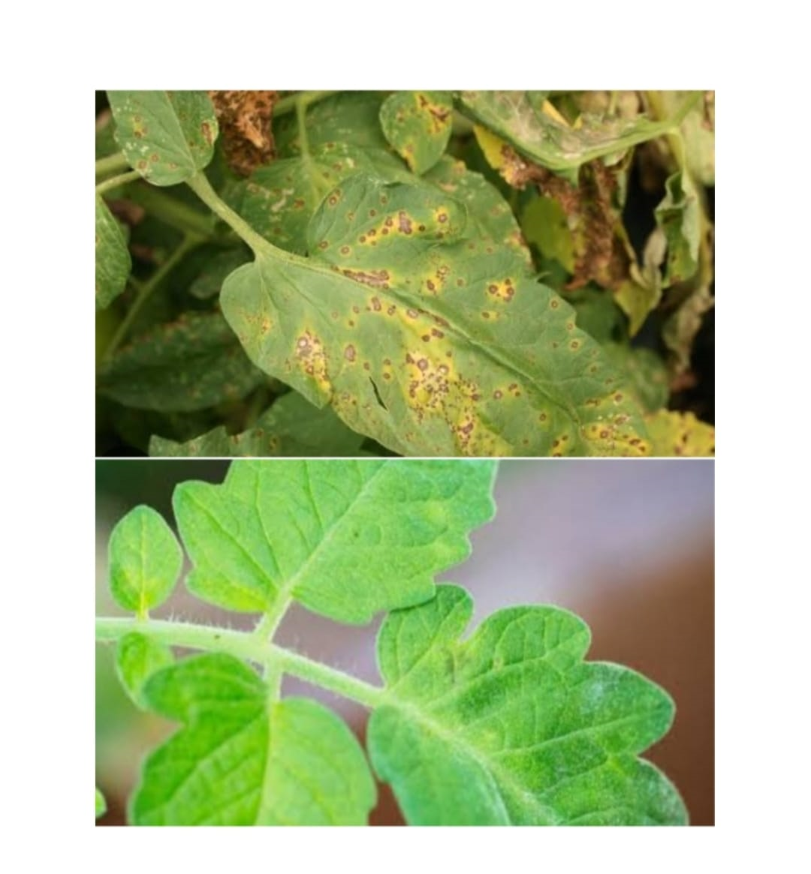
Continued…

Slide 4
EXISTING METHOD
Agriculture is an important source in the economic development of India. About 70% of Indian economy relies on agriculture.
The crops need to be monitored against diseases from the very first stage of their life-cycle to the time they are ready to be harvested.
The overall system disease detection and classification accuracy was found to be around 93%.
Many existing machine learning classifiers fails for leaf disease detection such as SVM , KNN, Decision Tree , Random Forest, etc

Slide 5
PROPOSED METHOD
This process describe about process to get the result of the classification of leaf disease.
Figure shows the flow chart of the proposed approach.
The fifty samples image for healthy leaf image and fifty sample unhealthy leaf images are taken and the image processing method is used.
The process for image processing has three components which are contrast enhancement, segmentation and features extraction.
Lastly, the collected data will be classified to health or unhealthy of leaves using Artificial Neural Network.

Slide 6
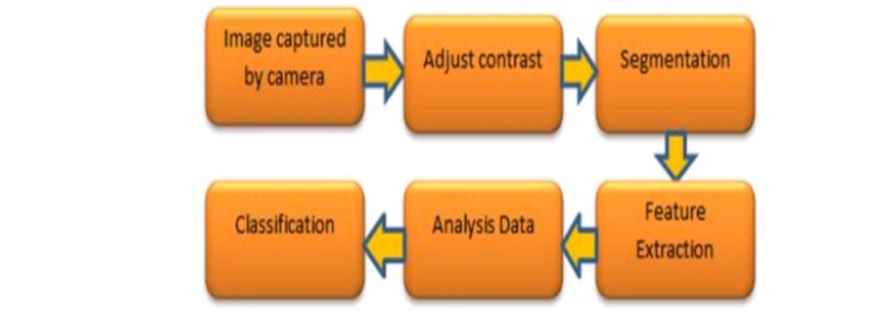
FLOW DIAGRAM

Slide 7
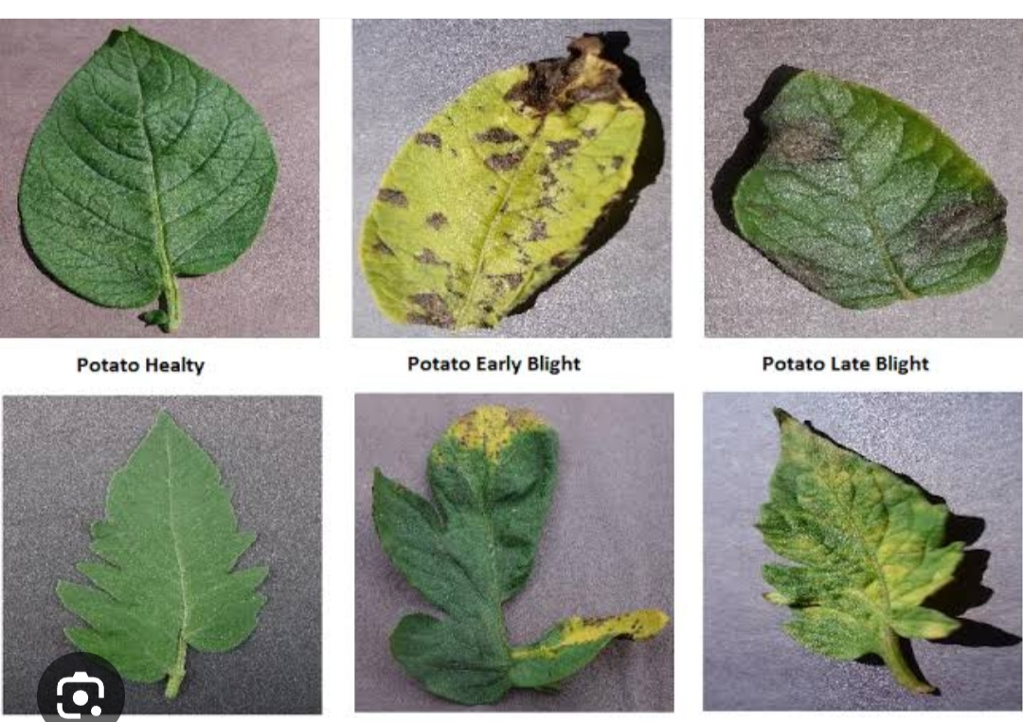
INPUT IMAGE SAMPLE
It is a type of signal processing in which input is an image and output may be image or features associated with an image

Slide 8
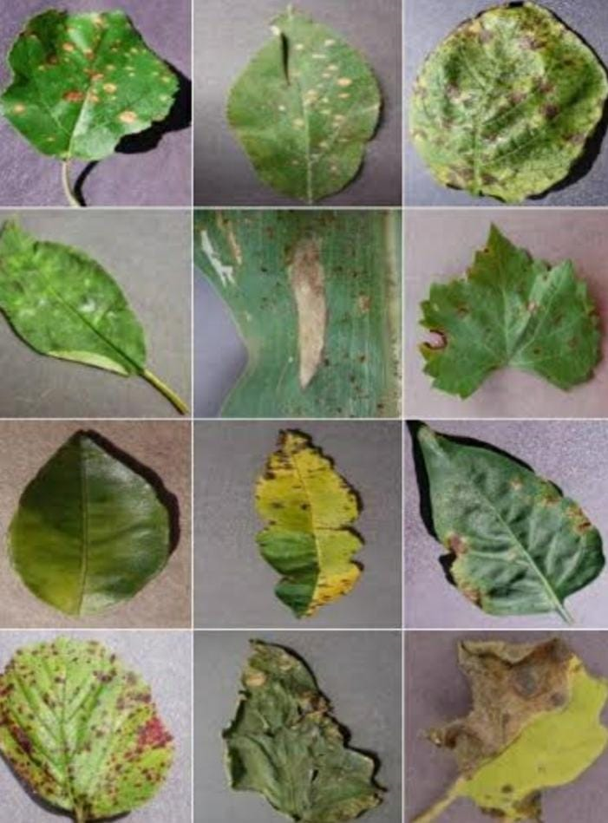
Continued…
The input images captured from devices at various instants may consist of the faces that are to be rotated in clockwise direction from horizontal axis to vertical axis such that face rotates clockwise and the face resembles the same as the database.

Slide 9
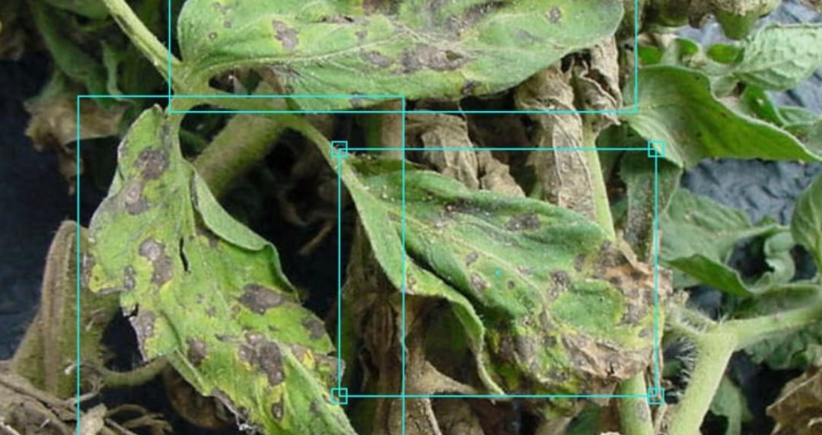
OBJECT DETECTION
Image or object Detection is a computer technology that processes the image and detects objects in it
People often confuse Classification.
The difference is rather clear.
If you need to classify image items you use classification

Slide 10
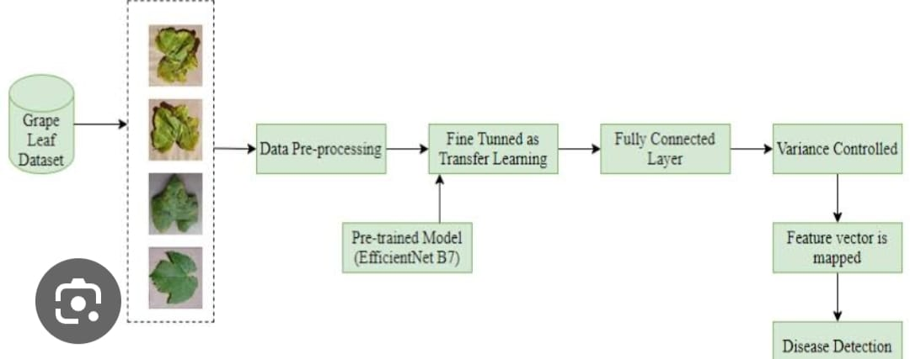
PREPROCESSING
Preprocessing for plant leaf disease detection and classification using an Artificial Neural Network (ANN) typically involves steps such as image normalization, resizing, noise reduction, and feature extraction. These steps help prepare the data before feeding it into the ANN model for training and classification.

Slide 11
SOFTWARE REQUIREMET
Tensor flow
Numpy
Pandas
Open cv
Keras
Python matlab

Slide 12
ADVANTAGES
Low complexity in algorithm
It can predict many types of diseases
Training time is less
Accuracy is high

Slide 13
APPLICATIONS
Smart farming
In government or private agriculture department
Fertilizers shops
Every farmer can use this to check what type of diseases and what fertilizer need to purchase

Slide 14
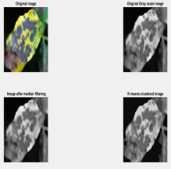
RESULT
RESULTS OF K-MEANS CLUSTERING:1
The figure shows the original image, the gray scale representation of same. Also the median filtered image can be seen. The K-means clustered image is present which clearly separates the infected part of leaf from the healthy part.The clustering is performed on the basis of the pixel intensity values

Slide 15

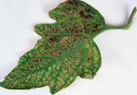
Continued…
RESULTS OF INITIAL SIX CENTRES FROM K MEANS CLUSTERING:2
The initial centers obtained from the program are shown as seen in the command window. These centers form the basis of the Kmeans algorithm which is used to segment image into different regions i.e healthy an infected. The following image is a tomato leaf diseased image and below are its initial centers calculated:

Slide 16
Continued…
RESULT OF FEATURE EXTRACTION:2
A set of features is extracted from the segmented image which are given as a input while training of the neural network. These features include covariance, standard deviation, entropy and energy. The following is the image of Yellow Sigatoka plant disease and the values of the features are listed below.
Average = 171.12
Energy = 147
Entropy = 0
Standard Deviation = 36.2912
Covariance = 1317.43

Slide 17

Continued…
The results of Feed Forward Neural Network for Black Spot Disease are as shown below
Average = 185.32
Energy = 128
Entropy = 0
Standard Deviation = 29.4282
Covariance = 277.5350
Data of Feature Set =
1.8528
1.2800

Slide 18

Continued…
RESULT OF CASCADED FEED NEURAL NETWORK :4
The results of Feed Forward Neural Network for Tobacco Ring Spot Disease are as shown below:
Average = 326.20
Energy = 147
Entropy = 0
Standard Deviation = 29.0432
Covariance = 119.6732

Slide 19
RESULTS: GRADING
Keep in mind that the success of the model heavily relies.
On the quality and size of the dataset as well as the proper tuning of parameters
Additionally newer techniques and architectures may have emerged beyond my knowledge cutoff in September 2021,so you may want to most up-to-date approaches

Slide 20
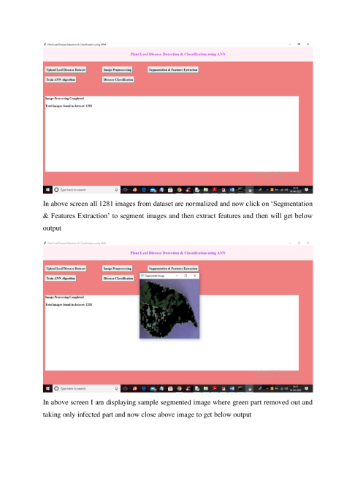
OUTPUT
Test the ANN on unseen data to see how well it generalizes to new samples.
The output of the ANN will be the predicted disease class for a given plant leaf image.

Slide 21
CONCLUSION
The applications of K-means clustering and Neural Networks (NNs) have been formulated for clustering and classification of diseases that affect plant leaves.
Recognizing the disease is mainly the purpose of the introduced approach. Thus, Feed Forward and Cascaded Feed Neural Networks Algorithm was tested on seven diseases which influence the plants; they are: Black Spot, Powdery Mildew, Yellow Sigatoka, Tobacco Ringspot, Tomato Leaf Disease, Frog Eye and Valedinsia Leaf Spot.

Slide 22
Continued…
The experimental results indicate that both the approaches can significantly support an accurate detection of Leaf Diseases with little computational effort.
Cascaded Feed approach is better as compared to Feed Forward approach as it requires lesser number of iterations because a smaller value of gradient facilitates quick adaption and also reduces the Mean Square error
 | Number of iterations | Performance | Gradient
Blackspot Disease | 59 | 0.00912 | 0.370
Frog Eye Disease | 51 | 0.0941 | 0.492

Slide 23
FUTURE SCOPE
The Feed Forward and Cascaded Feed Neural Network algorithms can be used to design an expert system for the farmers for early detection of Plant Diseases.
Presently seven Diseases as mentioned earlier can be detected by this process.
The Feed Forward and Cascaded Feed algorithms can be expanded for detection of multiple diseases on a significantly large scale.
The use of other algorithms can be explored to enhance the efficiency of the system in future.

Slide 24
REFERENCES
Al-Hiary, S. Bani-Ahmad, M. Reyalat, M. Braik and Z. ALRahamneh, “Fast and Accurate Detection and Classification of Plant Diseases”, International Journal of Computer Applications (0975 – 8887) Volume 17– No.1, March 2022.
Al-Bashish, D. M. Braik and S. Bani-Ahmad, 2011 Detection and classification of leaf diseases using K means-based segmentation and neural-networks based classification. Inform. Technol. J., 10: 267- 275. DOI: 10.3923/itj.2022.267.275.
Biological management of Yellow Sigatoka Disease of banana caused by Mycospharella Musicola by V.Shanthiya.

Slide 25
Continued…
Detection of Diseases in Different Plants Using Digital Image Processing by K.Gowthami, M.Pratyusha, B.Somasekhar
Disease Detection Using Different Algorithms by Trimi Neha Tete (Department of Electrical & Electronics) and Sushma Kam
The Component Median Filter forNoiseRemovalin Digital Images Harish 1 and M.R.Gowtham2 1Department of Electronics and Communication Engineering, Priyadarshini College of Engineering, NELLORE – 524 004, A. P., INDIA
R.Nathan,” Spatial Frequency Filtering,” in Picture Processing and Psychopictrotics,B.S .Lipkin and A.Roswnfeld,Eds., Academic Press, New York
R.Nathan,” Spatial Frequency Filtering,” in Picture Processing and Psychopictrotics,B.S .Lipkin and A.Roswnfeld ,Eds., Academic Press, New York.

Slide 26
THANK YOU

