Slide 1
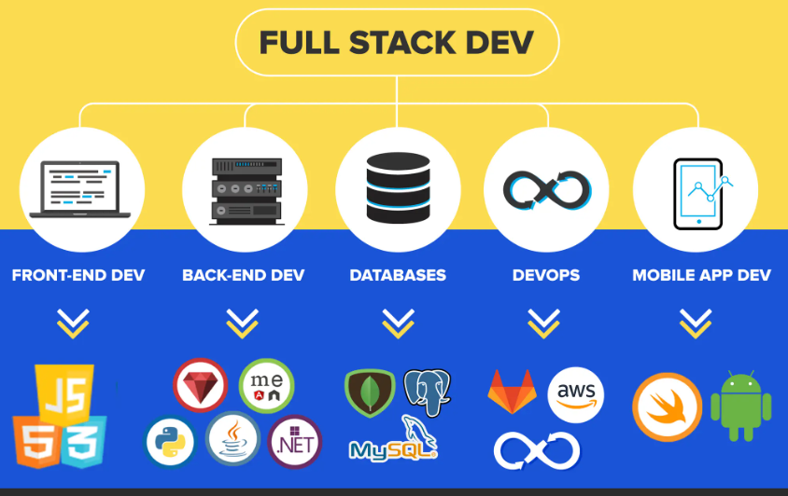
basic presentation
By :
NAGIREDDY VINEELA

Slide 2
CONTENTS
Introduction to Full stack development.
web application development.
front end development.
back end development.
Database server.
Tor browser.
Html language.

Slide 3
FULL STACK DEVLOPMENT
Full stack development refers to the practice of creating web applications or software products that encompass both the front-end (what users see and interact with) and the back-end (the server-side logic and database management).
A full stack developer is proficient in working on all aspects of a technology stack, from designing user interfaces to implementing server-side logic and databases, ensuring the entire application functions smoothly.
This versatility allows them to handle various tasks involved in building and maintaining a complete web application.

Slide 4
APPLICATION OF FULL STACK DEVELOPMENT
Full stack development refers to the ability to work on both the front-end (what users see and interact with on a website or app) and the back-end (the server-side logic and databases that support the front-end).
It's like being able to both design a house (front-end) and build its foundation and plumbing (back-end) – covering everything needed to create a fully functional application or website from start to finish.

Slide 5
APPLICATIONS
Web Development
E-commerce Platforms
Content Management Systems (CMS)
Social Media Platforms:
Mobile Applications:
IoT (Internet of Things)
API Development

Slide 6
WEB APPLICATION DEVELOPMENT
Web application development involves creating software applications that run on web browsers.
Key steps in web app development includes:
Planning: Defining goals, features, and target users
Design: Creating wireframes and UI design.
Frontend Development: Writing code for the client-side (what users see and interact with).
Backend Development: Implementing server-side logic, databases, and APIs.
Testing: Identifying and fixing bugs.
Deployment: Making the web app live for users.

Slide 7
FRONT-END DEVELOPMENT
Front end development involves creating the visible parts of websites or web applications that users interact with directly. It includes HTML, CSS, and JavaScript coding to build the user interface (UI) and ensure a responsive, engaging user experience.
Plan: Understand requirements.
Design: Create UI/UX wireframes.
Code: Write HTML, CSS, JS.
Test: Ensure functionality and compatibility.
Optimize: Improve performance and responsiveness.
Deploy: Make live.

Slide 8
BACK END DEVELOPMENT
Backend development involves building and maintaining the server-side logic, databases, and APIs that enable the functionality of websites and web applications.
It focuses on handling data storage, business logic, security, and server-side interactions, supporting the frontend and ensuring smooth application operation.
Popular backend languages include Python, Ruby, Java, PHP, and frameworks like Django, Ruby on Rails, Spring Boot, and Laravel facilitate backend development tasks efficiently.

Slide 9
SERVERS
Web Servers
Application Servers
Programming Languages and Frameworks
Key Server-Side Technologies
APIs

Slide 10
TOR BROWSER
Privacy Protection:
The browser blocks trackers and ads that try to follow you across websites.
It isolates each website you visit, preventing them from tracking your activity across multiple sites.
Data Protection:
Automatically clears cookies and browsing history after each session.
Ensures that no data is retained between sessions.
Onion browser:
Available on the Apple App Store.
Orbot (Android):
A proxy app that allows other apps to use the Tor network on Android.
Often used in combination with browsers like Firefox to route traffic through Tor.

Slide 11
HTML:HYPER TEXT MARKUP LANGUAGE
HTML document typically starts with a <!DOCTYPE html> declaration.
followed by <html>, <head>, and <body> sections.
<head>: Contains meta-information about the document, such as the title and character encoding.
<body>: Contains the content of the web page, including text, images, and links.
Purpose:
HTML defines the structure and content of a web page.
It tells web browsers how to display text, images, and other elements on the screen.
Usage:
HTML is used alongside CSS (Cascading Style Sheets) for styling and JavaScript for interactivity.
creating complete and dynamic web experiences.

Slide 12
THANK YOU BY:NAGIREDDY VINEELA

