Slide 1

SMART INDIA HACKATHON 2026
TITLE PAGE
• Problem Statement ID – SIH26086
• Problem Statement Title- Hyperlocal Monsoon Onset & Break Prediction System (Block/Village Scale)
• Theme- Agriculture, FoodTech & Rural Development
• PS Category- Software
• Team ID- 120087
• Team Name- TITANS
• Idea Title- VARSHASETU
• Technical Subtitle- Hyperlocal Monsoon Onset, Break & Agricultural Advisory System
• Tagline- “Bridging Climate Intelligence with Every Farmer”
• Ministry / Ref Org- Ministry of Earth Sciences (MoES) | NCMRWF
• College / Institute- MVGR College of Engineering (Autonomous), Vizianagaram, AP

Slide 2
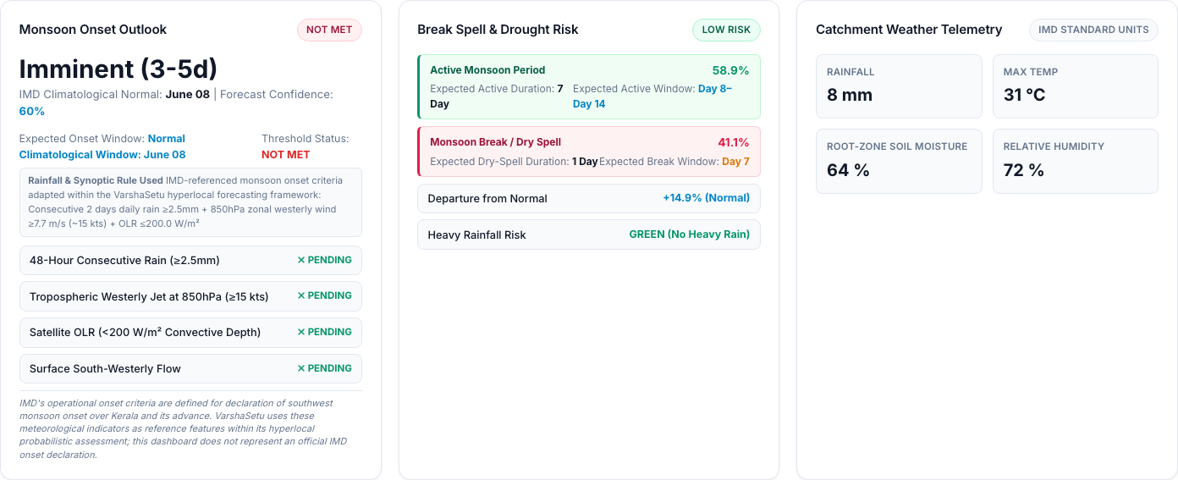
VARSHASETU: Hyperlocal Monsoon Onset, Break & Agricultural Advisory System
TITANS
Proposed Solution (Describe your Idea/Solution/Prototype)
Detailed explanation of the proposed solution
How it addresses the problem
Innovation and uniqueness of the solution
Live Dharmasagar Catchment Status: Onset MET, Active 74%, Break 18%.

Slide 3
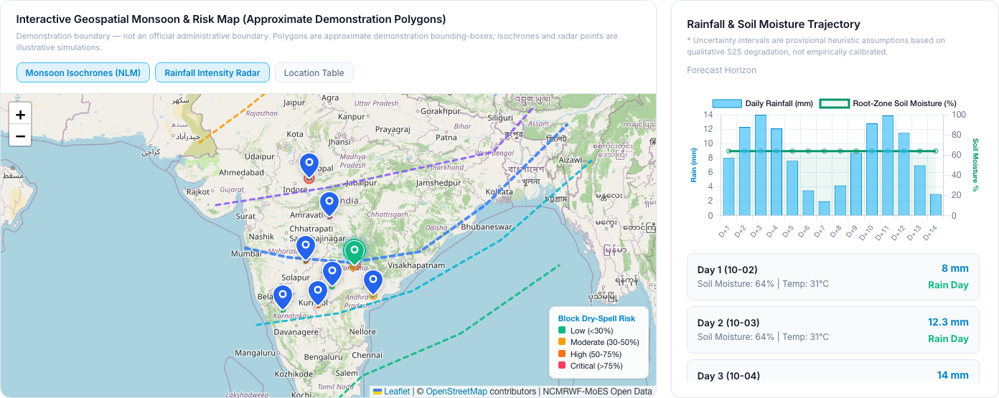
TECHNICAL APPROACH
TITANS
Technologies to be used (e.g. programming languages, frameworks, hardware)
Methodology and process for implementation (Flow Charts/Images/ working prototype)
Notice: Demonstration boundaries — approximate visualization, not official administrative boundaries.

Slide 4
FEASIBILITY AND VIABILITY
TITANS
Analysis of the feasibility of the idea
Potential challenges and risks
Strategies for overcoming these challenges

Slide 5
IMPACT AND BENEFITS
TITANS
Potential impact on the target audience
Benefits of the solution (social, economic, environmental, etc.)

Slide 6
RESEARCH AND REFERENCES
TITANS
Details / Links of the reference and research work

