Slide 1

SMART INDIA HACKATHON 2026
TITLE PAGE
VARSHASETU
Hyperlocal Monsoon Onset, Break & Agricultural Advisory System
“Bridging Climate Intelligence with Every Farmer”
Problem Statement ID: SIH26086
Problem Title: Hyperlocal Monsoon Onset & Break Prediction System
Spatial Resolution: Block / Village Scale (5–10 km)
Ministry / Org: Ministry of Earth Sciences (MoES) | NCMRWF
Theme & Category: Agriculture, FoodTech & Rural Development | Software
Team ID & Name: 120087 | TITANS
Institution: MVGR College of Engineering (Autonomous), Vizianagaram, AP
DECISION CONTINUUM: “From climate signals to field-level decisions.”
• 1. Climate Signals: ENSO (NOAA CPC) | IOD (DMI) | MJO (RMM)
• 2. Regional Weather: NASA POWER + Tenali Catchment Daily Data (2015-2025)
• 3. AI Forecast: 7, 14, 21, 30-Day Probabilistic S2S Outlooks
• 4. Decision Support: Onset (MET) | Active Spells | Break Risk (>7d Dry Runs)
• 5. Farmer Action: ICAR-CRIDA Crop Sowing, Irrigation & Contingency Directives

Slide 2
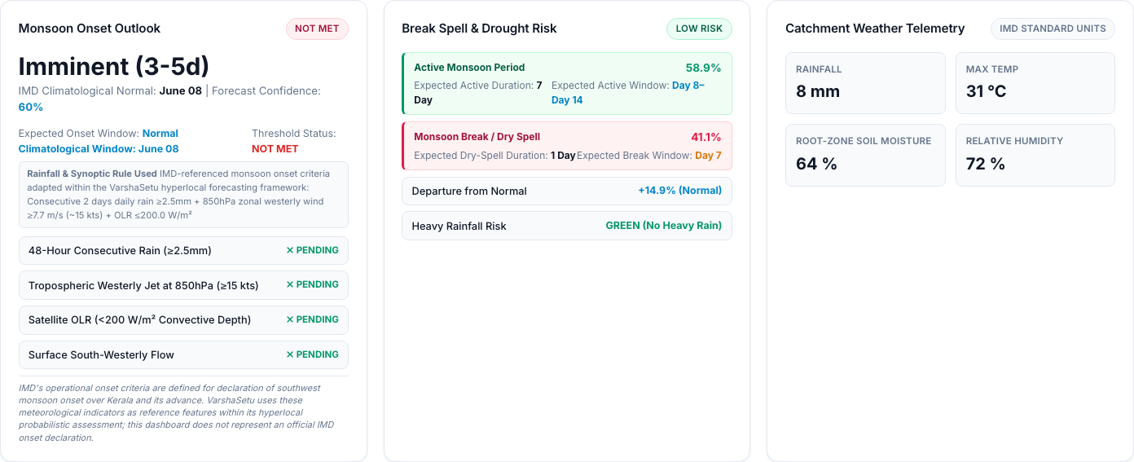
VARSHASETU: Hyperlocal Monsoon Onset, Break & Agricultural Advisory System
TITANS
❖ Proposed Solution (Describe your Idea/Solution/Prototype) • Detailed Explanation • How It Addresses The Problem • Innovation & Uniqueness
“From predicting rainfall to translating uncertainty into agricultural decisions.”
CONVENTIONAL APPROACH: Forecast → Information
• Coarse 50–100 km district forecasts mask village micro-climates and localized dry spells.
• Delivers raw millimeter rain predictions; leaves farmers to guess sowing & irrigation timing.
VARSHASETU APPROACH: Forecast → Risk → Agricultural Decision → Action
• Hyperlocal block/village precision (5–10 km) bridging the scale gap with local agro-meteorology.
• Translates 7–30 day S2S probabilities directly into ICAR-CRIDA crop stage directives.
ONSET OUTLOOK
Probabilistic Monsoon Onset Assessment
• Adapts IMD criteria: 2d rain ≥2.5mm, 850 hPa wind ≥7.7 m/s, OLR ≤200 W/m²
• Status: MET / NOT MET with arrival date probability
• Directs optimal sowing preparation window
ACTIVE SPELL OUTLOOK
Intra-Seasonal Active Wet-Spell Outlook
• Detects sustained wet circulation (>+20% normal rain for ≥5 days)
• Identifies expected duration & soil saturation curves
• Maximizes rainwater harvesting & nursery sowing
BREAK SPELL OUTLOOK
Dry-Spell / Severe Break Outlook
• Predicts prolonged dry runs: 3–5d, 5–7d, and >7d continuous dry spell alerts
• Helps reduce re-sowing risk through break-spell awareness
• Triggers life-saving irrigation & contingent crop alerts
HEAVY RAIN RISK
Extreme Precipitation Warnings (>64.5 mm)
• Evaluates daily rainfall exceeding 64.5 mm IMD threshold
• Prevents fertilizer leaching and expensive urea top-dressing washout
• Advises field furrow drainage to prevent root rot
DECISION CHAIN: Climate Signals ➔ Regional Weather ➔ Probabilistic S2S Forecast ➔ Hyperlocal Risk ➔ Crop-Specific Advisory ➔ Farmer / Officer Action
SIX CORE INNOVATION PILLARS (HOW VARSHASETU DIFFERS):
• 1. Hyperlocal Scale: Bridges scale gap between broader 50km models and 5–10km village agricultural decisions.
• 2. Planetary Teleconnections: Integrates global ENSO ONI, IOD DMI, and MJO RMM with localized agro-meteorology.
• 3. Probabilistic S2S Outlooks: 7, 14, 21, and 30-day forecast windows with calibrated uncertainty bounds.
• 4. Operational Decision Layers: Dedicated onset, active, break, and heavy-rain threshold assessments.
• 5. Crop-Specific Agronomy: ICAR-CRIDA rules for 6 Kharif crops + automatic contingent short-duration cultivars.
• 6. Inclusive Last-Mile Reach: 7 Indian languages, native Urdu RTL layout, and Web Speech audio TTS.
WORKING PROTOTYPE EVIDENCE (STATUS GRID):
Dharmasagar Catchment: Onset MET, Active 74%, Break 18% (Helps reduce re-sowing risk)

Slide 3
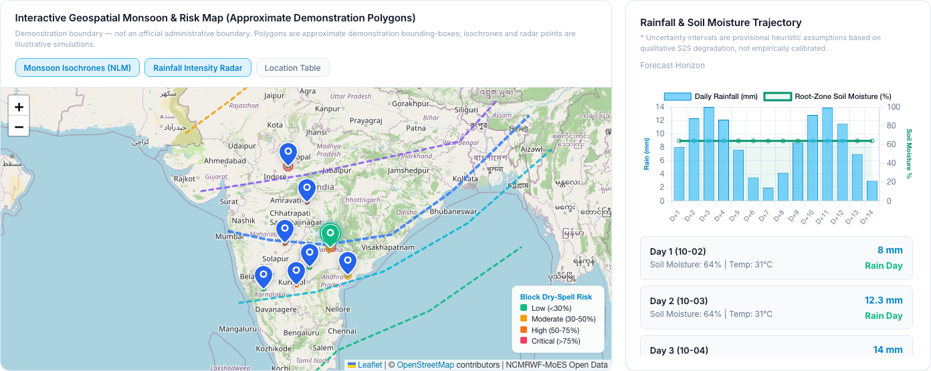
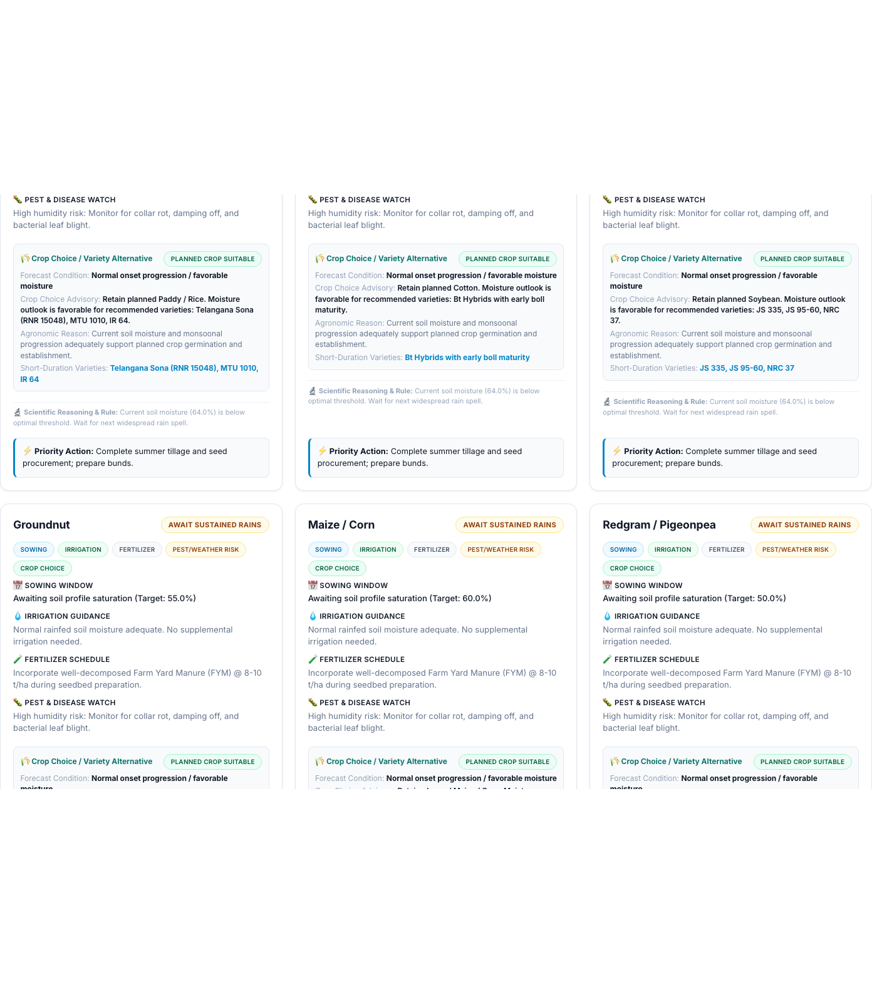
TECHNICAL APPROACH
TITANS
❖ Predefined Pointers • Technologies to be used (languages, frameworks, hardware) • Methodology and process for implementation (Flow Charts/Images/ working prototype)
END-TO-END ARCHITECTURAL & METHODOLOGY PIPELINE
1. HYPERLOCAL GEOSPATIAL RISK MAP & ISOCHRONES (LEAFLET.JS GIS)
1. GLOBAL TELECONNECTIONS: NOAA CPC ONI (real SST connector) | IOD (DMI) & MJO (RMM) benchmarks
2. REGIONAL AGRO-MET TELEMETRY: NASA POWER API + Tenali catchment daily observations (2015–2025; 4,018 rows)
3. FEATURE ENGINEERING: 18 input features: Lagged anomalies (7d, 14d, 30d), moisture deficit, thermal gradients
4. PHYSICS-INFORMED ML ENGINE: Random Forest Classifier (break_model_rf_real_candidate.joblib) trained on S2S physics
* Demonstration boundary — not an official administrative boundary. Isochrones & radar are simulated.
5. PROBABILISTIC S2S OUTLOOK: 7 / 14 / 21 / 30-Day Multi-Horizon calibrated probabilistic distributions & spreads
2. ICAR-CRIDA AGRICULTURAL ADVISORY & CONTINGENCY ENGINE
6. OPERATIONAL DECISION LAYER: IMD-adapted Onset (MET) | Active Spells | Break Risk (>7d dry run) | Heavy Rain (>64.5mm)
7. GEOSPATIAL & ADVISORY ENGINES: Leaflet GIS Risk Polygons + ICAR-CRIDA stage rules for 6 Kharif crops & alternatives
8. MULTI-CHANNEL RURAL DELIVERY: Farmer / Extension Officer workflows | 7 Languages | Web Speech TTS | Simulated SMS/WhatsApp
Automatic alternative crop recommendation: Short-duration Telangana Sona RNR 15048 / Kadiri-6.
TECH STACK: Python 3.14 / Flask 3.1 | Scikit-Learn 1.6.1 / Joblib | Leaflet.js 1.9.4 | Chart.js 4.4.1 | SQLite3 | Web Speech API | 7-Language i18n

Slide 4
FEASIBILITY AND VIABILITY
TITANS
❖ Predefined Pointers • Analysis of the feasibility of the idea • Potential challenges and risks • Strategies for overcoming these challenges
+0.158
Brier Skill Score (BSS)
Verified skill improvement over 30-year climatology baseline (BS: 0.171 vs 0.203).
0.756
ROC-AUC Score
Strong discriminative capability separating active wet spells from damaging dry break spells (Recall: 0.692).
60 / 60
Backend Tests Passed
100% Pytest pass rate across API contracts, ML inference, crop rules & i18n integrity.
42 / 42
Mobile Audit Passed
100% responsive pass rate across 6 viewport resolutions (320px–1440px) and all 7 languages.
MODEL VALIDATION & ZERO LEAKAGE POLICY:
• Chronological Train/Test Split: Strict temporal partition without k-fold leakage.
• Train Set: 2015–2022 (2,922 daily observed records)
• Test Set: 2023–2025 (1,096 daily unseen records)
• Zero Temporal Leakage Policy: Standard random cross-validation allows future atmospheric states to leak into past predictions. VarshaSetu strictly evaluates on out-of-sample forward horizons.
• Verified Candidate Metrics: • Brier Score: 0.171 (vs 0.203 Climatology Baseline)
• ROC-AUC: 0.756 | Precision: 0.621 | Recall: 0.692
• F1-Score: 0.655 for rare damaging break spell events
• Zero Cost Burden on Farmers: Lightweight browser execution requiring no high-end devices, app store downloads, or paid farmer subscriptions.
ENGINEERING FEASIBILITY, TRANSPARENCY & INTEGRATION ROADMAP:
CURRENTLY IMPLEMENTED (Working Prototype):
✓ Physics-informed ML forecasting (7, 14, 21, 30 days) | ✓ Live NOAA CPC ENSO ONI connector
✓ Interactive Leaflet risk mapping (isochrones & radar) | ✓ ICAR-CRIDA stage rules for 6 Kharif crops
✓ Contingent short-duration cultivars | ✓ 7 Indian languages with native Urdu RTL | ✓ Web Speech audio TTS
✓ Dual Farmer & Extension Officer workflows | ✓ SQLite transmission audit logging
CURRENT ENGINEERING LIMITATION (Radical Transparency):
• Operational NCMRWF ERPS upper-air gridded data socket requires institutional MoES security credentials.
• Current Prototype Solution: Gracefully utilizes statistically calibrated climatological benchmark distributions
for 850 hPa wind and satellite OLR, transparently disclosed as [CONFIGURED BENCHMARK] in UI.
FUTURE INTEGRATION ROADMAP (Deployment Readiness):
• Live NCMRWF Feed Integration: Plug-and-play architecture ready for NCMRWF NEPS 12km ensemble stream.
• Production Telecom Gateway: Sandbox payload generator ready for State portals (e.g. Rythu Bharosa SMS).
• Multi-State Rollout: Pluggable ICAR-CRIDA rules support seamless expansion to Maharashtra, MP, and Karnataka.
MATURITY CONTINUUM: Prototype (Verified) ➔ Pilot (Target Catchments) ➔ Operational Integration (MoES/NCMRWF Aligned)

Slide 5
IMPACT AND BENEFITS
TITANS
❖ Predefined Pointers • Potential impact on the target audience • Benefits of the solution (social, economic, environmental, etc.)
FARMERS: KNOW ➔ DECIDE ➔ ACT
Micro-Level Actionable Field Directives
• Onset Uncertainty Awareness: Prepares nursery and seedbed with thermodynamic confidence instead of speculative sowing.
• Break-Spell Risk Awareness: Avoids sowing directly before a 10-day dry spell, helping reduce re-sowing risk.
• Heavy-Rain Precautions: Protects freshly applied fertilizers from leaching; opens drainage furrows to prevent seedling submergence.
• Crop-Specific Sowing Gates: Moisture saturation minimums tailored to Paddy (70%), Cotton (60%), Groundnut (50%).
• Informed Irrigation Timing: Maximizes natural rainfall utilization; schedules life-saving protective irrigation only when necessary.
• Contingency Cultivar Choices: Suggests short-duration varieties (e.g. Telangana Sona RNR 15048) if onset is delayed >14 days.
• Vernacular Voice Access: Illiterate and marginal farmers listen to advisories via one-tap Web Speech audio TTS in native dialect.
EXTENSION OFFICERS: SEE ➔ PRIORITIZE ➔ COMMUNICATE
Mandal-Scale Tactical Oversight & Coordination
• Spatial Risk Visualization: Evaluates composite vulnerability clusters (Low to Severe) across 10–20 adjoining Panchayats simultaneously.
• Block/Mandal Aggregates: Synthesizes regional rainfall anomalies and dry spell duration for proactive administrative intervention.
• Standardized Crop Intelligence: Harmonizes ICAR-CRIDA agronomic guidance across Krishi Vigyan Kendras (KVKs) and field workers.
• Contingency Seed Mobilization: Prepositions buffer stocks of drought-resilient alternative seeds ahead of forecast break spells.
• Input Supply Synchronization: Directs Primary Agricultural Credit Societies (PACS) to schedule subsidized fertilizer release around heavy rain.
• Targeted Messaging Workflow: Dispatches localized mobile alerts to specific village farming groups via simulated gateway.
• Audit Accountability: Maintains transparent SQLite records of dispatch history, delivery status, and timestamps.
SYSTEM & SOCIETY: TRIPLE IMPACT PILLARS
Social, Economic & Environmental Value
SOCIAL INCLUSIVITY:
• 7 regional languages (English, Telugu, Hindi, Tamil, Kannada, Urdu, Malayalam) with 231 keys each.
• Native Urdu RTL layout transformation and Nastaliq typography.
• Web Speech API TTS delivers audio to illiterate smallholders.
• Mobile-first web access operates on basic smartphone browsers without requiring paid app downloads.
ECONOMIC RESILIENCE:
• Supports optimal timing of seed sowing, irrigation cycles, and fertilizer application.
• Helps manage avoidable re-sowing risk through 10–14 day break-spell awareness.
• Promotes low-cost contingency cultivars to salvage late-onset seasons.
ENVIRONMENTAL SUSTAINABILITY:
• Fertilizer precautions around heavy-rain risk prevent chemical runoff into rural water bodies.
• Informed irrigation timing conserves valuable groundwater reserves.
• Fosters climate-resilient crop selection adapted to S2S rainfall variability.
EVIDENCE STRIP: WORKING PROTOTYPE | 60/60 BACKEND TESTS | 42/42 MOBILE AUDITS | 7 LANGUAGES | PROBABILISTIC S2S ML | HYPERLOCAL GIS

Slide 6
RESEARCH AND REFERENCES
TITANS
❖ Predefined Pointers • Details / Links of the reference and research work
RESEARCH-TO-PROTOTYPE PIPELINE: Problem Identification ➔ Scientific Research ➔ Climate Features ➔ ML Model ➔ Probabilistic Validation ➔ Working Prototype
MONSOON & METEOROLOGICAL RESEARCH:
• India Meteorological Department (IMD): Operational criteria for Southwest Monsoon onset declaration over Kerala, S2S extended range protocols, and agro-met advisories. [mausam.imd.gov.in]
• Ministry of Earth Sciences (MoES) & NCMRWF: National Centre for Medium Range Weather Forecasting Extended Range Prediction System (ERPS) reanalysis and model documentation. [ncmrwf.gov.in]
• NOAA Climate Prediction Center (CPC): Oceanic Niño Index (ONI) 3-month running mean SST anomalies in Niño 3.4 region (Real external connector). [cpc.ncep.noaa.gov]
• Australian Bureau of Meteorology (BOM): Indian Ocean Dipole (DMI) and Wheeler-Hendon Real-time Multivariate MJO (RMM1/RMM2) indices. [bom.gov.au/climate]
AGRICULTURE & SATELLITE DATA SOURCES:
• ICAR - CRIDA Agro-Met Protocols: Central Research Institute for Dryland Agriculture technical contingency bulletins, moisture saturation gates, and cultivar selection protocols for rainfed Kharif crops. [crida.in]
• NASA POWER Agro-Climatology Project: Prediction of Worldwide Energy Resources surface agro-climatology data access for solar radiation, relative humidity, precipitation, and surface temperature. [power.larc.nasa.gov]
• Tenali Agricultural Catchment Records: 4,018 daily observed weather records (2015–2025) utilized for chronological out-of-sample model training and evaluation.
EVALUATION STANDARDS & ACCESSIBILITY:
• WMO S2S Prediction Project: World Meteorological Organization Subseasonal-to-Seasonal prediction research, Brier Skill Score standards, and probabilistic verification frameworks. [s2sprediction.net]
• Probabilistic Forecast Scoring: Brier Score (BS), Brier Skill Score (BSS), and ROC-AUC verification standards for calibrated binary and multi-class weather probability assessment.
• W3C Web Speech & Telecom Standards: SpeechSynthesis API BCP-47 localized voice standards & TRAI DLT rural messaging template specifications.
SCIENTIFIC INTEGRITY, PROTOTYPE BOUNDARIES & ETHICAL DISCLOSURES:
• NCMRWF Connectivity Disclosure: NCMRWF upper-air variables (850 hPa wind, satellite OLR) are currently represented via calibrated climatological benchmark fallbacks; live supercomputing integration is an MoES-authorized post-hackathon deployment step.
• IMD Onset Advisory Limitation: IMD-referenced monsoon onset criteria adapted within the VarshaSetu hyperlocal forecasting framework; this dashboard does not issue an official statutory IMD onset declaration.
• Rural Messaging Sandbox: SMS and WhatsApp delivery workflows are demonstrated through a sandboxed simulation gateway without live commercial cellular telecom charges.
• Cartographic Boundaries: Demonstration village polygons and isochrones are approximate visualization bounding-boxes, not official Survey of India administrative cadastral boundaries.

