Slide 1
Machine Instructions and Programs

Slide 2
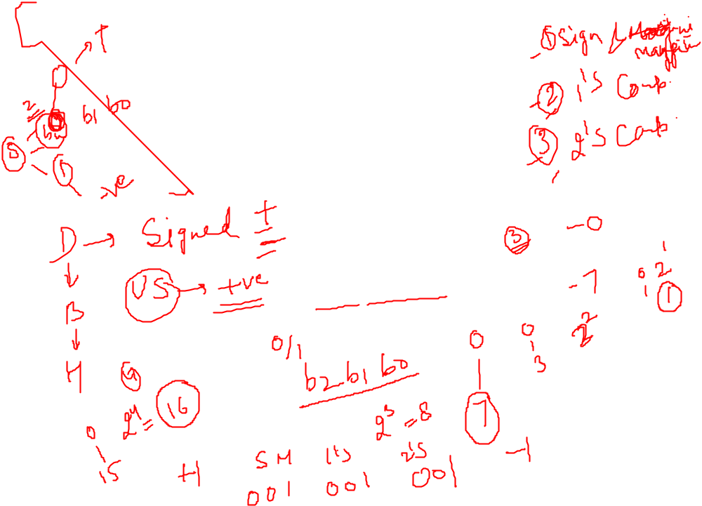
Number, Arithmetic Operations, and Characters

Slide 3
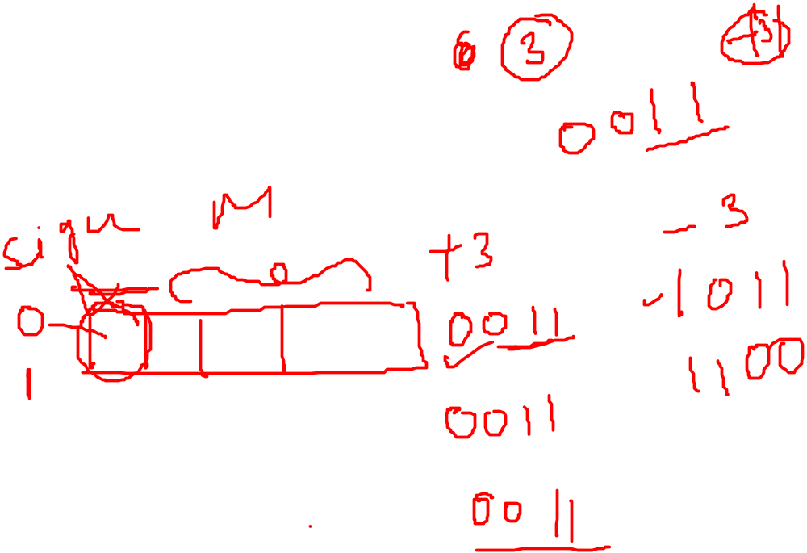
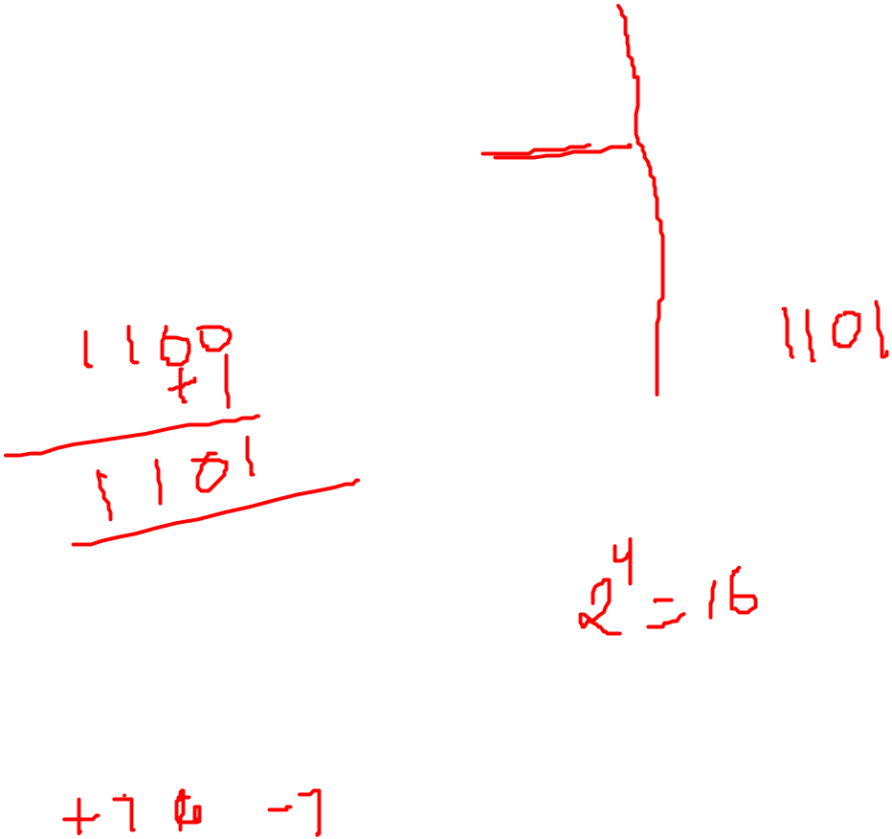
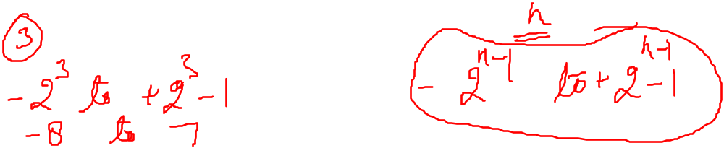
Signed Integer
3 major representations:
Sign and magnitude
One’s complement
Two’s complement
Assumptions:
4-bit machine word
16 different values can be represented
Roughly half are positive, half are negative

Slide 4
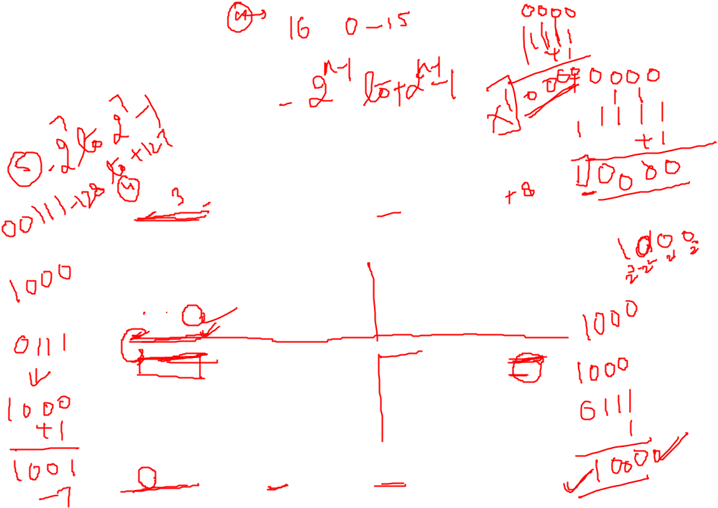
Binary, Signed-Integer Representations
B
V
alues represented
Sign and
b
3
b
2
b
1
b
0
magnitude
1'
s complement
2'
s complement
0
1
1
1
+
7
+
7
+
7
0
1
1
0
+
6
+
6
+
6
0
1
0
1
+
5
+
5
+
5
0
1
0
0
+
4
+
4
+
4
0
0
1
1
+
3
+
3
+
3
0
0
1
0
+
2
+
2
+
2
0
0
0
1
+
1
+
1
+
1
0
0
0
0
+
0
+
0
+
0
1
0
0
0
-
0
-
7
-
8
1
0
0
1
-
1
-
6
-
7
1
0
1
0
-
2
-
5
-
6
1
0
1
1
-
3
-
4
-
5
1
1
0
0
-
4
-
3
-
4
1
1
0
1
-
5
-
2
-
3
1
1
1
0
-
6
-
1
-
2
1
1
1
1
-
7
-
0
-
1
Figure 2.1. Binary, signed-integer representations.

Slide 5
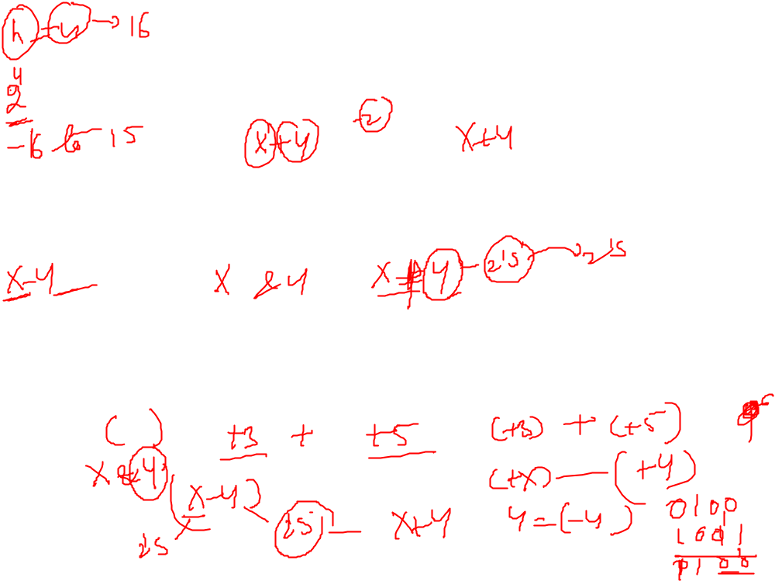
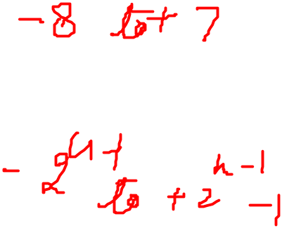
Addition and Subtraction of signed Numbers in 2’s complement
To add two numbers , add their n bit representation, ignoring the carry out signal from the MSB. The sum will be algebraically correct value in the 2’s complement representation as long as the answer is in the -2^{n-1} through +2^{n-1}-1.
To subtract two numbers X and Y , that is to X-Y , from the 2’s complement of Y and then add it to X, as in rule 1. The result will be algebraically correct value in the 2’s complement representation as long as the answer is in the -2^{n-1} through +2^{n-1}-1.

Slide 6
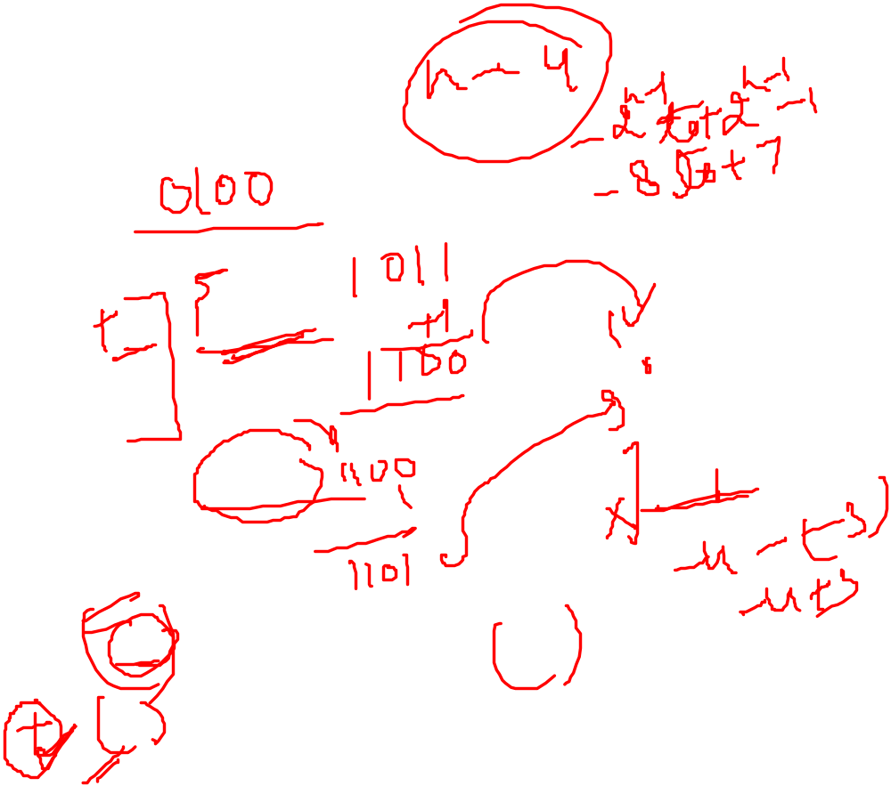
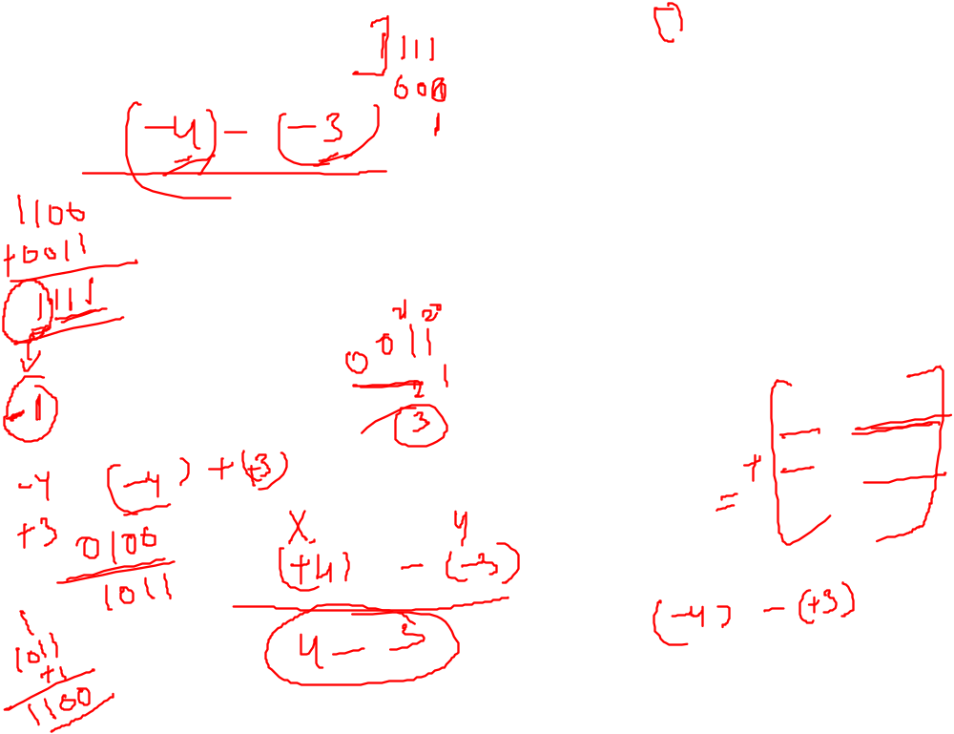

Addition and Subtraction – 2’s Complement
4
+ 3
7
0100
0011
0111
-4
+ (-3)
-7
1100
1101
11001
If carry-in to the high
order bit =
carry-out then ignore
carry
if carry-in differs from
carry-out then overflow
4
- 3
1
0100
1101
10001
-4
+ 3
-1
1100
0011
1111
Simpler addition scheme makes twos complement the most common
choice for integer number systems within digital systems

Slide 7
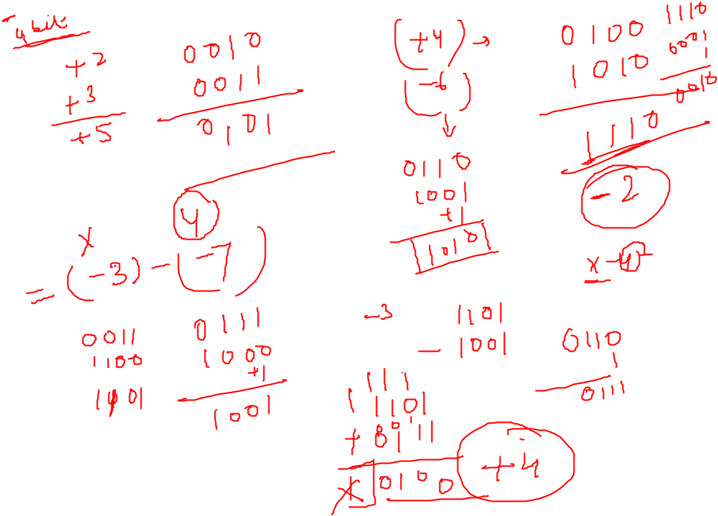

Slide 8
Arithmetic overflow
When the result of an arithmetic operation requires n+1
1 bits, upon operation on n-bit numbers, an overflow occurs
If result exceeds the range of 2^{n}-1 an over occurs
For ex: 4 bit range is 0-2⁴-1 that is 0-15
In signed arithmetic, the overflow causes the sign bit of answer to change.
Overflow occurs, if the result does not occur in the range.
It occur when two positive and 2 negative numbers are added in signed arithmetic.

Slide 9
Overflow Conditions
0 1 1 1
0 1 0 1
0 0 1 1
1 0 0 0
1 0 0 0
1 0 0 1
1 1 0 0
1 0 1 1 1
5
3
-8
-7
-2
7
Overflow
Overflow
0 0 0 0
0 1 0 1
0 0 1 0
0 1 1 1
1 1 1 1
1 1 0 1
1 0 1 1
1 1 0 0 0
5
2
7
-3
-5
-8
No overflow
No overflow
Overflow when carry-in to the high-order bit does not equal carry out

Slide 10
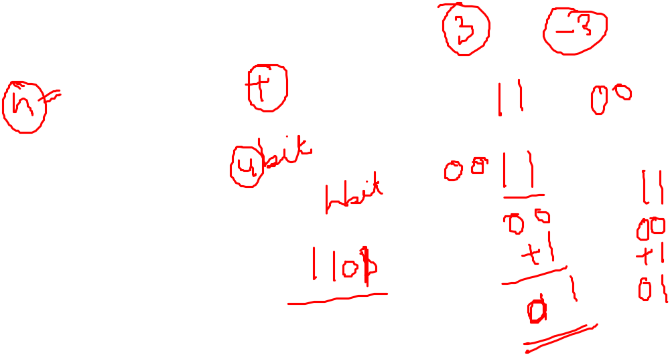
Sign Extension
Task:
  Given w-bit signed integer x
  Convert it to w+k-bit integer with same value
Rule:
  Make k copies of sign bit:
  X ′ = x_{w–1} ,…, x_{w–1} , x_{w–1} , x_{w–2} ,…, x₀
w
X
• • •
k copies of MSB
• • •
X ′
• • •
• • •
k
w

Slide 11

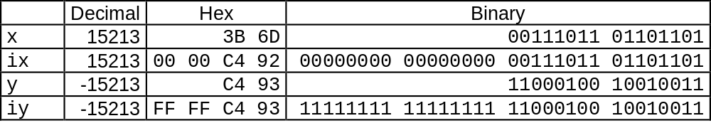

Sign Extension Example
short int x = 15213;
int ix = (int) x;
short int y = -15213;
int iy = (int) y;

Slide 12
Memory Locations, Addresses, and Operations

Slide 13
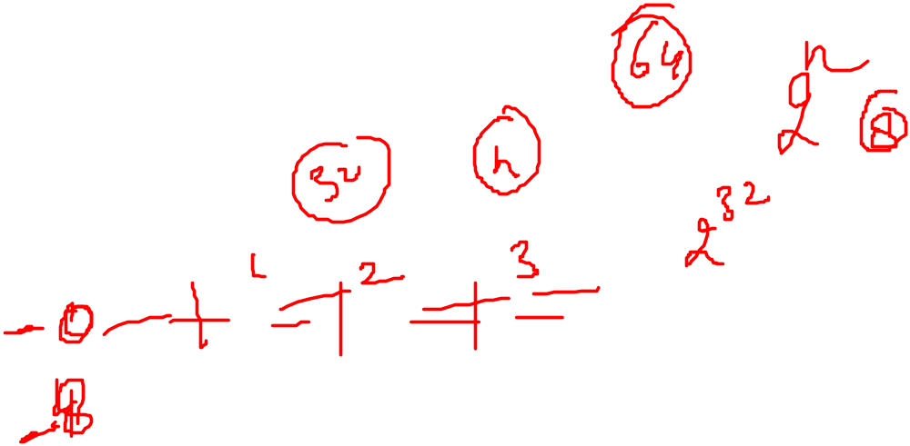
Memory Location, Addresses, and Operation
n
bits
Memory consists of many millions of storage cells, each of which can store 1 bit.
Data is usually accessed in n-bit groups. n is called word length.
first word
second word
•
•
•
i
th word
•
•
•
last word
Figure 2.5. Memory words.

Slide 14
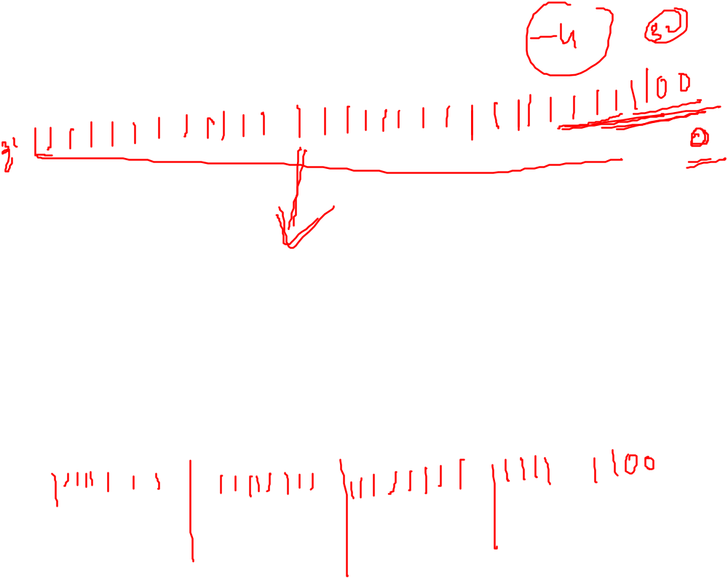
Memory Location, Addresses, and Operation
32-bit word length example
32 bits
•
•
•
b
31
b
30
b
1
b
0
Sign bit:
b
31
=
0
for positive numbers
b
31
=
1
for negative numbers
(a) A signed integer
8 bits
8 bits
8 bits
8 bits
ASCII
ASCII
ASCII
ASCII
character
character
character
character
(b) Four characters

Slide 15
Memory Location, Addresses, and Operation
To retrieve information from memory, either for one word or one byte (8-bit), addresses for each location are needed.
A k-bit address memory has 2^{k} memory locations, namely 0 – 2^{k}-1, called memory space.
24-bit memory: 2²⁴ = 16,777,216 = 16M (1M=2²⁰)
32-bit memory: 2³² = 4G (1G=2³⁰)
1K(kilo)=2¹⁰
1T(tera)=2⁴⁰

Slide 16
Memory Location, Addresses, and Operation
It is impractical to assign distinct addresses to individual bit locations in the memory.
The most practical assignment is to have successive addresses refer to successive byte locations in the memory – byte-addressable memory.
Byte locations have addresses 0, 1, 2, … If word length is 32 bits, they successive words are located at addresses 0, 4, 8,…

Slide 17

Big-Endian and Little-Endian Assignments
Big-Endian: lower byte addresses are used for the most significant bytes of the word
Little-Endian: opposite ordering. lower byte addresses are used for the less significant bytes of the word
W
ord
address
Byte address
Byte address
0
0
1
2
3
0
3
2
1
0
4
4
5
6
7
4
7
6
5
4
•
•
•
•
•
•
2
k
-
4
2
k
-
4
2
k
-
3
2
k
-
2
2
k
-
1
2
k
-
4
2
k
-
1
2
k
-
2
2
k
-
3
2
k
-
4
(a) Big-endian assignment
(b) Little-endian assignment
Figure 2.7. Byte and word addressing.

Slide 18
Suppose a byte-addressable processor uses the little endian representation and x is a 32-bit integer stored in memory starting at the memory address 100 in signed, 2’s complement representation. Specify in hexadecimal what would be in memory locations 100,101,102 and 103 if the program has the statement: int x = - 4;

Slide 19
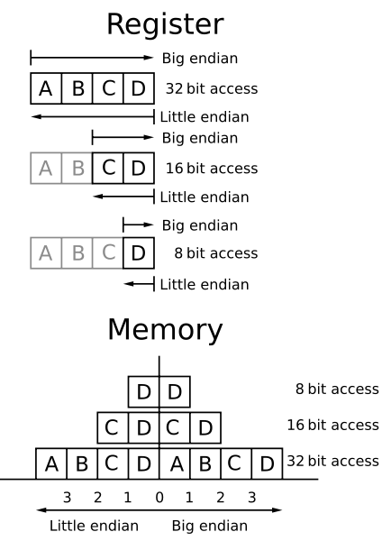


Slide 20
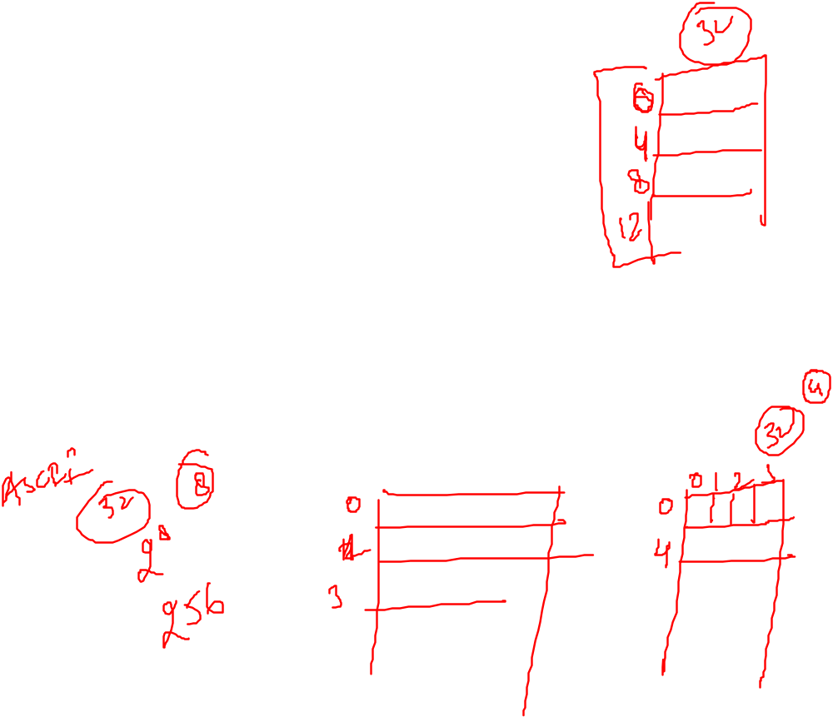
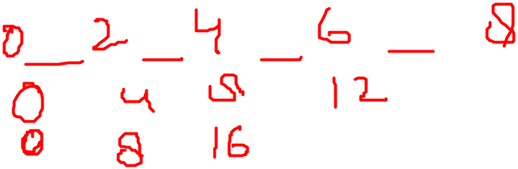

Memory Location, Addresses, and Operation
Address ordering of bytes: b₇,b₆...b₀
Word alignment
  Words are said to be aligned in memory if they begin at a byte addr. that is a multiple of the num of bytes in a word.
    16-bit word: word addresses: 0, 2, 4,….
    32-bit word: word addresses: 0, 4, 8,….
    64-bit word: word addresses: 0, 8,16,….
Access numbers, characters, and character strings

Slide 21
Memory Operation
Load (or Read or Fetch)
Copy the content. The memory content doesn’t change.
Address – Load
Registers can be used
Store (or Write)
Overwrite the content in memory
Address and Data – Store
Registers can be used

Slide 22
Instruction and Instruction Sequencing

Slide 23
“Must-Perform” Operations
Data transfers between the memory and the processor registers
Arithmetic and logic operations on data
Program sequencing and control
I/O transfers

Slide 24
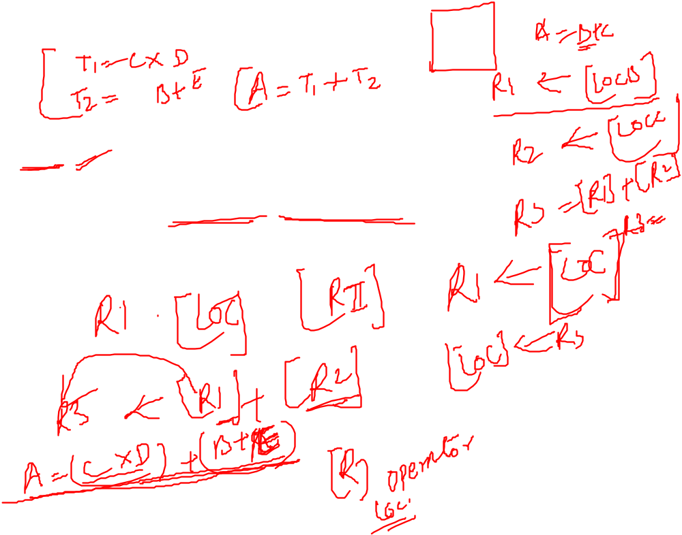
Register Transfer Notation
Identify a location by a symbolic name standing for its hardware binary address (LOC, R0,…)
Contents of a location are denoted by placing square brackets around the name of the location (R1←[LOC], R3 ←[R1]+[R2])
Register Transfer Notation (RTN)

Slide 25

Assembly Language Notation
Represent machine instructions and programs.
Move LOC, R1 = R1←[LOC]
Add R1, R2, R3 = R3 ←[R1]+[R2]

Slide 26
CPU Organization
Single Accumulator
  Result usually goes to the Accumulator
  Accumulator has to be saved to memory quite often
General Register
  Registers hold operands thus reduce memory traffic
  Register bookkeeping
Stack
  Operands and result are always in the stack

Slide 27

Instruction Formats
Three-Address Instructions
  ADD R1, R2, R3 R1 ← R2 + R3
Two-Address Instructions
  ADD R1, R2 R1 ← R1 + R2
One-Address Instructions
  ADD M AC ← AC + M[AR]
Zero-Address Instructions
  ADD TOS ← TOS + (TOS – 1)
RISC Instructions
  Lots of registers. Memory is restricted to Load & Store
Instruction
Opcode
Operand(s) or Address(es)

Slide 28
Instruction Formats
Example: Evaluate (A+B) ∗ (C+D)
Three-Address
  ADD R1, A, B ; R1 ← M[A] + M[B]
  ADD R2, C, D ; R2 ← M[C] + M[D]
  MUL X, R1, R2 ; M[X] ← R1 ∗ R2

Slide 29
Instruction Formats
Example: Evaluate (A+B) ∗ (C+D)
Two-Address
  MOV R1, A ; R1 ← M[A]
  ADD R1, B ; R1 ← R1 + M[B]
  MOV R2, C ; R2 ← M[C]
  ADD R2, D ; R2 ← R2 + M[D]
  MUL R1, R2 ; R1 ← R1 ∗ R2
  MOV X, R1 ; M[X] ← R1

Slide 30
Instruction Formats
Example: Evaluate (A+B) ∗ (C+D)
One-Address
  LOAD A ; AC ← M[A]
  ADD B ; AC ← AC + M[B]
  STORE T ; M[T] ← AC
  LOAD C ; AC ← M[C]
  ADD D ; AC ← AC + M[D]
  MUL T ; AC ← AC ∗ M[T]
  STORE X ; M[X] ← AC

Slide 31
Instruction Formats
Example: Evaluate (A+B) ∗ (C+D)
RISC
  LOAD R1, A ; R1 ← M[A]
  LOAD R2, B ; R2 ← M[B]
  LOAD R3, C ; R3 ← M[C]
  LOAD R4, D ; R4 ← M[D]
  ADD R1, R1, R2 ; R1 ← R1 + R2
  ADD R3, R3, R4 ; R3 ← R3 + R4
  MUL R1, R1, R3 ; R1 ← R1 ∗ R3
  STORE X, R1 ; M[X] ← R1

Slide 32
Using Registers
Registers are faster
Shorter instructions
  The number of registers is smaller (e.g. 32 registers need 5 bits)
Potential speedup
Minimize the frequency with which data is moved back and forth between the memory and processor registers.

Slide 33
Instruction Execution and Straight-Line Sequencing
Address
Contents
Assumptions:
- One memory operand
per instruction
- 32-bit word length
- Memory is byte
addressable
- Full memory address
can be directly specified
in a single-word instruction
Begin execution here
i
Move
A,R0
3-instruction
i
+ 4
Add
B,R0
program
segment
i
+ 8
Move
R0,C
A
B
Data for
the program
Two-phase procedure
Instruction fetch
Instruction execute
C
Figure 2.8. A program for C ← [Α] + [Β].

Slide 34
Adding n numbers
i
Move
NUM1,R0
i
+
4
Add
NUM2,R0
i
+
8
Add
NUM3,R0
•
•
•
i
+
4
n
-
4
Add
NUM
n
,R0
i
+
4
n
Move
R0,SUM
•
•
•
SUM
NUM1
NUM2
•
•
•
NUM
n
Figure 2.9. A straight-line program for adding n numbers.

Slide 35
Branching
Move
N,R1
Clear
R0
LOOP
Determine address of
"Next" number and add
Program
"Next" number to R0
loop
Decrement
R1
Branch target
Branch>0
LOOP
Move
R0,SUM
Conditional branch
•
•
•
SUM
N
n
NUM1
Figure 2.10. Using a loop to add n numbers.
NUM2
•
•
•
NUM
n

Slide 36
Condition Codes
The processor keep track of information about the result of various operations for the use of subsequent conditional branch instruction.
This is accomplished by recording by recording the required information in individual bits, called Condition code flags
These flag are group together in a special processor register called Condition code register / status register
  N (negative): set to 1 for negative result
  Z (zero): set to 1 for result zero
  V (overflow): set to 1 if overflow
  C (carry): set to 1 if carry out result
Different instructions affect different flags

Slide 37
Conditional Branch Instructions
A: 1 1 1 1 0 0 0 0
Example:
  A: 1 1 1 1 0 0 0 0
  B: 0 0 0 1 0 1 0 0
+(−B): 1 1 1 0 1 1 0 0
1 1 0 1 1 1 0 0
C = 1
Z = 0
S = 1
V = 0

Slide 38

Status Bits
C_{n-1}
A
B
C_{n}
ALU
F
V
Z
S
C
F_{n-1}
Zero Check

Slide 39
Addressing Modes
The different way in which the location of an operand is specified in an instruction are referred to as addressing modes.

Slide 40
Addressing Modes
Implied
  AC is implied in “ADD M[AR]” in “One-Address” instr.
  TOS is implied in “ADD” in “Zero-Address” instr.
Immediate
  The use of a constant in “MOV R1, 5”, i.e. R1 ← 5
Register
  Indicate which register holds the operand
Instruction
Mode
...
Opcode

Slide 41
Variables
We assessed an operand by specifying the name of the register (Register mode) or the address of memory location where the operand is located (Absolute mode/direct mode)
Register mode
    MOVE R1, R2
Absolute mode/direct mode
    Integer A, B;
Both
    Move LOC,R2

Slide 42
Constant
Immediate
  The use of a constant in “MOV R1, 5”, i.e. R1 ← 5
    MOVE #5, R1
Example
A=B+6
Move B,R1
ADD #6, R1
Move R1,A

Slide 43
Indirect Address
  The instruction does not give the operand or its address explicitly. Instead it provide information from which the memory address of the operand can be determined. This address is called effective address.
  Indicate the memory location that holds the address of the memory location that holds the data
Memory
AR = 101
100
101
0 1 0 4
102
103
104
1 1 0 A

Slide 44
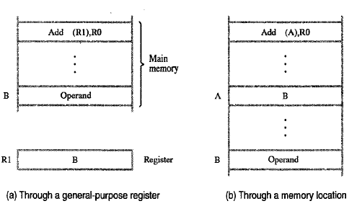
Indirect Address

Slide 45
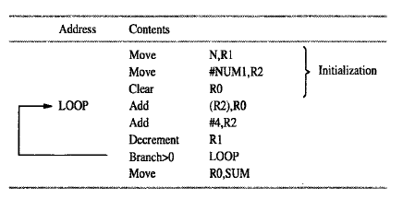
Indirect Address
Example: Adding a list of numbers (Array)
32 bit system, Num1 is address if first number in the list

Slide 46
Indexing and Arrays
Index mode – the effective address of the operand is generated by adding a constant value to the contents of a register.
Index register
    X(R_{i}):
  EA = X + [R_{i}]
The constant X may be given either as an explicit number or as a symbolic name representing a numerical value.
If X is shorter than a word, sign-extension is needed.

Slide 47
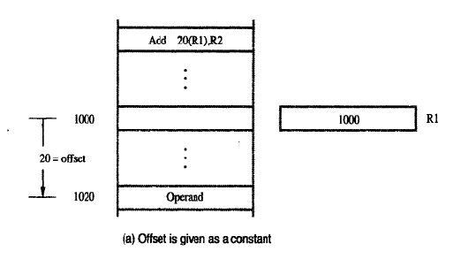

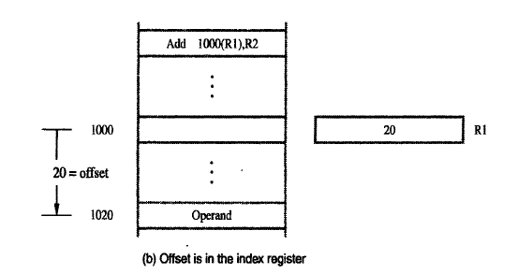
Indexed addressing

Slide 48
Addressing Modes
Indexed
  EA = Index Register + Relative Addr
Memory
Useful with “Autoincrement” or “Autodecrement”
XR = 2
+
100
AR = 100
101
Could be Positive or Negative
(2’s Complement)
102
1 1 0 A
103
104

Slide 49
Addressing Modes
Base Register
  EA = Base Register + Relative Addr
Memory
Could be Positive or Negative
(2’s Complement)
AR = 2
+
100
0 0 0 5
BR = 100
101
0 0 1 2
102
0 0 0 A
Usually points to the beginning of an array
103
0 1 0 7
104
0 0 5 9

Slide 50
Indexing and Arrays
In general, the Index mode facilitates access to an operand whose location is defined relative to a reference point within the data structure in which the operand appears.
Several variations:
(R_{i}, R_{j}): EA = [R_{i}] + [R_{j}]
X(R_{i}, R_{j}): EA = X + [R_{i}] + [R_{j}]

Slide 51
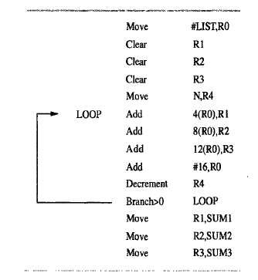
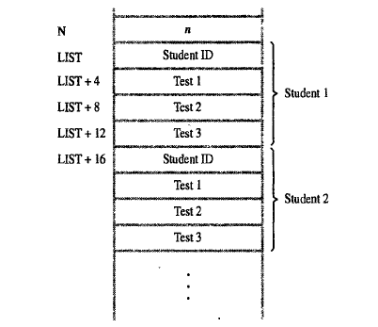
Example

Slide 52
Relative Addressing
Relative mode – the effective address is determined by the Index mode using the program counter in place of the general-purpose register R_{i} .
X(PC) – note that X is a signed number
Branch>0 LOOP
This location is computed by specifying it as an offset from the current value of PC.
Branch target may be either before or after the branch instruction, the offset is given as a singed num.

Slide 53

Addressing Modes
Name
Assem
bler
syn
tax
Addressing
function
The different ways in which the location of an operand is specified in an instruction are referred to as addressing modes.
Immediate
#V
alue
Op
erand
=
V
alue
Register
R
i
EA
=
R
i
Absolute
(Direct)
LOC
EA
=
LOC
Indirect
(R
i
)
EA
=
[R
i
]
(LOC)
EA
=
[LOC]
Index
X(R
i
)
EA
=
[R
i
]
+
X
Base
with
index
(R
i
,R
j
)
EA
=
[R
i
]
+
[R
j
]
Base
with
index
X(R
i
,R
j
)
EA
=
[R
i
]
+
[R
j
]
+
X
and
offset
Relative
X(PC)
EA
=
[PC]
+
X
Autoincremen
t
(R
i
)+
EA
=
[R
i
]
;
Incremen
t
R
i
Autodecrement
−
(R
i
)
Decremen
t
R
i
;
EA
=
[R
i
]

Slide 54
Additional Modes
Autoincrement mode – the effective address of the operand is the contents of a register specified in the instruction. After accessing the operand, the contents of this register are automatically incremented to point to the next item in a list.
(R_{i})+. The increment is 1 for byte-sized operands, 2 for 16-bit operands, and 4 for 32-bit operands.
Autodecrement mode: -(R_{i}) – decrement first
Move
N,R1
Move
#NUM1,R2
Initialization
Clear
R0
LOOP
Add
(R2)+,R0
Decrement
R1
Branch>0
LOOP
Move
R0,SUM
Figure 2.16. The Autoincrement addressing mode used in the program of Figure 2.12.

Slide 55
Assembly Language

Slide 56
Types of Instructions
Data Transfer Instructions
Name | Mnemonic
Load | LD
Store | ST
Move | MOV
Exchange | XCH
Input | IN
Output | OUT
Push | PUSH
Pop | POP
Data value is not modified

Slide 57
Data Manipulation Instructions
Name | Mnemonic
Increment | INC
Decrement | DEC
Add | ADD
Subtract | SUB
Multiply | MUL
Divide | DIV
Add with carry | ADDC
Subtract with borrow | SUBB
Negate | NEG
Arithmetic
Logical & Bit Manipulation
Shift
Name | Mnemonic
Clear | CLR
Complement | COM
AND | AND
OR | OR
Exclusive-OR | XOR
Clear carry | CLRC
Set carry | SETC
Complement carry | COMC
Enable interrupt | EI
Disable interrupt | DI
Name | Mnemonic
Logical shift right | SHR
Logical shift left | SHL
Arithmetic shift right | SHRA
Arithmetic shift left | SHLA
Rotate right | ROR
Rotate left | ROL
Rotate right through carry | RORC
Rotate left through carry | ROLC

Slide 58
Conditional Branch Instructions
Mnemonic | Branch Condition | Tested Condition
BZ | Branch if zero | Z = 1
BNZ | Branch if not zero | Z = 0
BC | Branch if carry | C = 1
BNC | Branch if no carry | C = 0
BP | Branch if plus | S = 0
BM | Branch if minus | S = 1
BV | Branch if overflow | V = 1
BNV | Branch if no overflow | V = 0

Slide 59
Additional Instructions

Slide 60
Logical Shifts
Logical shift – shifting left (LShiftL) and shifting right (LShiftR)
C
R0
0
before:
0
0
1
1
1
0
.
.
.
0
1
1
after:
1
1
1
0
.
.
.
0
1
1
0
0
(a) Logical shift left
LShiftL #2,R0
0
R0
C
before:
0
1
1
1
0
.
.
.
0
1
1
0
after:
0
0
0
1
1
1
0
.
.
.
0
1
(b) Logical shift r
ight
LShiftR #2,R0

Slide 61
Arithmetic Shifts
R0
C
before:
1
0
0
1
1
.
.
.
0
1
0
0
after:
1
1
1
0
0
1
1
.
.
.
0
1
(c) Ar
ithmetic shift r
ight
AShiftR #2,R0

Slide 62
Rotate
C
R0
before:
0
0
1
1
1
0
.
.
.
0
1
1
after:
1
1
1
0
.
.
.
0
1
1
0
1
(a) Rotate left without carr
y
RotateL #2,R0
C
R0
before:
0
0
1
1
1
0
.
.
.
0
1
1
after:
1
1
1
0
.
.
.
0
1
1
0
0
(b) Rotate left with carr
y
RotateLC #2,R0
R0
C
before:
0
1
1
1
0
.
.
.
0
1
1
0
after:
1
1
0
1
1
1
0
.
.
.
0
1
(c) Rotate r
ight without carr
y
RotateR #2,R0
R0
C
before:
0
1
1
1
0
.
.
.
0
1
1
0
after:
1
0
0
1
1
1
0
.
.
.
0
1
(d) Rotate r
ight with carr
y
RotateRC #2,R0
Figure 2.32. Rotate instructions.

Slide 63
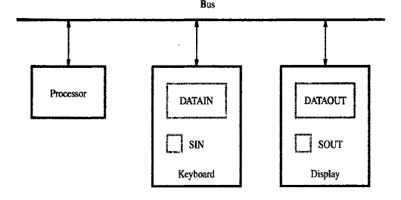

Basic Input Output Operation
To read value from input device/ show on output device
To performing such I/O tasks is to use a method known as program-controlled I/O
Simple way to do this is through I/O operations
Speed mismatched between input and output process

Slide 64
Memory Mapped I/O
Some memory address values are used to refer to peripheral device buffer register
No special instructions is needed to access the content of these registers.
Movebyte DATAIN R1
Movebyte R1, DATAOUT

Slide 65
int main()
{
int array[100], n, c, d, swap;
printf("Enter number of elements\n");
scanf("%d", &n);
printf("Enter %d integers\n", n);
for (c = 0; c < n; c++)
scanf("%d", &array[c]);
for (c = 0 ; c < n - 1; c++)
{
for (d = 0 ; d < n - c - 1; d++)
{
if (array[d] > array[d+1]) /* For decreasing order use < */
{
swap = array[d];
array[d] = array[d+1];
array[d+1] = swap;
}
}
}
printf("Sorted list in ascending order:\n");
for (c = 0; c < n; c++)
printf("%d\n", array[c]);
return 0;
}

Slide 66

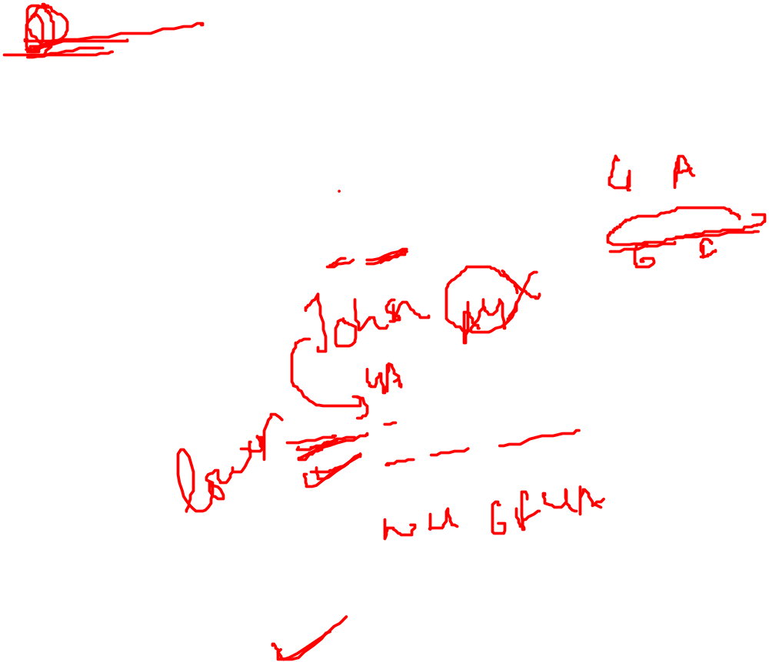
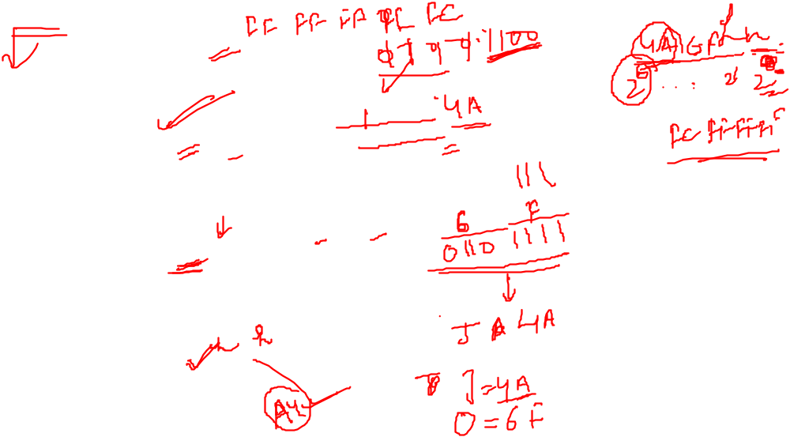
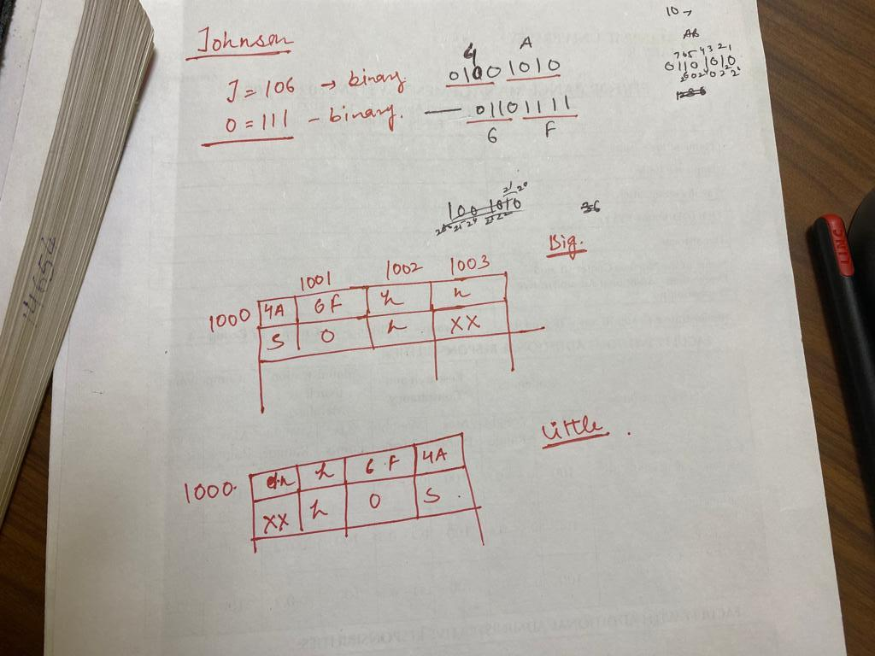

Slide 67

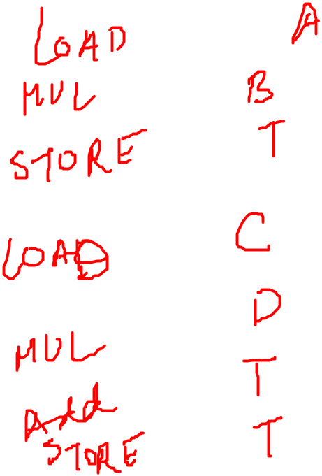

Slide 68
