Slide 1
Data Communication (CC-2103)
By: Dr. Lal Pratap Verma

Slide 2
Data Link Layer
Flow Control:
It is a set of procedures that tells the sender how much data it can transmit before the data overwhelms the receiver.
The receiving device has limited speed and limited memory to store the data. Therefore, the receiving device must be able to inform the sending device to stop the transmission temporarily before the limits are reached.
It requires a buffer, a block of memory for storing the information until they are processed.

Slide 3
Data Link Layer
Flow Control:
Two methods have been developed to control the flow of data:
Stop-and-wait
Sliding window

Slide 4
Data Link Layer
Stop-and-wait
In the Stop-and-wait method, the sender waits for an acknowledgment after every frame it sends.
When an acknowledgment is received, then only the next frame is sent. The process of alternately sending and waiting of a frame continues until the sender transmits the EOT (End of transmission) frame.
Advantage of Stop-and-wait
The Stop-and-wait method is simple as each frame is checked and acknowledged before the next frame is sent.
Disadvantage of Stop-and-wait
Stop-and-wait technique is inefficient to use as each frame must travel across all the way to the receiver acknowledgment travels all the way before the next frame is sent. Each frame sent and received uses the entire time needed to traverse the link.

Slide 5
Data Link Layer

Slide 6
Data Link Layer
Stop-and-wait ARQ
Stop-and-wait ARQ is a technique used to retransmit the data in case of damaged or lost frames.
This technique works on the principle that the sender will not transmit the next frame until it receives the acknowledgement of the last transmitted frame.

Slide 7
Data Link Layer
Four features are required for the retransmission:
The sending device keeps a copy of the last transmitted frame until the acknowledgement is received. Keeping the copy allows the sender to retransmit the data if the frame is not received correctly.
Both the data frames and the ACK frames are numbered alternately 0 and 1 so that they can be identified individually. Suppose data 1 frame acknowledges the data 0 frame means that the data 0 frame has been arrived correctly and expects to receive data 1 frame.
If an error occurs in the last transmitted frame, then the receiver sends the NAK frame which is not numbered. On receiving the NAK frame, sender retransmits the data.
It works with the timer. If the acknowledgement is not received within the allotted time, then the sender assumes that the frame is lost during the transmission, so it will retransmit the frame.

Slide 8
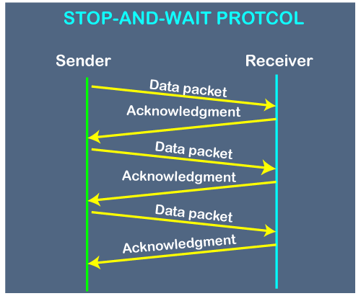
Data Link Layer
Stop-and-wait

Slide 9
Data Link Layer
Stop-and-wait ARQ
Two possibilities of retransmission:
Damaged Frame: When the receiver receives a damaged frame, i.e., the frame contains an error, then it returns the NAK frame.
Lost Frame: Sender is equipped with the timer and starts when the frame is transmitted.

Slide 10
Data Link Layer
Sliding Window ARQ (Automatic Repeat Request)
The Sliding Window is a method of flow control in which a sender can transmit the several frames before getting an acknowledgement.
In Sliding Window Control, multiple frames can be sent one after the another due to which capacity of the communication channel can be utilized efficiently.
A single ACK acknowledge multiple frames.
Sliding Window refers to imaginary boxes at both the sender and receiver end.

Slide 11
Data Link Layer
Sliding Window ARQ (Automatic Repeat Request)
The window can hold the frames at either end, and it provides the upper limit on the number of frames that can be transmitted before the acknowledgment.
Frames can be acknowledged even when the window is not completely filled.
The window has a specific size in which they are numbered as modulo-n means that they are numbered from 0 to n-1. For example, if n = 8, the frames are numbered from 0,1,2,3,4,5,6,7,0,1,2,3,4,5,6,7,0,1........
The size of the window is represented as n-1. Therefore, maximum n-1 frames can be sent before acknowledgment.
When the receiver sends the ACK, it includes the number of the next frame that it wants to receive.

Slide 12
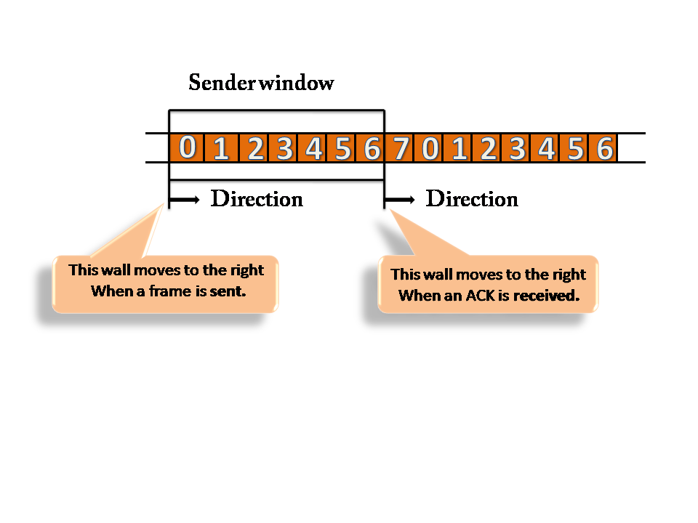
Data Link Layer
Sender Window
At the beginning of a transmission, the sender window contains n-1 frames, and when they are sent out, the left boundary moves inward shrinking the size of the window.
Once the ACK has arrived, then the sender window expands to the number which will be equal to the number of frames acknowledged by ACK.

Slide 13
Data Link Layer
Receiver Window
At the beginning of transmission, the receiver window does not contain n frames, but it contains n-1 spaces for frames.
When the new frame arrives, the size of the window shrinks.
The receiver window does not represent the number of frames received, but it represents the number of frames that can be received before an ACK is sent.
Once the acknowledgement is sent, the receiver window expands by the number equal to the number of frames acknowledged.

Slide 14
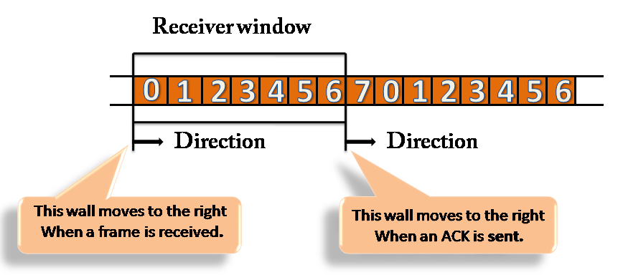
Data Link Layer
Receiver Window

Slide 15
Data Link Layer
Sliding Window ARQ
In this case, the sender keeps copies of all the transmitted frames until they have been acknowledged.
The receiver can send either NAK or ACK depending on the conditions. The NAK frame tells the sender that the data have been received damaged.
The ACK frame consists of a number that represents the next frame that the receiver expects to receive.
The NAK frame consists of a number that represents the damaged frame.
The sliding window ARQ is equipped with a timer to handle the lost acknowledgments.

Slide 16
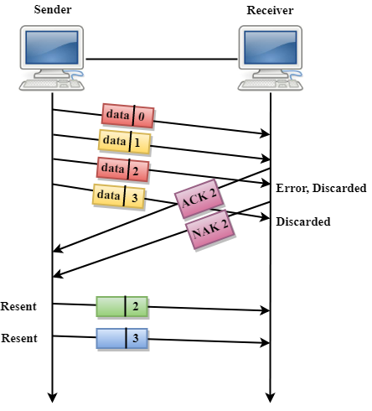
Data Link Layer
Go-Back-n ARQ: In Go-Back-N ARQ protocol, if one frame is lost or damaged, then it retransmits all the frames after which it does not receive the positive ACK.

Slide 17
Data Link Layer
Selective Repeat ARQ
Selective Repeat ARQ technique is more efficient than Go-Back-n ARQ.
In this technique, only those frames are retransmitted for which negative acknowledgment (NAK) has been received.
The receiver storage buffer keeps all the damaged frames on hold until the frame in error is correctly received.
The receiver must have an appropriate logic for reinserting the frames in the correct order.
The sender must consist of a searching mechanism that selects only the requested frame for retransmission.

Slide 18
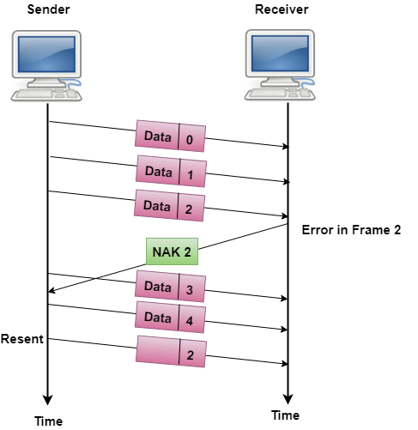
Data Link Layer
Selective Repeat ARQ

Slide 19
References
W. Stallings, Data and Computer Communications, (10e), Pearson Education, 2014.
B. A. Forouzan, Data Communications & Networking, (5e), McGraw Hill, 2013.
D. P. Bertsekas, R. G. Gallager, Data Networks, (2e), Prentice Hall of India, 2011.
A. S. Tenenbaum, Computer Networks, (5e), Prentice Hall of India, 2008.
L. L. Peterson, B. S. Davie, Computer Networks: A Systems Approach, (5e), Morgan Kaufmann Publishers, 2011.

