Slide 1

Python Capstone Project
Presented by: Jinnala Vinay Babu
Date:27-04-2025

Slide 2
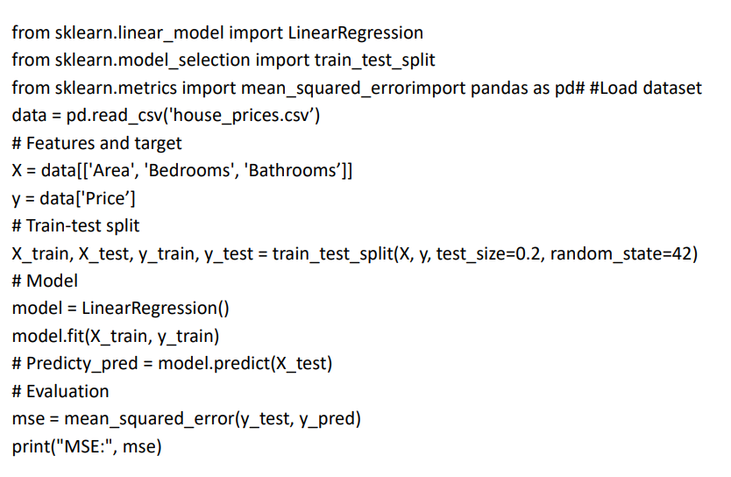
Code 1:Linear Regression:House Price Prediction

Slide 3
CODE 2:Logistic Regression Project:EMAIL Spam Protection
import pandas as pd
from sklearn.model_selection import train_test_split
from sklearn.feature_extraction.text import TfidfVectorizer
from sklearn.linear_model import LogisticRegression
from sklearn.metrics import accuracy_score, precision_score, recall_score, confusion_matrix
import nltk
from nltk.corpus import stopwords
import string

Slide 4
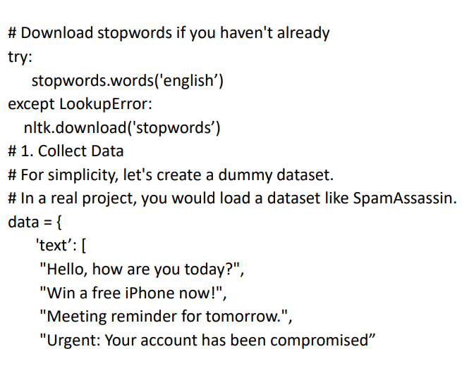

Slide 5
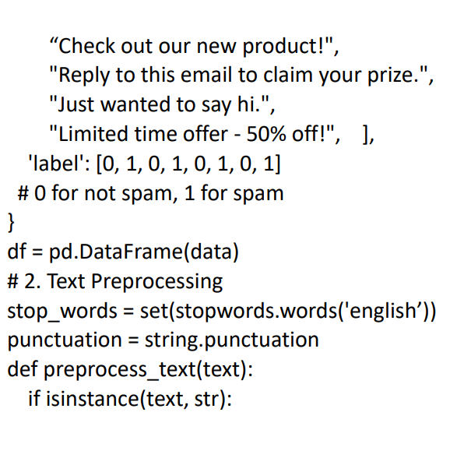

Slide 6
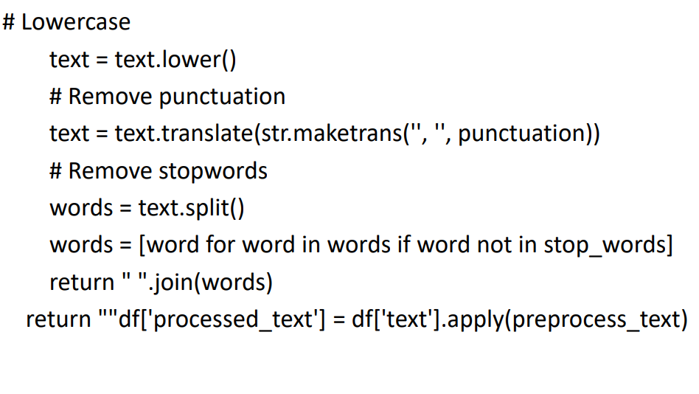

Slide 7
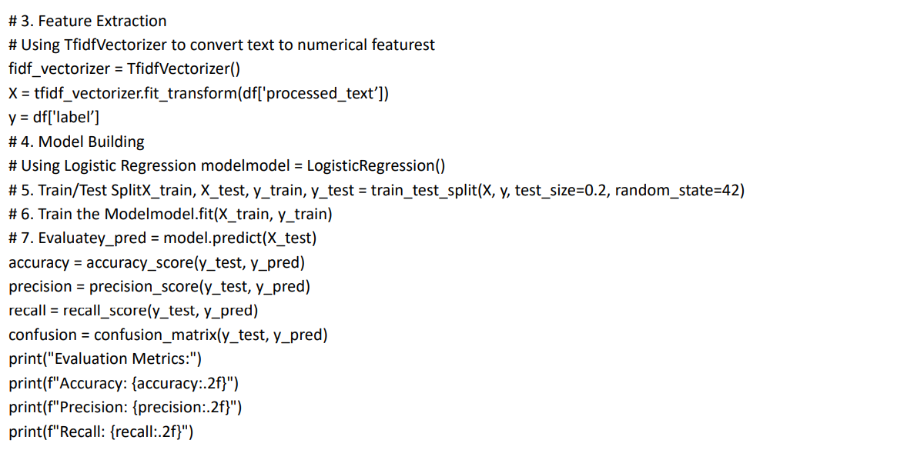

Slide 8
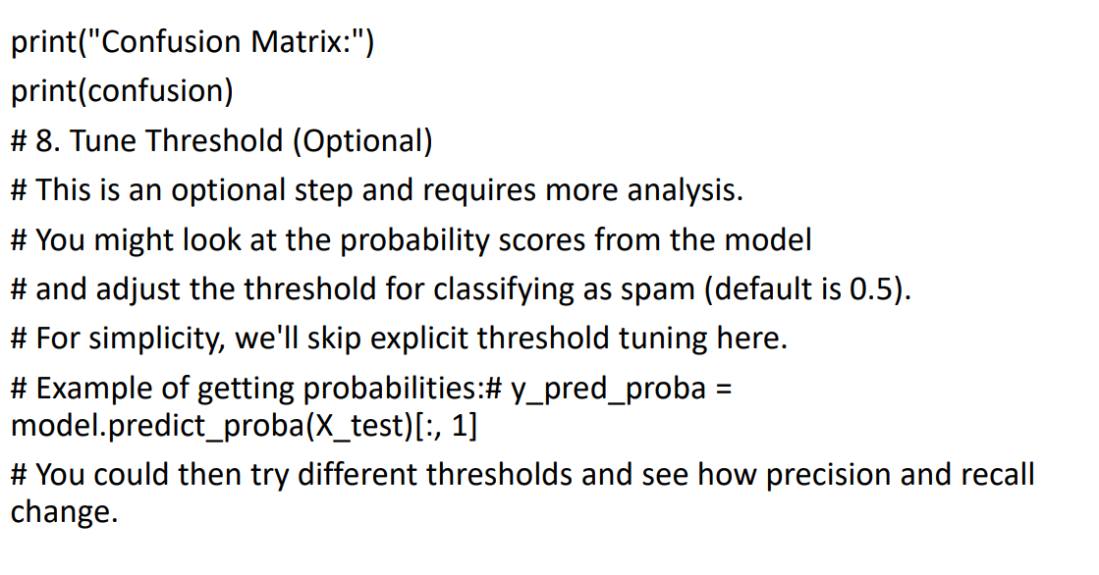

Slide 9
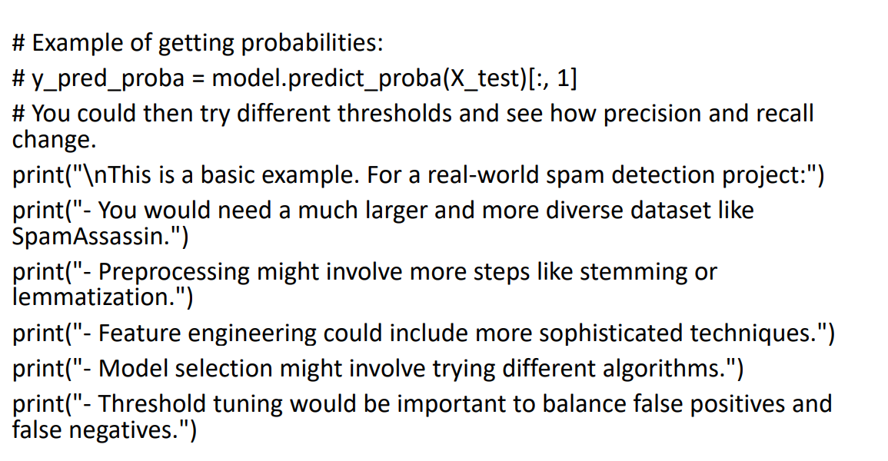

Slide 10


