Slide 1
ARTIFICIAL FACES GENERATION USING DCGAN
Presentation by
Ch. VINAY KISHOR

Slide 2
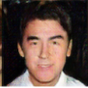
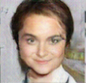
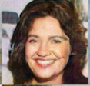
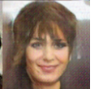
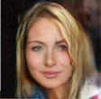
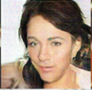
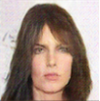
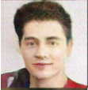

Slide 3
Machine Learning Algorithms
Discriminative
Generative
Performs tasks on existing data like classification etc.
Ex: Classification, Regression, Clustering models
Performs tasks that generates new data.
Ex: Generative Adversarial Networks (GAN)

Slide 4
DCGAN Architecture
Deep Convolutional Generative Adversarial Networks
A GAN essentially comprises of a Generator and a Discriminator. The Generator Generates new faces and the Discriminator predicts whether they are real or fake ones. The underlying idea behind GAN is that its two neural networks (Generator and Discriminator) competes with each other in a zero-sum game framework.
When Convolutional Neural Networks (CNN) are used in both Generator and Discriminator, it takes a new form called ‘DCGAN’.

Slide 5
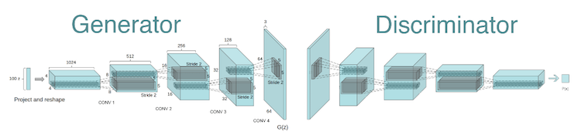
DCGAN Architecture
The Generator and Discriminator Networks in a GAN are usually connected and transmission takes place by the connecting Vector mappings.

Slide 6
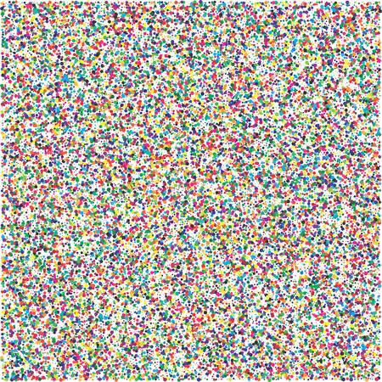
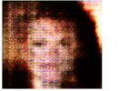
Generator
Generator in DCGAN
The Generator takes random noise as an input and generates samples as an output. Its goal is to generate such samples that will fool the Discriminator to think that it is seeing real images while actually seeing fakes. If the Discriminator identifies the Generator’s output as real, it means that the Generator did a good job and it should be rewarded. On the other hand, if the Discriminator recognized that it was given a fake, it means that the Generator failed and it should be punished with negative feedback.

Slide 7
Discriminator
Discriminator in DCGAN
Discriminator takes both real images from the input dataset and fake images from the Generator and outputs a verdict whether a given image is legit or not.
If the Discriminator correctly classifies fakes as fakes and reals as reals, we can reward it with positive feedback in the form of a loss gradient. If it fails at its job, it gets negative feedback. This mechanism allows it to learn and get better. We can think of the Discriminator as a policeman trying to catch the bad guys while letting the good guys free.

Slide 8
Deep Convolutions
A general Convolutional Neural Network comprises of three phase layers:
Convoluting layer (with a custom filter)
Pooling layer (max or avg)
Fully-Connect512 ed layers
Here is an equated demo of the CNN architecture we adopted in the projects for both Generator and Discriminator:
8 X 8 X 1024 -> 16 X 16 X 512 -> 32 X 32 X 256 -> 64 X 64 X 128 -> 128 X 128 X 64 -> 128 X 128 X 3 -> 64 X 64 X 64 -> 32 X 32 X 128 -> 16 X 16 X 256 -> 16 X 16 X 512 -> 8 X 8 X 1024.
We used the generalized Latent Dirichlet Allocation (LDA) to the refined images.

Slide 9
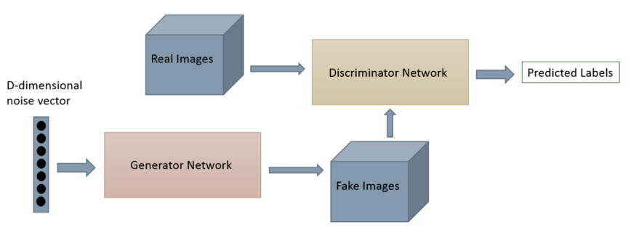
GAN Depiction
If you think about it for a while, you’ll realize that with the above approach we’ve tackled the Unsupervised Learning problem with combining Game Theory, Supervised Learning and a bit of Reinforcement Learning.

Slide 10
Loss Function & Optimizers
In order for our Discriminator and Generator to learn over time, we need to provide loss functions that will allow back propagation to take place.
Training GANs is notoriously hard because of the two loss functions (for the Generator and Discriminator) and getting a balance between them is a key to the good results.
We used Adam optimizers for the purpose of optimising the model.
Similarly to the declarations of the loss functions, we can also balance the Discriminator and the Generator with appropriate learning rates.

Slide 11
Training
Training Generator & Discriminator
Once the model is built and the data set is prepared, it has to be on the images present in the Celebrities 100K dataset. In this specific project, I’ve set the number of epochs to 10 with a doubling iteration period for better results.
The core training part is where we are training Discriminator and Generator. Same as with the loss functions and learning rates, it’s also a possible place to balance the Discriminator and the Generator. Some researchers found that modifying the ratio between Discriminator and Generator training runs may benefit the results. In my case 1:1 ratio is performed.

Slide 12
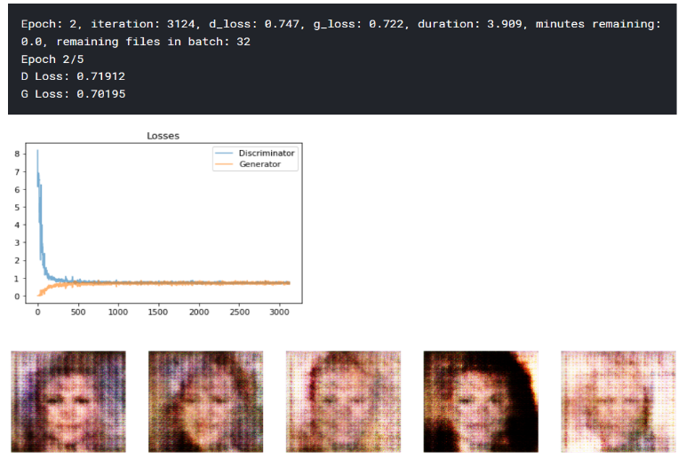
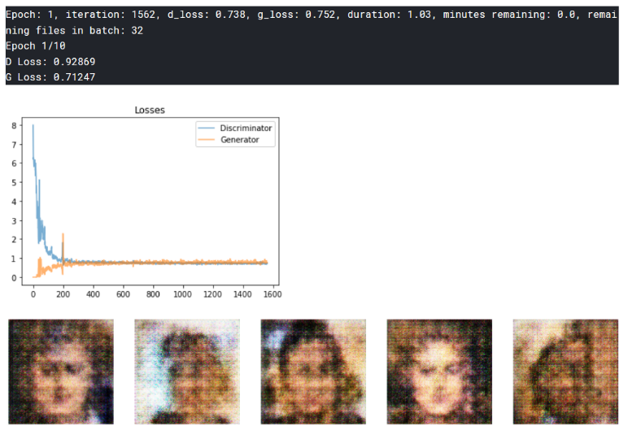
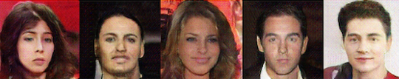
Results
Epoch 1: Training
Epoch 2: Training
Final Results

Slide 13
Future Work
This project can be modified and can be used to generate artificial Cartoon faces, Dogs, Cats faces etc. All that you need to change is the training data set, tune certain impacting parameters and setting the appropriate epochs, loss gradients and optimization functions.
This could possibly be of great use in the animation industry, where tedious effort is put-forth for the creation of new characters. The model can deliver the desired animated structures as per the features of the custom data set it is trained on.

Slide 14
Thank You

