Slide 1
Test-Time Adaptation for Image Classifiers under Continuous Distribution Shift
Student Presentation
Name: Vineet Yadav
Professor: Sudipta Roy

Slide 2
What is an Image Classifier?
An image classifier takes an image and predicts a label.
Example:
Image → Model → Prediction
Dog image → Classifier → 'Dog'
Models are usually trained on large datasets like ImageNet.

Slide 3
Distribution Shift
Distribution shift happens when:
Training data distribution ≠ Test data distribution
Examples:
- Clear images during training
- Foggy or noisy images in real-world deployment
This leads to accuracy drop.

Slide 4
Test-Time Adaptation (TTA)
Test-Time Adaptation allows the model to adjust during testing.
Pipeline:
Train → Adapt during testing → Predict
Important:
No labels are available during testing.

Slide 5
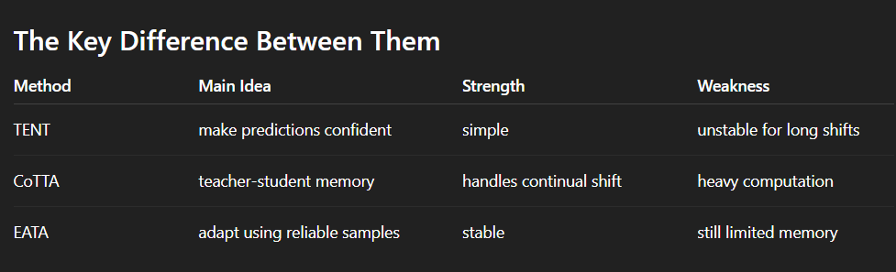
Existing Methods
Important methods in Test-Time Adaptation:
- TENT (Entropy minimization)
- CoTTA (Continual adaptation with teacher-student model)
- EATA (Efficient adaptation using reliable samples)
These methods work well for small shifts.
Important methods in Test-Time Adaptation:
- TENT (Entropy minimization)
- CoTTA (Continual adaptation with teacher-student model)
- EATA (Efficient adaptation using reliable samples)
These methods work well for small shifts.

Slide 6
Entropy Minimization Idea
The model should make confident predictions.
Uncertain prediction:
Dog 0.35 | Cat 0.33 | Horse 0.32
Confident prediction:
Dog 0.95 | Cat 0.03 | Horse 0.02
Entropy minimization pushes predictions to be confident.

Slide 7
Continuous Distribution Shift Problem
Real-world environments change continuously.
Example sequence:
Sunny → Fog → Rain → Night
Models keep adapting and may forget previous knowledge.
This is called catastrophic forgetting.

Slide 8
Proposed Idea: ContinualTTA
Goal: Handle continuous distribution changes.
Main components:
1. Prototype Memory Bank
2. Entropy Minimization
3. Shift Detection

Slide 9
Prototype Memory Bank
The model stores representative features for each class.
Example:
Prototype_dog = average feature of dog images
This memory helps maintain stable knowledge even when shifts occur.

Slide 10
Shift Detection
The model detects when the environment changes.
Method:
- Compare prediction distributions
- If difference is large → shift detected
Adaptation is triggered only when necessary.

Slide 11
Experiments
Datasets used:
ImageNet-C: Benchmark with 15 corruption types for robustness evaluation.
CIFAR-10-C: Corrupted CIFAR-10 dataset for testing model adaptation to noisy images.
DomainNet: Multi-domain dataset used for domain adaptation research.
ImageNet-R: Artistic renditions of ImageNet classes for evaluating natural distribution shift.

Slide 12
Expected Contributions
1. Handle continuous distribution shifts
2. Prototype memory for stability
3. Efficient test-time adaptation
4. Reduced catastrophic forgetting

Slide 13
Proposed Research Plan
Step 1 – Reproduce Baselines
Implement Tent: Fully Test-Time Adaptation by Entropy Minimization and Efficient Test-Time Adaptation without Forgetting
Evaluate on CIFAR-10-C and ImageNet-C
Step 2 – Identify Limitations
Existing methods lack long-term memory
Performance degrades under continuous distribution shifts
Step 3 – Extend EATA with Proposed Method
Introduce prototype memory bank for stable class representations
Add prototype consistency loss to prevent feature drift

Slide 14
Proposed Research Plan
Step 4 – Shift Detection
Use Kullback–Leibler divergence to detect distribution changes
Trigger adaptation only when a shift occurs
Step 5 – Evaluation
Test the method under continual shift sequences using:
ImageNet-C
CIFAR-10-C
DomainNet

Slide 15
In Short
Proposed Research Plan 1. Reproduce TENT and EATA baselines 2. Analyze limitations under continual shifts 3. Extend EATA with prototype memory 4. Add prototype consistency loss 5. Detect shifts using KL divergence 6. Evaluate on ImageNet-C, CIFAR-10-C, DomainNet

Slide 16
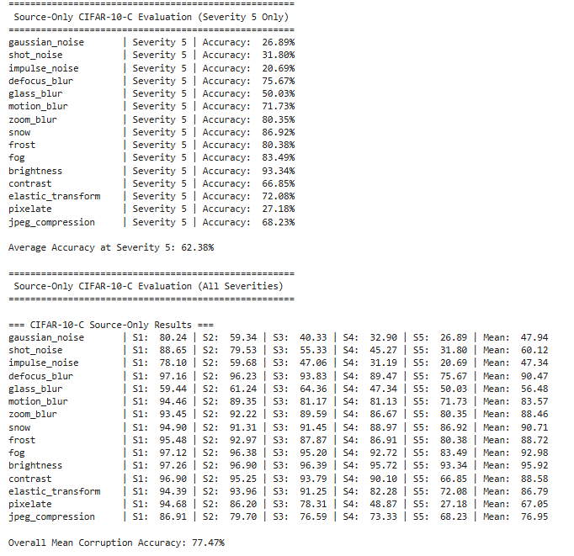

Slide 17
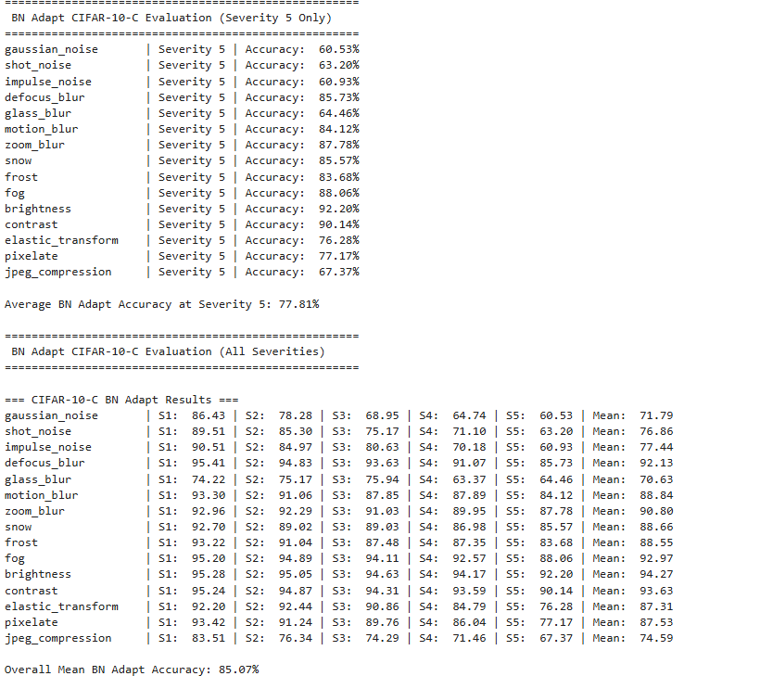

Slide 18
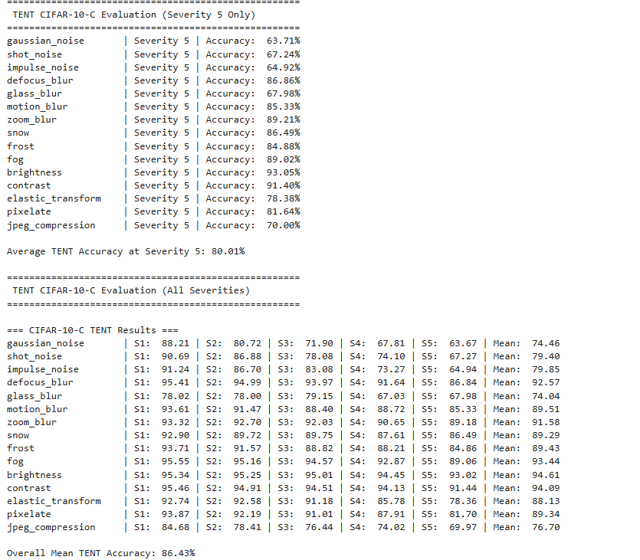

Slide 19
What CoTTA improved over earlier TTA methods
(a) It moved beyond static TTA
Earlier methods like TENT assume test data comes from one relatively stable shifted domain.
CoTTA improved this by handling:
continually changing target distributions
streaming test-time adaptation
sequential domain changes instead of one fixed corruption
That is a major conceptual improvement.
(b) It tried to reduce error accumulation
A big problem in TTA is that the model adapts using its own predictions.
If predictions become wrong, adaptation reinforces those mistakes.
CoTTA improved this using:
weight-averaged predictions
augmentation-averaged predictions
This gives more stable pseudo-targets than using one noisy prediction alone.

Slide 20
(c) It addressed catastrophic forgetting
As the model keeps adapting, it may forget what it learned before — or drift too far from the source model.
CoTTA improved this with:
stochastic restoration, meaning: some parameters are randomly restored toward the original source model during adaptation

Slide 21
Input Test Stream
↓
Frozen Backbone (ResNet-50)
↓
Feature Extraction
↓
┌─────────────────────────────┐
│ Shift Detection (KL Trigger)│
└─────────────────────────────┘
↓
┌─────────────────────────────┐
│ Lightweight Adaptation │
│ - Entropy Minimization │
│ - Prototype Consistency │
└─────────────────────────────┘
↓
┌─────────────────────────────┐
│ Prototype Memory Bank (EMA) │
└─────────────────────────────┘
↓
Final Prediction
↓
Update for Next Test Batch

Slide 22
CoTTA has no explicit semantic memory
CoTTA has no explicit semantic memory
CoTTA preserves knowledge by:
weight averaging
restoration to source parameters
But it does not maintain a structured memory of:
class prototypes
domain states
recent feature geometry
recurring shift episodes
So when the environment changes again, CoTTA does not really “remember” the structure of what it adapted to before.

Slide 23
CoTTA VS OUR METHOD :
CoTTA
Continuous adaptation
Pseudo-label stabilization
Stochastic restoration
Our ContinualTTA
Detects when shift changes
Stores prototype-based memory
Maintains feature consistency
Prevents long-term drift
Runs efficiently in near real-time

Slide 24
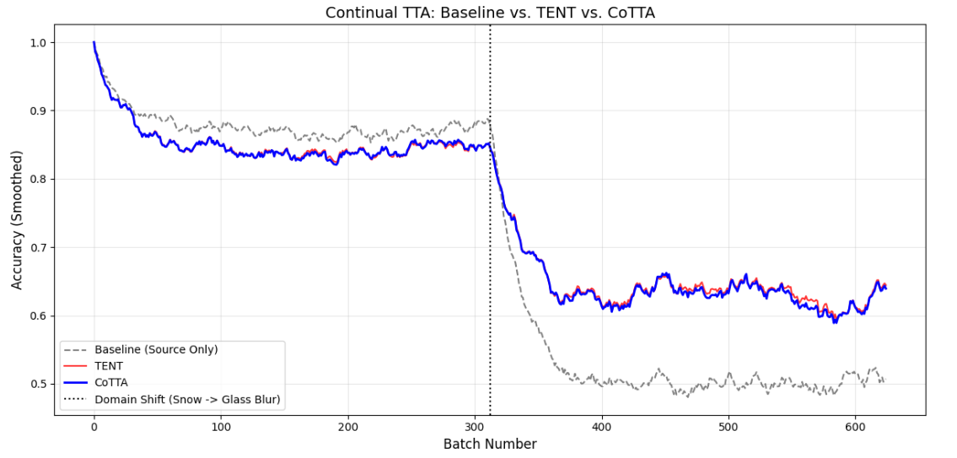
Baseline vs TENT vs CoTTA

Slide 25
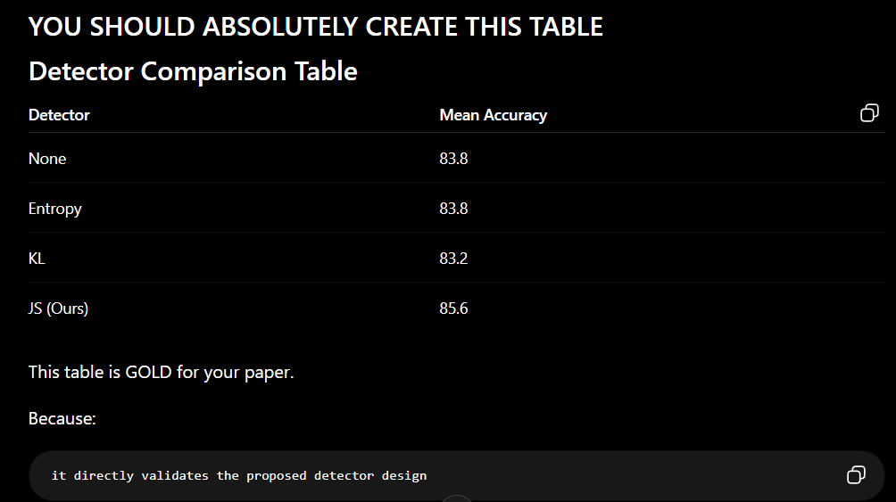

Slide 26
Real Time Applications of Our Method :-
1. Autonomous vehicles
This is the most direct fit. A car's camera sees clean roads during testing, then encounters rain, fog, snow, glare, and sensor degradation in deployment — all in sequence, all correlated. Standard TTA methods reset or forget.
2. Medical imaging across hospitals
A model trained on MRI scans from one hospital scanner gets deployed across multiple hospitals, each with different scanner brands, calibration settings, and imaging protocols.
3. Satellite and drone imagery
Remote sensing models face seasonal shift (summer → autumn → winter), atmospheric shift (clear → hazy), and sensor aging over months of operation.
4. Underwater robotics
Underwater cameras face extreme distribution shift from turbidity (water clarity), depth-dependent colour distortion, and biofouling on lenses over time.

Slide 27
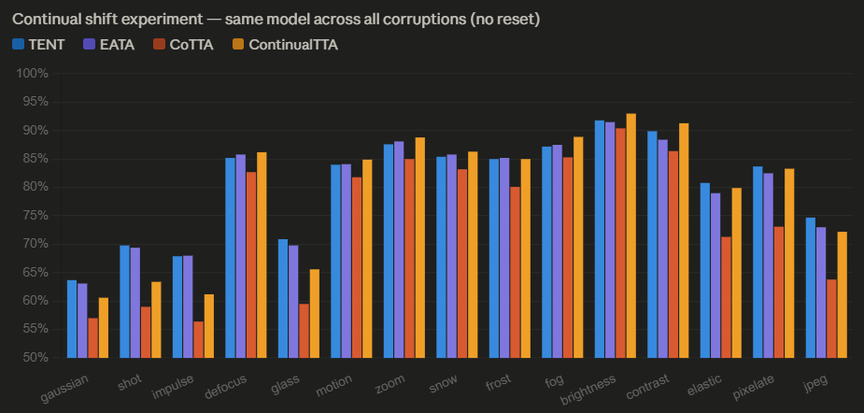
For severity – 5

Slide 28
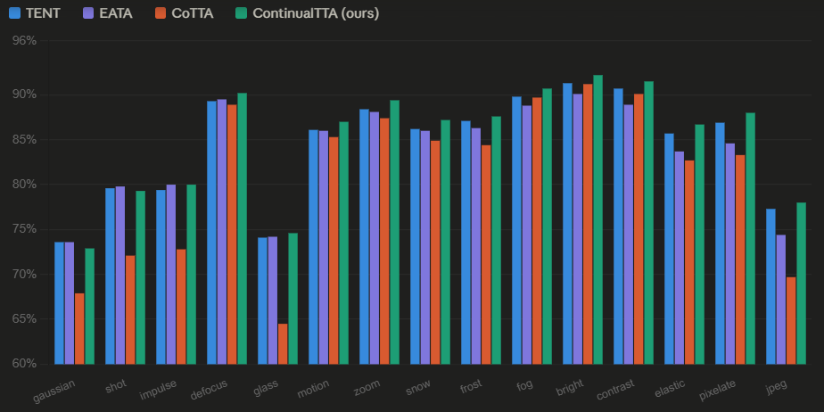
ALL Methods from S1 to S5 :

Slide 29
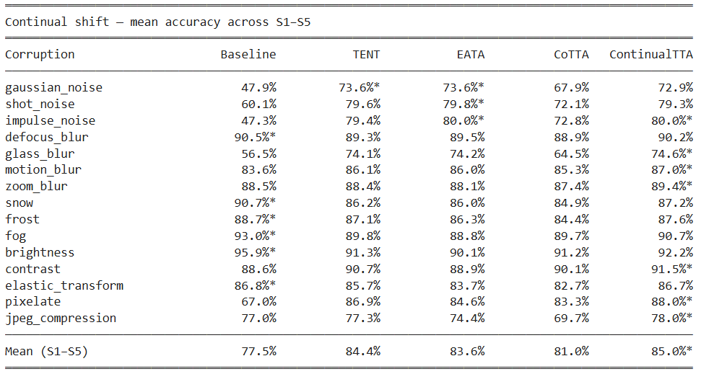
Our Method vs ALL (S1 to S5)

Slide 30
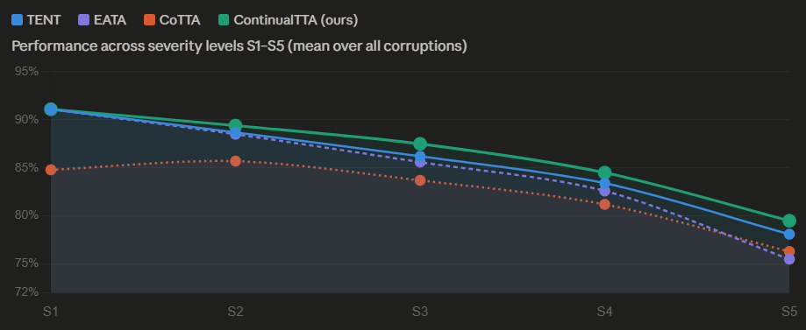
Our method works best for more corrupted images :

Slide 31
Updates for next meet :
Some other method instead of KL Divergence for shift detection, Which is giving best results as a shift detector and how can we modify it such that it’ll give best results.
How to improve the prototype memory bank.
Application areas of our method.(With examples of images)
In which setting our method does not work best.

Slide 32
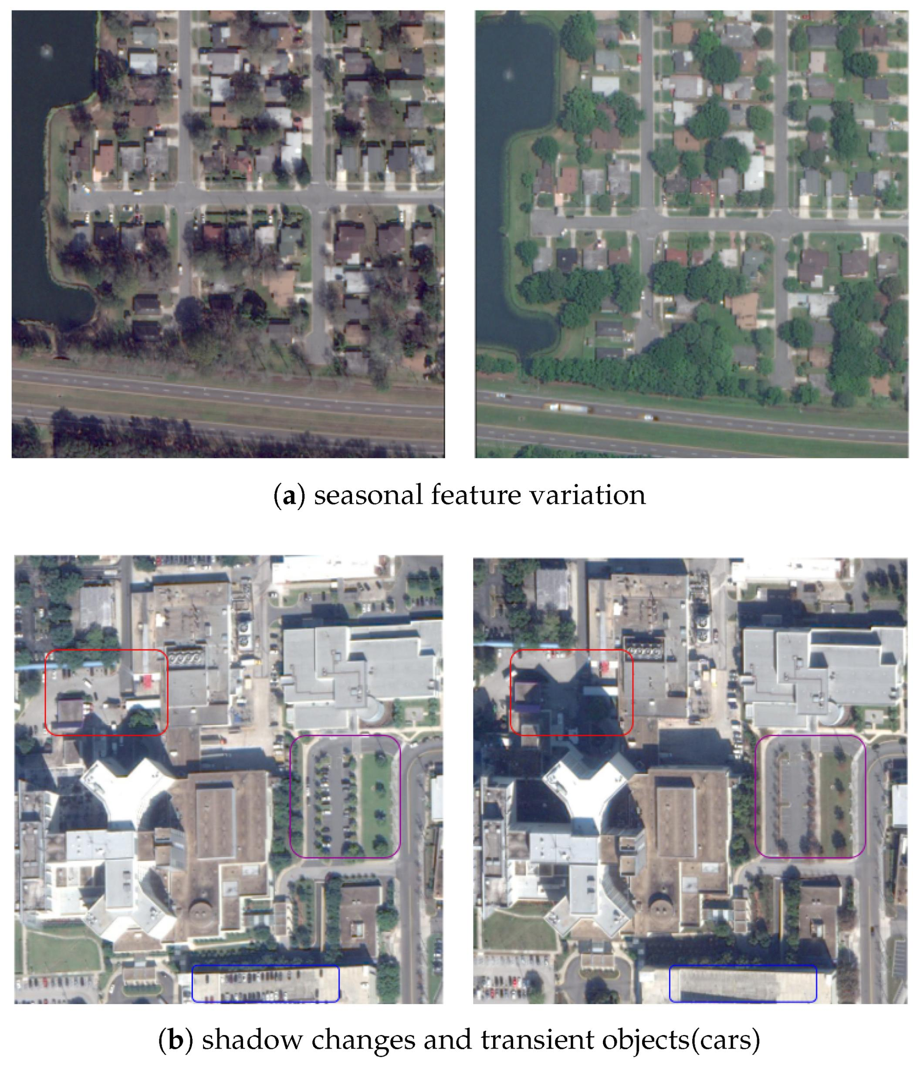
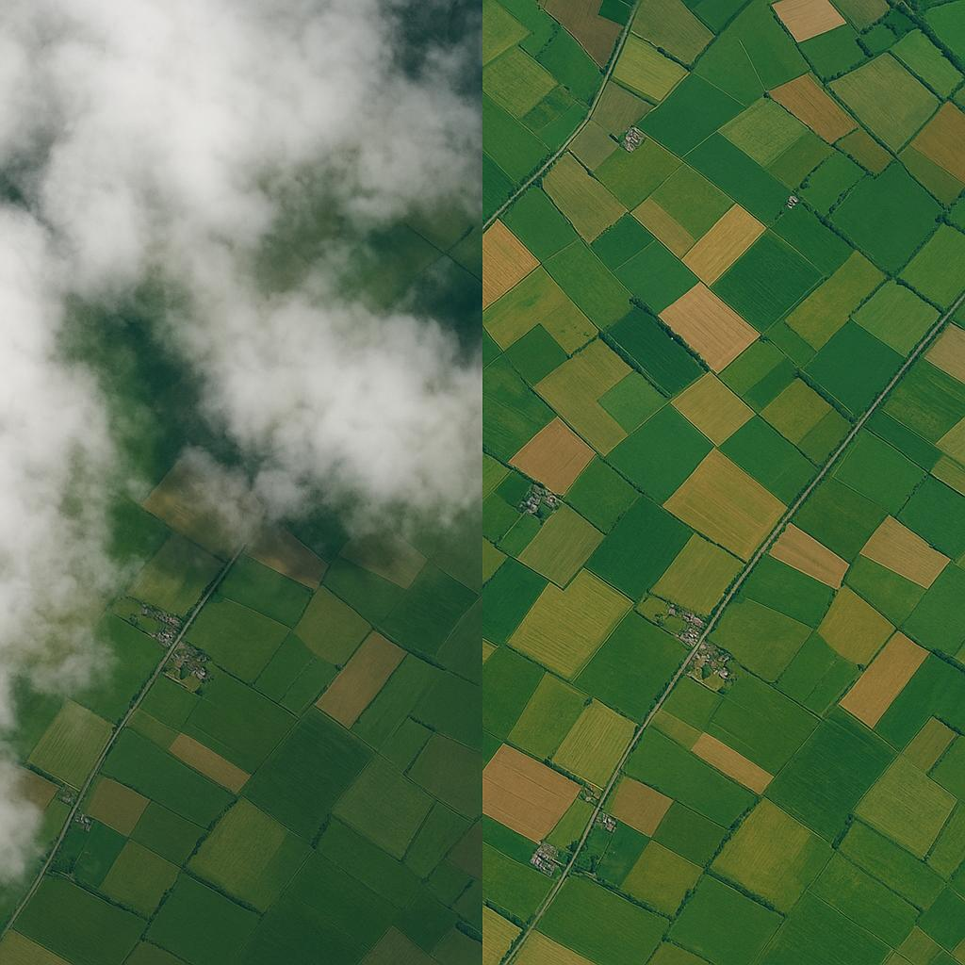
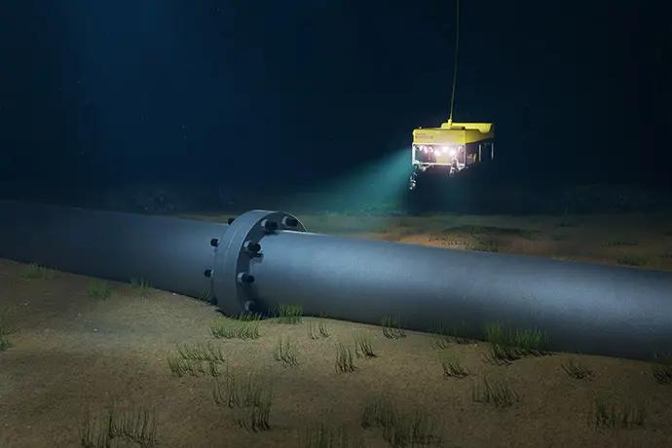

Slide 33
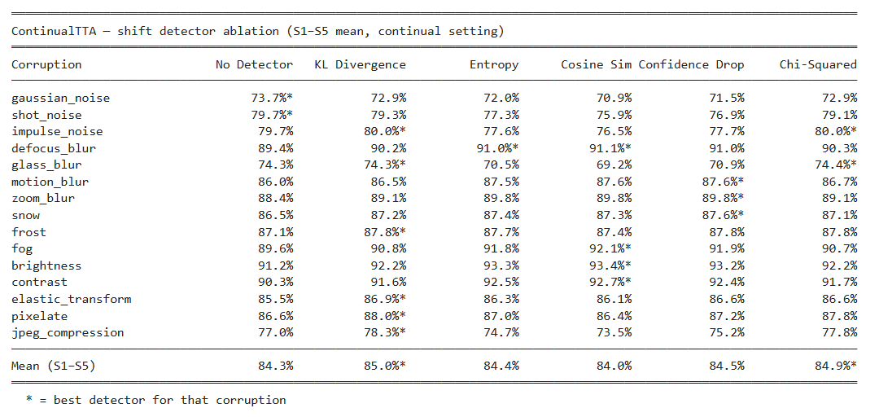
Shift detection comparison :

Slide 34
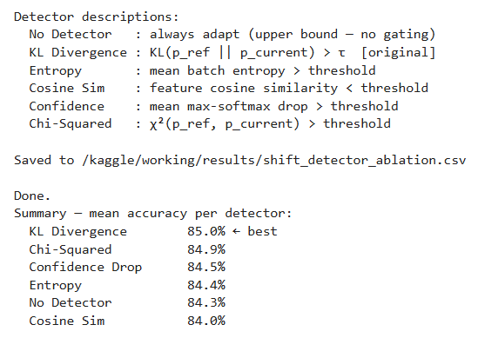

Slide 35
