Slide 1
Facial Expression Recognition with music
Omar Ismail, Vineeth Reddy Sheri AND PIYUSH nARHIRE

Slide 2
Goals
To classify the expression a user makes
Play a music with respect to the expression made by the user
Create a web application
Deploy the model so anyone can use the web application

Slide 3
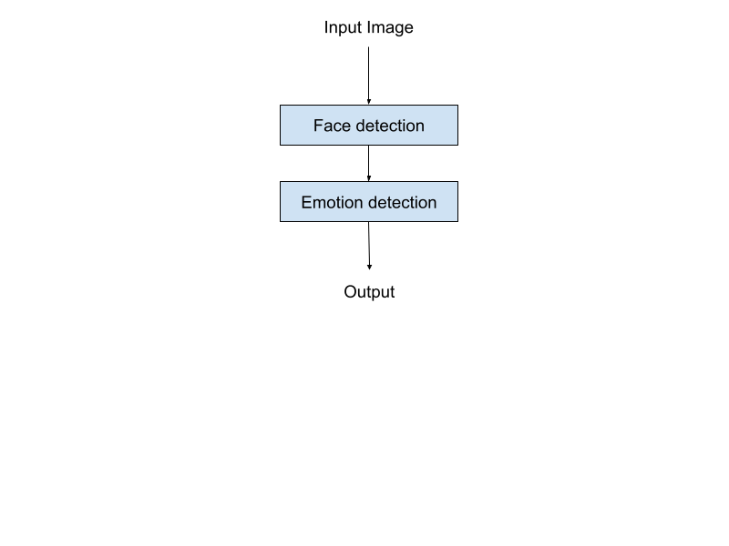
Work Flow Diagram

Slide 4
Face Detection
We used MTCNN(Multi-task Cascaded Convolutional Neural Networks) to detect the human faces in the image.
Passing the identified face to the emotion detection module for detecting the emotion.
Drawing a box around the face of a person and displaying the person's emotion.

Slide 5
Emotion Detection
For the emotion model, we came up with two different approaches.
One approach is building our own custom model
Another approach is by transfer learning on a pre-trained MobileNetV2 model.

Slide 6
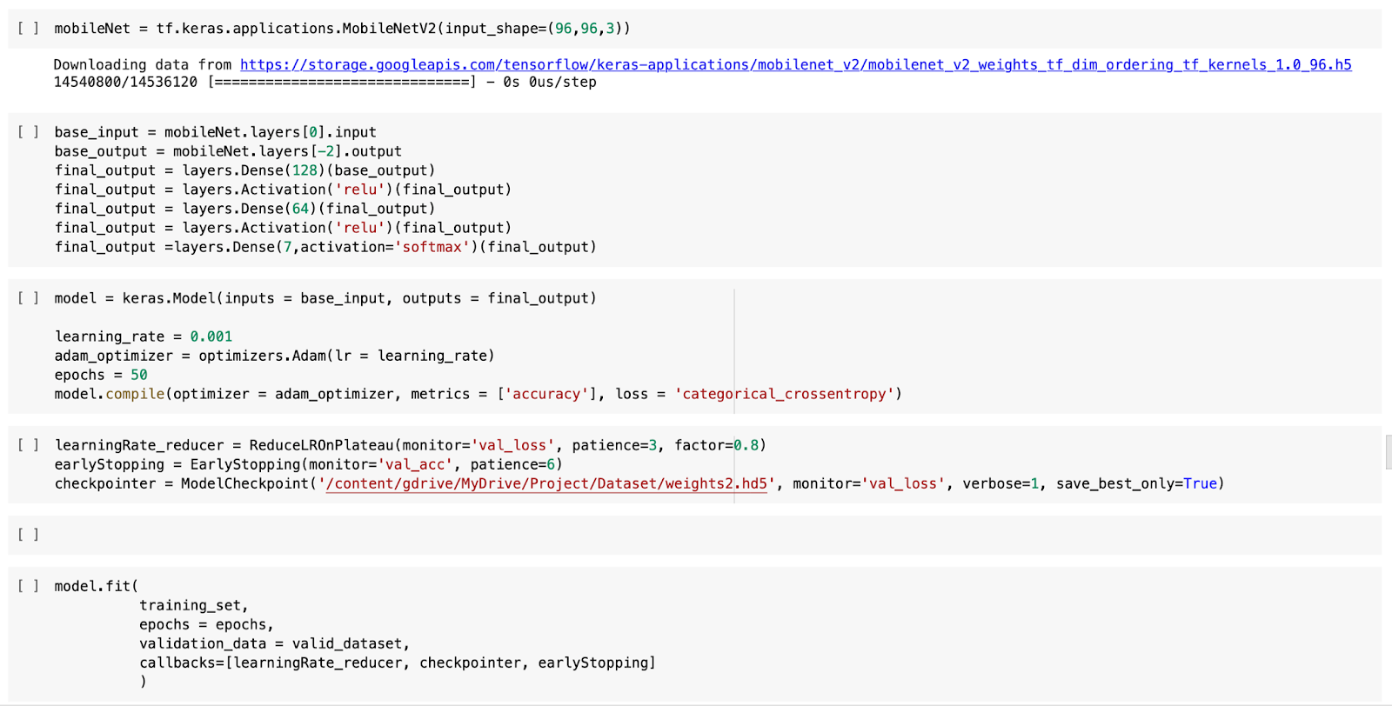
Transfer Learning
Using a pre-trained MobileNetV2 model for transfer learning with FER2013.
The model contains 3,538,984 parameters out of which 3,504,872 trainable parameters. Trained the model for 50 epochs with learning rate as 0.001, Adam optimizer and loss function as categorical cross entropy
the training accuracy of the model is 95%, validation accuracy is 90.2% and testing accuracy is 66.4%.

Slide 7
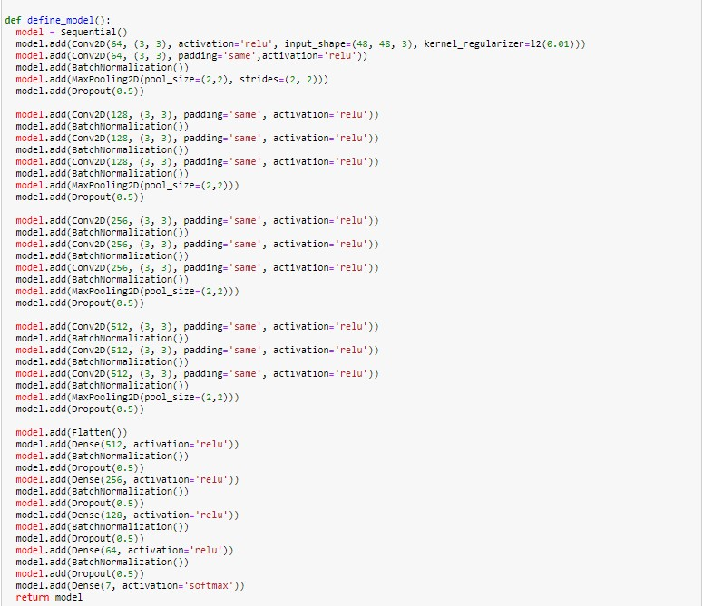
Custom Model Implementation
Performing preprocessing tasks on the dataset like normalizing the data and splitting the train dataset in 4:1 ratio for training and validation phase
Defined the custom model which contains 11 convolutional layers and 5 fully connected layers.

Slide 8
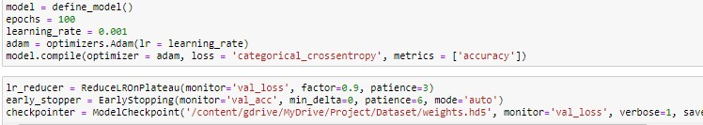
Implementation
Introduced Batch Normalization layer to deal with covariate shift and dropout layer to avoid overfitting of data
Trained the model for 100 epochs with learning rate as 0.001, Adam optimizer and loss function as categorical cross entropy

Slide 9
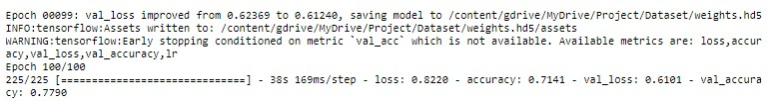
Implementation
After training for 100 epochs, the training accuracy of the model is 71%, validation accuracy is 0.77% and testing accuracy is 67.5%

Slide 10
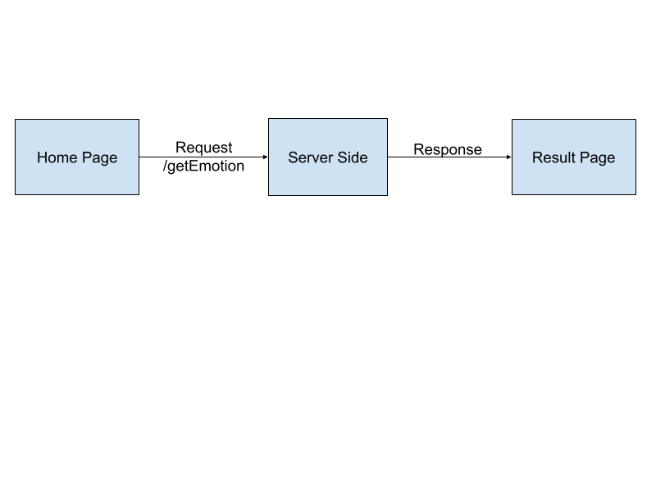
Web Application
We utilized flask, Java script, HTML and CSS to create the web application
Flask served as the backbone of the program

Slide 11
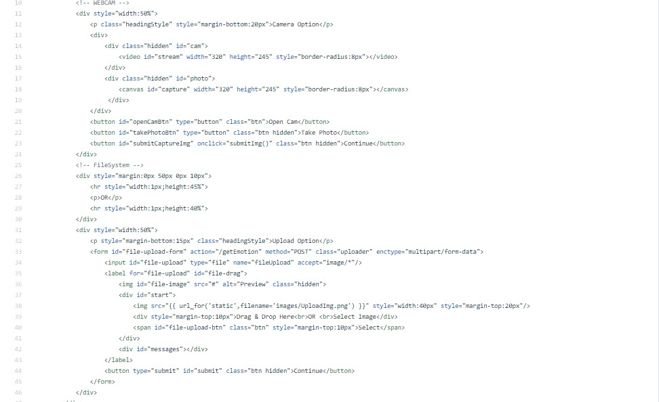
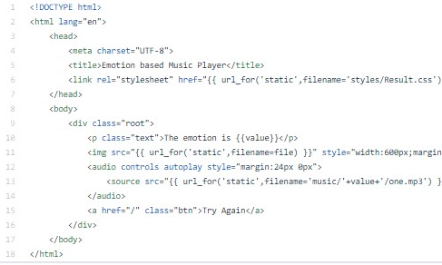
Web application
The user will either take a photo through the webcam option or upload the image.
The Home page on top, Result page on the bottom

Slide 12
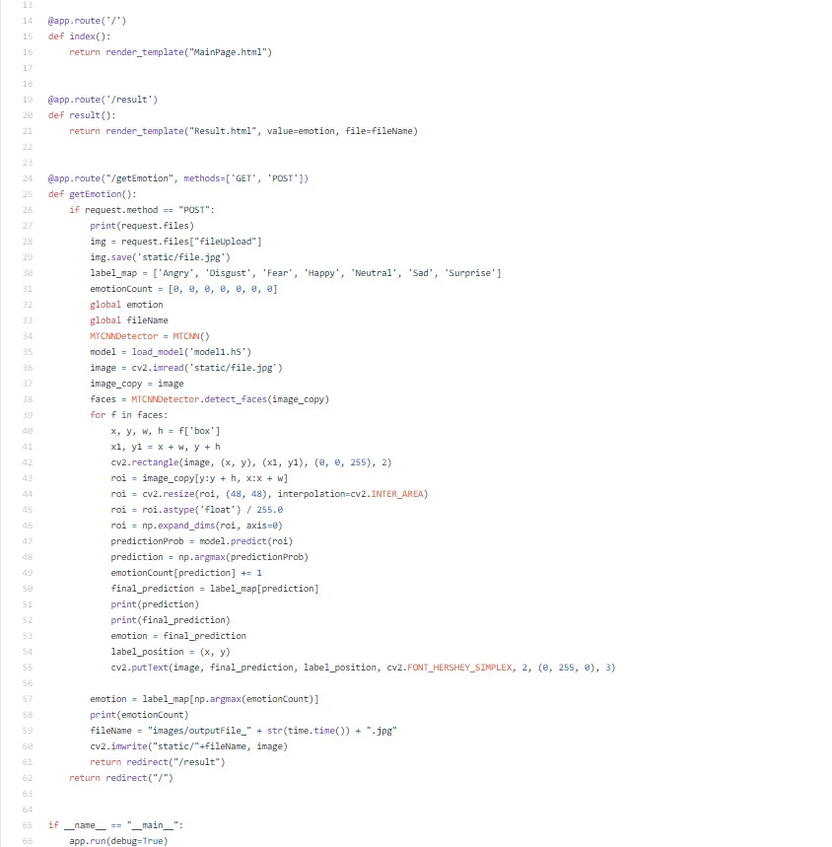
Web Application
At the server-side, for the given image the facial emotion is identified.
A boundary box is drawn around the person face along with emotion label and routed to the results page.

Slide 13
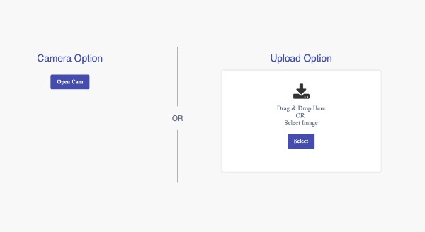
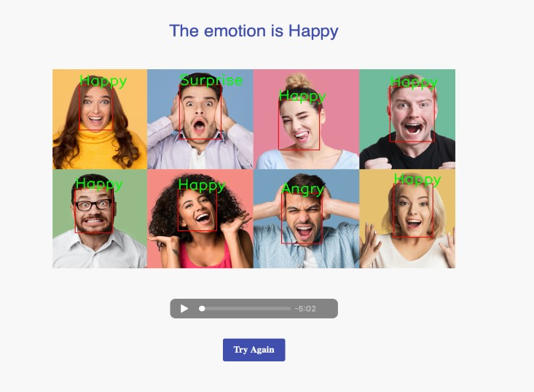
Web Application
Home Page
Result Page

Slide 14
Deployment
We deployed a project through Heroku
Heroku uses requirement.txt to install Dependencies needed to run the web app and specify gunicron as the gateway interface.
Due to the size of the project the web app is slow but functional
url: https://emotion-based-music-system.herokuapp.com

