Slide 1
Software Testing
Those slides are taken from : http://www.ecs.csun.edu/~rlingard/COMP595VAV/SoftwareTesting.ppt, extra material is used from http://www.slideshare.net/ketanmehta4u/software-testing-ppt
Edited by: Enas Naffar

Slide 2
Observations about Testing
“Testing is the process of executing a program with the intention of finding errors.” – Myers
“Testing can show the presence of bugs but never their absence.” - Dijkstra

Slide 3
Good Testing Practices
A good test case is one that has a high probability of detecting an undiscovered defect, not one that shows that the program works correctly
It is impossible to test your own program
A necessary part of every test case is a description of the expected result

Slide 4
Good Testing Practices (cont’d)
Assign your best people to testing
Ensure that testability is a key objective in your software design
Never alter the program to make testing easier
Testing, like almost every other activity, must start with objectives

Slide 5
Acceptance Testing
Customers are present or directly involved.
Usually the tests are developed by the customer

Slide 6
Test Methods
White box or glass box testing
Black box testing
……

Slide 7
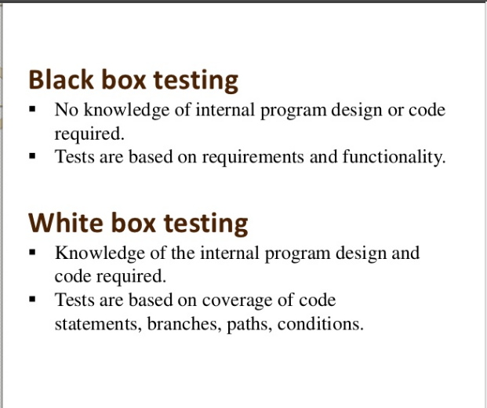

Slide 8
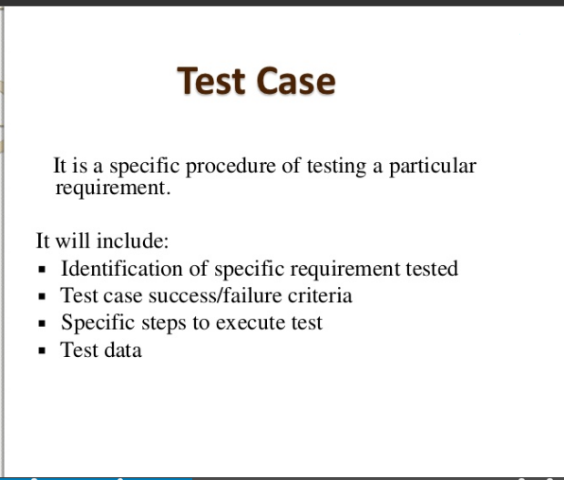

Slide 9
White box testing example
Generate test data for the following program:
Read P
Read Q
IF P+Q > 100
Print “Large”
ELSE
If P > 50
Print “P Large”
ENDIF
ENDIF

Slide 10
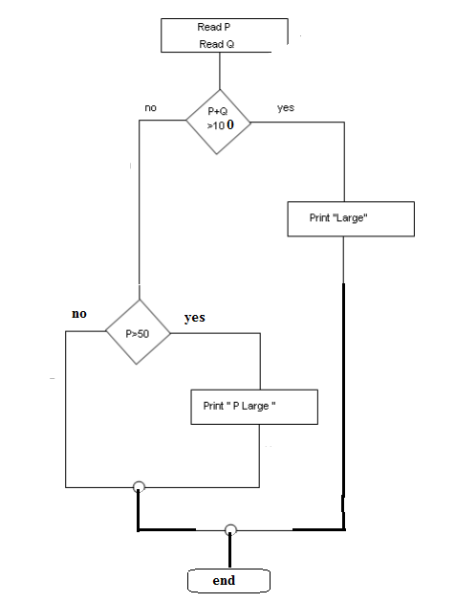
Test data for Path coverage:
Path 1: p = 40, Q= 70
Path 2: p= 60, Q= 10
Path 3 : p= 40, Q=10

