Slide 1
E-Commerce Sales & Customer Behaviour
What Olist's 99,441 Brazilian orders reveal about customers, fulfilment and sales
Excel · PostgreSQL · Power BI

Slide 2
Dataset at a Glance
The Olist public dataset covers orders placed between 2016 and 2018
99,441
96,096
4,119
99,441
2016–18
Customer records
Unique customers
Cities
Order records
Period covered
Five datasets analysed
Customers
Orders
Order Items
Payments
Products
ID, city, state
Status, purchase time
Price, freight
Type, installments, value
Product category

Slide 3
Data Preparation
Cleaned, validated and linked five tables before any analysis
1
Import
2
Inspect
3
Check quality
Loaded the CSV files into PostgreSQL and Excel
Reviewed table structures, column names and data types
Looked for duplicates and missing values
4
Validate keys
5
Calculate fields
6
Link tables
Verified order, customer and product IDs
SUMIF for order payment totals; VLOOKUP for product categories
Joined on customer_id, order_id and product_id; set Power BI relationships

Slide 4
Where Customers Are
São Paulo state alone holds about 42% of all customer records
Top cities (customer records)
Top states (customer records)
São Paulo
São Paulo
15,540
41,746
Rio de Janeiro
Rio de Janeiro
6,882
12,852
Third: Belo Horizonte
Third: Minas Gerais

Slide 5
Order Fulfilment
Almost every order is delivered; problem orders are a small fraction
97.02%
of 99,441 orders were delivered (96,478)
Canceled and unavailable orders total 1,234
*Invoiced, processing, created and approved combined

Slide 6
Sales Performance
Roughly R$16 million in payments at about R$161 per order
R$16.1M
R$160.99
2016–18
Total order payment value
Average order value (AOV)
Monthly payments rose through 2017, then levelled off in 2018
Note: the dashboard KPI cards show R$15.42M and R$159.85 (96.478K orders). Confirm which figures to quote.

Slide 7
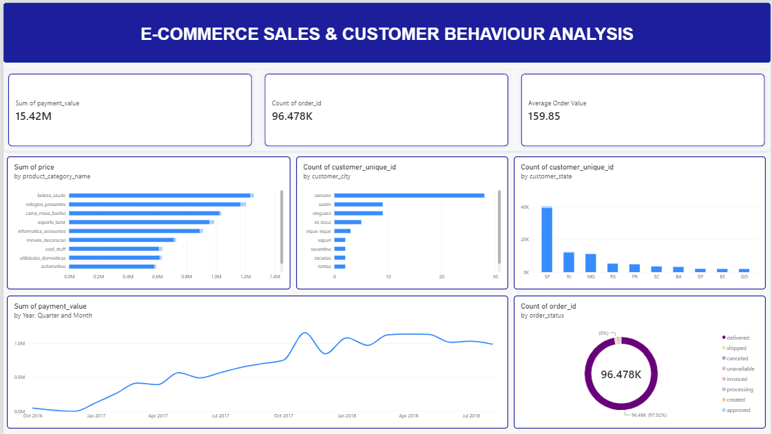
Power BI Dashboard
One interactive view of sales, customers and order status
Total revenue
Total orders
Average order value
Monthly sales trend
Top 10 customer cities
Top 10 product categories
Order status split
Top 10 customer states

Slide 8






Recommendations
Six actions that follow from the analysis
Focus on top locations
Prioritise marketing in São Paulo and Rio de Janeiro
Improve fulfilment
Track canceled and unavailable orders to find causes
Optimise categories
Give high-revenue categories more visibility
Monitor sales trends
Plan inventory and promotions around monthly patterns
Improve retention
Run targeted campaigns and loyalty initiatives
Raise order value
Add recommendations and bundled offers

Slide 9
Conclusion
Customers are concentrated in São Paulo, fulfilment is strong at 97%, and sales average about R$161 per order.
Verify before presenting
Revenue and AOV: report says R$16.1M and R$160.99; dashboard shows R$15.42M and R$159.85
City rankings count records, but the dashboard chart counts unique customers
Category revenue values are only in the chart; no figures are stated
The dashboard gives stakeholders one place to track marketing, product and operations decisions.

