Slide 1


Restaurant Website
Presented by:
C. Mallikarjuna
K. Hemanth Kumar
E. Vinay Goud

Slide 2
INDEX
Introduction
Technologies
Project Flow
Advantages
Disadvantages
Output

Slide 3
INTRODUCTION
E-Commerce website is online portals that facilitate online transactions of goods and services through means of the transfer of information and funds over the Internet. In the early days, e-commerce was done partially through emails and phone calls.
Now, with a single website, anything and everything that a transaction needs, can be executed online.

Slide 4
Technologies
HTML -5
CSS -3
JavaScript

Slide 5
Project Flow
Register
Login
Home
page
Add to cart
Add Coupon
Payment& Order

Slide 6
Advantages
Faster buying process
Store and product listing creation
Cost reduction
Flexibility for customers

Slide 7
Disadvantages
Ecommerce Is Highly Competitive
Shipping Times Can Be Lengthy

Slide 8
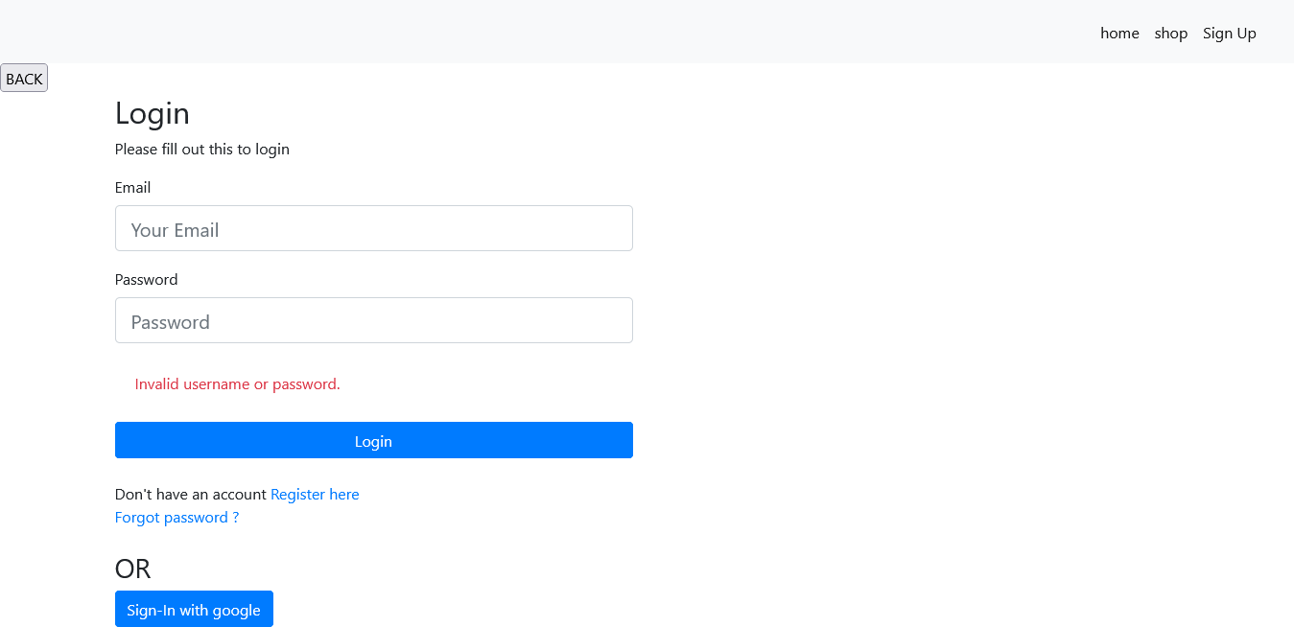
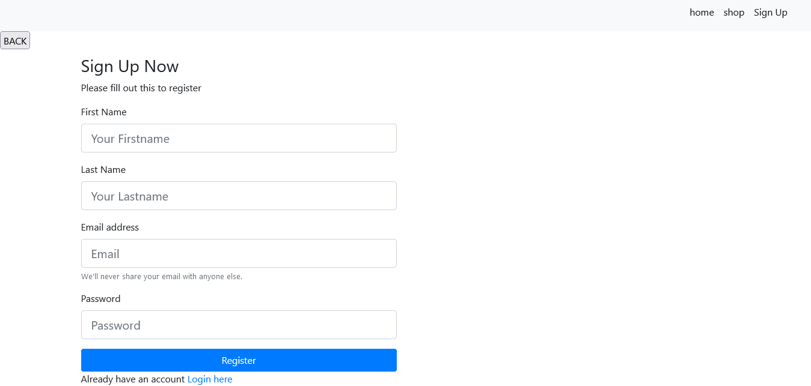
Output :
Login Form
Signup Form

Slide 9
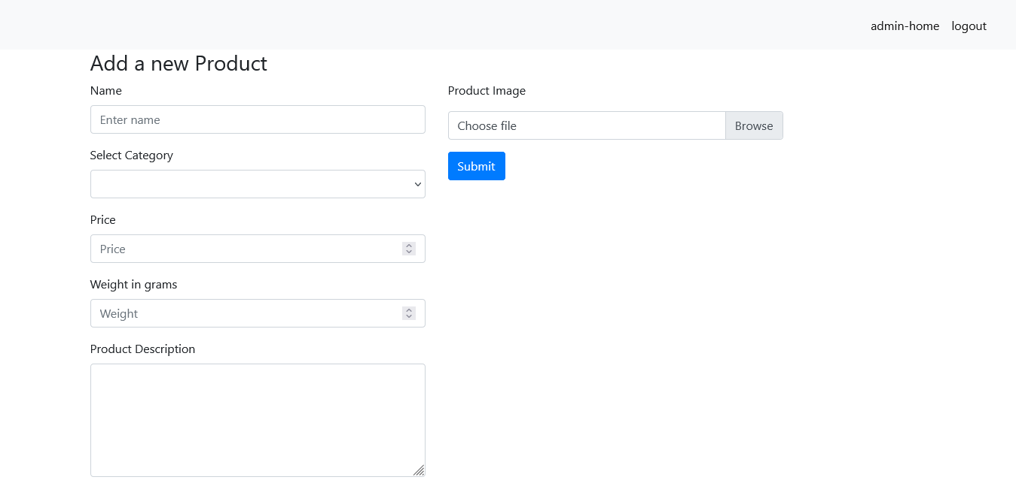
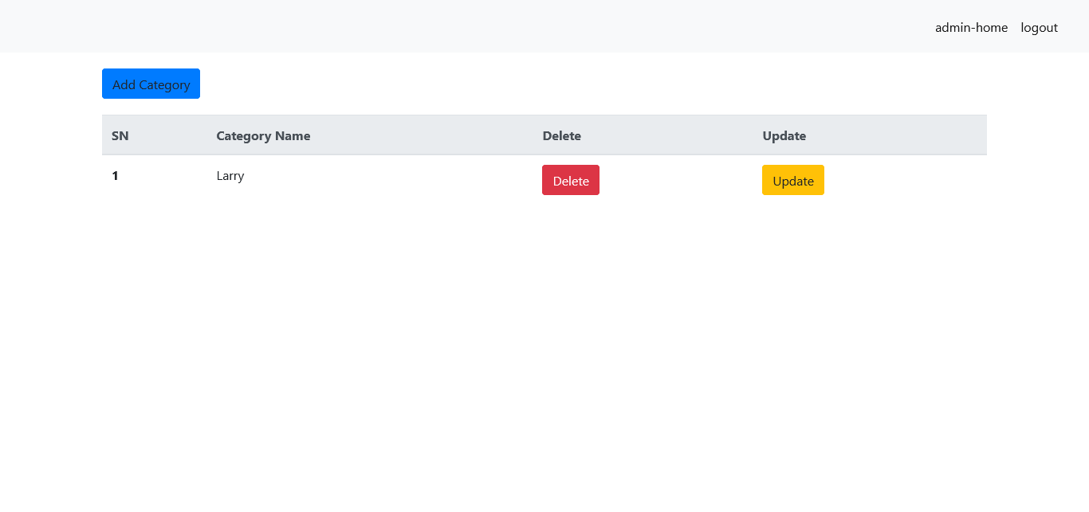
Output :
Add Product Page
After Adding Product

Slide 10
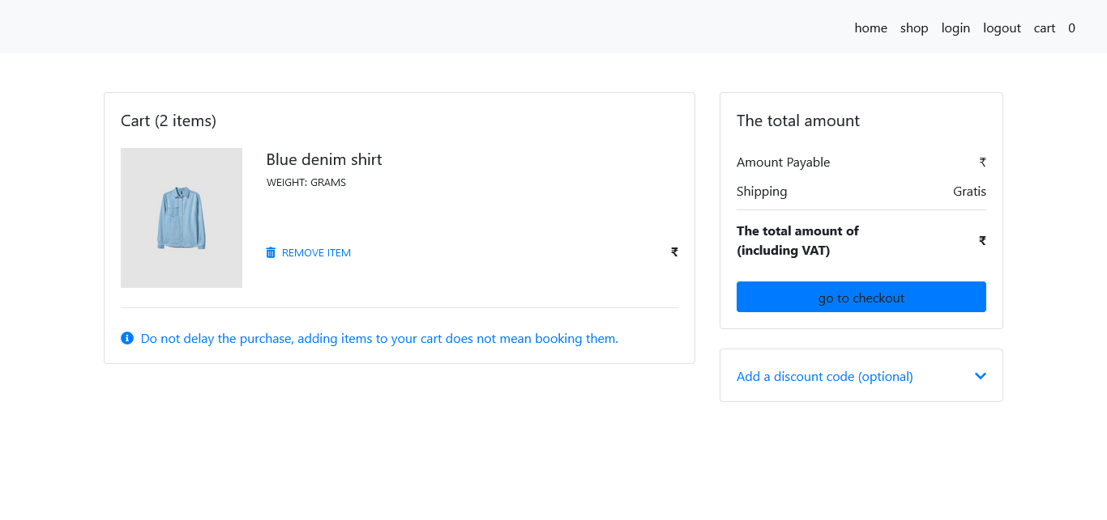
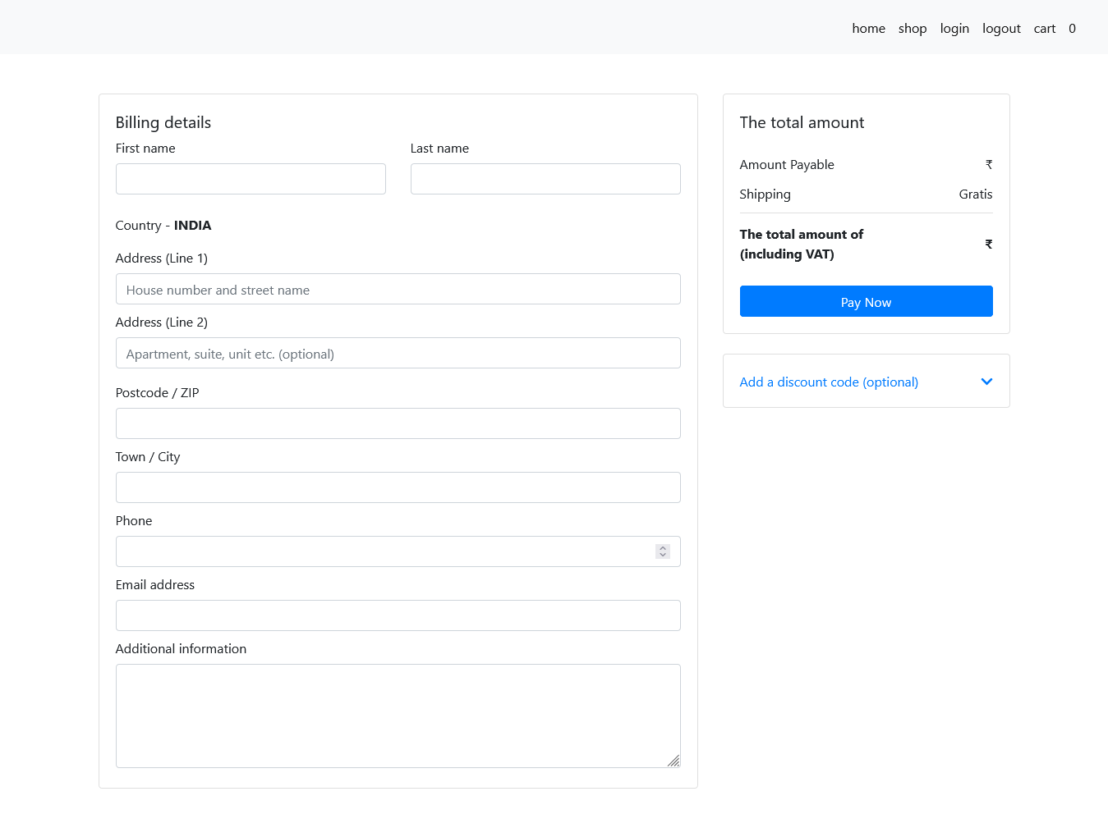
Output
Cart Page
Payment Page

Slide 11
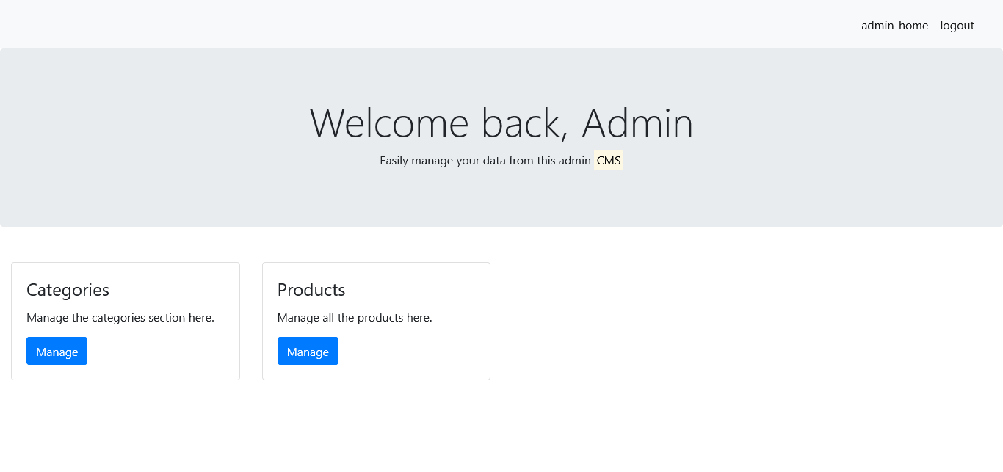
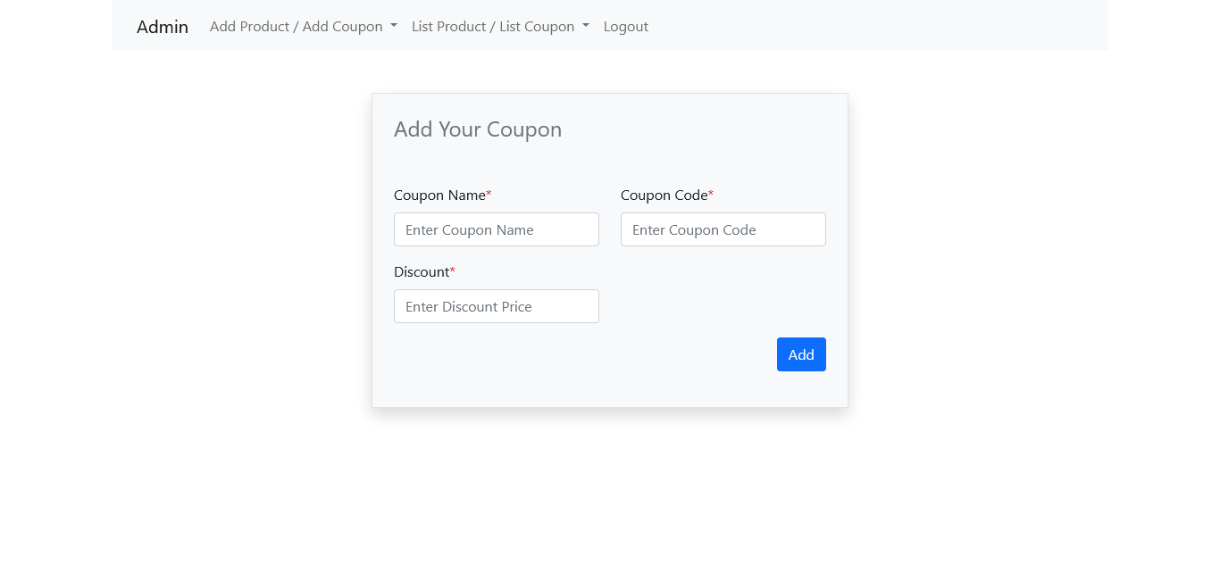
output :
Admin Page
Coupon Page

Slide 12
Thank You

