Slide 1
TABLEAU DASHBOARD
CORONA DATA ANALYSIS

Slide 2


Slide 3
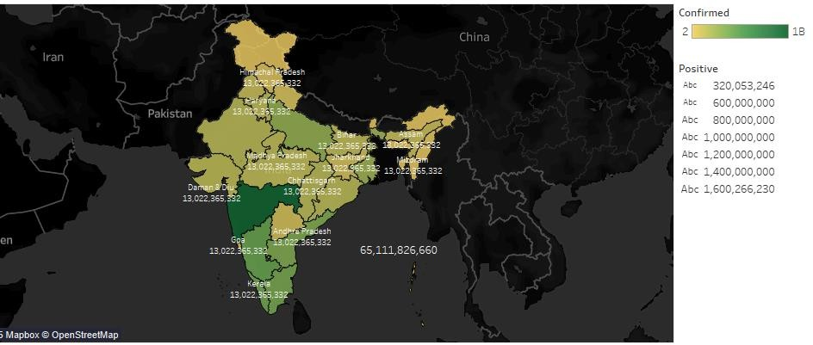
TOTAL CASES

Slide 4
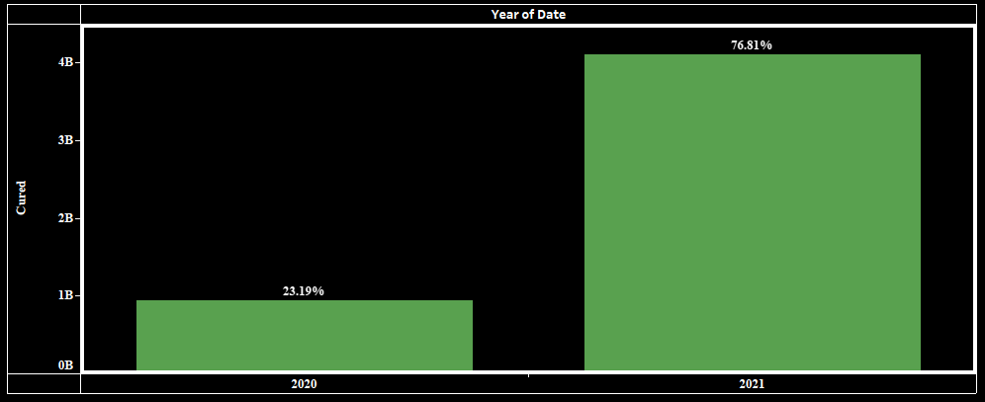
CURED CASES YEAR WISE

Slide 5
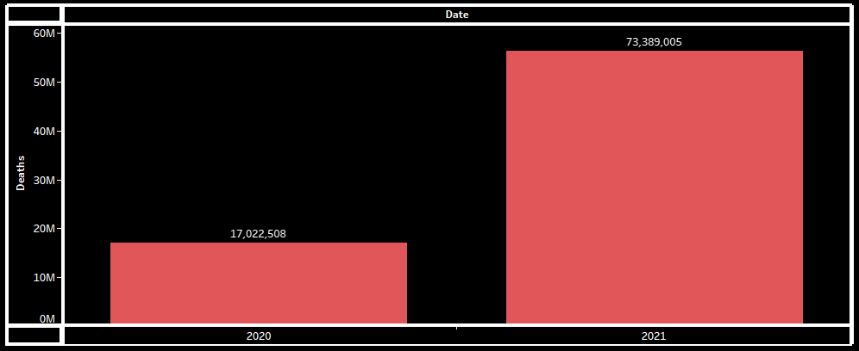
DEATHS DUE TO CORONA YEAR WISE

Slide 6
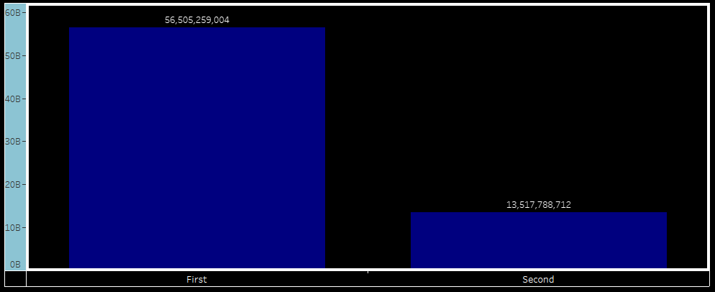
FIRST VS SECOND DOSE ADMINISTERED IN INDIA

Slide 7
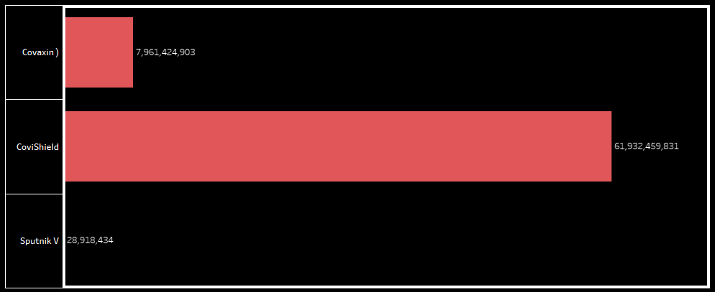
DOSES ADMINISTERED IN INDIA FOR DIFFERENT DOSES

Slide 8
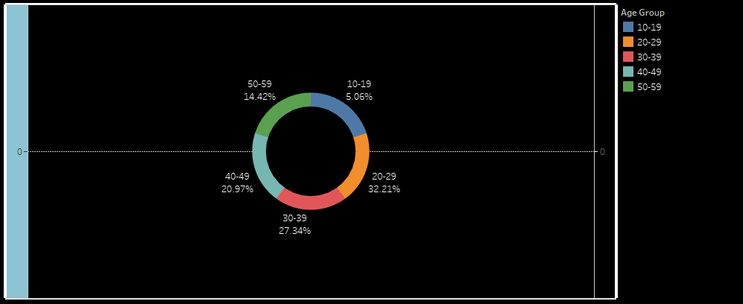
AGE GROUP DETAILS WHO CONFIRMED POSITIVE IN CORONA CHECKUPS

Slide 9
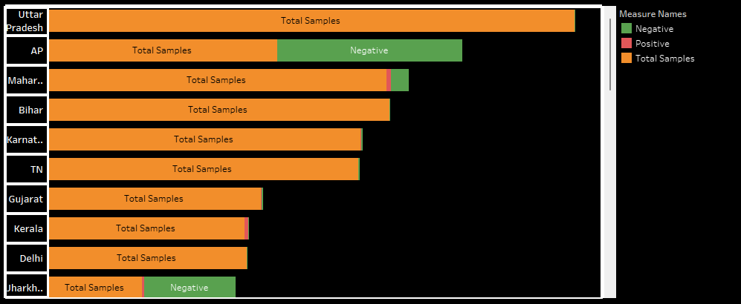
STATEWISE DETAILS OF CORONA CHECKUPS

Slide 10
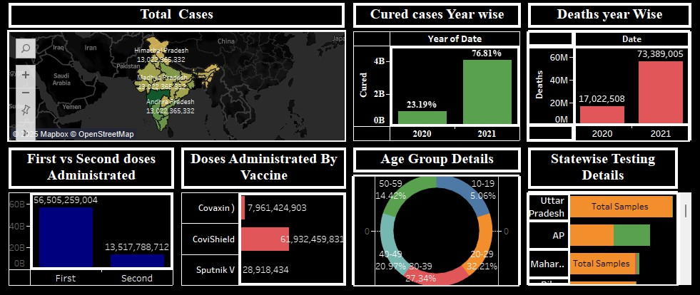
OVERALL VIEW OF DASHBOARDS FOR CORONA ANALYIS IN INDIA

Slide 11
THANKYOU

